Slide 1
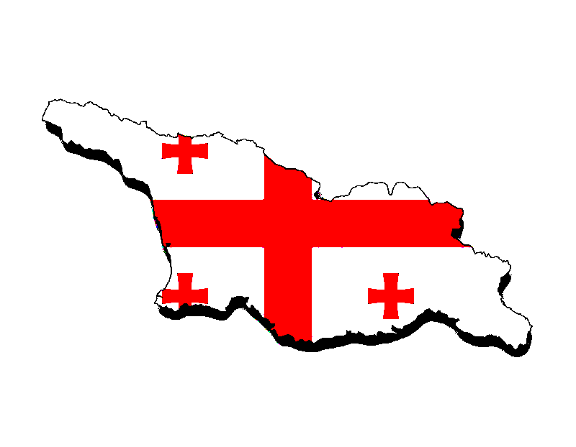

georgia

Slide 2

georgia
Georgia is a transcontinental country located in Eastern Europe[ and West Asia. It is part of the Caucasus region, bounded by the Black Sea to the west, Russia to the north and northeast, Turkey to the southwest, Armenia to the south, and by Azerbaijan to the southeast. The country covers an area of 69,700 square kilometres and has a population of 3.7 million people.Tbilisi is its capital and largest city, home to roughly a third of the Georgian population.

Slide 3
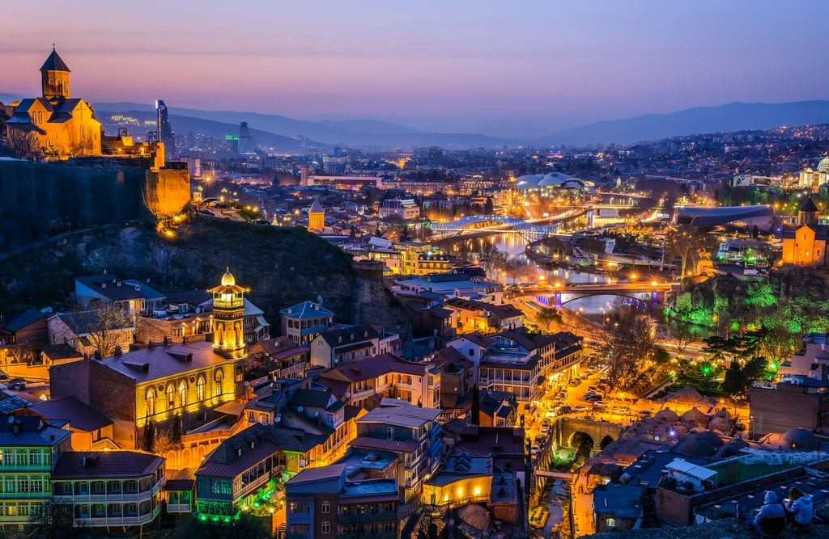
The capital of georgia,
tbilisi

Slide 4
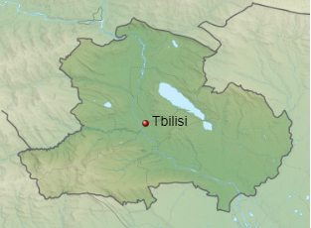
Tbilisi in some languages still known by its pre-1936 name Tiflis is the capital and largest city of Georgia, lying on the banks of the Kura River with a population of around 1.2 million people. Tbilisi was founded in the fifth century AD by Vakhtang I of Iberia, and since then has served as the capital of various Georgian kingdoms and republics. Between 1801 and 1917, then part of the Russian Empire, Tiflis was the seat of the Caucasus Viceroyalty, governing both the northern and the southern parts of the Caucasus.

Slide 5
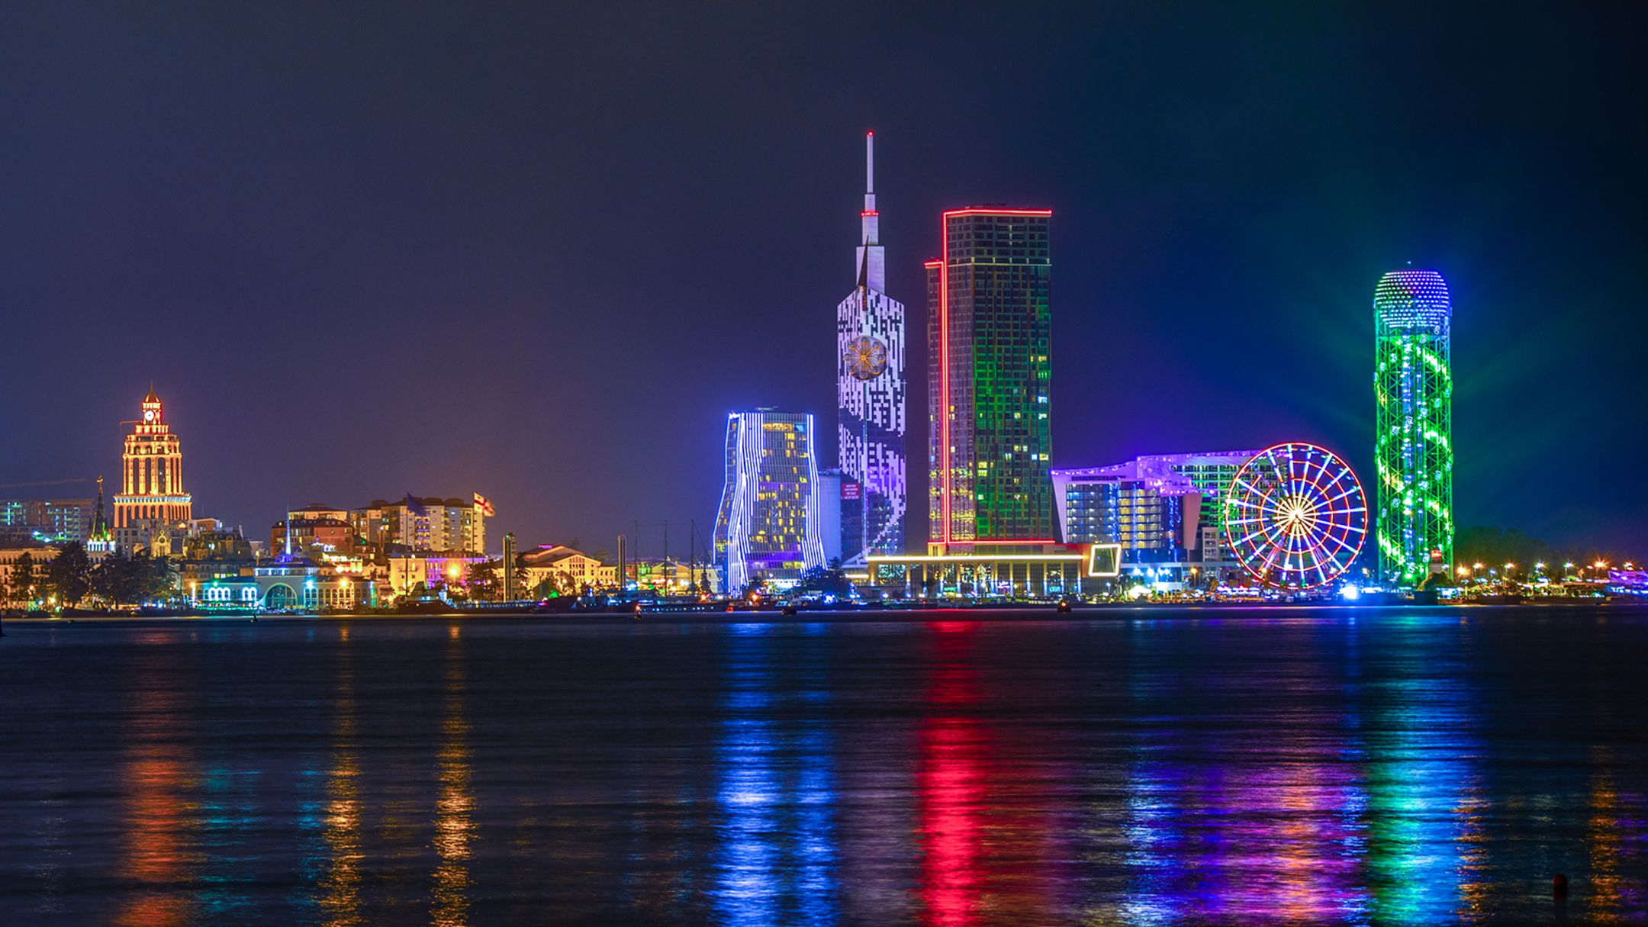
Sea resort of Georgia
Batumi

Slide 6
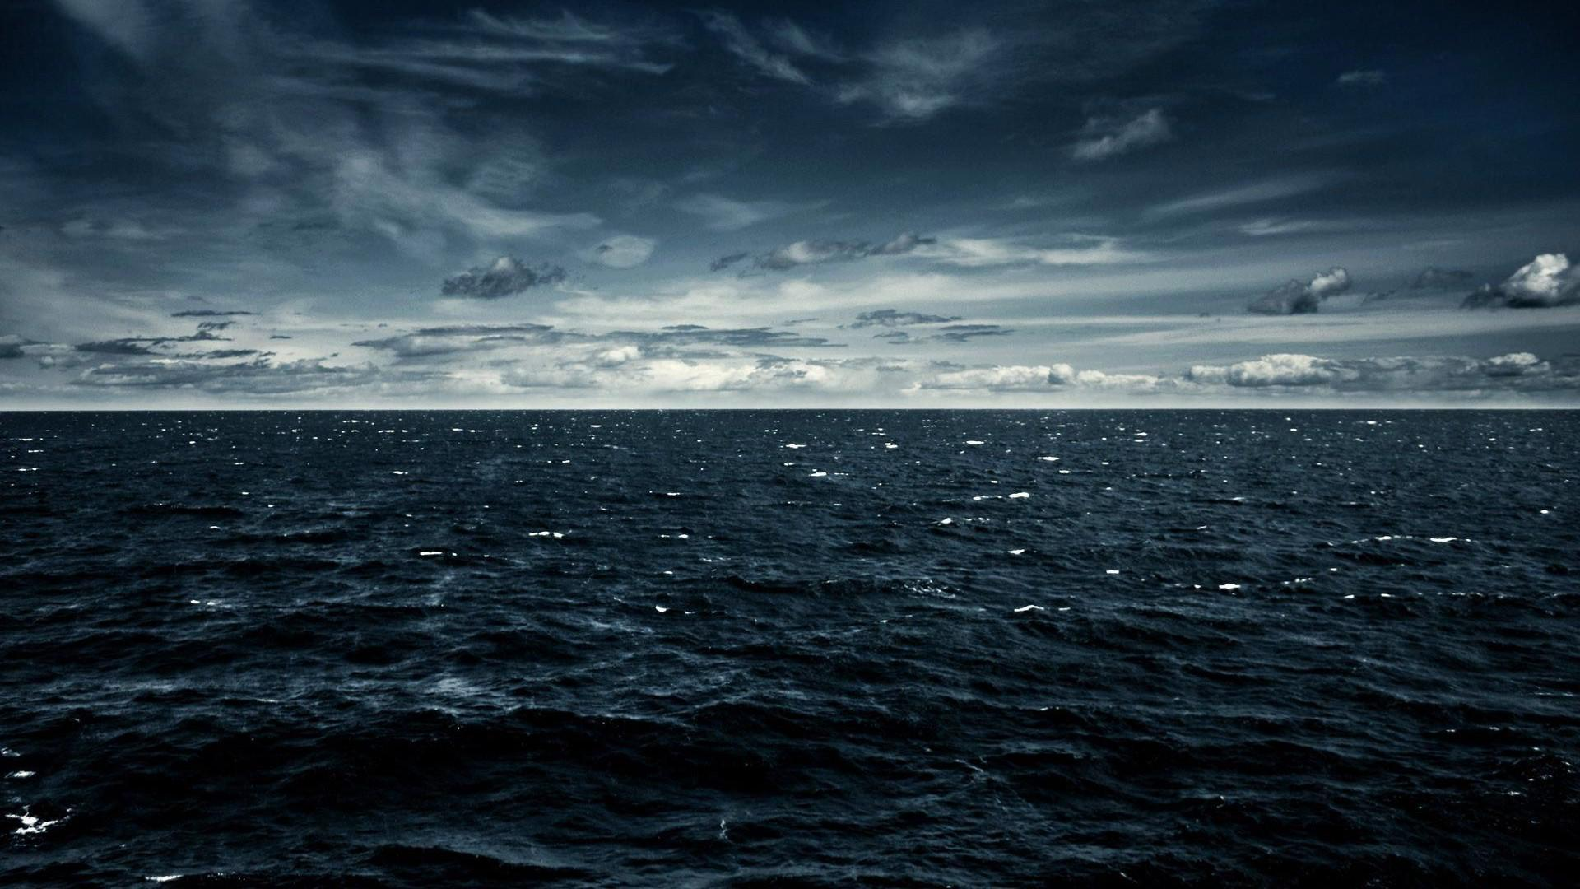
batumi
Batumi is the second-largest city of Georgia and the capital of the Autonomous Republic of Adjara, located on the coast of the Black Sea in Georgia's southwest, 20 kilometers north of the border with Turkey. It is situated in a subtropical zone at the foot of the Caucasus. Much of Batumi's economy revolves around tourism but the city is also an important seaport and includes industries like shipbuilding, food processing and light manufacturing. Since 2010, Batumi has been transformed by the construction of modern high-rise buildings, as well as the restoration of classical 19th-century edifices lining its historic Old Town.

