Slide 1
Power LED driver HW
LEDs are highly efficient light sources, available in different colours.
LEDs need a constant current (a constant voltage may not be applied directly).
In ETP we will use 1W power LEDs with a nominal current of 350mA. For example: 5 x white + 4 x red + 4 x green + 4 x blue (connected in series)
A high-efficiency constant-current-source is required.
Typically a buck-converter (switched DC-DC-converter) is used.
The LED current is monitored, compared to the desired set point and a controller adjusts the PWM-duty-cycle of the switch.
See also https://home.zhaw.ch/~hhrt/EK1/LEDtreiber/LED-Treiber.pdf

Slide 2
Power LED driver block diagram
Power supply
Step-down converter
Current sense shunt resistor
Power LEDs
Re-adjust PWM duty-cycle
Adjustable set-point for LED current
Proportional- Integral- controller
Level-shifter / amplifier for actual current

Slide 3
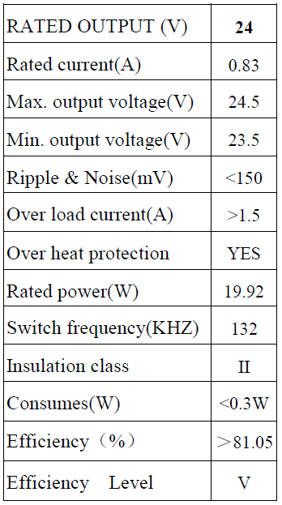
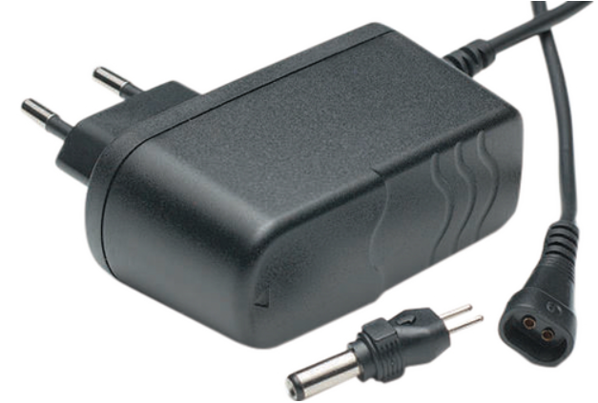
Power supply: 24V, 20W
Note: Place a schottky diode at the input as a polarity reversal protection

Slide 4
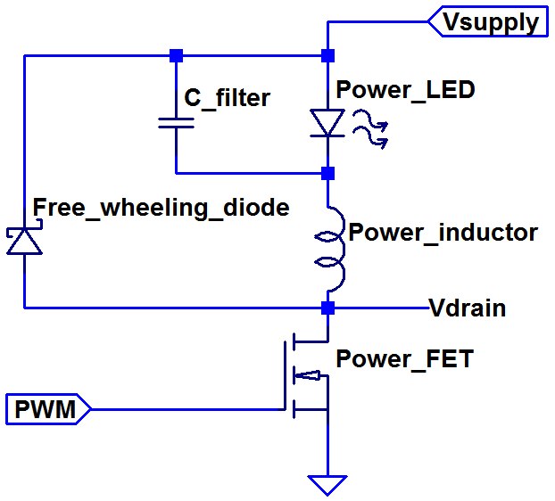
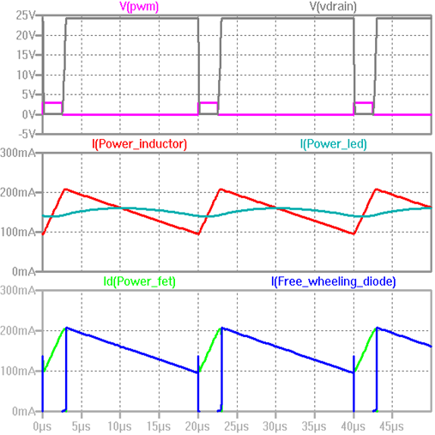
Step down converter
For dimensioning see https://home.zhaw.ch/~hhrt/EK1/LeistungsFETundIGBT/LeistungsFETundIGBT.pdf

Slide 5
Current measurement, PI controller, …
Power supply and step-down converter are the only parts where a significant current flows.
The rest is signal processing.
Signal processing can be done in the analog (HW) or the digital domain (SW).
Whereas the analog solutions might be easier to simulate and test, the digital solutions are more flexible and need less HW components.
Some solution possibilities are presented subsequently.
Feel free to propose and realize different solutions.

Slide 6
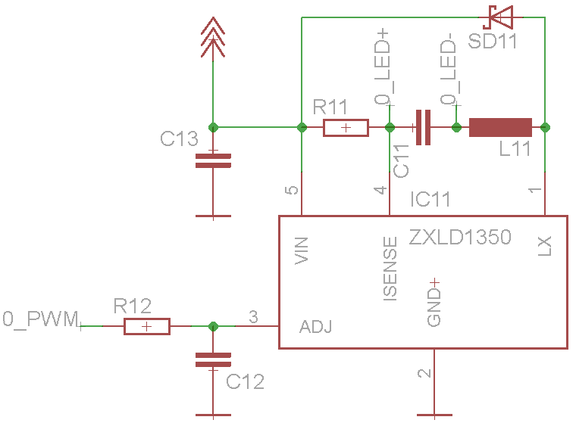
Solution 0: Driver-IC with PWM input
A LED-driver-IC is dimmed with a slow PWM-signal.
Note: use open drain configuration for this uC output pin with this specific driver-IC.
See datasheet for component values.
R11 is the current sense shunt resistor.
R12, C12 is just a low pass filter.
C11 reduces LED current ripple.
PWM > 200Hz
Spannungsteiler vor PWM
Timer für PWM benutzen

Slide 7
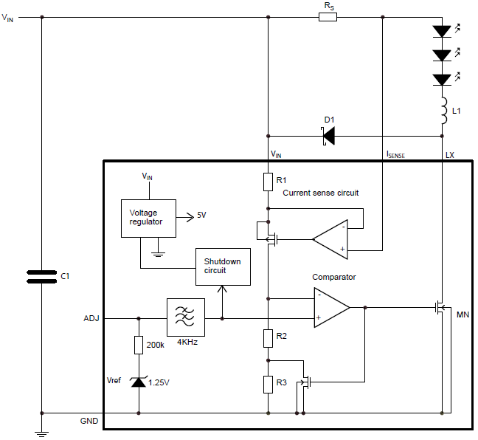
Solution 0 continued: Driver-IC inside
Upper OpAmp is a voltage follower: V(R1) = V(Rs)
Upper FET is a level shifter: I(drain) = I(source)
I(R2) = I(R1)
V(R2) = I(Rs) * Rs * R2/R1
V(R3) = I(Rs) * Rs * R3/R1 | 0 if FET is on
Comparator switches power FET on/off
V(ADJ) > V(R2)? => FET on V(ADJ) < V(R2)+V(R3)? => FET off
with comparator hysteresis = V(R3)

Slide 8
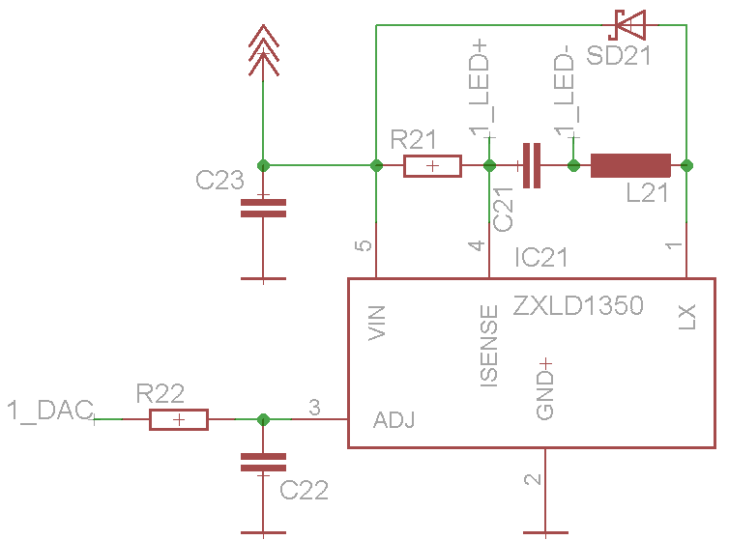
1: Driver-IC with analog adjust input
A LED-driver-IC is dimmed with an analog voltage from the DAC.
As the IC-internal comparator is an analog component the same IC can be used as in the previous solution.
See datasheet for component values,
ADJ input voltage range, etc.
Spannungsteiler bei DAC hinzufügen

Slide 9
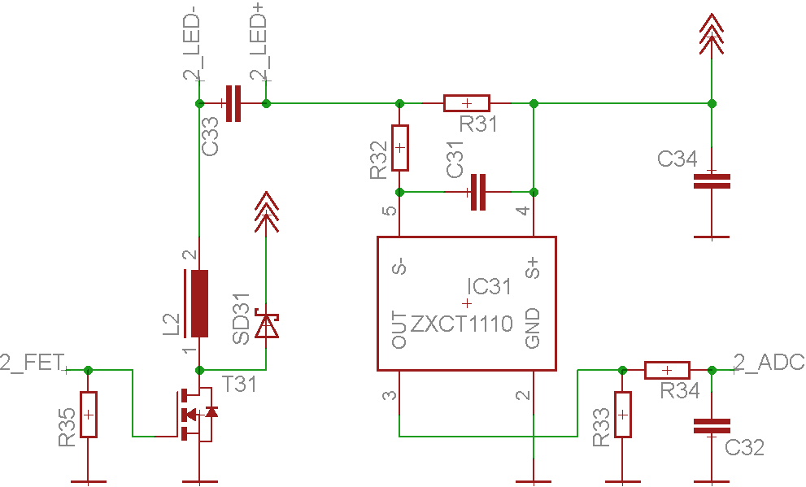
2: LED-current with controller in uC-SW
The LED-current is sensed by the ADC and compared to the set point by the uC.
The PI controller (in SW) adjusts the PWM duty cycle and switches the MOSFET.
R35 turns FET off when uC not ready.
ADC define input range,
2.5 V ref voltage
350 mA → 2V ADC
FET Timer 50-200kHz

Slide 10
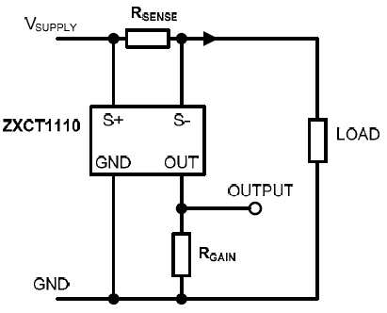
2 continued: High side current monitor
As the FET T31 switches to GND, the LED current must be sensed at the hot side.
Classically the shunt voltage over R31 would be amplified by a differential amplifier.
The problem, however, is the very high common mode input voltage range.
The ZXCT1110 is a transconductance amplifier:
The output current at OUT and consequently V(R33) is proportional to the voltage difference between S+ and S-.
R32, C31 is for input overvoltage protection.
R34, C32 is just a low pass filter.
See datasheet for component values, etc.

Slide 11
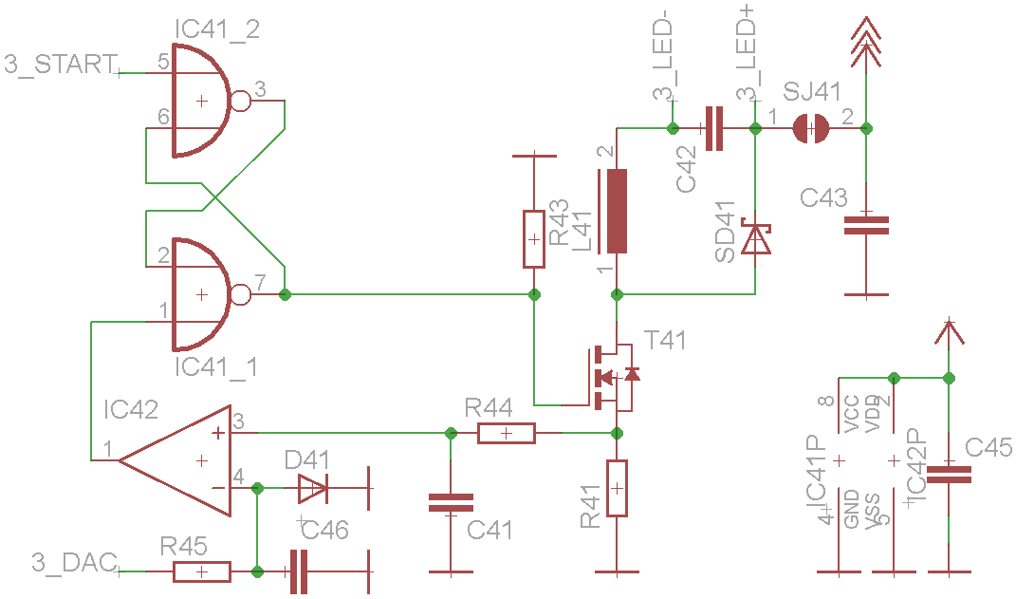
3: Current mode control: HW solution
The analog set point for the LED current is set by a DAC.
The current is sensed at the drain shunt resistor R41.
The comparator IC42 compares drain (= LED) current and current set point.

Slide 12
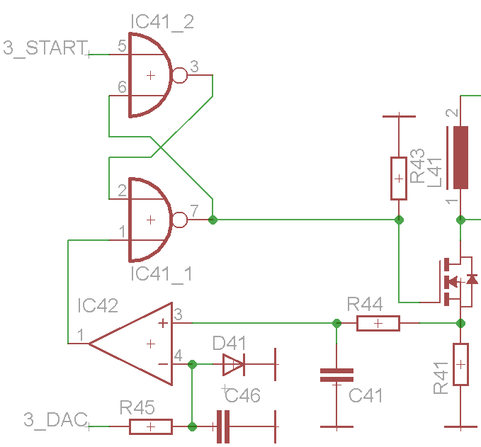
3 continued: Current mode control
IC41 is a ResetSet-FlipFlop which is set periodically by a microcontroller output.
The comparator resets the FF when the drain current is higher than the set point.
R45, C46 is just a low pass filter with D41 acting as voltage limiter.
R44, C41 as well is a low pass filter.
C45 is a block capacitor for the supply voltage of IC41 and IC42.

Slide 13
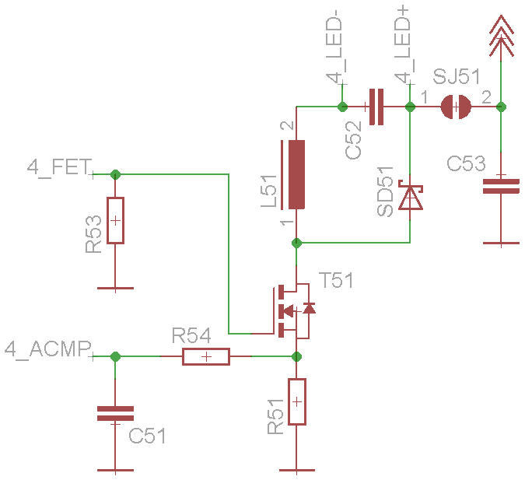
4: Current mode control: SW solution
Same as previous solution, but with ACMP, interrupt and DO of microcontroller.
The FET is turned on periodically (timer) by setting a digital output.
When voltage at the input of the ACMP (analog comparator) rises above the set-point an interrupt is triggered and the interrupt handler turns the FET off by resetting the digital output.

Slide 14
Protection of the circuits
Protect the board from supply voltage polarity reversal (Schottky diode in series).
Design the circuit in a way that overvoltage on the uC GPIOs or the inputs and outputs of any analog or digital IC is impossible.
Where the circuit design cannot guarantee safety from overvoltage in faulty conditions, a protection circuit has to be included (protection diodes, resistors, RC low pass filters).
Filter out transient spikes (ceramic blocking capacitors, low-ohmic ground)

Slide 15
Comparison of solutions
Some solution ideas for the power LED driver HW have been presented here.
They certainly have different properties.
Do they meet your requirements? Which are your requirements, anyway?
What can be changed/added to result in the desired behaviour? Can that be achieved by HW and/or by SW?

Slide 16
Requirements?
Write down your requirements:
Dimming range: 0 … 100%? For each colour?
Dimming resolution/step: 1%? 10%? on/off?
Start-up behaviour? All LEDs full on? Dimmed to xx%? Off? Note: At microcontroller start up the outputs are undefined, what do the LEDs?
Power efficiency, standby losses?
Switching frequency?
Influence on colour rendering quality?

Slide 17
Own solution?
Do you have other ideas?
Different HW and/or SW approaches?

