Slide 1

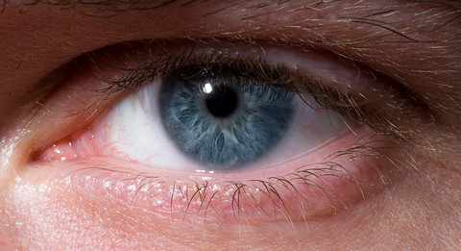
ETP
Considerations on Eye Safety with Power LEDs

Slide 2
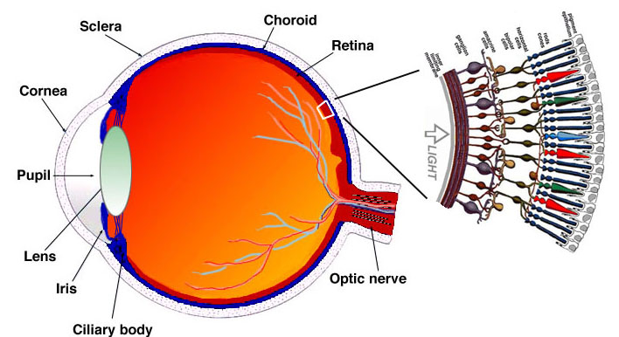
The Human Eye

Slide 3
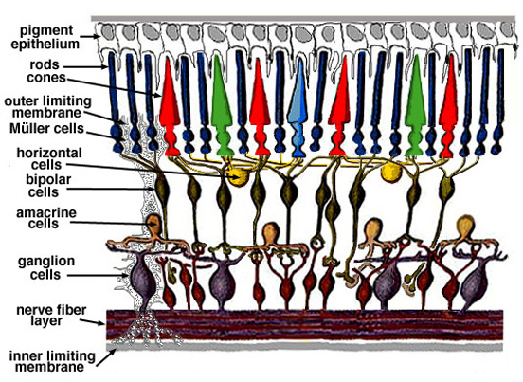
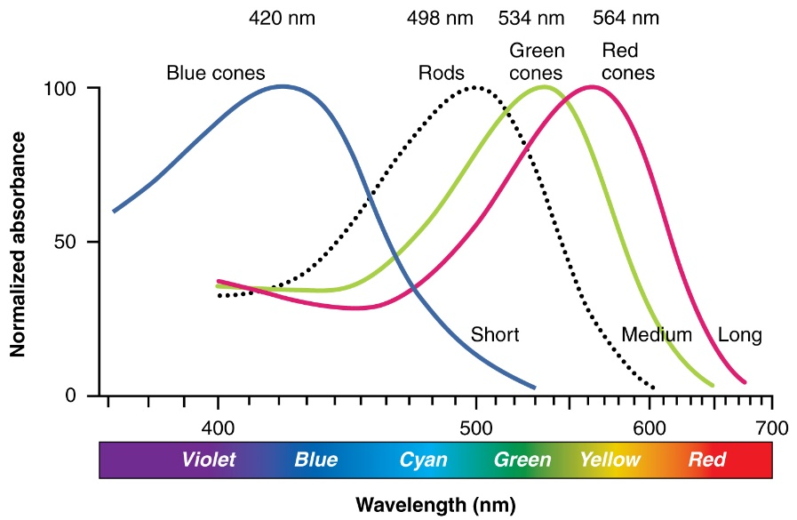
The Human Eye Photoreceptor Cells
Classic photoreceptor cells (light sensors) are rods and cones
The retina of a human eye contains:
≈ 120 million rod cells, extremely sensitive, no color vision
≈ 6 million cone cells, enable color vision; three different types with max. sensitivity for blue, green or red light

Slide 4
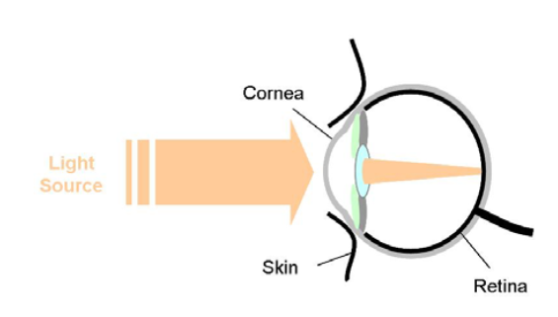
Potential Risks with Power LEDs Retinal Thermal Hazard
Retinal thermal hazard: Thermal damage to the retina (overheating), caused by the energy of incident light.
Occurs with very intensive light .
Even short exposure times (<10s) can be sufficient.
Very light intensive, high power LEDs (P >> 1W) may bear some potential risk.

Slide 5
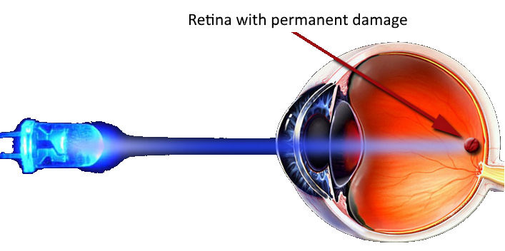
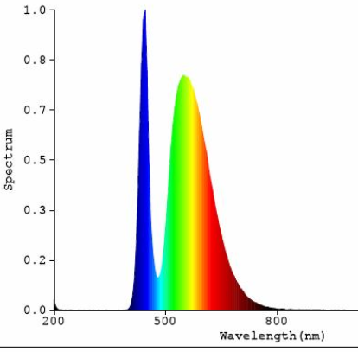
Potential Risks with Power LEDs Blue Light Hazard (Photoretinitis)
Blue light hazard: Short wavelength light with high intensity and long exposure times may cause degeneration of the retina, due to chemical changes.
Effect is to be integrated over lifetime.
Research still ongoing.
No risk for LED colors other than white or blue

Slide 6
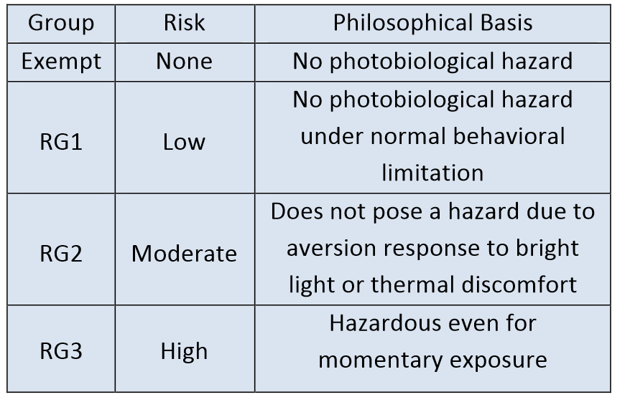
IEC62471 Risk Classification
Red, yellow or green LEDs
Most white or blue power LEDs
Some white or blue, high intensity power LEDs (power > 1W)
No LEDs found in RG3

Slide 7
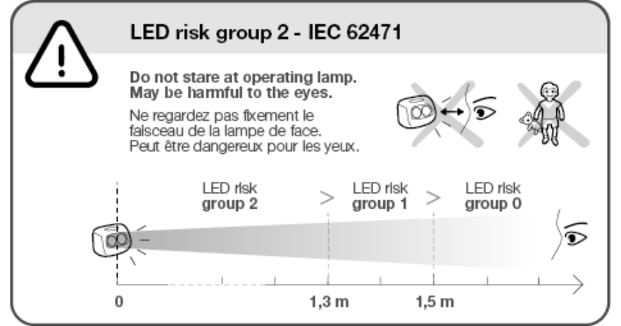
Example of Risk Group 2 Declaration
Source: www.petzl.com

Slide 8
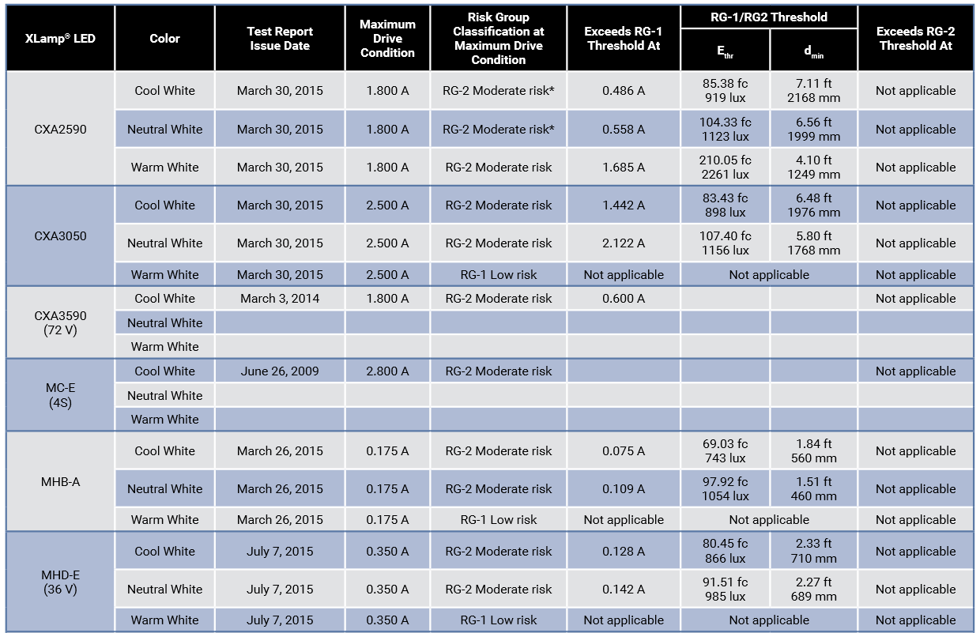
Example of LED Safety Testresults
RG2 is never exceeded
RG2 for Blue Hazard
*: also classified as RG2 for retinal thermal hazard
Source:http://www.cree.com

Slide 9
Conclusion
Power LEDs in “normal use cases” are safe.
No specific risks identified with red, yellow and green LEDs.
Blue or white high power LEDs may pose some risk under very specific conditions.
However to prevent any risk, always follow the basic safety rule: Never look directly at an operating power LED!!!
Safety measures when working with power LEDs :
Always use a diffusor (e.g. piece of paper) or a lamp shade
For measurements, where possible, replace the LED in your circuit with a power resistor or with power diodes.

Slide 10

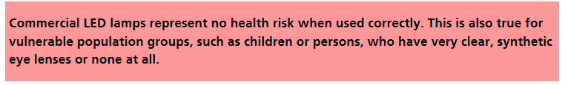
Conclusion
For further reading refer to the Swiss Federal Office of Public Health (BAG):
http://www.bag.admin.ch/themen/strahlung/03710/15953/index.html?lang=en

Slide 11
Thank you for your attention!

