Slide 1
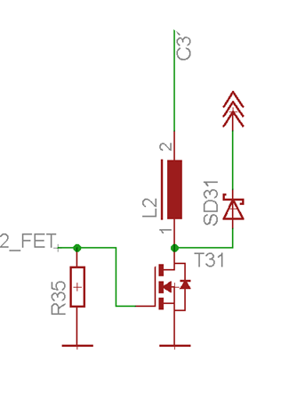

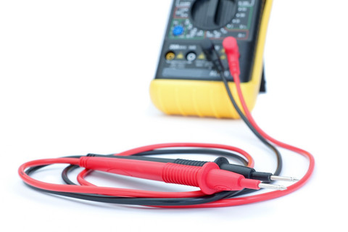


ETP
Testing Hardware

Slide 2

Purpose of Testing
Verify or proof that the requirements / expectations on the Device Under Test (DUT) are reliably met.
Reduce the risk of failures.
Locate defects.

Slide 3
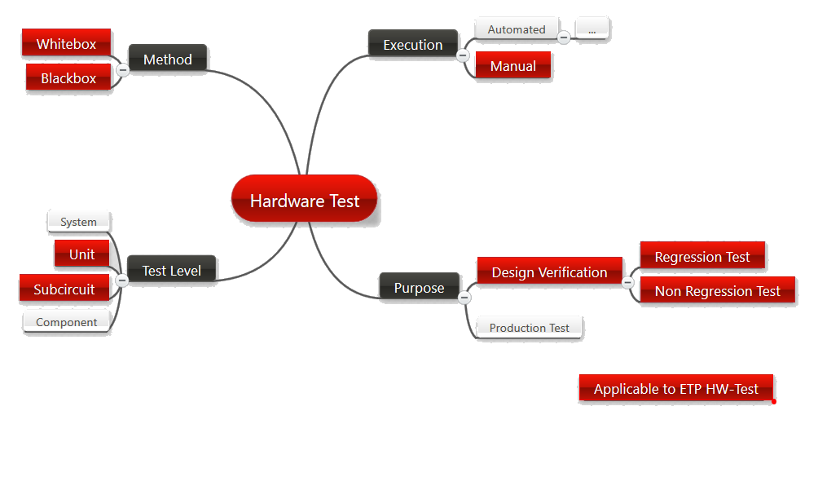
Hardware Test Classification
Red boxes are related to ETP hardware testing.

Slide 4
Design for Test
Testing starts with the hardware design!
When defining the requirements, also think about how to verify them.
When designing a circuit, identify its critical aspects and find a way how to test them.
Where senseful extend your circuit for better testability:
  Add test pins, test pads, jumpers, 0Ω R … where useful .
  Connect Enable/Disable pins of ICs via pullup- / pulldown R’s to power or ground.
  Allows to deactivate the IC for test purposes.
  But make sure that such built - in test circuitry has no negative influence on the main functionality of the circuit.
  Note: Microcontroller based systems often include built in test functionality.
Design the PCB to support testability:
  Make sure that the relevant nodes are accessible e.g. for oscilloscope probes.
  Don’t forget to add a ground pin to connect ground clips etc.
  You may add some supporting text on the PCB. E.g. signal labels .
  But here again, make sure that this measures have no negative impact on the main function of the circuit. Avoid long lines, don’t loose compactness …

Slide 5

Test Plan
Look at the requirements and at your circuit.
Identify the aspects to be tested
Write down the list of test cases, for each of them define:
  The test purpose / principle / sequence.
  How can the related requirement or the specific functionality be measured / verified?
  The test setup.
  What test equipment or test circuits are required?
  The test conditions.
  E.g. supply voltage, input signals , output loads, temperature, any settings in the DUT (jumpers, IC registers, …) or in the test equipment.
  Conditions to pass the test.
  What are the expected results?

Slide 6

Test Plan
Define the overall test sequence.
Check the test plan for good test coverage.
  But be aware that100% test coverage is not possible.
  The cases should at least cover the main functionality under standard conditions (e.g. defined in a requirements document), critical aspects and main risks.
  The test depth should be adapted accordingly and well balanced.
The test plan must be finished before the tests are started and not afterwards.
However, it’s common practice, to modify a test plan during the tests.

Slide 7
Testing Power Electronics Hardware
Always follow the principle: Safety First !!
Define the test cases accordingly.
  Personal safety: Prevent risk of electric shock or any other danger due to high voltages or high currents, heat, intensive light (power LEDs), …
  Prevent risk of damage of the DUT or the test equipment.
Before switching on the power supply …
  Do a visual inspection of the PCB: Solderings, no short circuits, correct orientation of the components, no missing components, correct values …
  Verify the test setup: Correct power supply (voltage, current limits, polarity), …
Start with safe measurements.
E.g. with current limited to a safe value DC power supply), non critical load (power R instead of LEDs), etc. …
Do the more critical measurements after having gained enough confidence.
If possible, divide the whole circuit into sections (sub-circuits), operate and test them separately before doing the overall test. Start with the low power sections.

Slide 8
Running the Test
Execute the tests as defined in the test plan.
It should therefore always be clear what results you would expect.
Write a test protocol while doing the tests. It should include:
  All information about the conditions and results of the measurement.
  E.g. tables with raw data, generated log files or graphs
  Comments on any noteworthy observations: unexpected results, special insights, instabilities …
  Formal information: who did the test, date, time, location, identification of equipment used
Having the test plan and the test protocol, it should be possible to redo a measurement and reproduce the results.
When a test case has been finished, it should be clear whether the test is passed or failed.
When a test is failed, decide whether the test session can be continued or whether is has to be aborted.

Slide 9
Test Analysis
Test analysis is done after the test session has been finished.
It may include:
  Post processing of the test results
  Presentation of the results e.g. as graphs, tables ..
  Detailed comparison of the results against the expectations, simulations, datasheets …
  Finding reasons for deviations and errors
  Commenting / discussing the results
  Final verdict: Passed or Failed

Slide 10
Test Documentation
Test protocol or raw test data go to the appendix.
Add a separate section to the hardware report.
For each test case, document the previously described steps
  Purpose: Why?
  Test description: Test setup, test principle, test sequence: How?
  Conditions to pass: Expectations, references, limits …
  Results: Should be presented in a appropriate form. E.g. graphs, tables…
  Discussion, comments remarks, verdict: Passed or failed
Sometimes it’s possible to use a table with four or five columns with the above aspects and a row for each test case.
Purpose, Description | Expected | Results | Discussion

Slide 11

Thank you for your attention!

