Slide 1
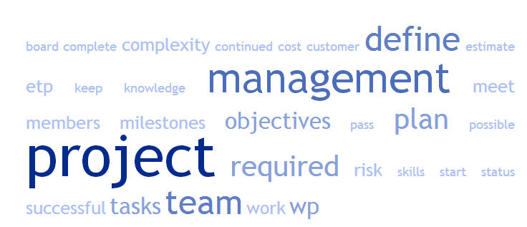
ETP Project Management
Project Management
eand / hhrt 2018

Slide 2
What is a Project?
A project is an endeavor undertaken
to create a new product or a new service (e.g. development projects)
or to achieve some specific results (e.g. scientific studies)
It normally has (or should have)
a certain uniqueness (no daily business …)
a certain complexity
a project team
well defined objectives / deliverables
a well defined timescale (start and end dates)
limited resources: budget, head count, infrastructure, ..

Slide 3
What is a Project?
How does this fit to the ETP project?
What is special to this project?

Slide 4

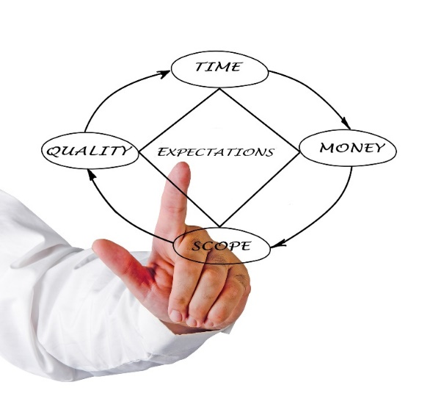
What is Project Management?
Project management shall help to successfully finish a project
in time (no missed deadlines)
in budget (no cost overruns)
and with the expected quality
It is used to
plan
organize
and control
projects.

Slide 5


What is Project Management?
Project management comprises a set of
skills,
tools
and processes
Project management should always be adapted (scaled) to the complexity of the project.

Slide 6


What is Project Management?
In most cases, a project leader is in charge.
But →
Project management is a task to be performed by all members of the project team

Slide 7
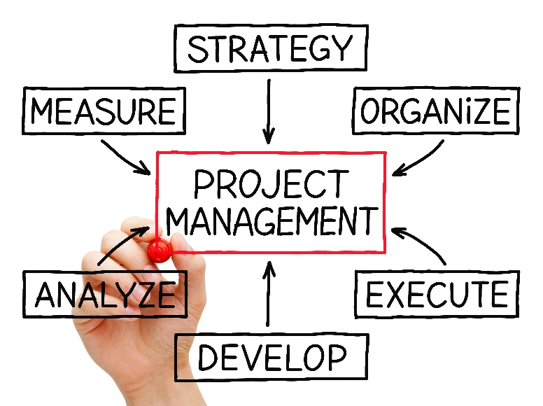
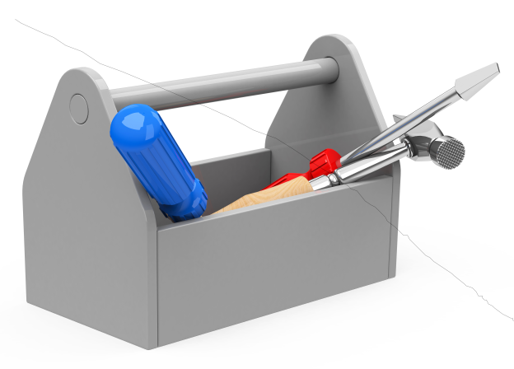
Project Management Skills & Tools
Some of the required skills may be:
team leading,
organizing,
planning,
expert knowledge in the field of the subject of the project
Useful tools may be:
templates,
checklists,
diagrams, …
often supported by dedicated software

Slide 8
Project Management Processes
Involved processes may be:
Time management,
Cost management,
Resource management,
Communication:
team internal
and external (e.g. reporting to the project board, comm. with the customer …),
Risk management,
Change management,
Troubleshooting
etc. …

Slide 9
Project Management for ETP Proposed steps to start:
Build your project team: define the roles and responsibilities of both team members, define rules of cooperation, …
Define the milestones For each of them define the criteria to pass.
Identify all tasks to be performed. Break down the whole project work into work packages (WP). Assign the WPs to the team members. Estimate the effort required (in time units) for each WP.
Setup the project plan showing all milestones and WPs on a timeline, e.g. using a Gantt chart (see next slide)
In most cases multiple iterations through above points will be required.

Slide 10
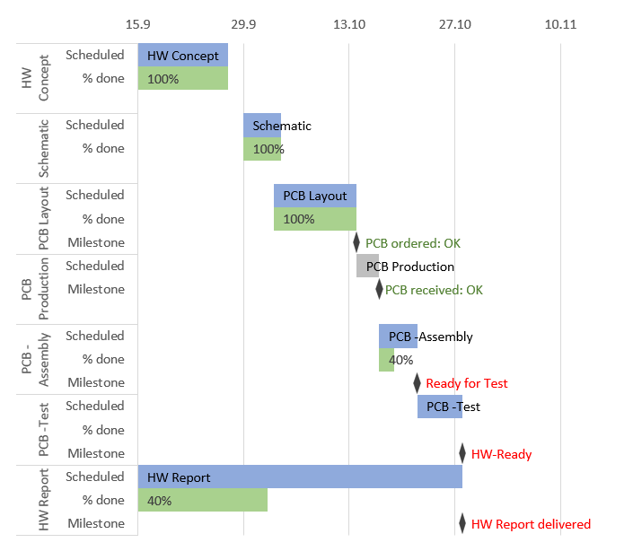
Simple Gantt Chart Example with Excel
Timeline
Scheduled WP
e.g. defined by start time and duration
Passed Milestone
(defined by point in time)
Percentage of fulfilment (relative to WP duration)
Not yet
passed Milestone

Slide 11
Project Management for ETP: During the project
Regularly update the project status e.g. milestones passed and percentage of fulfilment
Update/ refine your project plan in the ongoing project. During your work you will gain more knowledge about the tasks to do. Copy older versions into an archive.
Always look ahead with the planning: How can we come to a successful project result in the remaining time. Keep in mind: It is required to meet the project objectives, but there is no requirement to meet the original project plan as accurate as possible.

Slide 12
Thank you !!!
And have a successful project start ….

