Slide 1
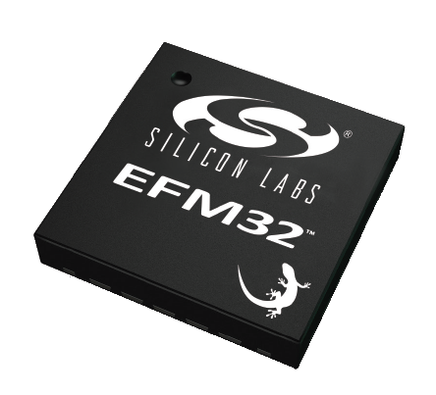


ETP Microcontroller - Architecture

Slide 2

EFM32G890F128
EFM32 → 32 Bit “Energy Friendly Microcontroller“ family from Silicon Labs
G → Gecko: ARM Cortex-M3 processor core
890 → Type Identifier
F128 → 128kByte flash memory (16kB RAM)

Slide 3
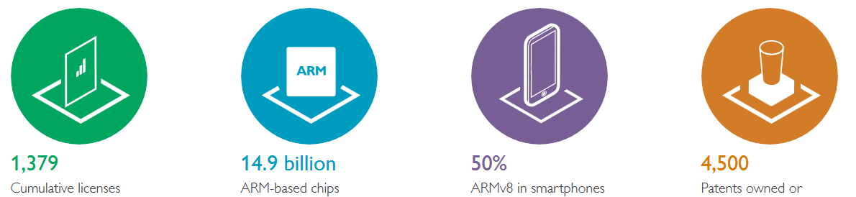

ARM Processor Core Concept
Family of 32 bit (and 64 bit) processor cores licensed by ARM Holdings (UK), provided as Verilog IP-cores ARM = Advanced RISC Machines, (RISC = Reduced Instruction Set Computer)
Used by leading microcontroller manufacturers who build their own µC products around ARM cores. E.g.: Samsung, Microchip, Sillicon Labs, NXP, ST, TI …
Enables common programmer’s model and common tool set (compilers etc.) for these ARM based products
Find more on www.arm.com

Slide 4
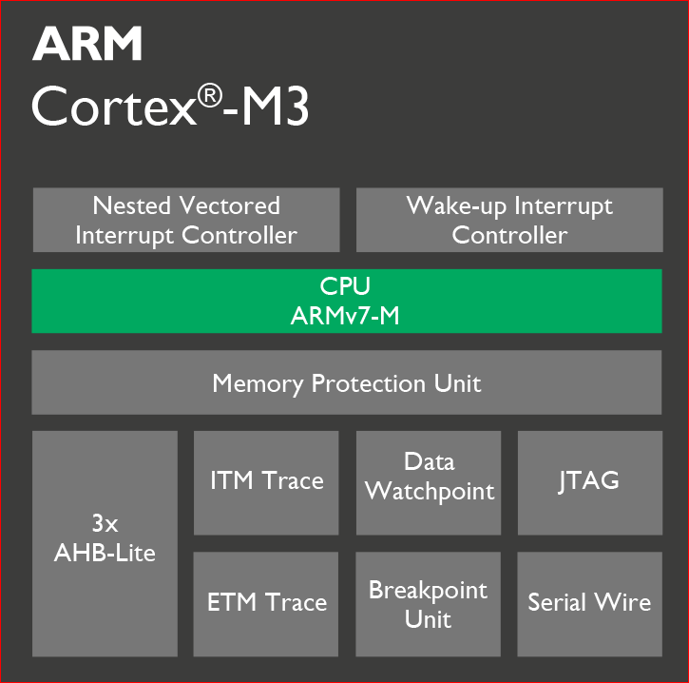
ARM Cortex M3 Processor Core
32 bit ARM core → basic type int is 32 bit wide
Very energy efficient ARM core
High code density (30% smaller code than 8 bit devices)
Good performance
Hardware multiplier
100% C programmable

Slide 5

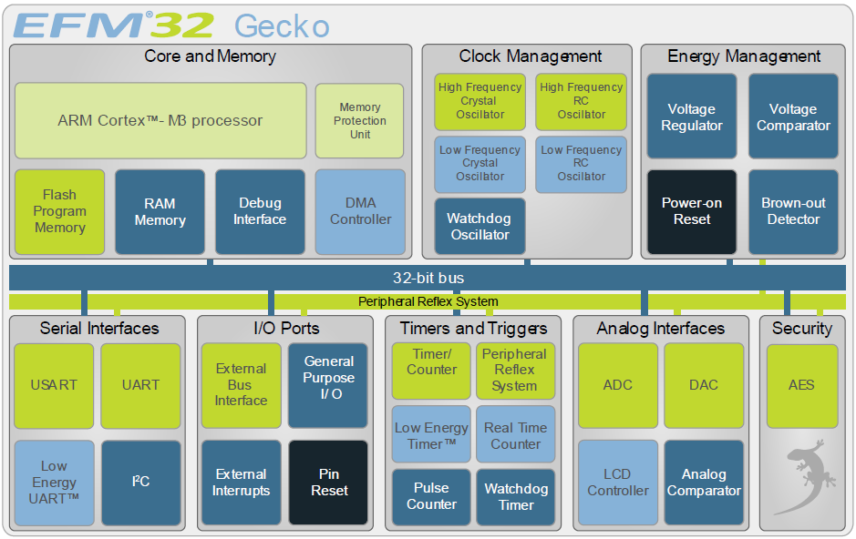
EFM32 Gecko Overview Energy modes:

Slide 6
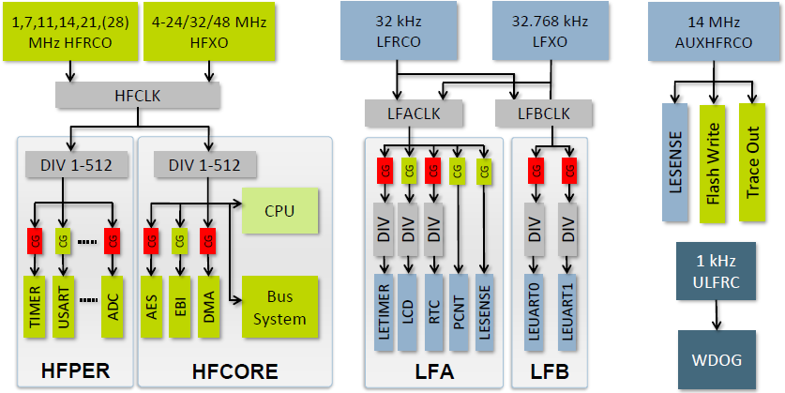
EFM32 Gecko Clock System
Almost every peripheral requires a clock. → Don’t forget to enable it.
Flexible clock system with clock selectors, clock dividers (aka prescalers) and six on-chip oscillators to provide each unit with the appropriate clock signal.
Clock gates allow to disable clocks or complete clock domains when the associated peripherals are not used.
Highest clock frequency of the Gecko is the 32MHz crystal oscillator HFXO.

Slide 7
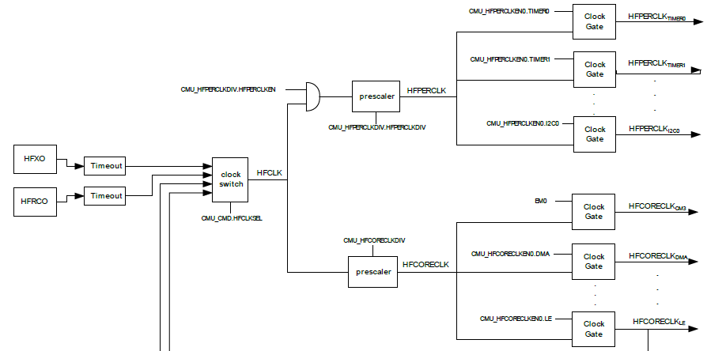
EFM32 Gecko High Frequency Clocks

Slide 8
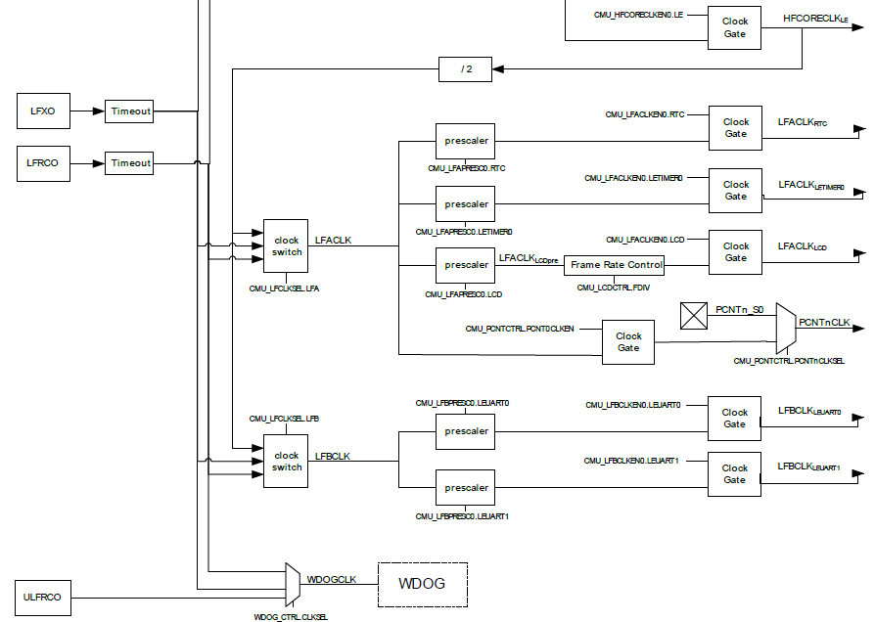
EFM32 Gecko Low Frequency Clocks

Slide 9
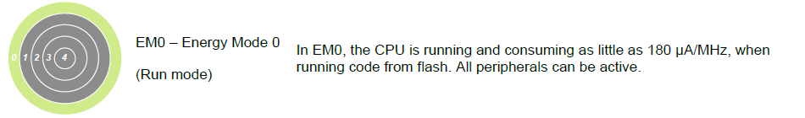
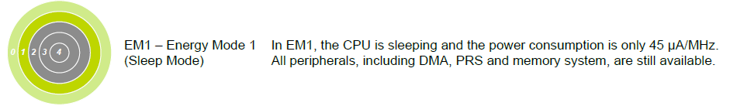
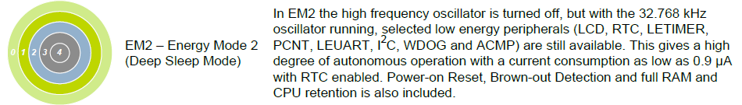
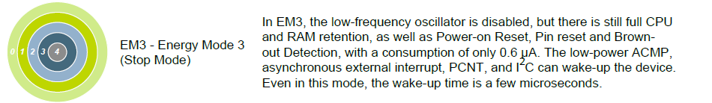
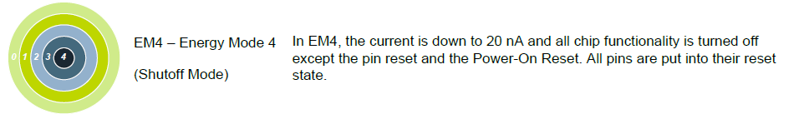
EFM32 Gecko Energy Modes

Slide 10
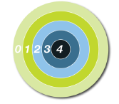
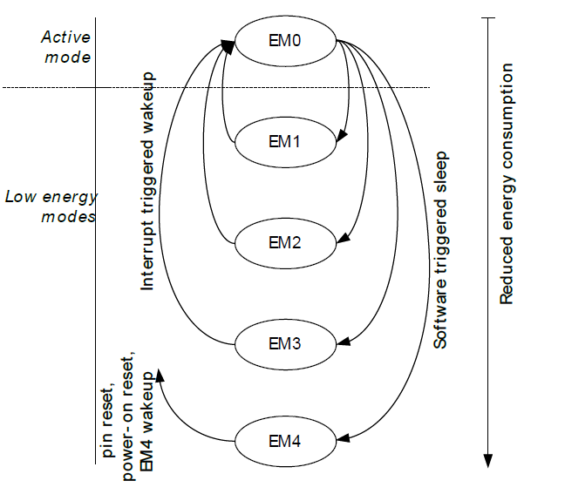
EFM32 Gecko Energy Modes

Slide 11

Interrupts
Interrupts are (external or internal) events which can cause the CPU to immediately stop execution of the (main) program and run another (short) routine which handles the event. When finished, the CPU continues execution in the main program from the point where it has been interrupted before.
Comparison: interrupts vs. polling: It’s like sleeping until the alarm clock rings rather than periodically checking a watch whether it’s time to get up.

Slide 12
Microcontroller Interrupt Hardware
Interrupt events are stored in “interrupt flags” (bits in a dedicated status register of the microcontroller).
Interrupts can be enabled / disabled using “interrupt enable bits” in a dedicated control register of the microcontroller.
Example: A push button triggers an interrupt event.

Slide 13
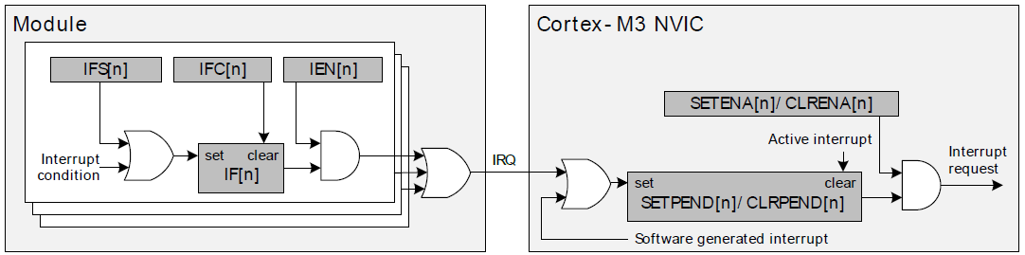
EFM32 Gecko Interrupt System
EFM32G interrupts are controlled on two different levels:
In the EFM Gecko modules (i.e. the peripheral units)
In the Cortex M3 Core (i.e. Nested Vector Interrupt Controller, NVIC )
Module interrupt flag can directly be set by software
Module interrupt flags are not cleared automatically
Enable / disable an interrupt in the module
Enable / disable an interrupt in NVIC
NVIC interrupt flags are cleared automatically
OR
AND
Final interrupt request sent to CPU
OR
OR
AND
Interrupt trigger event
Interrupt sources from the same module are concentrated to one NVIC interrupt request
Interrupt flag in the module
NVIC interrupt flag may be set directly by software
Interrupt flag in NVIC

Slide 14
General Purpose Input/Output (GPIO)
A pin can be configured to serve as digital output or as digital input. Many different modes and parameters can be configured.
90 out of the 112 pins of the EFM32G890F128 are GPIO pins.
GPIO pins are identified by port number and bit number. E.g. pin 1 is identified by PA0 (port A, bit 0).
Same functionality all GPIO pins of the EFM32. E.g. all GPIO pins can be used as interrupt inputs.
Reminder: Don’t forget to activate the clock for the GPIO system. Else the GPIO won’t work at all.

Slide 15
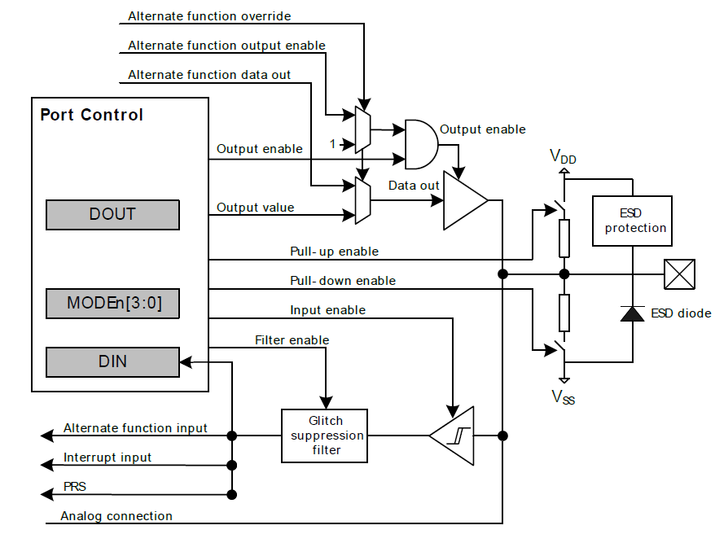
General Purpose Input/Output (GPIO)
Direct output from other peripherals
Output driver
Port Control Register
Set pin output to a logic level
Hardware pin
Set pin GPIO function
Read current logic level at the pin
Configurable pullup- or pulldown resistors
Direct input to other peripherals
GPIO interrupt
Schmitt trigger input
Trigger input

Slide 16
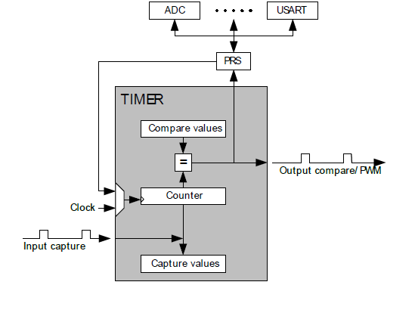
Timers
Timers are counters which are incremented (or decremented) with each clock cycle.
Timers may be used e.g. to:
Generate periodic events (i.e. timer interrupts)
Automatically generate a pulse width modulated (PWM) output signal.
Automatically measure the time between input events.
Set / get timestamps e.g. for debugging

Slide 17
Timer Up Mode with Interrupt
Timer counts up till TOP value is reached
On this overflow an interrupt is activated
This is a simple way to generate periodic timer interrupts
TOP value defines interrupt rate

Slide 18
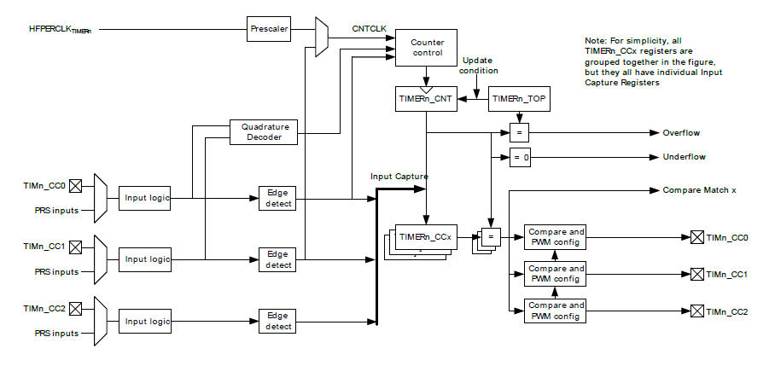
EFM32 Gecko Timer
Timer clock
Timer count register (16bit)
Top value
Capture event inputs
Timer interrupts
Compare registers
Timer output signals
Capture input signal conditioning

Slide 19
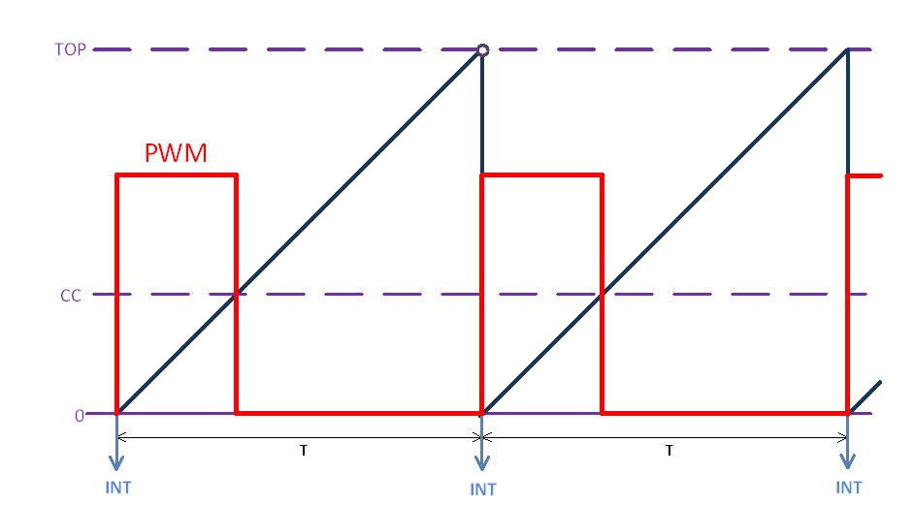
Gecko Timer PWM Example
Timer counts up
PWM is set at timer overflow
PWM is reset when timer crosses CC value
CC = Capture / Compare
PWM-duty-cycle = CC / TOP
PWM-frequency = timer-clock-frequency / TOP
A Gecko timer has 3 CC outputs, can be used to generate 3 PWM signals with different duty cycles but the same frequency.

Slide 20
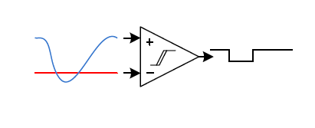
Analog Comparator ACMP
The on chip analog comparator compares two analog signals. The digital output tells which of them has a higher voltage.
Can generate interrupts or PRS trigger events.
May be configured to operate as a capacitive sensing circuit for touch-pads and touch-sliders.
Examples: - Moodlight solution 4 - Use the touchslider to input a “analog” value. - Detect when a voltage/current exceeds a limit.

Slide 21
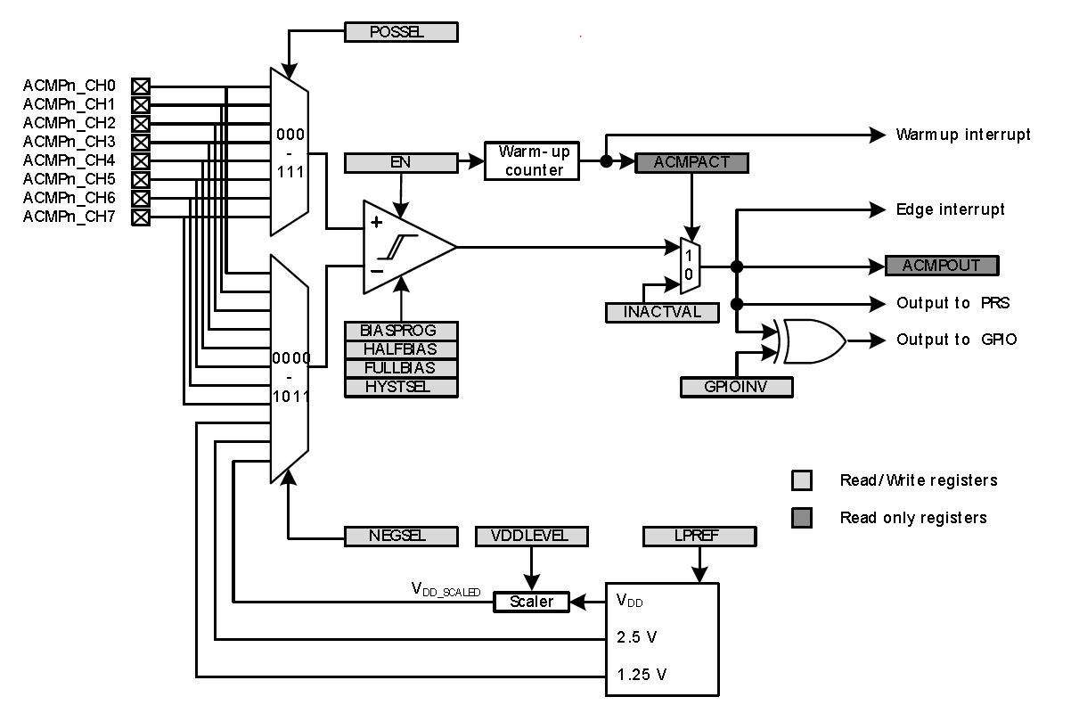
Analog Comparator ACMP
Select pos. input source
Enable comparator
Generates interrupts
SW adjustable voltage: 6bits (64 levels)
Select neg. input source

Slide 22
Analog Comparator ACMP0 ETP1 Solution 4

Slide 23
Short Intro to other Peripherals Energy modes:

Slide 24
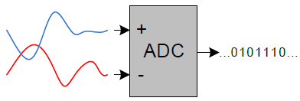
ADC Analog to Digital Converter
6/8/12 bit resolution, 1MSPS @ 12 bit
18 input channels, - external inputs - internal voltages (e.g. V_{DD} / 3, internal temp. sensor)
Can generate interrupt events, e.g. on “conversion complete”
Conversions can be triggered via PRS e.g. from a timer
Application Example: Measure a LED current

Slide 25
ADC Analog to Digital Converter ETP1 Solution 2

Slide 26
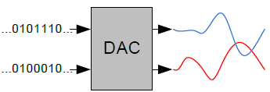
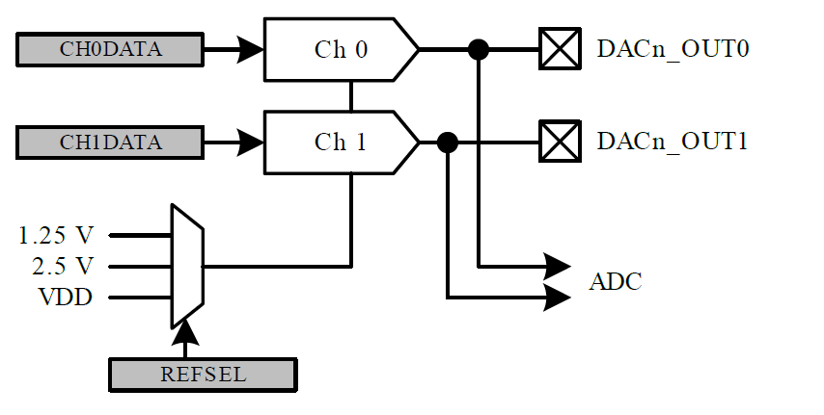
DAC Digital to Analog Converter
12 bit resolution, 0.5MSPS @ 12 bit
2 outputs that can be set individually
Application Example: Output an analog set-point value for a LED driver

Slide 27
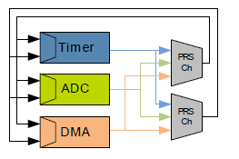
PRS: Peripheral Reflex System
On-chip network for trigger signals.
Runs independently from the CPU and the 32-bit-bus.
Allows to use an output signal from one peripheral to trigger another peripheral without any CPU interaction.
Application Example: - Trigger ADC conversions from timer overflow → Timer and ADC run synchronously without CPU intervention.

Slide 28
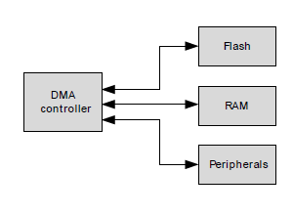
DMA: Direct Memory Access
Transfer data between memory sections and/or peripherals without any CPU interaction. The CPU can be in sleep mode or work on other tasks.
Transfers can be triggered by source events (via PRS).
Interrupts can be generated, when a transfer has been completed.
Significant reduction of interrupt rate can be achieved → better system performance and lower energy consumption.
Application Examples: - Transfer samples from ADC into a buffer in memory. - Copy bytes received from a serial interface to memory. - Copy bytes from memory to a serial interface.

Slide 29
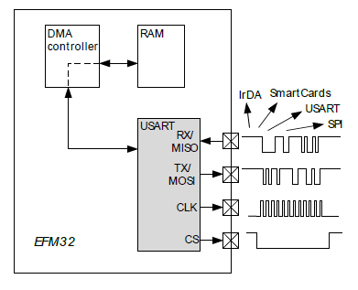
USART
USART: Universal Synchronous / Asynchronous Receiver Transmitter
Supports serial communication protocols such as SPI (synchronous), RS232 (3.3V, asynchronous) …
Application Examples: - SPI: Read sensor data and configure other chips. - UART: Communication with PC (FTDI-USB converter) and smartphone (Bluetooth).

Slide 30
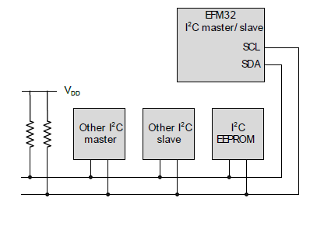
I²C: Inter IC Communication
2 wire standard for synchronous short distance communication with other integrated circuits.
The advantage over SPI is multi-master and multi-slave capability over just 2 wires.

Slide 31
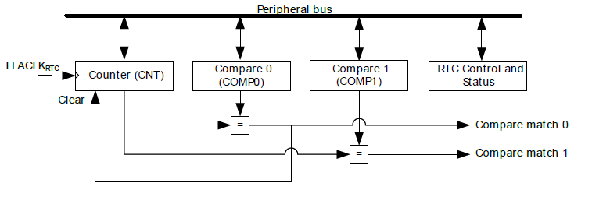
RTC Real Time Counter
A 24 bit low energy timer, clocked with the 32.768kHz clock (LFACLK).
Overflow period may last between 512s and 194days.
Can be used as real time clock for a watch.
Still runs when microcontroller is put into deep sleep mode.
Can generate one slow PWM signal

Slide 32
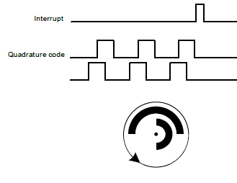
Pulse Counter
Counts pulses at input pin and generates an interrupt when a top value is reached.
Quadrature mode with two pins supported. E.g. allows detection of the rotational direction of turning mechanical shaft.

Slide 33
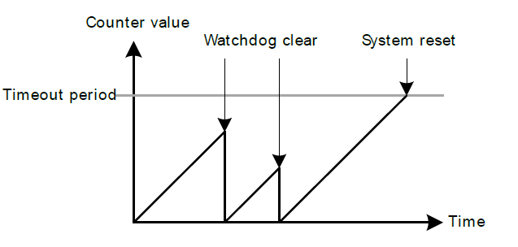
Watchdog Timer
Provides a last resort means of system fault handling.
Resets the system in case of a fault condition in the microcontroller.
Triggers a hardware reset when the CPU fails to restart the watchdog before the watchdog timeout occurred.

Slide 34
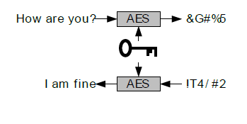
AES Advanced Encryption Standard Accelerator
Supports AES compliant symmetric block encryption / decryption
Block length: 128bit
128bit or 256bit keys supported
Chained block ciphering supported with additional XOR logic

