Slide 1
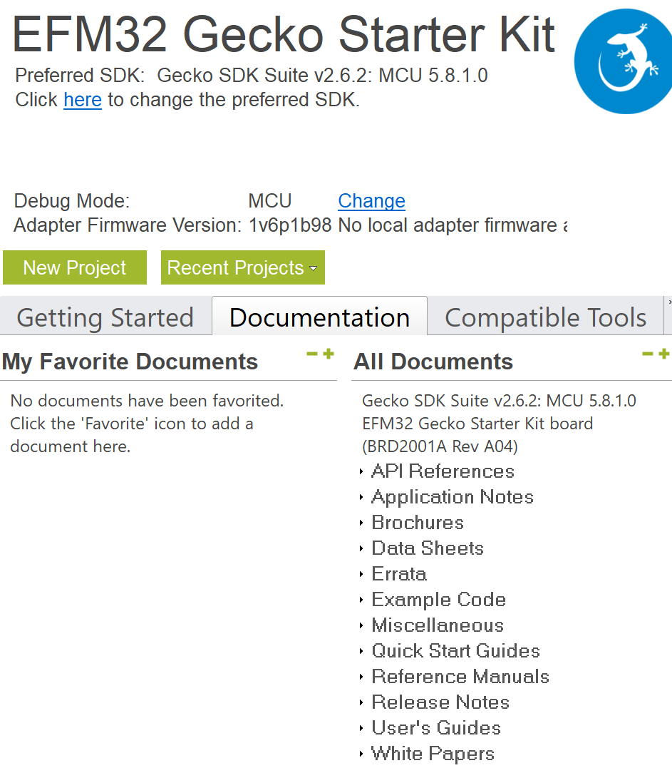
Peripherals
Peripherals are accessed by reading and writing registers.
Simplicity Studio - Launcher => Documentation
The Data Sheet lists the electrical characteristics of the selected specific microcontroller (i.e. EFM32G890F128).
The Reference Manual lists all the features, functions and registers of the peripherals for the selected microcontroller family (i.e. EFM32 Gecko).
As the server is often offline, the documentation is also provided here
\\shared.zhaw.ch\pools\t\T-ZSN-ETP\EFM32G_Starter_Kit_Gxxx

Slide 2
EMLIB and CMSIS
There are two ways to access the registers of the peripherals:
CMSIS = Cortex Microcontroller Software Interface Standard Coding standard for all ARM Cortex devices. Library containing header files, defines, startup files and commonly used functions. Direct access of registers and bits with C code is possible. Advantage: Very fast and straight forward
EMLIB = Energy Micro Library Provides a higher level of abstraction and a simpler application interface. Advantage: Quite easy to use for standard tasks
A developer is free to choose either one of these interfaces, or even mix and match between the two.

Slide 3
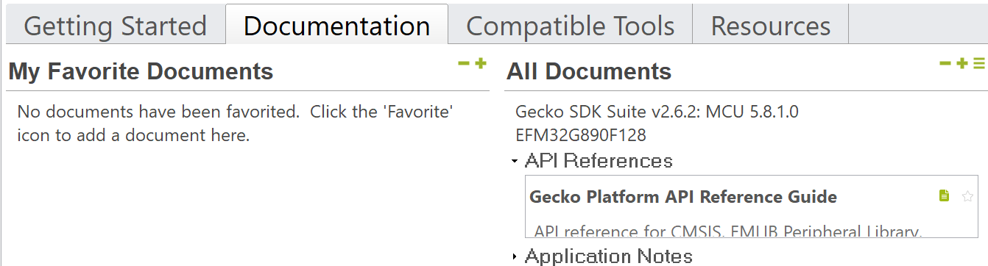
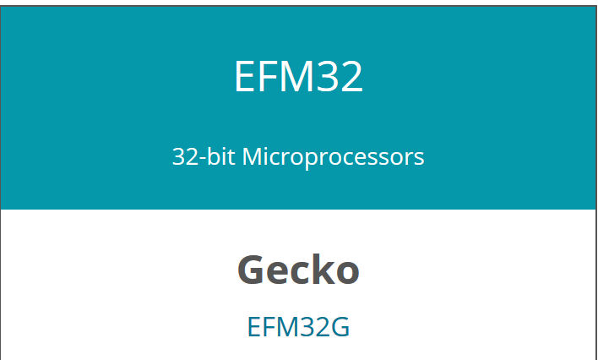
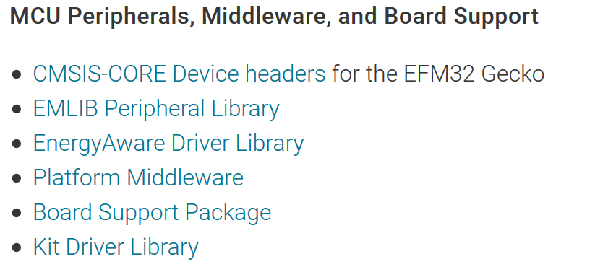
EMLIB Documentation
Simplicity Studio - Launcher => Documentation
→Gecko Platform API Reference Guide
Click this pane to open the website
and then on EFM32G
and then on EMLIB …
Or go directly to the website: https://docs.silabs.com/mcu/latest/efm32g/group-emlib

Slide 4
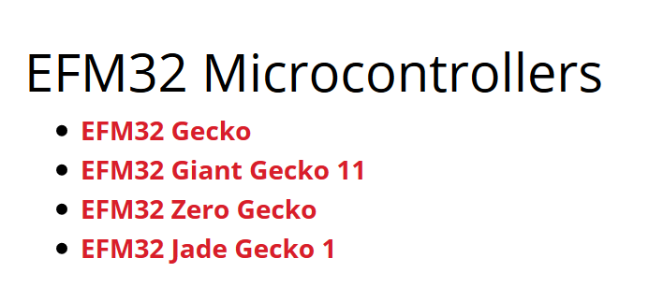
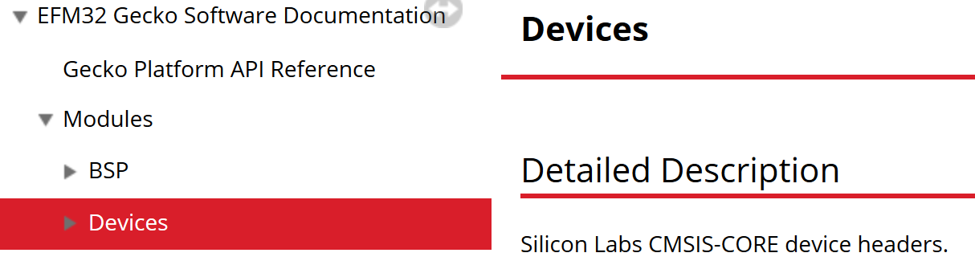
CMSIS Documentation
Only an abridged CMSIS documentation is directly accessible from Simplicity Studio. A comprehensive CMSIS documentation can be found here: http://devtools.silabs.com/dl/documentation/doxygen
… select EFM32 Gecko
… and then Modules→Devices
As the server is often offline, the documentation is also provided here (also for EMLIB)
\\shared.zhaw.ch\pools\t\T-ZSN-ETP\EFM32G_Starter_Kit_Gxxx\EM_CMSIS_3.20.7_DOC.zip
(newest version is not yet available for offline reading)

Slide 5
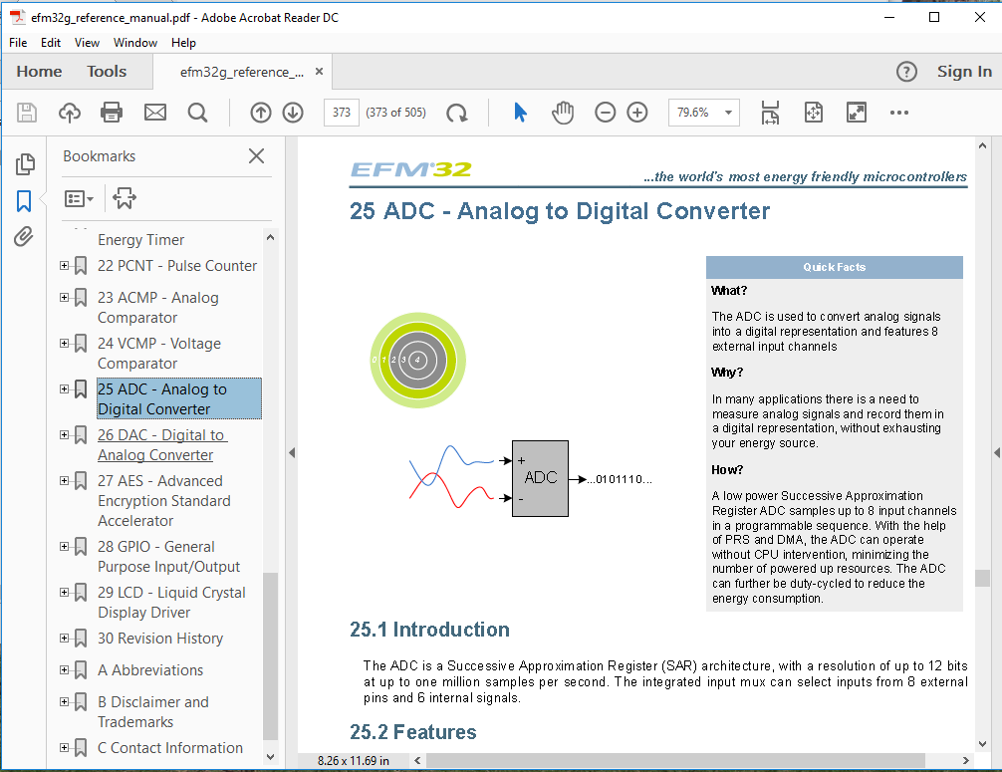
ADC Reference Manual
With all the documents available, let’s have a look at the ADC.

Slide 6
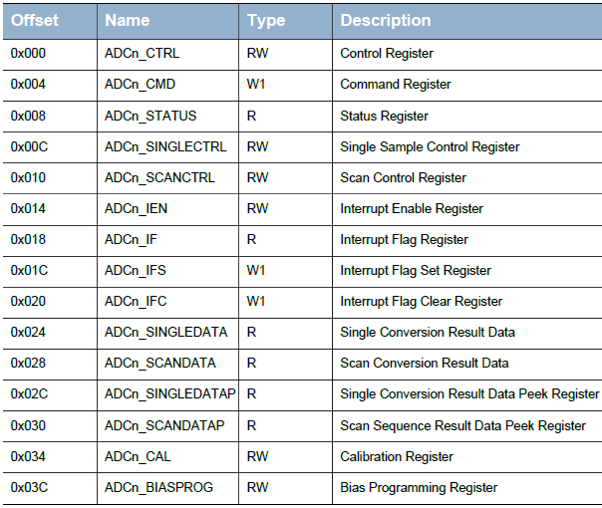
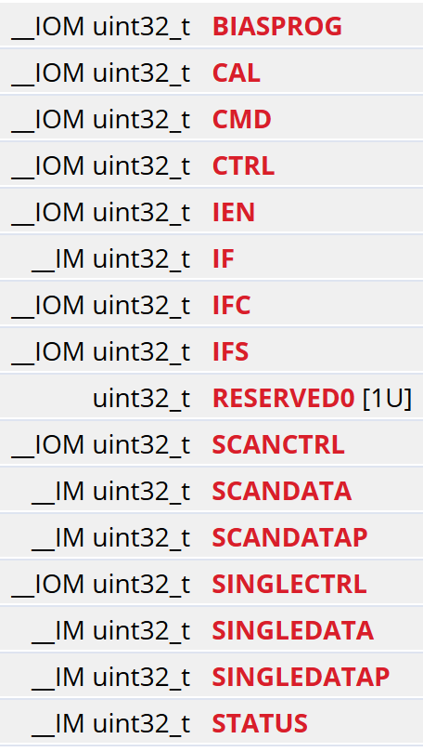
ADC Reference Manual and CMSIS
Reference manual, ADC, Register Map CMSIS documentation
ADC_TypeDef

Slide 7
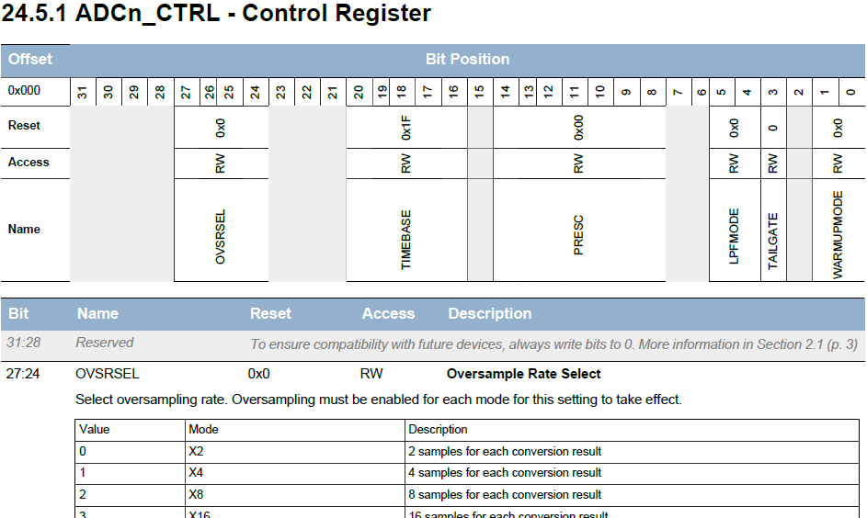
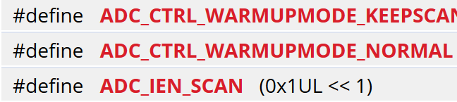
ADC Reference Manual and CMSIS
Reference manual, ADC, Register Description
CMSIS
ADC_BitFields
This gives the
following C-code:
ADC0->CTRL
= ADC_CTRL_WARMUPMODE_NORMAL;

Slide 8
ADC Code Example
What is the C-Code for checking if valid data is available to read from ADC0?

Slide 9
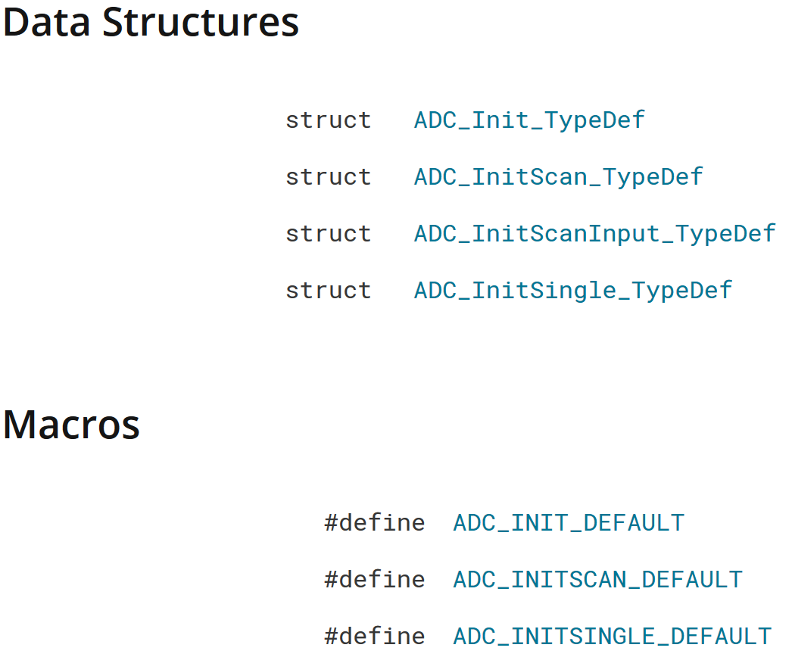

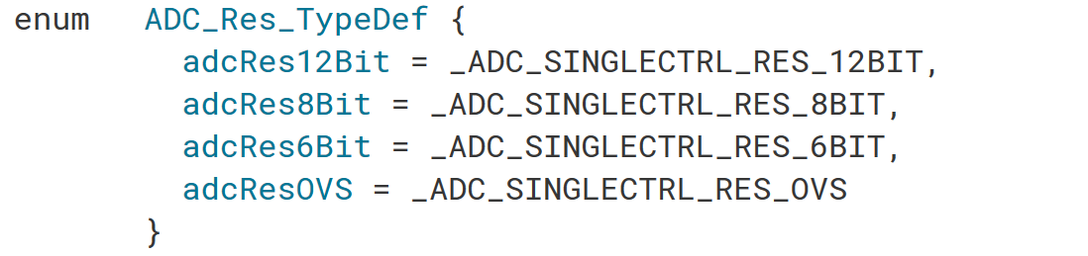

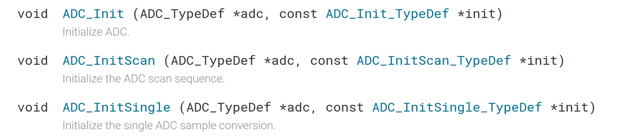
ADC with EMLIB
…
…
Predefined data types
Default values
Fields mapped to CMSIS
Functions use CMSIS

Slide 10
ADC with CMSIS or EMLIB Code
Example: void setupADC(void) { … }
CMSIS | EMLIB
ADC0->CTRL = ADC_CTRL_WARMUPMODE_NORMAL | 27 << _ADC_CTRL_TIMEBASE_SHIFT | 13 << _ADC_CTRL_PRESC_SHIFT; | ADC_Init_TypeDef init = ADC_INIT_DEFAULT; init.timebase = ADC_TimebaseCalc(0); init.prescale = ADC_PrescaleCalc(2080000, 0); ADC_Init(ADC0, &init);
ADC0->SINGLECTRL = ADC_SINGLECTRL_REP | ADC_SINGLECTRL_ADJ_RIGHT | ADC_SINGLECTRL_RES_12BIT | ADC_SINGLECTRL_INPUTSEL_VDDDIV3 | ADC_SINGLECTRL_REF_1V25; | ADC_InitSingle_TypeDef sInit = ADC_INITSINGLE_DEFAULT; sInit.rep = true; sInit.input = adcSingleInpVDDDiv3; sInit.reference = adcRef1V25; ADC_InitSingle(ADC0, &sInit);
ADC0->IEN |= ADC_IEN_SINGLE; | ADC_IntEnable(ADC0, ADC_IF_SINGLE);
NVIC_EnableIRQ(ADC0_IRQn); | NVIC_EnableIRQ(ADC0_IRQn);
ADC0->CMD = ADC_CMD_SINGLESTART; | ADC_Start(ADC0, adcStartSingle);
execution time @ 28MHz: 2.9us (Tiny G.) | execution time @ 28MHz: 22us (Tiny Gecko)
With compiler opt. high: 1.5us (Tiny G.) | With compiler opt. high: 19us (Tiny Gecko)

Slide 11
ADC with CMSIS or EMLIB Code
Example: void ADC0_IRQHandler(void) {
Code executed for every sample and in time-critical section!
CMSIS | EMLIB
rb_index = (rb_index+1) & (rb_size-1); | rb_index = (rb_index+1) & (rb_size-1);
rb[rb_index] = ADC0->SINGLEDATA; | rb[rb_index] = ADC_DataSingleGet(ADC0);
ADC0->IFC = ADC_IF_SINGLE; | ADC_IntClear(ADC0, ADC_IF_SINGLE);
if (sample_index >= sample_number) { ADC0->CMD = ADC_CMD_SINGLESTOP; } | if (sample_index >= sample_number) { ADC_Reset(ADC0); }
execution time @ 28MHz: 2.5us (Tiny Gecko) | execution time @ 28MHz: 2.9us (Tiny Gecko)
With compiler opt. high: 1.4us (Tiny Gecko) | With compiler opt. high: 1.4us (Tiny Gecko)

Slide 12
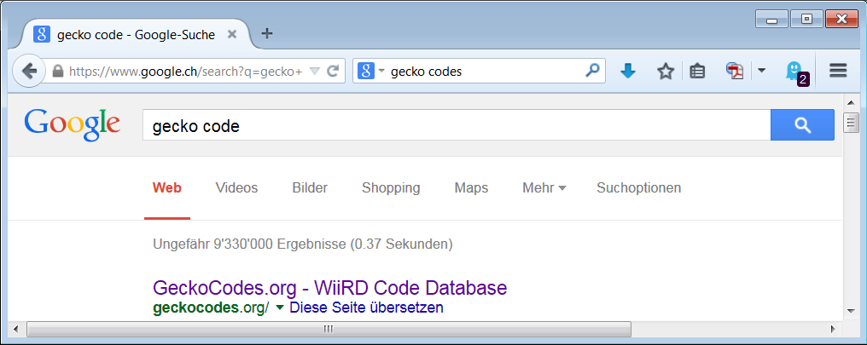
Peripherals: Finding Code Examples
Though all the required information for programming a peripheral is available in the Reference Manual, the Datasheet, the CMSIS and the EMLIB documentation, it is much easier to start with a functioning example code and adapt it to meet the requirements.
But where to find it?
Ask Google?
What is relevant?
This is a Wii console site ☹

Slide 13
Peripherals: Finding Code Examples
Simplicity Studio offers:
Software Examples Can be used as project template. Simplicity Studio – Launcher => Getting Started => Software Examples => Gecko Starter Kit
Application Notes Code examples, but not necessarily for the Gecko Starter Kit. Simplicity Studio – Launcher => Documentation => Application Notes

Slide 14
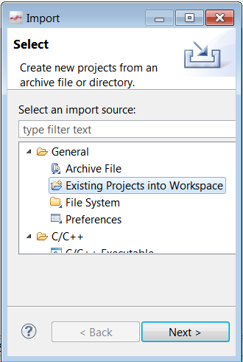
Peripherals: Finding Code Examples
The ETP team provides code from their prototype:
\\shared.zhaw.ch\pools\t\T-ZSN-ETP\Gecko_SW
The archive Moodlight_Template.zip can be imported in the Simplicity IDE Menu File => Import…
The file _peripherals_code_snippets.c contains commented sample code for the Gecko peripherals.
Note: This template is ready to run. Just compile and start it.

Slide 15
Evaluation Board
Note: On the evaluation board some GPIOs are already used for on-board devices such as push buttons, touch sliders, user LEDs, LCD display, etc.
Some GPIOs are easily accessible on the Expansion Header (20 pole connector) and some on the Breakout Pads (vias).
Simplicity Studio => Launcher => Documentation => t0008_efm32_g8xx_stk_user_manual
As the alternate functionalities are also used for PWM, ADC, DAC, UART, etc., the information from Reference Manual, Datasheet and User Manual were combined (which was quite arduous): \\shared.zhaw.ch\pools\t\T-ZSN-ETP\EFM32G_Starter_Kit_Gxxx\HeaderPinOutline_Gecko.xlsx

Slide 16
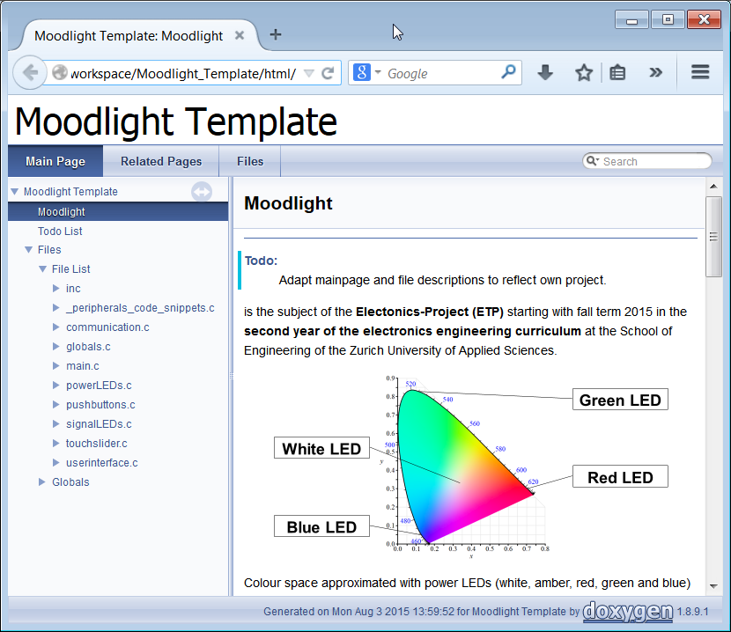
How to get an Overview of the Template
Read the documentation Open the file «index.html» in the folder «Doxygen\output».
Open «Files» then «File List» and read the «Detailed Description» of each file by clicking on «More …» on the 2nd line of each file. Don't go into details at this point. Just get an overview of what functionality is handled in which file.

Slide 17
How to start with your own code
Basically you have to modify the file "userinterface" for the menu.
And the file "powerLEDs" for the interface to the two HW-solutions of the LED driver (code snippets from the file "_peripherals_code_snippets" can be used).
All the other files can be left as they are.
Work on both files independently. That makes it easier to test the SW and to split the work between group members.
Once, both parts are tested, you have just to merge the files.

Slide 18
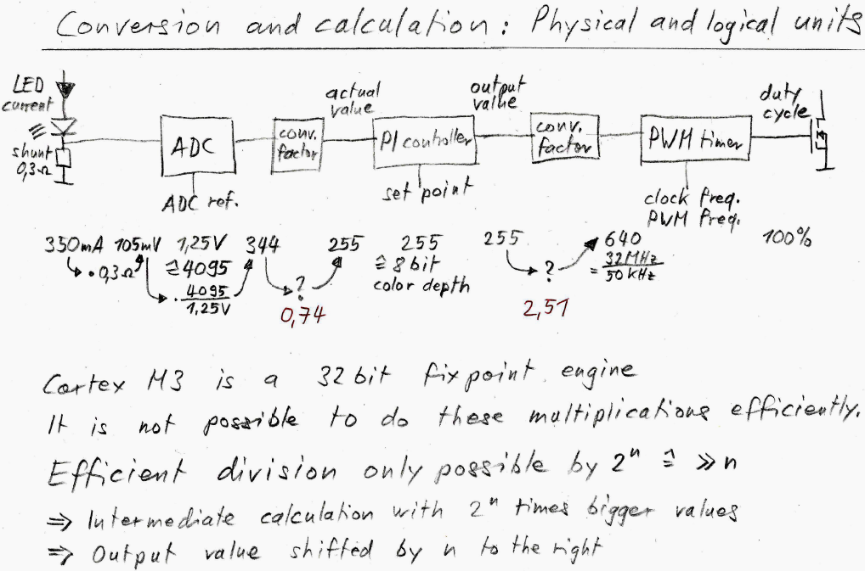
Integer-Arithmetics

Slide 19

Integer-Arithmetics (continued)
Examples with values from previous slide:

Slide 20
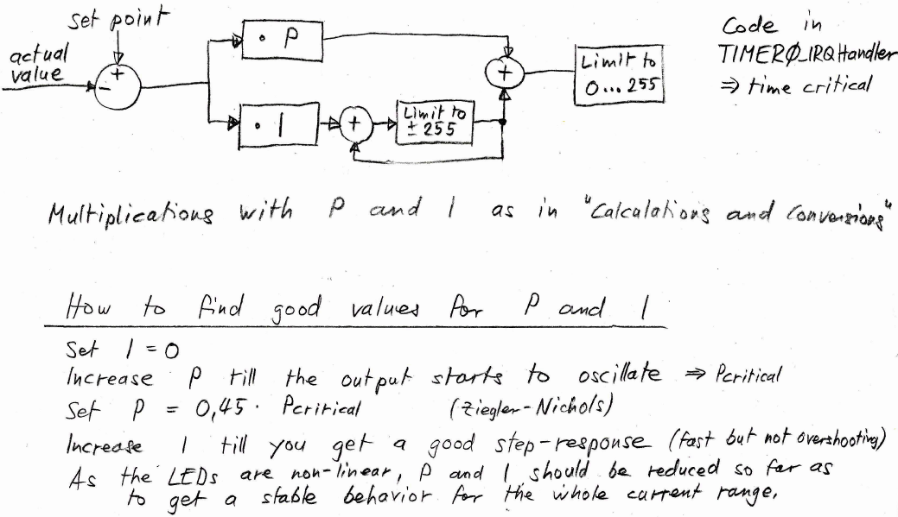
Digital Proportional-Integral Controller

