Slide 1

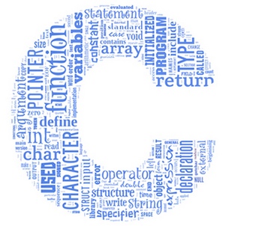
C Coding Style / Code Documentation
Goal: Make life easy for an other engineer who has to work with existing code.

Slide 2

Splitting the Code into several Modules
Avoid huge files!
Putting all the code into one single file:
difficult to maintain the code or find a specific section
impossible for several programmers to share a project
code can’t be reused without substantial modifications
complete code needs to be recompiled for new builds

Slide 3
How to Split the Code into several Modules
Define modules per
purpose e.g. “common definitions”, “math”, “initializations”
or per (sub-) system: e.g. user interface, LED driver …
Use meaningful filenames: ui_menu.h, ui_menu.c led_driver.h, led_driver.c

Slide 4
C Files
C files contain the implementation details (= private)
Locally used #define (not shared with other modules)
Locally used variables (not shared with other modules)
Functions with their code (function body)
Public data and functions are declared in header files (in addition to the instantiation in the .c file)
.h-file: extern int PB_IrqFlag; // declaration
.c file: int PB_IrqFlag = 1; // instantiation
.h file: void COM_Init(void); // declaration
.c file: void COM_Init(void) // instantiation { … here goes the code … }

Slide 5
Header Files
Every module has one header and one c file
ui_menu.h and ui_menu.c
Header files interface to other modules (= public)
Public function prototypes (function header only)
Global variables (important: declared as extern)
Common header files for global definitions
#define (for globally used constants or macros)
Type definitions (for globally used data types)
General rule:
Header files do never instantiate any memory

Slide 6
Inclusion Guards for Header Files
Several header and c files may include the same header files. → Could lead to multiple or nested inclusions.
But the content of the header file should not be repeated in a module. → Use compiler directives to solve this issue, it makes sure that the compiler reads a header file only once.
#ifndef _UI_MENU_H #define _UI_MENU_H // start of header file // … // here go all the details of the header file // … #endif // end of header file

Slide 7
Static Inline Functions
e.g.: static inline int sum(int x, int y);
Used for optimization:
The compiler inserts complete function body into every place where the function is called, rather than generating code to call the function.
For frequent calls of functions with small function body
Enabling depends on compiler optimization level setting
Note: External functions cannot be inlined:
Because the compiler does not know the function code at compilation time
Thus, public inlined functions may be defined in header files only.
Use of separate header files for this purpose is recommended

Slide 8
C Programming Style
Discuss and define (within your group) the coding guide lines for your project.
Aspects to be considered and defined, may be:
Use of global versus local variables: Follow the principle of information hiding: Make only that part of data public that really needs to be known by others. → Prefer local variables over global variables: Provides better readability → Prefer stack variables (auto variables) over static variables: Requires less data memory.

Slide 9
C Programming Style (cont.)
Define naming rules for constants, variables, type definitions and functions Expressive Names improve readability and maintainability a=b*c/4096; u_ADC = x_ADC * Vref / (1 << N_BIT) ;
Clearly show the programmers intention and don’t rely on compiler rules. E.g.: Rearrange order of terms, such that * comes before /, use additional clarifying parentheses and white space in complex statements. u =(int)x/(1<<NBIT)*Vref; u =( ((int)x) * Vref ) / (1<<NBIT);

Slide 10
C Programming Style (cont.)
Define guidelines for the graphical layout of the code: Indentation, white-space, block separation, … improve a codes readability.
Define criteria for splitting code into modules / files
Use ONE function for ONE task Is most likely true, if you can easily find an accurate function name.

Slide 11
C Programming Style (cont.)
Avoid code repetition. Place identical (or combine similar) code into a function and call it from several locations. Note: Code repetition is a common (and avoidable) source of errors because the code is modified in one place and not in the other(s).
Placing portions of code into functions may improve readability, even when the code is not repeated.

Slide 12
C Programming Style (cont.)
Some Links for “C Programming Style”:
http://www.cs.swarthmore.edu/~newhall/unixhelp/c_codestyle.html
https://www.kernel.org/doc/Documentation/process/coding-style.rst
http://homepages.inf.ed.ac.uk/dts/pm/Papers/nasa-c-style.pdf

Slide 13
Commenting C Code
Good source code comments improve readability and maintainability.
Every file has a comment header
Short description of the content / purpose
Administrative information such as author, project name, …
Every function is preceded by a comment
What does the function and how is this achieved?
List of all the parameters with a short description
Description of return value
Indication of side effects such as modifying a global variable

Slide 14
Commenting C Code (cont.)
Inline commenting (in the same line after the code)
Explain the purpose of the code, the intention of the programmer Connect the code with the program task → higher abstraction level
Avoid superfluous comments, x=x+1 //increment x by one this comment is obviously useless
“Self explaining” code highly reduces need for inline comments. May be achieved e.g. with: Expressive variable and function names Constants with meaningful names instead of literals (numbers in the code) GPIO_PortOutSet(PORT_D, PIN_4) instead of GPIO_PortOutSet(3,4)
Software should generally be commented in English

Slide 15

C Code Documentation with Doxygen
With the help of a tool, a documentation can be generated directly from the commented code.
This guarantees that the documentation is up to date.
Such a tool is Doxygen http://www.stack.nl/~dimitri/doxygen/
Introduction: http://www.stack.nl/~dimitri/doxygen/manual/docblocks.html
Reference: http://www.stack.nl/~dimitri/doxygen/manual/commands.html
Note: the libraries CMSIS und emlib have been documented with Doxygen

Slide 16
C Code Docu with Doxygen (cont.)
Doxygen does not have a fixed associated file name extension. To open a configuration file: Start the program Doxywizard
A suitable Doxygen configuration file named “Doxyfile” is available in the ETP1 Moodlight template folder. You may open it from within Doxywizard and adapt it to your needs. (File => Open or afterwards File => Open recent)
If needed edit the settings in the registers Wizard and/or Expert Save the changes: File => Save
Register Run => Run doxygen compiles the documentation
Register Run => Show HTML output opens the documentation in a browser

Slide 17
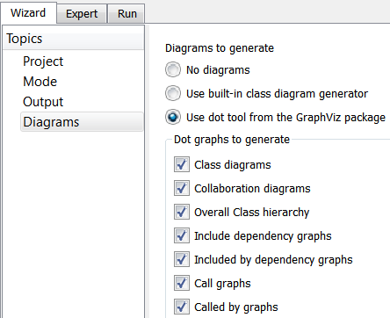
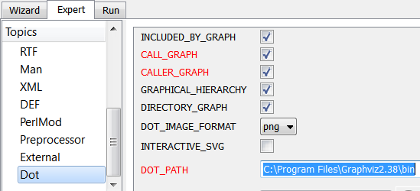
C Code Docu with Doxygen (cont.)
Doxygen can generate call and caller graphs using the graphviz tool to visualize the dependency of files and functions.
Download graphviz from http://www.graphviz.org and install it.
Configure Doxygen to use graphviz: Start Doxywizard, open configuration File => Open… or Open recent
File => Save
enter graphviz installation path here

Slide 18
C-Code Doxygen Examples Project Description
Put a short description of the whole project at the top of the C-file which contains the function main(). An example:
//** ***************************************************************************
* @mainpage Moodlight
*
* is the subject of the <b>Electonics-Project (ETP)</b>
* starting with fall term 2016
* in the <b>second year of the electronics engineering curriculum</b>
* at the School of Engineering of the Zurich University of Applied Sciences.
*
* <img src="img/colour_space_LEDs.png">
*
* Colour space approximated with power LEDs (white, amber, red, green and blue)
*
...
* * Board: Starter Kit EFM32-G8XX-STK
* Device: EFM32G890F128 (Gecko)
*
* @author Hanspeter Hochreutener (hhrt@zhaw.ch)
* @date 14.7.2015
*****************************************************************************/

Slide 19
C-Code Doxygen Examples (cont.) File Header
The content (purpose, task) of every C- and H-file should be documented.
An example:
/** ***************************************************************************
* @file
* @brief main file for the Moodlight
*
* Sets up uC, clocks, peripherals and user interface.
* Starts the powerLEDs, etc.
*
* Loops in the user interface
*
* @author Hanspeter Hochreutener (hhrt@zhaw.ch)
* @date 8.7.2015
*****************************************************************************/

Slide 20
C-Code Doxygen Examples (cont.) Function Headers
Each function should be preceeded by ist function header. It should be made clear what a function does,
which parameters it expects and what result it returns
An example:
/** ***************************************************************************
* @brief Calculate average value of one DMA-buffer
* @param [in] number of samples in data array
* @param [in] pointer to data array
* @return average of array data
*****************************************************************************/
uint16_t calculateAverage(uint16_t sampleNumber, uint16_t* dmaBuffer) {
...

Slide 21
C-Code Doxygen Examples (cont.) Commenting Constants and Variables
Constants and variables can be documented directly inline after ///<
An example:
#define TRF_COUNT 5 ///< num. of DMA transfers
#define BUFSIZE 20 ///< num. of entries in one DMA buffer
#define BUFCOUNT 4 ///< num. of DMA buffers (must be >= 2)
uint16_t DMA_buffer[BUFCOUNT][BUFSIZE]; ///< the data
uint16_t DMA_buffer_last; ///< buffer ready for processing
uint16_t DMA_buffer_current; ///< buffer is currently filled
uint16_t DMA_buffer_next; ///< buffer will be used next

Slide 22
SW Documentation Proposed Structure
A SW documentation may contain these sections:
Abstract and/or overview
Table of content
Specification of the purpose of the project
Description of module and files and how they are organized
Documentation of functions, variables, etc.
Explicit listing of coding guide lines
Documentation of use cases and tests
The above items can be put in separate files or at the top of the file containing the main function

