Slide 1
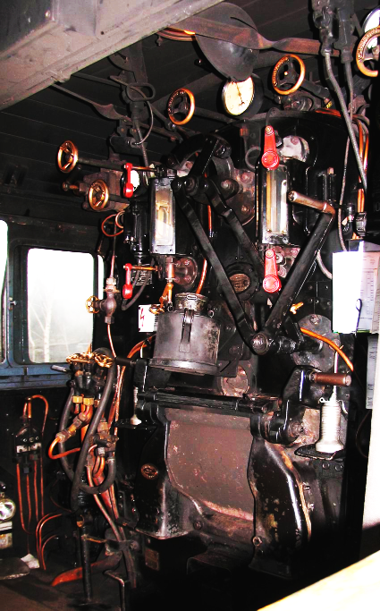
User Interface und Finite State Machine
A User Interface allows interaction between humans and machines.
A Finite State Machine is a simple way to implement a user interface in SW.

Slide 2
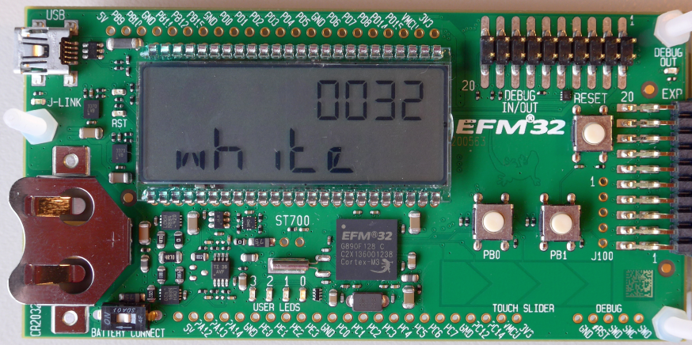
User Interface of the Gecko Starter Kit
A user interface consists of inputs and outputs (as seen from the uC)
Inputs = sensors
2 push buttons: PB0, PB1
1 TOUCH SLIDER (with 4 pads)
1 touch gecko
(1 reset button: RESET)
Outputs = actuators
4 USER LEDS: LED0, LED1, LED2, LED3
1 LCD display (7 char alpha-numeric, 4 digit numeric, symbols)

Slide 3
User Interface Design and Usability
User interface design is crucial:
Good Usability (also suitable for the disabled)
Poor user interface design => lack of acceptance => low sales figures
Perfect inner workings are useless without a good user interface
http://en.wikipedia.org/wiki/User_interface lists these qualities:
Clarity (avoid ambiguity)
Concision (keep it simple and clear)
Familiarity (elements already known from other devices)
Responsiveness (not sluggish)
Consistency (across the whole application)
Aesthetics (let the people feel good with an attractive gadget)
Efficiency (time is money)
Forgiveness (allow for possible user mistakes)

Slide 4
Testing the Usability of a User Interface
The developer is virtually blind to the usability of his own product because he knows exactly how to handle it. => It has to be evaluated by people who are not involved.
The best way to test the usability of a device is to let people without former experience use it. => The less help they need, the better.
Ask the testers what they like about the user interface and which suggestions they have. => Ask the people in the street, not the nerds.

Slide 5
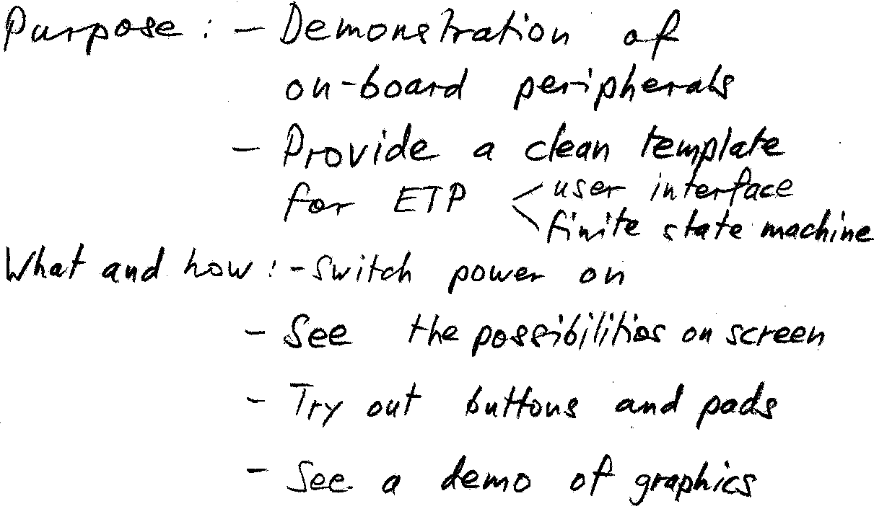
Scenarios and Use Cases: Purpose
What is the main purpose of the machine?
What would a user probably want to do with the device?
How should the user get there?
What information or feedback does the user need or want? What is irrelevant for a user?

Slide 6
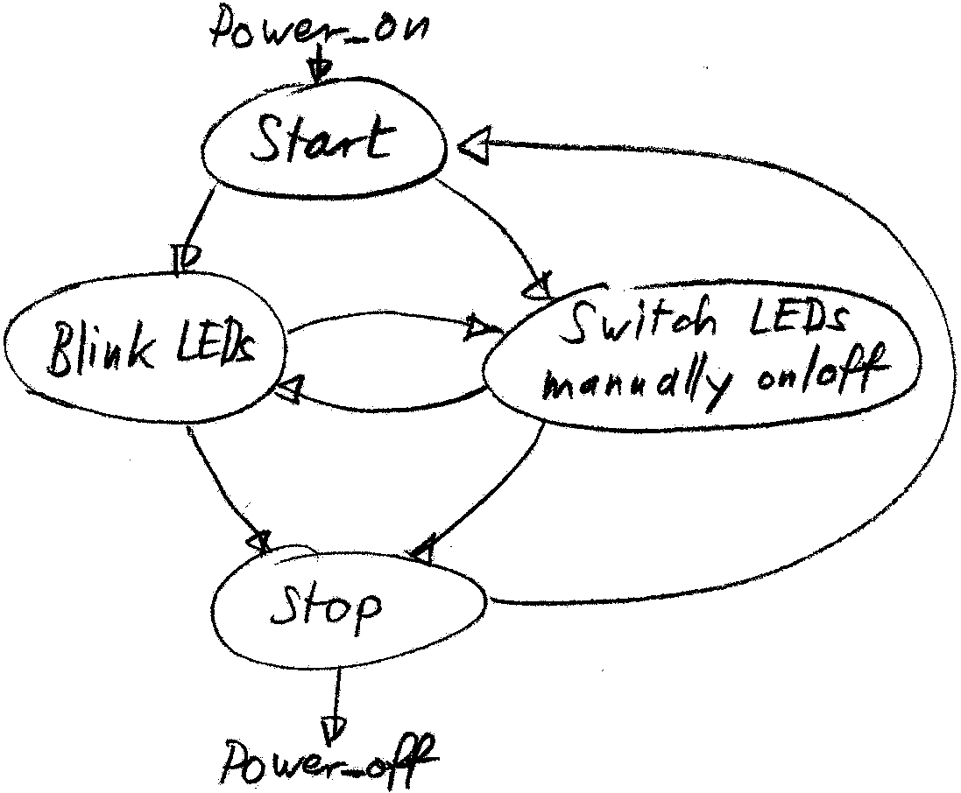
Scenarios and Use Cases: Map of Interaction
Draw a map with the typical flow of user interaction. => Are the items easily accessible?
Draw a map with the special or infrequent interactions. => Can they be included in the frequent interactions without complication?
Is it sensible to have separate user and maintenance modes? => More complicated user interface for maintenance could be acceptable.

Slide 7
Finite State Machine
The map with the flow of user interactions can be redrawn as a Finite State Machine diagram
The next 4 slides are from Andreas Rüst.
In the course Computer Technik 2 the design and application of Finite State Machines will be deepened.
In ETP2 the ETP1 Finite State Machine will be further expanded.

Slide 8
UML State-Diagram

Slide 9
UML State-Diagram: Begriffe
State (Zustand)
Ein Zustand, in welchem sich die FSM befindet und auf das nächste Ereignis wartet.
Event (Ereignis)
Ein Ereignis, das von der FSM erwartet wird und eventuell eine Transition auslöst.
Transition
Eine Reaktion auf ein Ereignis. Diese besteht aus einer Zustandsänderung und / oder einer Aktion.
Action (Aktion)
Das Erzeugen von Output-Messages (In erweiterten FSM auch Funktionsaufrufe).
Finite State Machine (FSM)
Endliche Zustandsmaschine, alle FSM die wir betrachten sind endlich, d.h. die Menge der möglichen Zustände und Transitionen ist endlich.

Slide 10
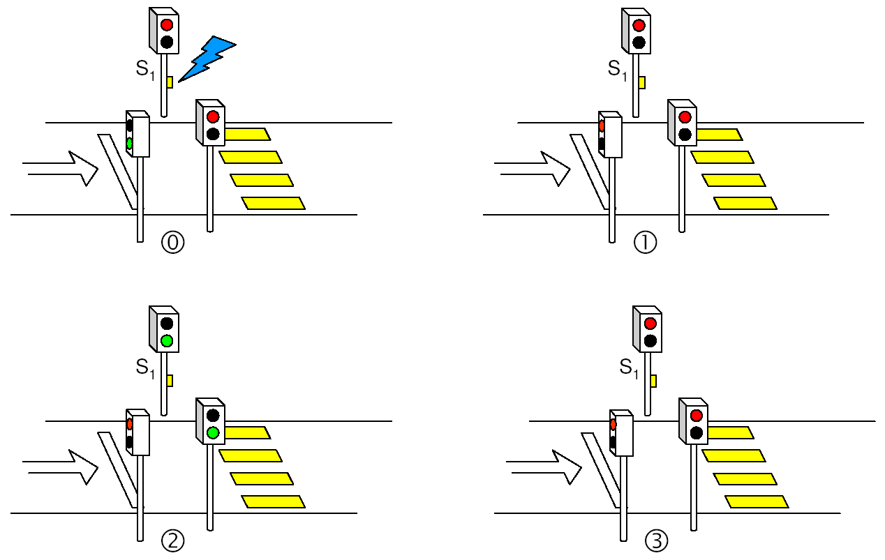
UML State-Diagram
Beispiel: Einfache Ampelsteuerung
↓
Autos grün
↓
S1 gedrückt
↓
Auto rot, Timer starten
↓
time out
↓
Fussgänger grün, Timer starten
↓
time out
↓
Fussgänger rot, Timer starten
↓
time out
↓

Slide 11
UML State-Diagram
Beispiel: Einfache Ampelsteuerung
startTimer
startTimer

Slide 12
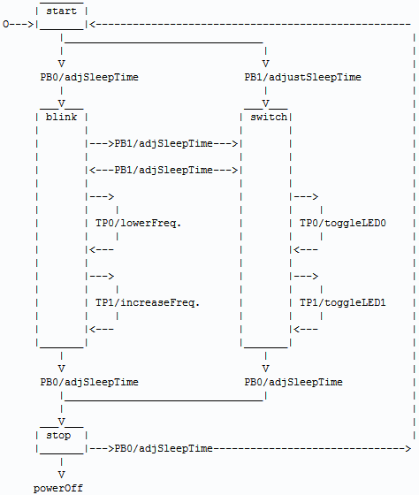
Finite State Machine
Above example drawn as Finite State Machine with more details.
UML design rules help to get a consistent design.
UML design rules help to think of all the possible transitions.

Slide 13
Finite State Machine implemented in Software
SW implementation usually consists of three parts
main loop, which is typically triggered by a user interaction or a timer
switch-case, which handles the events and transitions
switch-case, which handles the actions when staying in a state
In very simple cases one single switch-case is enough
In more complex situations the transition switch-case is split in to: one for the entry-actions, one for the exit-action.
Choose the solution with highest clarity and robust code.

Slide 14
Finite State Machine: main loop
main loop:
int main(void) {
CHIP_Init(); // Chip errata
...
while(1) {
FSM_Event(); // Change the FSM state if an event has occurred
FSM_Stay(); // Stay in a FSM state
RTCDRV_Delay(msec_sleep, true);
}
return 0;
}
loop for ever
wait in sleep mode for interrupt from timer, button, etc.

Slide 15
Finite State Machine: event and transition
switch-case, which handles the events and transitions:
void FSM_Event(void) {
switch (FSM_State) {
case START:
if (Pushbutton_RequestIRQ(1)) {
FSM_State = SWITCH;
msec_cpu = msec_cpu_SWITCH;
}
if (Pushbutton_RequestIRQ(0)) {
FSM_State = BLINK;
msec_cpu = msec_cpu_BLINK;
}
break;
case BLINK:
if (Touchpad_Status(1)) {
msec_delay = msec_delay /2;
...
}
break;
default:
while(1) { } // error has to be found and corrected
}
msec_sleep = msec_delay - msec_cpu; // recalculate possible sleep time
if (msec_sleep < 1) { msec_sleep = 1; } // negative sleep time not possible
}
switch to current state
check for possible events
transition to next state
exit-action of current state and/or entry-action for next state

Slide 16
Finite State Machine: staying in a state
switch-case, which handles the actions when staying in a state:
void FSM_Stay(void) {
LCD_Clear();
switch (FSM_State) {
case START:
LCD_Title("UI & FSM for ETP", "FSM state START");
LCD_Start("Press PB1 or PB0");
LCD_Menu(" PB1 PB0 ", "switch blink ");
break;
case BLINK:
LED_Toggle(1);
LED_Toggle(0);
LCD_Title("UI & FSM for ETP", "FSM state BLINK");
LCD_Blink(msec_delay*2, LED_Status(0), LED_Status(1));
LCD_Menu(" PB1 PB0 TP1 TP0 ", "switch stop fast slow");
break;
case SWITCH:
...
break;
default:
while(1) { } // error has to be found and corrected
}
LCD_Update();
}
switch to current state
update display, etc. important: no event handling here

Slide 17
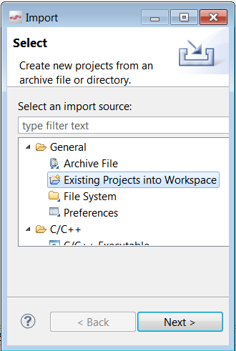
User Interface & Finite State Machine Sample Code
The ETP team provides code from their prototype:
\\shared.zhaw.ch\pools\t\T-ZSN-ETP\Gecko_SW
The archive Moodlight_Template.zip can be imported in the Simplicity IDE Menu File => Import…
Compile the project, load it onto the board and start the program.
Can you make out how the UI works?
Have a look at the while loop at the end of main.c which calls functions in the file userinterface.c

