Slide 1
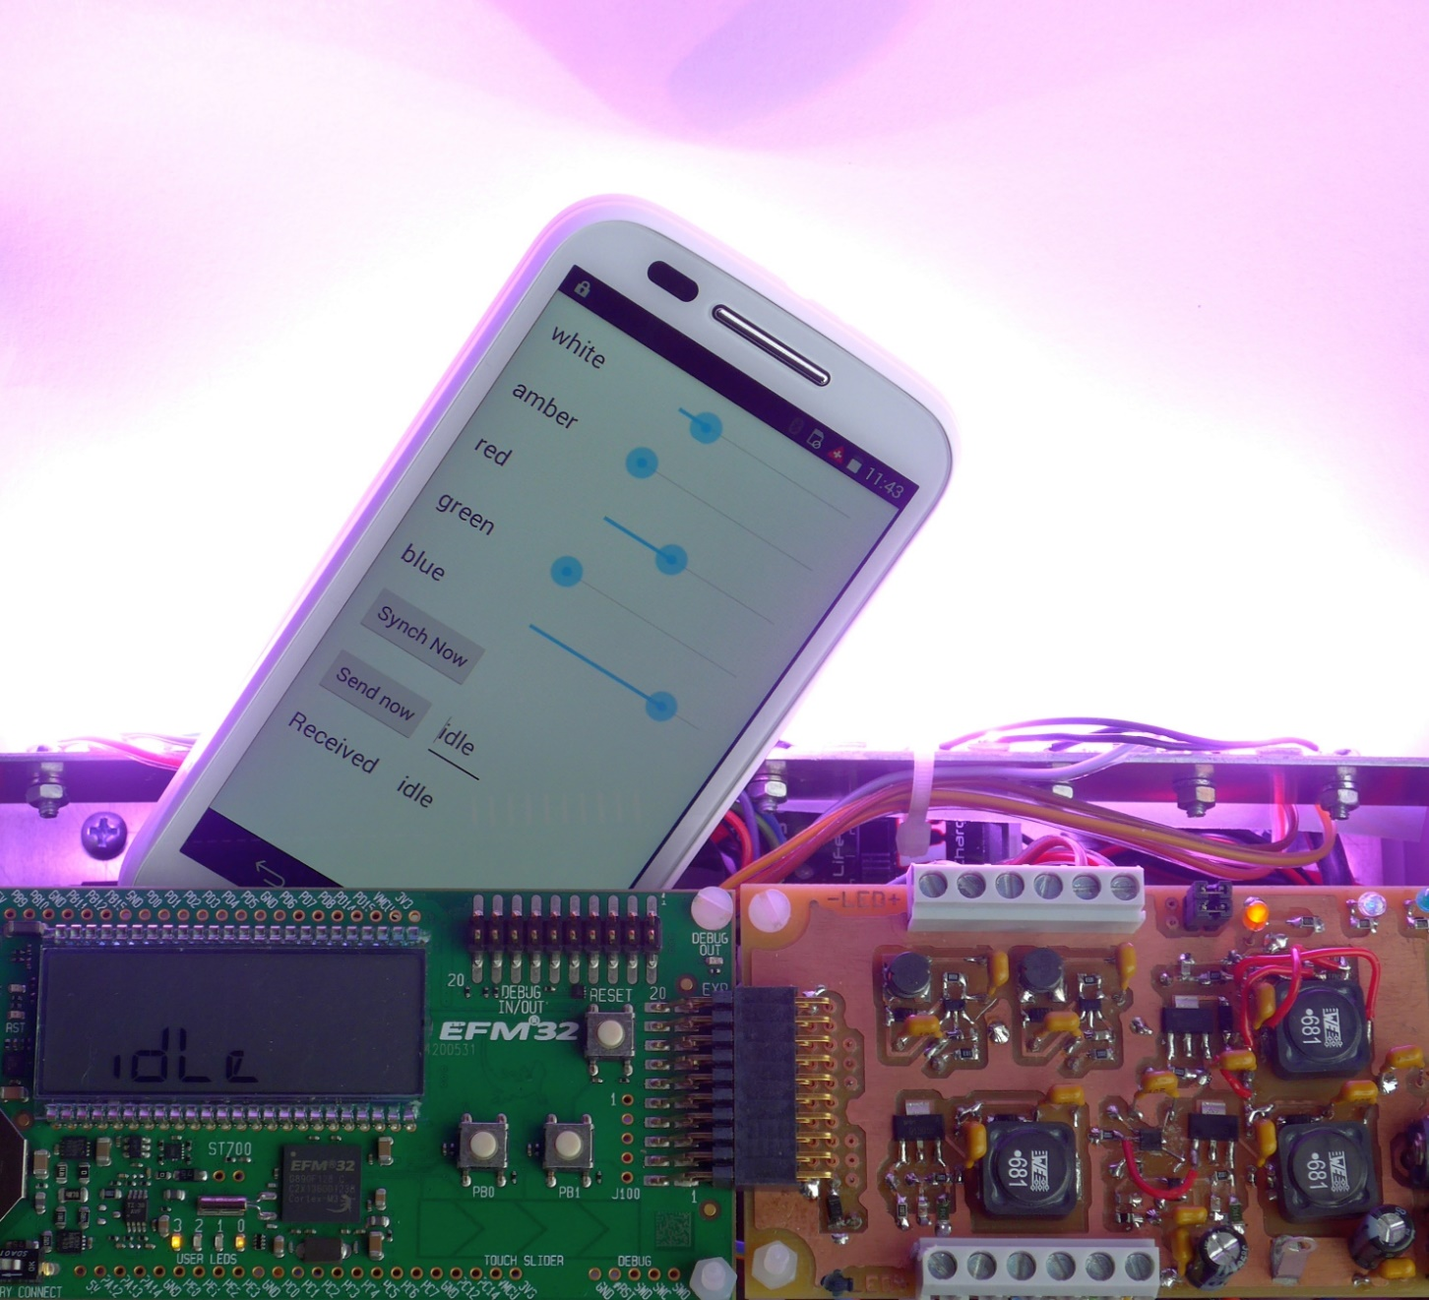
Tasks for ETP2
Additional HW feature
Documentation and Presentation
HW
SW
Remote control
Lampshade

Slide 2

Additional Hardware Feature
Implement ONE additional feature of your choice
Some suggestions are: - clap sensor, - motion detector, - colour adapted to ambient light, - colour as a function of air temperature, - light organ controlled by a microphone, - light spectrum features sound spectrum, - web integration, - visible light communication, …
Feel free to propose another feature

Slide 3
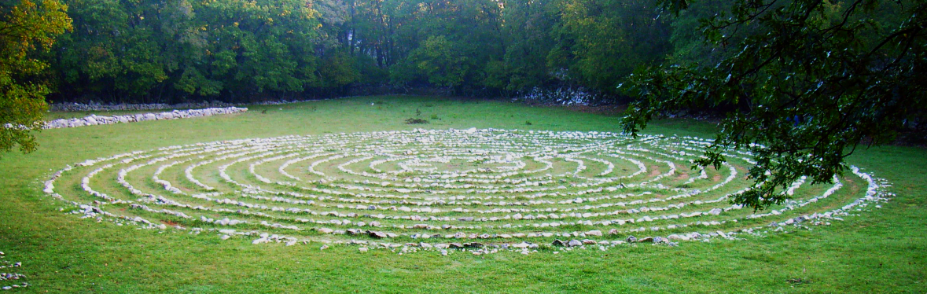
Documentation and Presentation
Define project management goals based on experiences in ETP1
Write a design report on the HW, SW and UI concepts
Write a user manual
Document the extra feature
Present and demonstrate the Moodlight

Slide 4
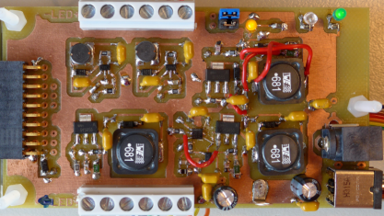
Hardware
HW current drivers for 4 LED strings: red, green, blue and white
Include a 3.3V step down voltage regulator on the PCB
Place the Bluetooth module on the PCB
HW for additional feature
PCB is manufactured externally

Slide 5
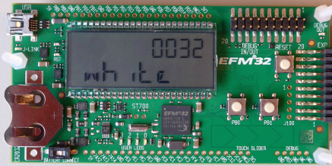
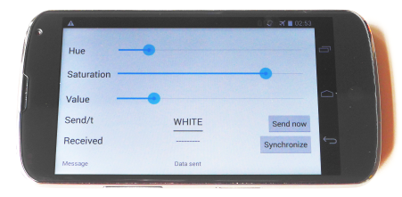
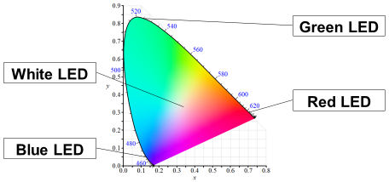
Software
Write microcontroller SW for the LED drivers
Adapt SW for remote control over Bluetooth
Write microcontroller SW for additional feature
Modify the Android SW for your solution
Or implement an other remote control user interface

Slide 6
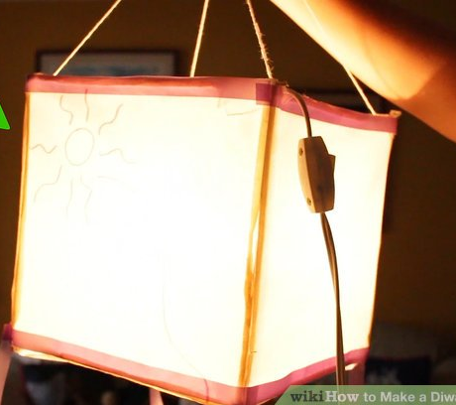
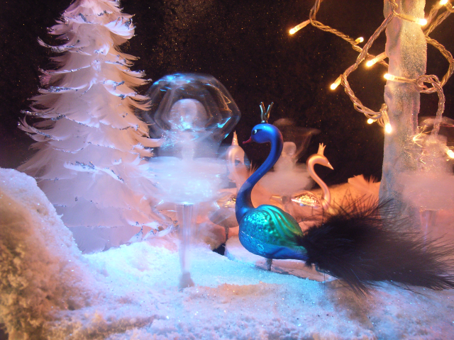
Lampshade
Make or buy a lampshade or a diffusor
https://www.wikihow.com/Make-a-Diwali-Paper-Lantern

