Slide 1
Step-Down Voltage Regulator
Power supply voltage of Moodlight is 24Vdc
Microcontroller and Bluetooth module need 3.3V
Analog circuits could also use 3.3V
The efficiency of a linear voltage regulator is 3.3V/24V = 14%
The efficiency of a step-down voltage regulator is approx. 90%
The disadvantage of a step-down regulator is the ripple on the output voltage. If a noise-free supply is required, a step-down regulator (24V to 5V) can be combined with a linear regulator (5V to 3.3V) with overall efficiency of 60%
The LM2674 is a simple to use step-down (buck) voltage regulator with low external component count.

Slide 2
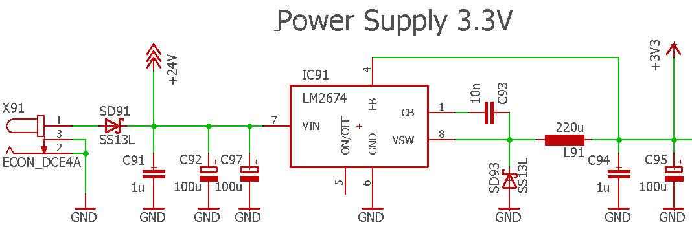
Schematic
A typical schematic is included in the datasheet: \\shared.zhaw.ch\pools\t\T-ZSN-ETP\Datasheets\LM2674_StepDownVoltageRegulator.pdf
Schematic with supply reversal protection, 3.3V regulator and blocking capacitors:

Slide 3
Component selection
Inductor value selection according to paragraph 9.2.1.2.1, “Figure 24. LM2674-3.3” and Table 7.
Output Capacitor value according to Tables 8 and 9. A correct value is important for stable operation of the circuit because it modifies the voltage regulator control loop properties. Un > 2*Uout Use a low ESR type and bypass it with a ceramic capacitor
Catch (or free-wheeling) Diode with Iav > 1.5*Iout and Ubr > 1.5*Uin Use a Schottky diode for high efficiency

Slide 4
Component selection (continued)
Input Capacitor with Un > 1.5*Uin (Un > 2*Uin for tantalum capacitor) Iripple,rms > 0.5*Iout (important to avoid overheating of capacitor) Use a low ESR type and bypass it with a ceramic capacitor. ESR = Equivalent Series Resistance Capacitor value is not critical: A bigger value reduces ripple on Uin. But chose a capacitor that is able to handle the ripple current. Note: The capacitor(s) at the input must also filter the current for the LED-drivers. Therefore, a bigger value or several capacitors in parallel are required.
Boost Capacitor = 10nF, 50V ceramic capacitor

Slide 5
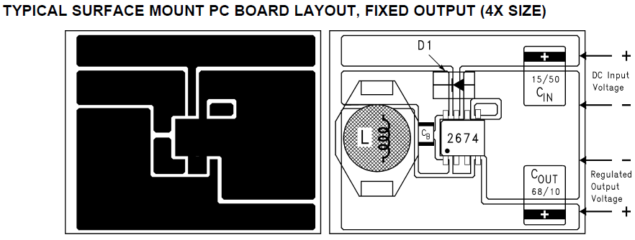
PCB layout
For rapidly switching currents a compact PCB layout is crucial because wiring inductance can generate high voltage transients
Suggestion from the datasheet:

Slide 6
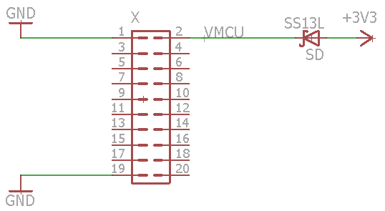
3.3V Supply for Microcontroller Board
The microcontroller board can be supplied via the debugging USB connector.
For the final Moodlight, however, it is more convenient to take the 3.3V supply from the LED board.
Care must be taken that the supplies don’t interfere when both are present.
After studying the schematic of the evaluation board, this solution is suggested:

