Slide 1
Remote Control HW: UART & Bluetooth
UART = Universal Asynchronous Receiver and Transmitter used for serial communication by computers and all sorts of devices https://en.wikipedia.org/wiki/Universal_asynchronous_receiver/transmitter
Bluetooth in Serial Port Profile (SPP) conceived as a wireless alternative to wired serial communication https://en.wikipedia.org/wiki/Bluetooth
USB = Universal Serial Bus used for wired connection, communication and power supply https://en.wikipedia.org/wiki/USB
This is about the remote control HW, for the remote control SW see \\shared.zhaw.ch\pools\t\T-ZSN-ETP\Documents_ETP2\RemoteControlSW.pptx

Slide 2
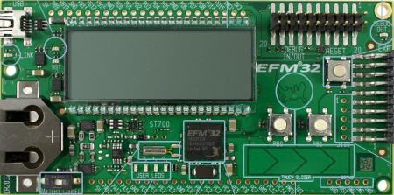
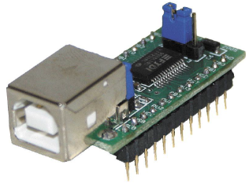
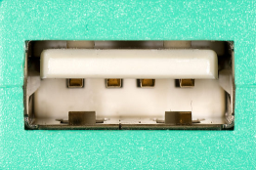
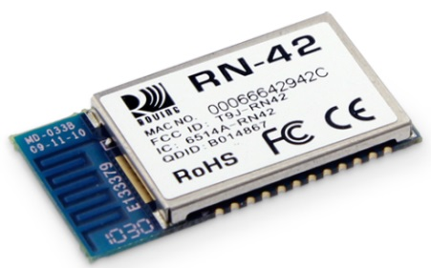
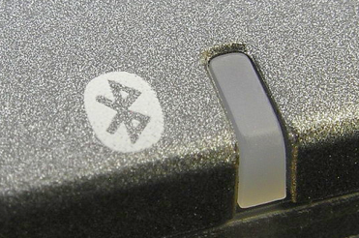
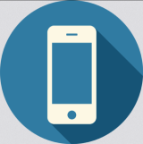
Remote Control of the Moodlight
Often used combinations are:
Microcontroller-UART – FTDI – USB-PC
Microcontroller-UART – RN42 – Bluetooth-PC
Microcontroller-UART – RN42 – Bluetooth-Smartphone

Slide 3
Microcontroller-UART
The Moodlight_Reference_Design uses:
Low-Energy-UART LEUART0 at location #0 with this configuration: 9600 bits/s 8 databits no parity 1 stopbit
Expansion header: TX (transmit) on pin 12 RX (receive) on pin 14 GND (ground) on pin 1

Slide 4
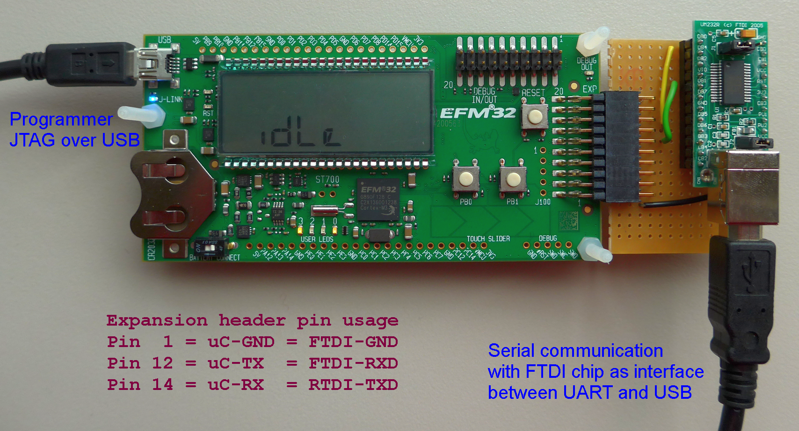
uC-UART – FTDI-USB-interface

Slide 5
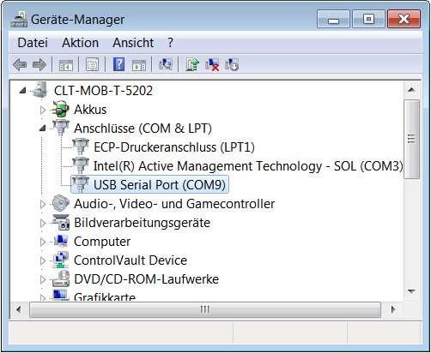
uC-UART – FTDI – USB-PC
When the FTDI adapter is connected to the PC the first time the device driver is installed (this takes a while).
To find out which COM port is used by the FTDI: Open the device manager, open Ports (COM & LPT) and read the COM port number. Here USB Serial Port is on COM9

Slide 6
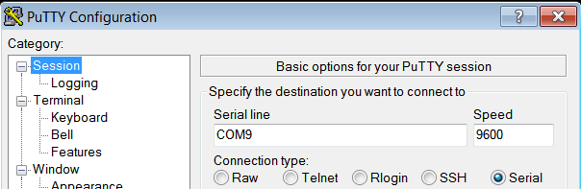
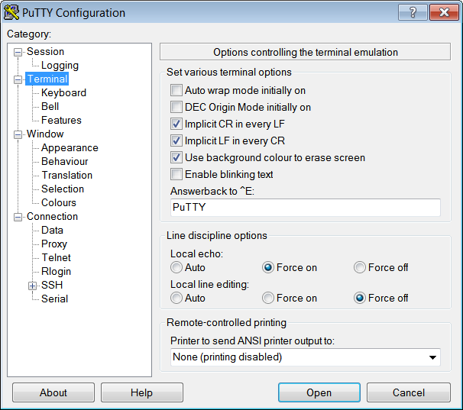
uC-UART – FTDI – USB-PC (cont.)
Start a terminal-SW such as PuTTY
In Category Session change: Connection type: Serial Serial line Your COM port Speed 9600
Change the Terminal behavior as shown in this screenshot:

Slide 7
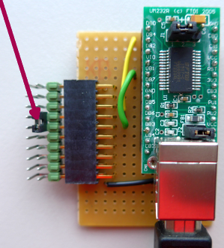
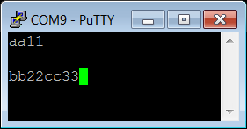
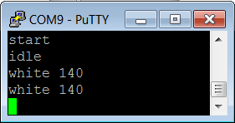
uC-UART – FTDI – USB-PC (cont.)
The first test in communications systems is the loopback test: Put a jumper between exp. header pins 12 (RXD) and 14 (TXD)
In PuTTY click on open. If the driver is installed and the FTDI is connected a terminal window opens and every key/character is sent and received through the loopback jumper.
Remove the jumper to check the behavior.
Now connect to the microcontroller.

Slide 8
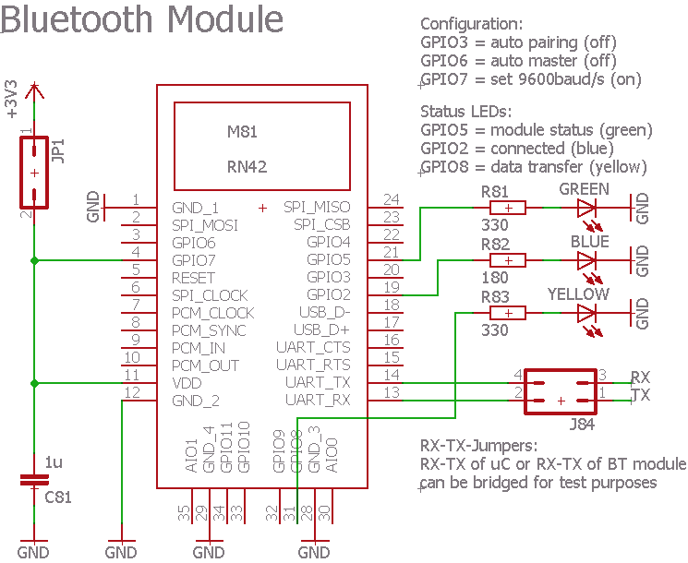
uC-UART – RN42-Bluetooth-interface
EAGLE footprint of the RN42 module is in Moodlight.lbr
Make sure that the antenna area of the RN42 is not shielded by wires, GND plates or other metal objects.

Slide 9
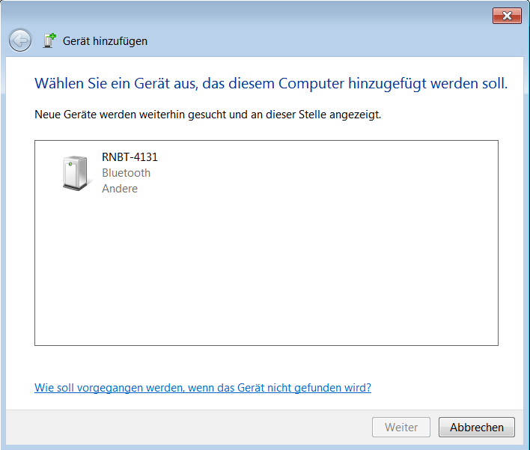
uC-UART – RN42 – Bluetooth-PC
If communication over FTDI works, RN42-Bluetooth can be tested.
Turn Bluetooth in the PC on (this takes a while). Power the RN42.
In the Bluetooth menu click on Add device. Click on the RNBT-**** device. PC and RN42 are exchanging an encryption key. Click Yes to accept the key and pair the device. (This has to be done only once because the PC stores the key.)
Find out the COM port in the same way as for the FTDI chip. Two COM ports are listed: take the lower COM port number.
Connect with PuTTY in the same way as before with the FTDI chip.

Slide 10
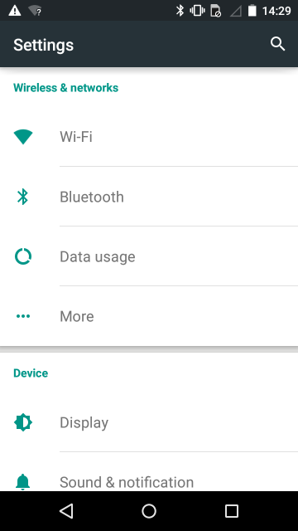
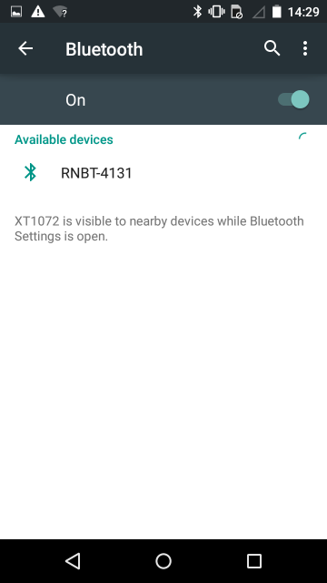
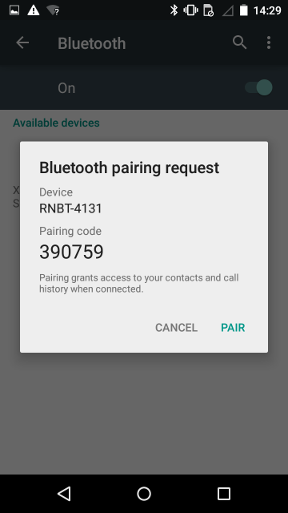
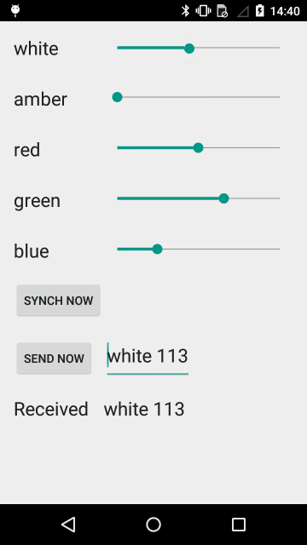
uC-UART – RN42 – BT-Smartphone
Pairing from a Smartphone is similar to the procedure from a PC:
Install a Bluetooth terminal app on your smartphone OR leave it at that and use later in the semester the built-in terminal of the Moodlight_Reference_Design app

Slide 11

Using BLE (Bluetooth Low Energy)
E.G. with BLE-Microcontroller nRF52832
BLE has no Serial Port Profile
If a laptop has BLE functionality at all, you still would have to create an application to be able to communicate with your special device
Consequences
No simple debugging possible using a laptop
You have to work with a cell phone (tablet possibly) from start
You cannot use the app framework which will be provided later
However, for the nRF52832 there is some support:
https://github.com/NordicSemiconductor/Android-nRF-UART
nRF Toolbox App (Android, iOS)

