Slide 1
Remote Control SW
The Moodlight can be remotely controlled by a computer or a smartphone.
This document addresses the remote control SW: Communication protocol, parser, command strings, error handling and SW implementation on both sides
For the remote control HW and how to establish a connection see \\shared.zhaw.ch\pools\t\T-ZSN-ETP\Documents_ETP2\RemoteControlHW.pptx Basically the remote control commands are transmitted over a serial interface: UART or Bluetooth (Bluetooth is encrypted to protect against third party interference.)

Slide 2
Communication Protocol
A protocol defines rules for information transmission. It has to be known by all parties involved.
The protocols on the physical and transport layers (with low complexity) are often handled by dedicated HW:
UART: baudrate, databits, parity and stopbit
Bluetooth: connection handling, error coding and recovery, encryption
The (more complex and extensible) protocols on the application layer are mostly handled by SW:
Format and meaning of a message in a given context
Range of possible responses to any valid request

Slide 3
Parser
A parser analyses data according to the rules defined in the protocol.
Mostly the input is a string of bytes or words.
Generally the output is a tree representation of the input.
This structured data is used to initiate some specific action.
A formal description of parser rules (and programming languages) can be done in the “Extended Backus–Naur Form (EBNF)”.

Slide 4
Moodlight Protocol
There is no standard protocol for Moodlights.
Hence, Mr. Hochreutener defined a sample protocol, commands and answers to meet the given requirements.
You may modify the commands and answers or even define your own protocol.

Slide 5
Moodlight Command
state value\r
state = { "white", "amber", "red", "green", "blue", "idle", "stop", "start“} Only the 3 first characters are compared: “white” = “whish” = “whisky”
“ “ = blank space = ASCII 32
value expected as a long int (integer, not float or double) Any other character or string (for example a “?”) does not change a value.
\r = end of string character. \r = carriage return = ASCII 13

Slide 6
Moodlight Action
There are 3 possible outcomes after analyzing a received command:
No valid state is recognized => Nothing happens
A valid state is recognized, but no (valid) value => Switch to that state, don't change the value, send an answer and update the display
Valid state and value received => Switch to that state and change the value, send an answer and update the display
Restart listening for a next command.

Slide 7
Moodlight Answer
state value\r
The answer has exactly the same structure as a command.
The state and the value are included in the answer regardless whether they have been changed or not.

Slide 8
Moodlight Error Handling
Bluetooth works with error correction and retransmission. Nevertheless, transmitted data might be incorrect. Some reasons are:
Radio interference or signal loss
Bad command received due to a SW error
Hacker attack
The Moodlight is not considered as a critical infrastructure. It should just:
Discard a bad or uncomplete command
Restart listening for a next command
Inform the remote control device if the command was successful

Slide 9
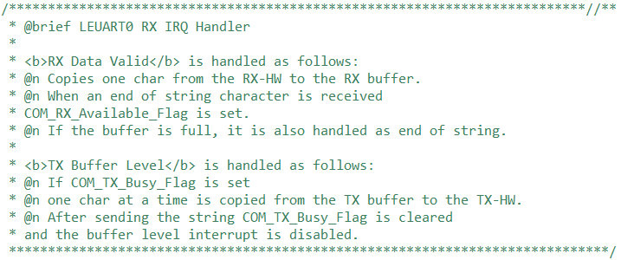
Microcontroller: RX/TX SW
This is the interface between the dedicated UART-HW and the input buffer of the parser-SW.

Slide 10
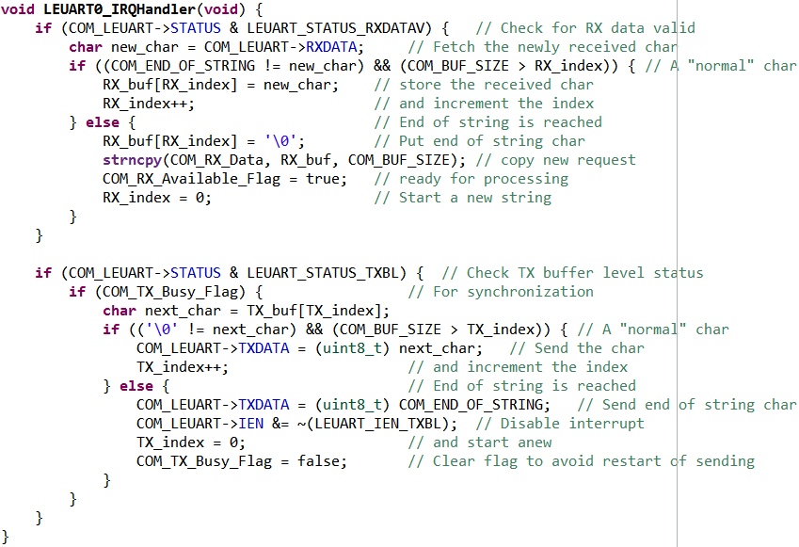
Microcontroller: RX/TX SW (cont.)

Slide 11
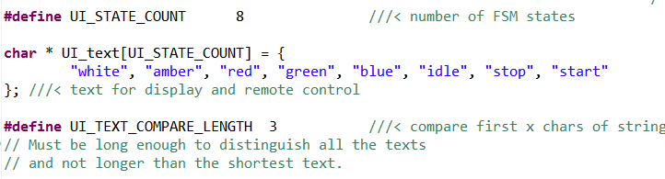
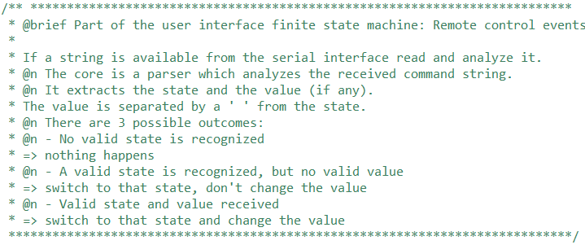
Microcontroller: Parser SW

Slide 12
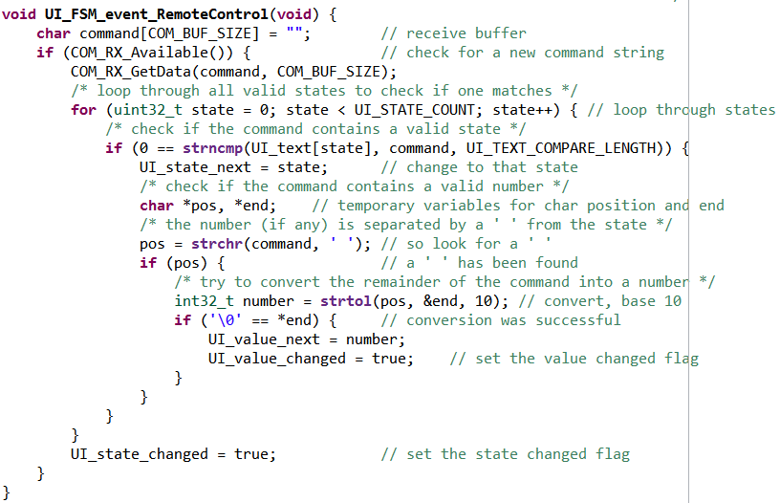
Microcontroller: Parser SW (cont.)

Slide 13
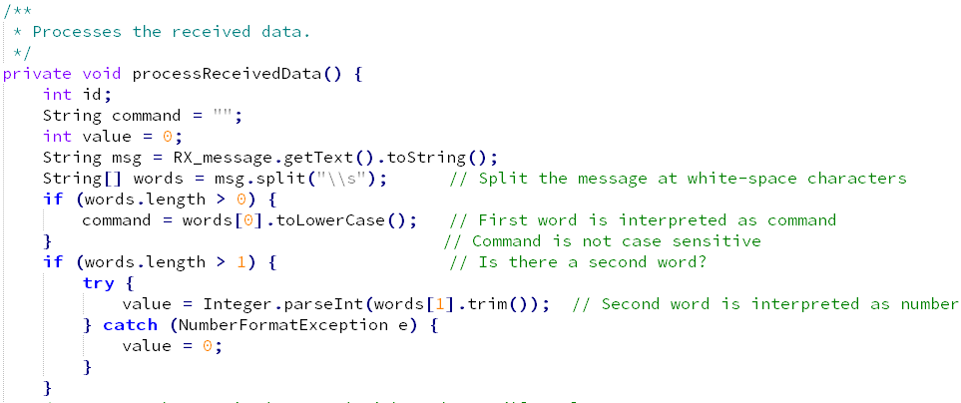
Android: Parser SW
Note that the same protocol and commands are used in the smartphone as in the microcontroller. But the JAVA implementation looks quite different from the one in C.

Slide 14
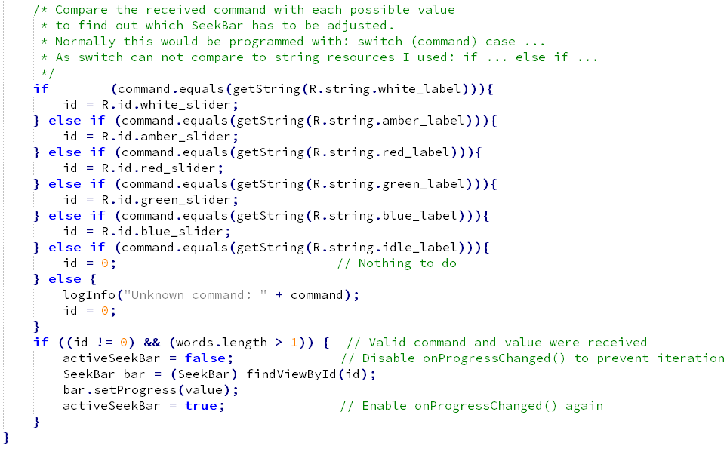
Android: Parser SW (cont.)

Slide 15
Programming Language Ranking
Java and C are currently the most popular programming languages in many published rankings: https://www.tiobe.com/tiobe-index/ (March 2017) http://spectrum.ieee.org/static/interactive-the-top-programming-languages-2016

