Slide 1
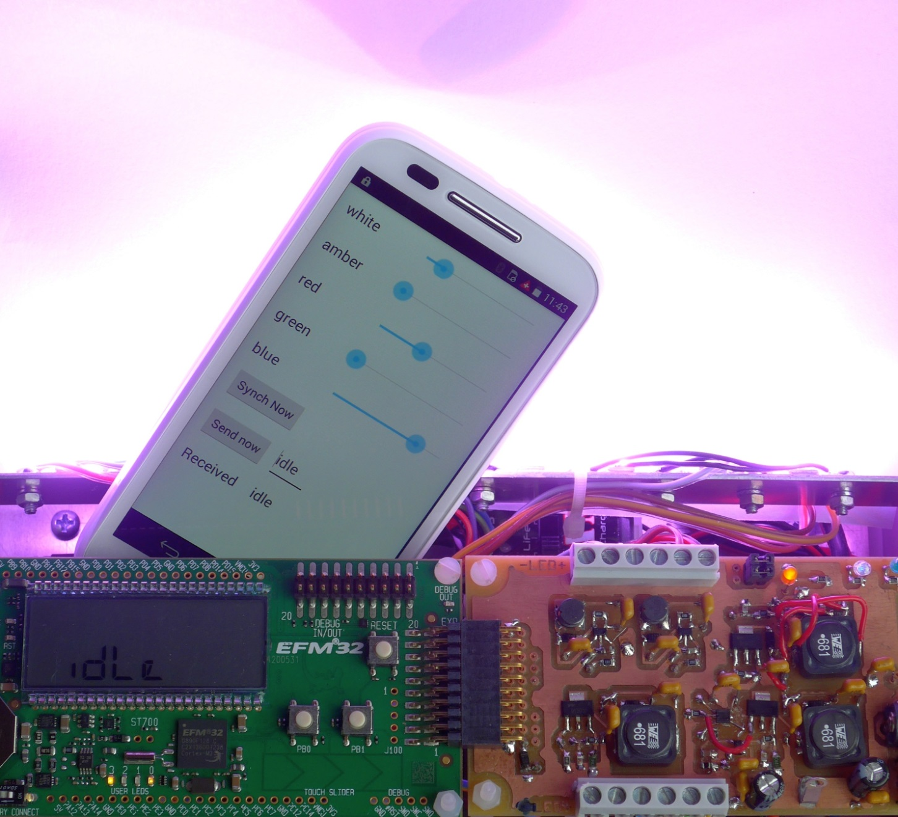
ETP1 + ETP2: Moodlight
Electro Technics Project in the second year of the electronics engineering curriculum at the Zurich University of Applied Sciences

Slide 2
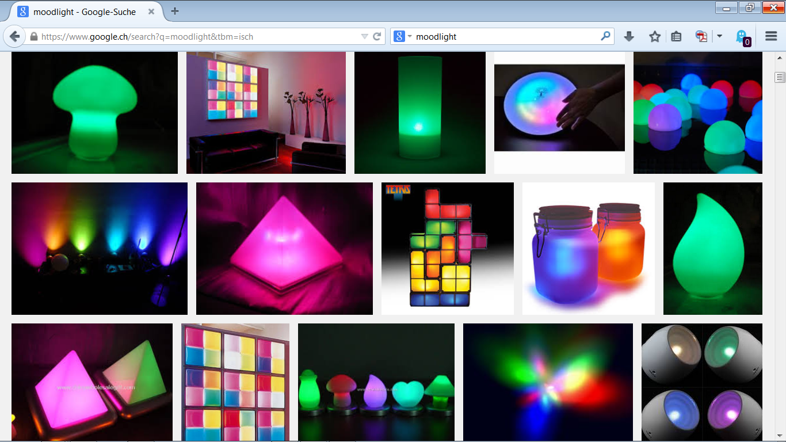
What is a Moodlight?

Slide 3
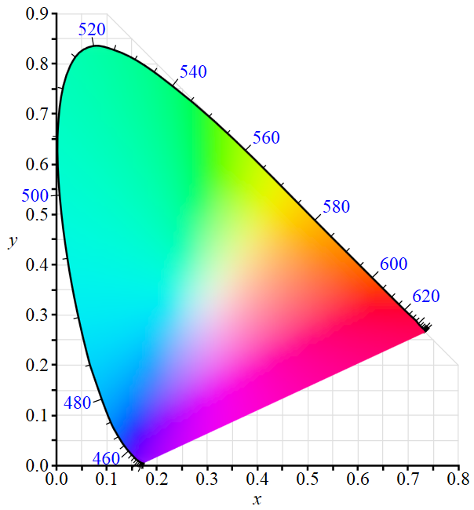
CIE 1931 color space
The CIE 1931 color spaces are the first defined quantitative links between physical pure colors in the electromagnetic visible spectrum, and physiological perceived colors in human color vision. ( https://en.wikipedia.org/wiki/CIE_1931_color_space )
Green LED
White LED
Red LED
Blue LED

Slide 4
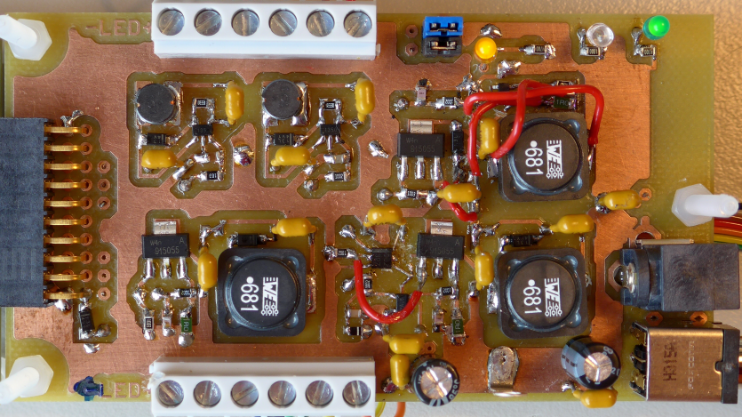
Project Overview
Design, develop, build, test and document a “Moodlight”.
LED driver HW: - HW Design - PCB layout - Soldering - Testing - Documentation

Slide 5
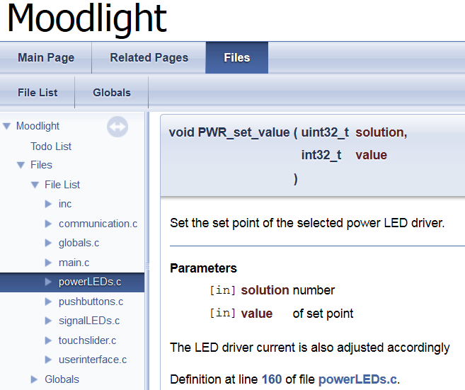
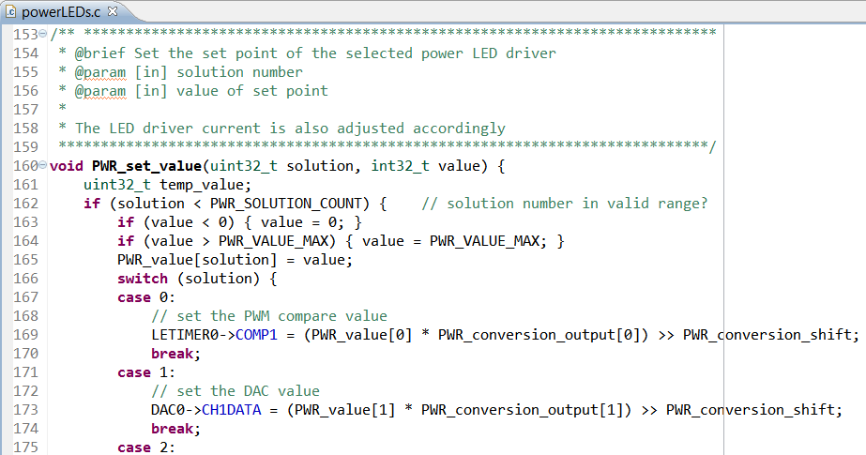
Project Overview
Microcontroller SW: - Write C-Code - Testing - Documentation

Slide 6
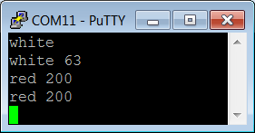
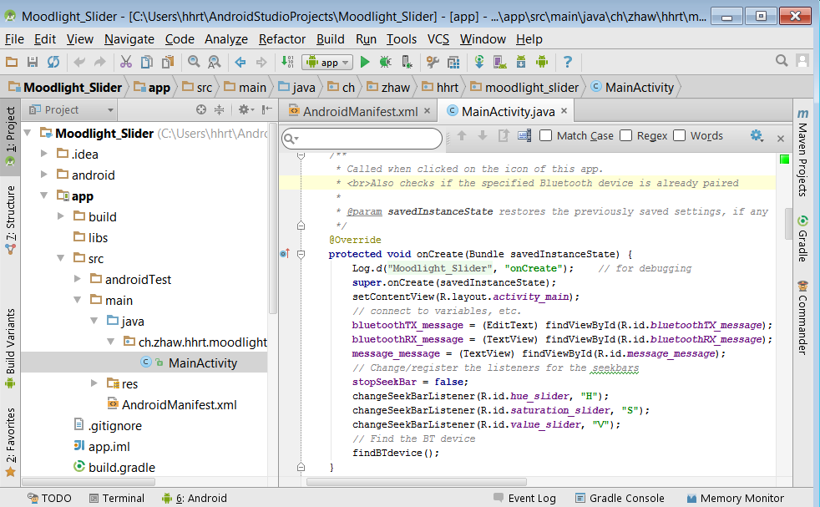
Project Overview
Remote Control over Bluetooth: from PC for testing and as connection to smartphone
Android SW: - Java-Code - XML-Layout - Testing - Documentation

Slide 7
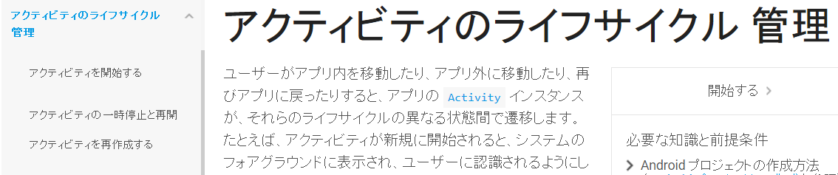
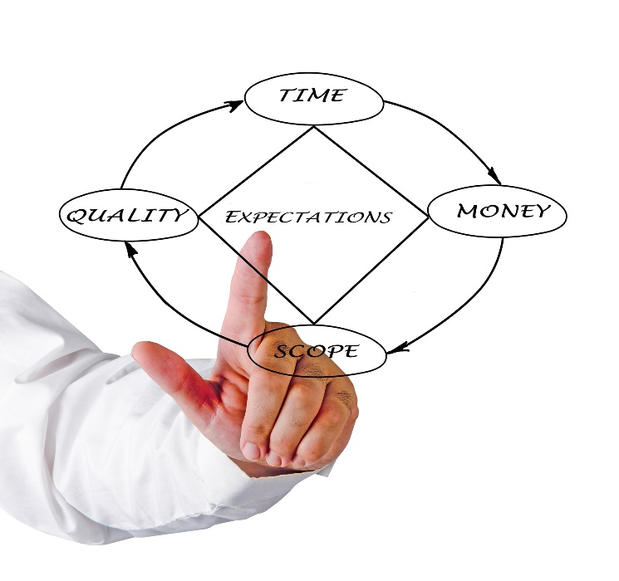
Project Overview
User Manual
Project management
English as working language

Slide 8
Project Goals and Organisation
Subject | ETPx | Organisation
Subjects | ETP1 ETP2 | Moodlight prototype (LED driver HW, uC SW, uC user interface) Final Moodlight device, including remote user interface
Documents | ETP1+2 | \\shared.zhaw.ch\pools\t\T-ZSN-ETP
Students | ETP1+2 | Groups of 2 (or 3)
Lecturers | ETP1 ETP2 | A. Ehrensperger (eand), H. Hochreutener (hhrt) eand, hhrt, M. Nussberger (nusm), M. Longthorn (lgtm, English / NoTech)
Lessons | ETP1 ETP2 | 2 lessons weekly 4 lessons weekly

Slide 9
Project Deliveries and Marks
Module | Deliveries | Weight for Mark
ETP1 | Demonstration of the LED driver HW Documentation of the LED driver HW Demonstration of the prototype Documentation and quality of the microcontroller SW | 20% 20% 20% 40%
ETP2 | Design concept report for the final Moodlight device: Concepts of LED driver HW, uC SW and remote UI Project management User manual for the final device Documentation (including tests) of the extra feature Presentation of the final device Demonstration of the final device | 20% 0% Technical: 10% English: 10% 20% Technical: 10% English: 10% 20%

Slide 10
ETP1 timeline for Monday Group (ET 17t)
Week / Date | Subject of Theory Input | Student Activities / Milestones
1 / 16 Sep. 2019 | Overview: Moodlight prototype | Installation of eagle (and LTspice EK2) Start with eagle tutorial
2 / 23. Sep. 2019 | Power LED driver HW: controlled current source, different solution possibilities Project management | Choose 2 circuit principles for implementation Circuit design and simulation
3 / 30.Sep. 2019 | Power LEDs for lighting: Technology, optical, electrical and thermal properties Lampshade and diffusors against dazzling | Circuit simulation ok Start PCB layout
4 / 7. Oct. 2019 |  | PCB layout
5 / 14. Oct. 2019 | Documenting HW, Testing HW | Start with HW report
6 / 21. Oct. 2019 | Human eye: Lens, retina, photoreceptor cells Eye safety: Retinal thermal hazard, blue light hazard | 21.10. (or earlier): Hand in PCB layout Continue with HW report
7 / 28. Oct. 2019 | Microcontroller architecture: CPU, GPIO, main, interrupts, peripherals | PCB assembly and tests Continue with HW report
8 / 4. Nov. 2019 | Peripherals, EMLIB and CMSIS: SW for LED driver HW (TIMER, PWM, ADC, DAC, ACMP) | 8.11.: Hand in docu on LED driver HW + indiv. log Download and install Simplicity Studio
9 / 11. Nov. 2019 | SW modularization and documentation: Header and C files, coding guide lines, Doxygen Testing SW | SW concept for LED driver HW
10 / 18. Nov. 2019 | User interface: Finite State Machine, pushbuttons, touchpads, LEDs and LCD | Feedback on HW report and project management Write, test and document SW for LED driver HW Demo LED driver HW
11 / 25. Nov. 2019 |  | Write, test and document SW for LED driver HW Adapt SW for user interface
12 / 2. Dec. 2019 |  | Test and document user interface SW Demo LED driver HW+SW, demo UI SW
13 / 9.Dec. 2019 |  | Combine LED SW with UI SW
14 / 16. Dec. 2019 |  | Demo of prototype
3. Jan. 2020 |  | 3.1.2020: Hand in SW and SW documentation

Slide 11
ETP1 timeline for Friday Groups (ET 18a)
Week / Date | Subject of Theory Input | Student Activities / Milestones
1 / 20 Sep. 2019 | Overview: Moodlight prototype | Installation of eagle (and LTspice EK2) Start with eagle tutorial
2 / 27. Sep. 2019 | Power LED driver HW: controlled current source, different solution possibilities Project management | Choose 2 circuit principles for implementation Circuit design and simulation
3 / 4. Oct. 2019 | Power LEDs for lighting: Technology, optical, electrical and thermal properties Lampshade and diffusors against dazzling | Circuit simulation ok Start PCB layout
4 / 11. Oct. 2019 |  | PCB layout
5 / 18. Oct. 2019 | Documenting HW, Testing HW | Start with HW report
6 / 25. Oct. 2019 | Human eye: Lens, retina, photoreceptor cells Eye safety: Retinal thermal hazard, blue light hazard | 25.10. (or earlier): Hand in PCB layout Continue with HW report
7 / 1. Nov.. 2019 | Microcontroller architecture: CPU, GPIO, main, interrupts, peripherals | PCB assembly and tests Continue with HW report
8 / 8. Nov. 2019 | Peripherals, EMLIB and CMSIS: SW for LED driver HW (TIMER, PWM, ADC, DAC, ACMP) | 9.11.: Hand in docu on LED driver HW + indiv. log Download and install Simplicity Studio
9 / 15. Nov. 2019 | SW modularization and documentation: Header and C files, coding guide lines, Doxygen Testing SW | SW concept for LED driver HW
10 / 22. Nov. 2019 | User interface: Finite State Machine, pushbuttons, touchpads, LEDs and LCD | Feedback on HW report and project management Write, test and document SW for LED driver HW Demo LED driver HW
11 / 29. Nov. 2019 |  | Write, test and document SW for LED driver HW Adapt SW for user interface
12 / 6. Dec. 2019 |  | Test and document user interface SW Demo LED driver HW+SW, demo UI SW
13 / 13.Dec. 2019 |  | Combine LED SW with UI SW
14 / 20. Dec. 2019 |  | Demo of prototype
3. Jan. 2020 |  | 3.1. 2020: Hand in SW and SW documentation

Slide 12
ETP2 timeline
Week / Date | Subject of Theory Input | Student Activities / Milestones
1 / 17.2.20 | Tasks: Moodlight device with individual additional feature LED driver HW + SW (RGB+white), UI (uC + PC + Android app) Step down voltage regulator | Decide on additional feature Start with circuit design
2 / 24.2.20 | PCB rules for external manufacturing Remote control HW: UART and Bluetooth | Circuit design ok (peer review successful) Start with PCB layout
3 / 2.3.20 | No class (Fasnachtsmontag in Winterthur)
4 / 9.3.20 | Design concept report | PCB layout Start to write design concept report
5 / 16.3.20 | Colour spaces, especially HSV Colour model conversion: HSV => R+G+B+white | PCB layout ok (peer review successful) 21.3.20: Hand in PCB layout for external manufacturing
6 / 23.3.20 | Remote control SW: Protocol, parser, Moodlight commands and answers | 28.3.20: Hand in design concept report for the final Moodlight
7 / 30.3.20 |  | Adapt microcontroller SW for 4 channels and for remote control add HSV => R+G+B+white conversion if applicable Download and install Android Studio
8 / 6.4.20 | Android app: Activity life cycle, screen layout with XML, event handler in Java Moodlight Reference App Smartphone USB debugging / driver, Android Studio config, import and debug app | Demo of remote control from PC over Bluetooth PCB assembly and test Feedback on report
9 / 13.4.20 | No class (Easter Monday)
10 / 20.4.20 | Documenting an Android app Testing an app | Demo of uC SW, LED driver HW and extra feature Enhance android app and add items
11 / 27.4.20 | User manual (2 lessons by English language lecturer) | Start to write user manual
12 / 4.5.20 |  | Plan, execute and document final tests
13 / 11.5.20 | Presentation techniques (2 lessons by English language lecturer) | Demo of the final remote control user interface
14 / 18.5.20 |  | Tie up loose ends and finalise the SW Make a lampshade or diffusor (at home) 20.5.20: Hand in user manual
15 / 16 |  | 6.6.20: Hand in documentation of the extra feature tbd: Presentation and demonstration in the examination weeks

