Slide 1
Pacman game using Python technologies

Slide 2
Technologies used
Python — interpreted object-oriented high-level programming language with strict dynamic typing
Pygame — module for creating video games.
PDM — a modern Python package and dependency manager that supports the latest PEP standards.

Slide 3
How the game works
The game consists of several levels. Each level consists of a maze, coins, fruits, ghosts, and the player in the role of Pac-Man.
The player needs to go through the maze, collecting coins and fruits.
Each level ends with eating all the coins and fruits.
The game also has a menu with options to start a new game, quit, and customize the sound and font size.

Slide 4
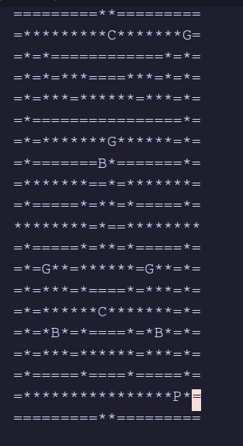
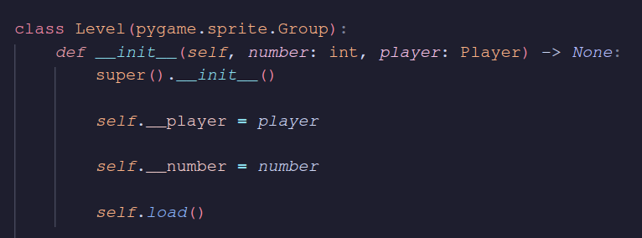
Level generation
Levels stores in text file with symbols for each object.
Extending class pygame.sprite.Group for Level

Slide 5
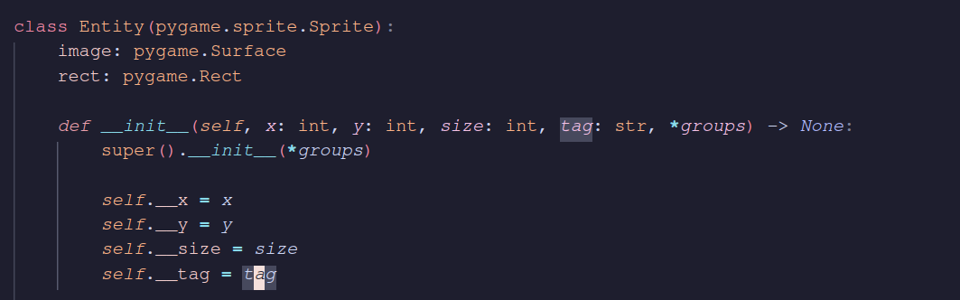
Managing creating of ghosts, player and money
Creating base class for entity
Extending classes that are represeting player, ghost, money (fruit)

Slide 6
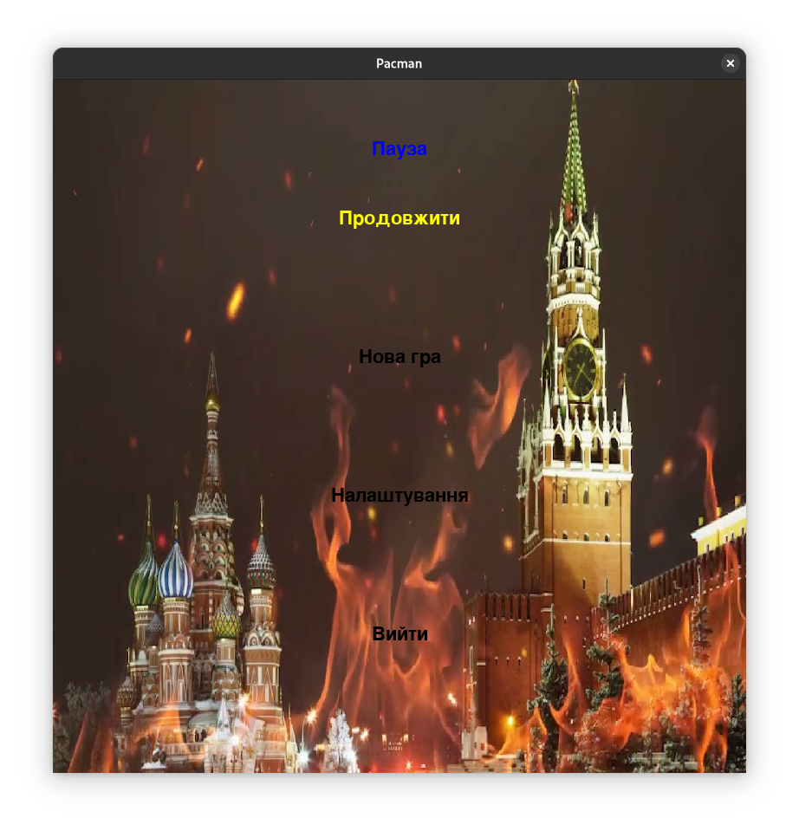
Creating Menu
Menu Design
Menu functionally

Slide 7
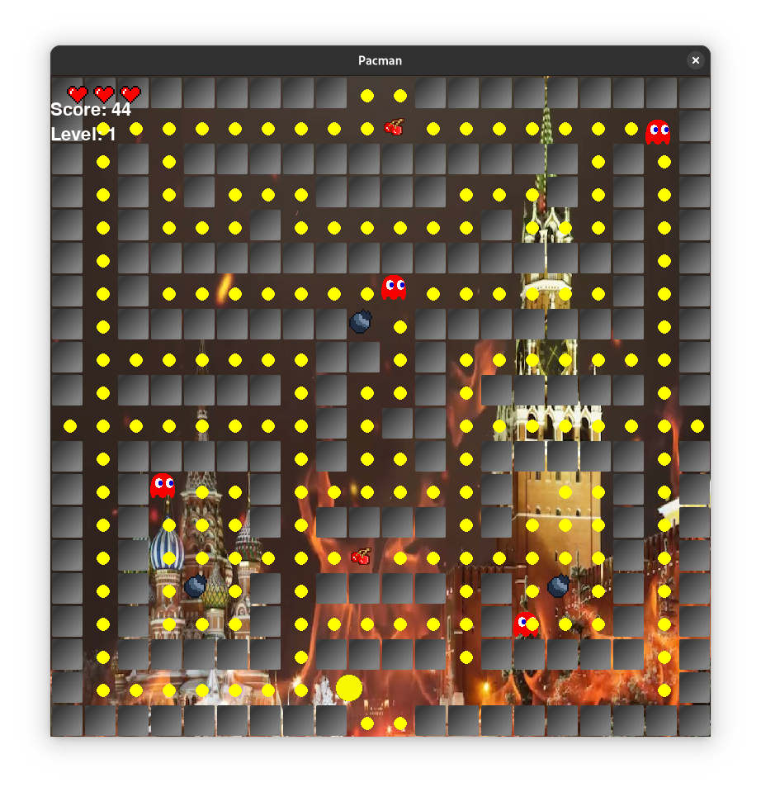
Game in action

Slide 8
Conclusion
Using Python and Pygame libraries, I recreated the classic Pacman game.
I learned the technologies such as python, pygame.
The project allowed us to experiment with game development skills while creating a fun and educational project.

Slide 9
List of references
Sound effects https://www.classicgaming.cc/classics/pac-man/sounds
Online encyclopedia Wikipedia https://uk.wikipedia.org/wiki/Python
Python documentation https://docs.python.org/3/
Pygame documentation https://www.pygame.org/docs/

