Slide 1
Automated testing in Java

Slide 2
Agenda
Testing
Level of testing
Clean test
Libraries and tools
Maven and testing
Show case
Good practices in testing

Slide 3
Testing
Specification -> Write Code -> Test
Testing – manual or automated testing
Automated testing
Faster than manual testing;
Automates repetitive actions;
Very helpful in regression testing when code changes frequently;
Gives programmer safeness to change code;
Covers more test cases in a same amount of time than manual testing.

Slide 4
Levels of testing
According to the book Growing Object-Oriented Software Guided by Tests
Unit: Do our objects do the right thing, are they convenient to work with?
Integration: Does our code work against code we can't change?
Acceptance: Does the whole system work?

Slide 5
Some rules
Breaking Out: Splitting a Large Object into a Group of Collaborating Objects
Break up an Object if it becomes too large to test easily, or if its test failures become difficult to interpret. Then unit-test the new parts separatley.
Building Off: Defining a new service that an object needs and add in a new object to provide it
Building Up: Hiding Related Objects into a containing Object -> When we have a cluster of related objects that work together, we can package them up in a containing object. The new object hides the complexity in an abstraction that allow us to program at a higher lever
When the test for an object becomes too complicated to set up - when there are too many moving parts to get the code into the relevant state - consider bundling up some of the collaborating objects

Slide 6
Clean test
F.I.R.S.T
Fast
Independent
Repeatable
Self-Validating
Timely
BUILD-OPERATE-CHECK pattern
Give test methods meaningful names
public void should_do_something_when_conditions_are_fulfilled()

Slide 7
Libraries
JUnit - testing framework
http://junit.org/junit4/
AssertJ - fluent assertions for java
http://joel-costigliola.github.io/assertj/
Mockito – enables mock creation, verification and stubbing
http://mockito.org/
Spring-test (Spring framework)
http://docs.spring.io/spring/docs/current/spring-framework-reference/html/integration-testing.html
Arquillian (Java EE) – very similar to spring-test
http://arquillian.org/
Flyway – database migrations
https://flywaydb.org/

Slide 8
Maven and testing
validate - compile - test - package - verify - install – deploy
Plugins
Surefire (unit testing)
Failsafe (integration testing)
pre-integration-test phase (build test environment)
Naming conventions:
Surefire – NameOfTheClassTest
Class path same as the class that is being tested
Packages private methods can be accessed this way
Failsafe – NameOfTheClassTestIT
Plugin must be specified in pom.xml
Verify and IntegrationTest phases

Slide 9
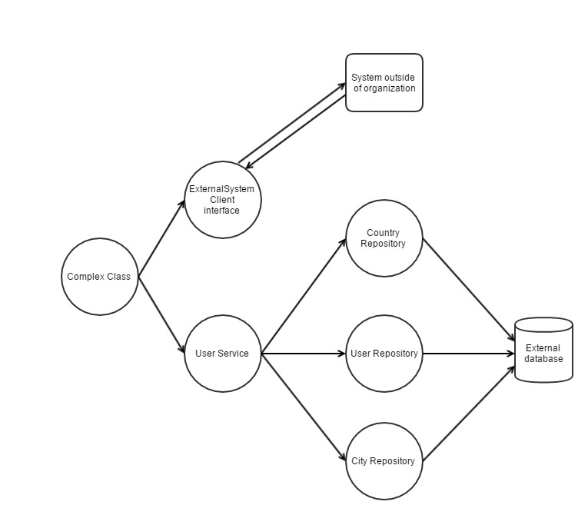
Show case 1 Integration testing and unit testing

Slide 10
Basic idea – test layer by layer
Repository layer
Simulate environment in which application will be ran
Do not mock entity manager, use real database
Use repository persist/findById method to set up test case
Service layer
Simulate environment in which class will be ran
Construct all dependencies (repository layer)
Use repository persist/findById method to set up test case
Complex class
Mock external client, cover all cases (simple case - true or false)
Construct all dependencies (service + repository layer)

Slide 11
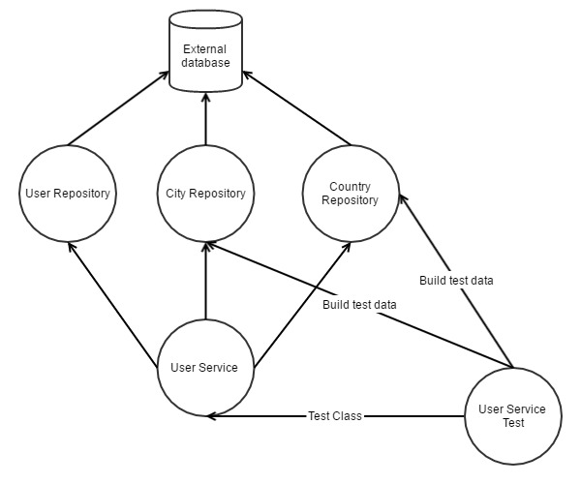
Test – service under test relationship

Slide 12
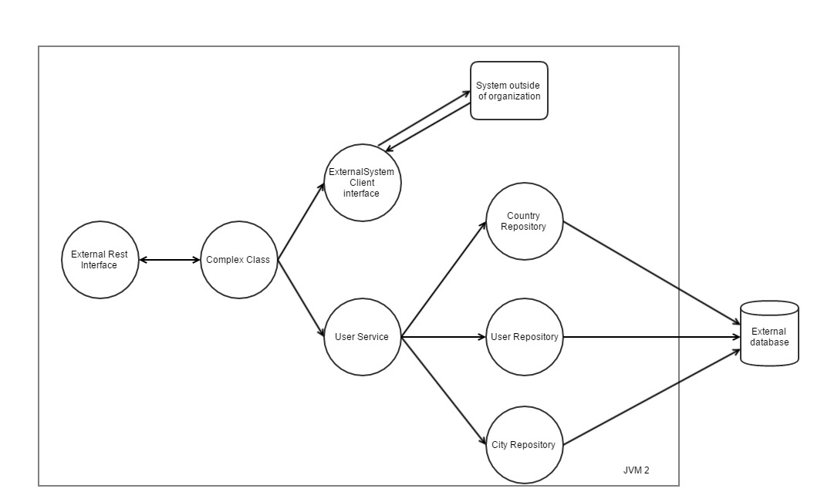
Show case 2 Integration testing on app server

Slide 13
Basic idea
Use real database
Build clean database before integration test phase (use flyway -> maven plugin exists)
Build and deploy war to a real app server (use embedded if possible)
Use repository layer to insert test data
Use test data builders for defaults – plugins for IDEs exists
Clear database after every test
Clean database after integration test phase is finished

Slide 14
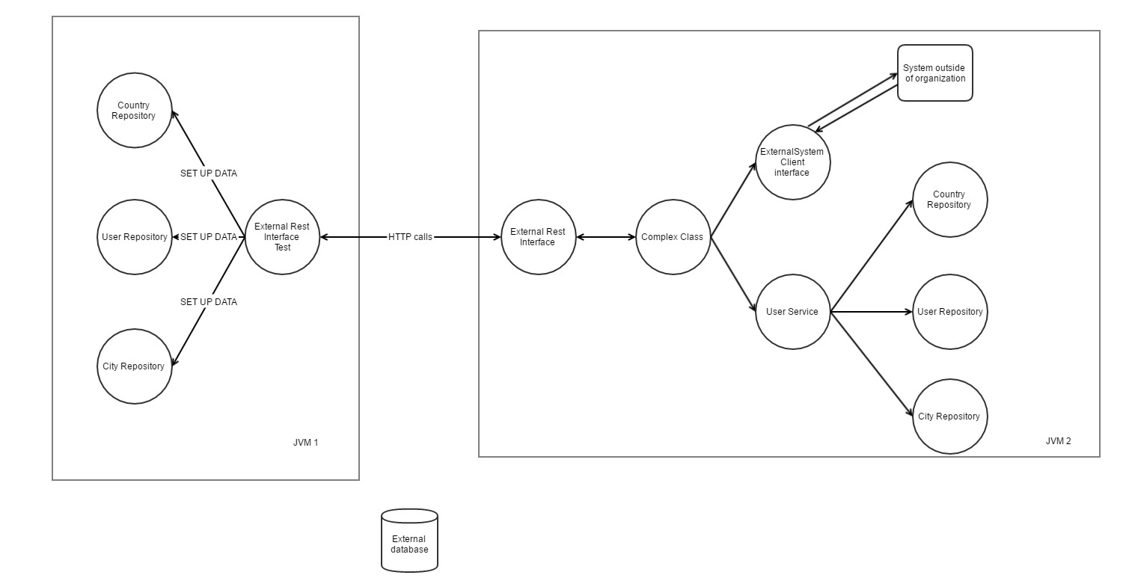
Test – system under test relationship

Slide 15
Testing system with dependency (client) to another system
Do not write integration tests with real client !!!
Hard to maintain tests
Hard to set up test environment (instead of setting up only one system you need to set up multiple systems)
Write integration test which tests client <–> external system communication
For example write a test which sends a request to system but with no authentication data – expected error authentication exception
In system and integration test use mocks that accepts limited set of data
For example checkAddressExists – there are 2 possible outcomes, cover them with you test. If the other system do what it is expected to do, this will be sufficient
Your job is not to test other systems !!!
Test manually whole test flow and capture the right behaviour with mock objects

Slide 16
Testing Repository Layer
Do not test persist, remote or findById methods which are directly calling entity manager methods
Do not test AbstractMethods that are shared across Repositories which are already tested on one or two Repository implementation – for example findPaged

Slide 17
Testing Facade Web Services
Do not use real client, use mocks when writing integration tests
Write integration test which tests client <–> external system communication
In mocks cover cases:
Everything went ok;
External system threw Exception.
Test those cases and capture the correct behaviour with integration and/or unit tests.
Run manual testing with real clients and capture correct behaviour in the integration test when communicating with the mock

