Slide 1
Java testing

Slide 2
Testing
Specification - Write Code - Test
Testing – manual or automation testing
Automation testing –
Faster than manual testing;
Automates repetative actions;
Very helpful in regression testing when code changes frequently;
Gives programmer safeness to change code;
Covers more test cases in a same amount of time than manual testing.

Slide 3
Levels of testing
According to the book Growing Object-Oriented Software Guided by Tests
Acceptance: Does the whole system work?
Integration: Does our code work against code we can't change?
Unit: Do our objects do the right thing, are they convenient to work with?

Slide 4
Some rules
Breaking Out: Splitting a Large Object into a Group of Collaborating Objects
Break up an Object if it becomes too large to test easily, or if its test failures become difficult to interpret. Then unit-test the new parts separatley.
Building Off: Defining a new service that an object needs and add in a new object to provide it
Building Up: Hiding Related Objects into a containing Object -> When we have a cluster of related objects that work together, we can package them up in a containing object. The new object hides the complexity in an abstraction that allow us to program at a higher lever
When The test for an object becomes too complicated to set up - when there are too many moving parts to get the code into the relevant state - consider bundling up some of the collaborating objects

Slide 5
Clean test
F.I.R.S.T
Fast
Independent
Repeatable
Self-Validating
Timely
BUILD-OPERATE-CHECK pattern
Give test methods meanangful names
public void should_do_something_when_conditions()

Slide 6
Libraries
JUnit - testing framework
http://junit.org/junit4/
AssertJ - fluent assertions for java
http://joel-costigliola.github.io/assertj/
Mockito – enables mock creation, verification and stubbing
http://mockito.org/
Spring-test (Spring framework)
http://docs.spring.io/spring/docs/current/spring-framework-reference/html/integration-testing.html
Arquillian (Java EE) – very similar to spring-test
http://arquillian.org/
Flyway – database migrations
https://flywaydb.org/

Slide 7
Maven and testing
validate - compile - test - package - verify - install – deploy
Plugins
Surefire (unit testing)
Failsafe (integration testing)
pre-integration-test phase (build test environment)
post-integration-test phase (clean test environment) – always executes
Naming conventions:
Surefire – NameOfTheClassTest –
Classpath same as the class that is being tested
Packages private methods can be accessed this way
Failsafe – NameOfTheClassTestIT
Must be specified in pom.xml
Verify and IntegrationTest phases

Slide 8
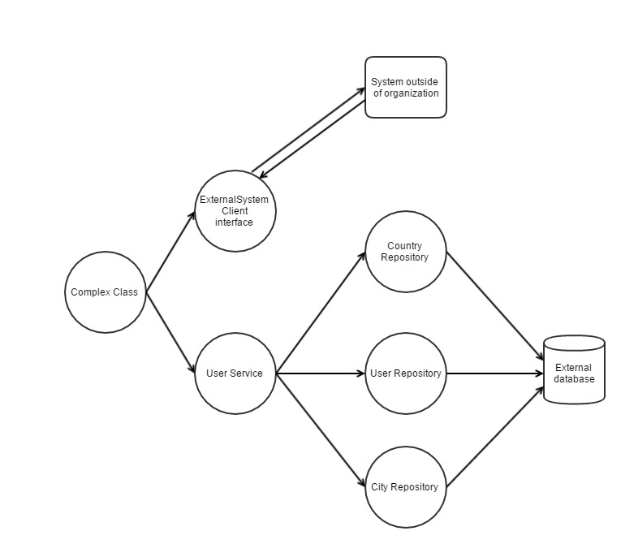
Show case 1 Integration testing and unit testing

Slide 9
Basic idea – test layer by layer
Repository layer
Simulate environment in which application will be ran
Do not mock entity manager, use real database
Service layer
Simulate environement in which class will be ran
Construct all dependencies (repository layer)
Complex class
Mock external client, cover all cases (simple case - true or false)
Construct all dependencies (service + repository layer)

Slide 10
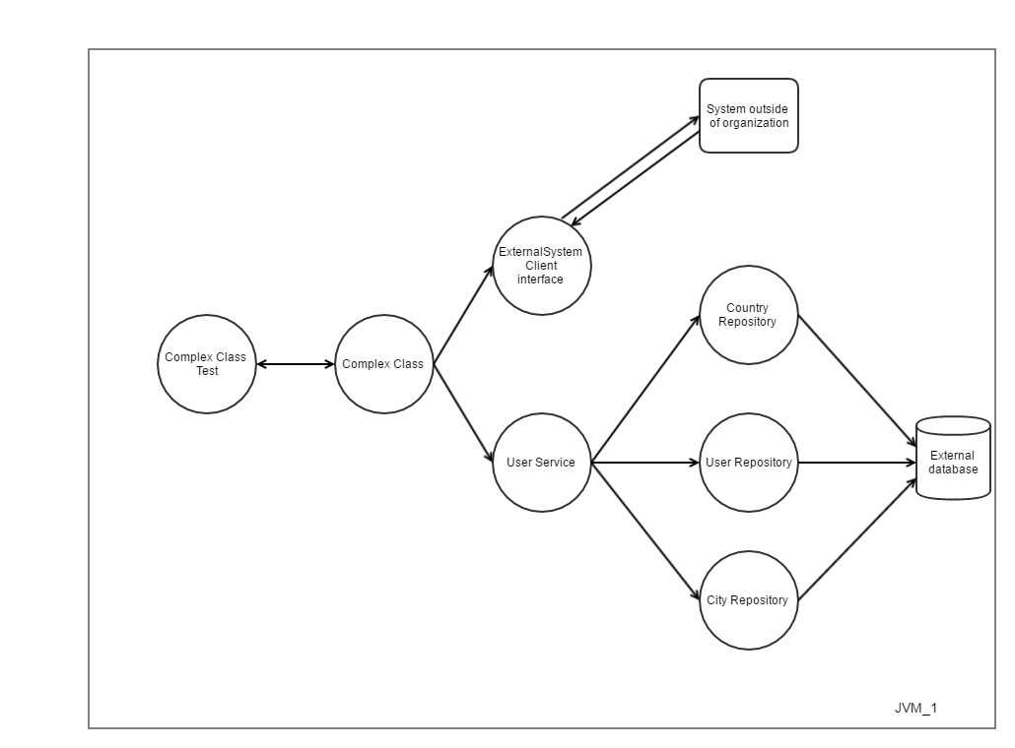
Test – system under test relationship

Slide 11
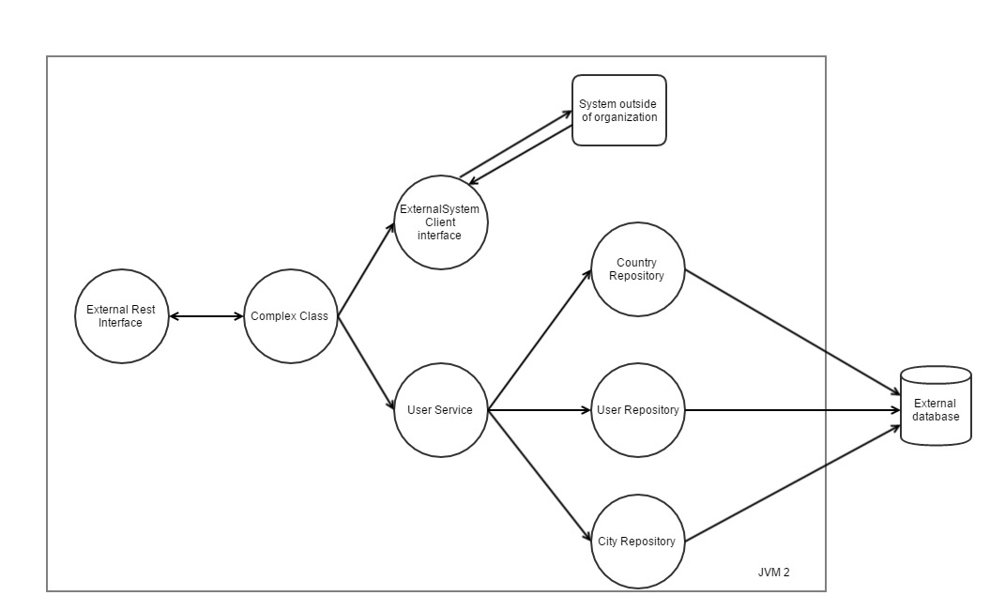
Show case 2

Slide 12
Basic idea
Use real database
Build clean database before integration test phase (use flyway -> maven plugin exists)
Build and deploy war to a real app server (use embedded if possible)
Use repository layer to insert test data
Use test data builders for defaults
Clear database after every test
Clean database after integration test phase is finished

Slide 13
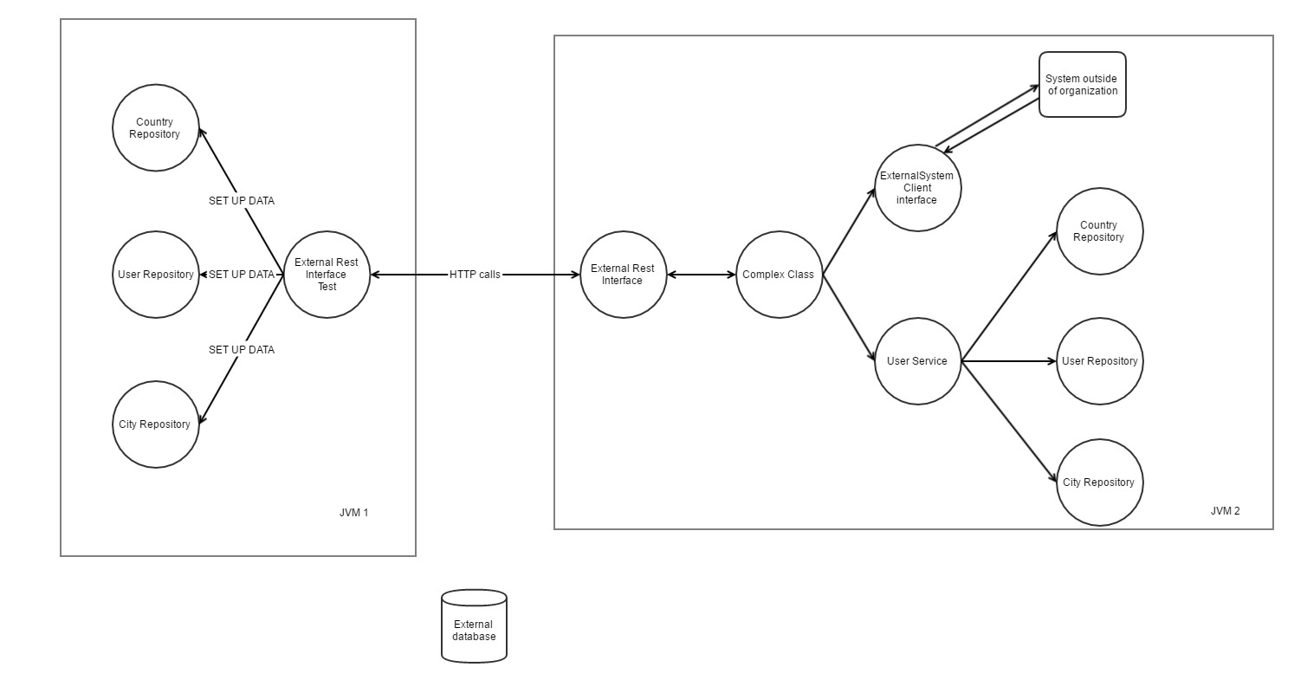
Test – system under test relationship

Slide 14
Testing system with dependency (client) to another system
Do not write integration tests with real client !!!
Hard to maintain tests
Hard to set up test environment (instead of setting up only one system you need to set up multiple systems)
Write integreation test which tests client <–> external system communication
For example write a test which sends a request to system but with no authentication data – expected error authentication exception
In system and integration test use mocks that accepts limited set of data
For example checkAddressExists – there are 2 possible outcomes, cover them with you test. If the other system do what it is expected to do, this will be sufficient
Your job is not to test other systems !!!

