Slide 1
Java testing

Slide 2
Testing
Specification - Write Code - Test
Testing – manual or automation testing
Automation testing –
Faster than manual testing;
Automates repetative actions;
Very helpful in regression testing when code changes frequently;
Gives programmer safeness to change code;
Covers more test cases in a same amount of time than manual testing.

Slide 3
Levels of testing
According to the book Growing Object-Oriented Software Guided by Tests
Acceptance: Does the whole system work?
Integration: Does our code work against code we can't change?
Unit: Do our objects do the right thing, are they convenient to work with?

Slide 4
Some rules
Breaking Out: Splitting a Large Object into a Group of Collaborating Objects
Break up an Object if it becomes too large to test easily, or if its test failures become difficult to interpret. Then unit-test the new parts separatley.
Building Off: Defining a new service that an object needs and add in a new object to provide it
Building Up: Hiding Related Objects into a containing Object -> When we have a cluster of related objects that work together, we can package them up in a containing object. The new object hides the complexity in an abstraction that allow us to program at a higher lever
When The test for an object becomes too complicated to set up - when there are too many moving parts to get the code into the relevant state - consider bundling up some of the collaborating objects

Slide 5
Clean test
F.I.R.S.T
Fast
Independent
Repeatable
Self-Validating
Timely
BUILD-OPERATE-CHECK pattern
Give test methods meanangful names
public void should_do_something_when_conditions()

Slide 6
Libraries
JUnit - testing framework
AssertJ - fluent assertions for java
Mockito – enables mock creation, verification and stubbing
Spring-test (Spring framework)
Arquillian (Java EE) – very similar to spring-test

Slide 7
Maven and testing
validate - compile - test - package - verify - install – deploy
Plugins
Surefire (unit testing)
Failsafe (integration testing)
pre-integration-test phase (build test environment)
post-integration-test phase (clean test environment) – always executes
Naming conventions –
Surefire – NameOfTheClassTest – name of the class under test full name
Failsafe - NameOfTheClassITTest

Slide 8
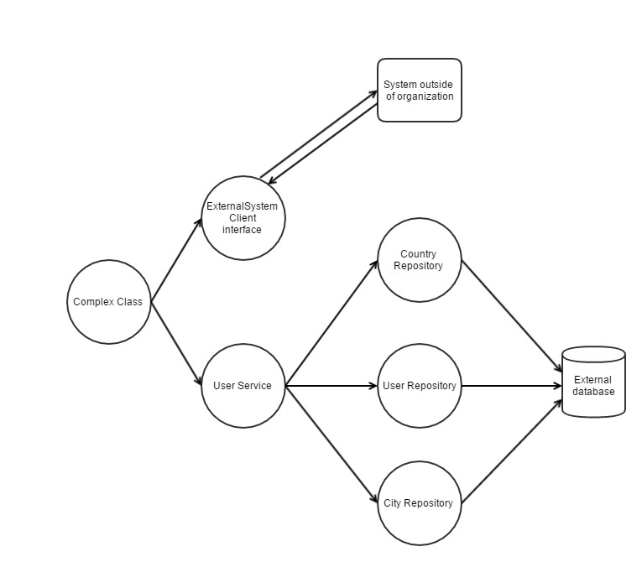
Show case

Slide 9
Basic idea
Repository layer
Simulate environment in which application will be ran
Do not mock entity manager, use real database
Service layer
Simulate environement in which class will be ran
Construct all dependencies (repository layer)
Complex class
Mock external client, cover all cases (simple case - true or false)
Construcat all dependencies (service + repository layer)

