Slide 1

Sprint 2 Overview -
Goals, Progress, and Limitations
12-FA25-SP26-VI-WEB
WSU Capstone - Sponsored by: Votegrity
November, 2025

Slide 2

Intro
Developing a Web-Based Election Document Builder
Current workflow for Votegrity is inefficient (Microsoft Word)
Creating a solution to the problem
Drag-and-Drop
Intuitive design
Template starting point
WSU Capstone: 12-FA25-SP26-VI-WEB
Intro

Slide 3

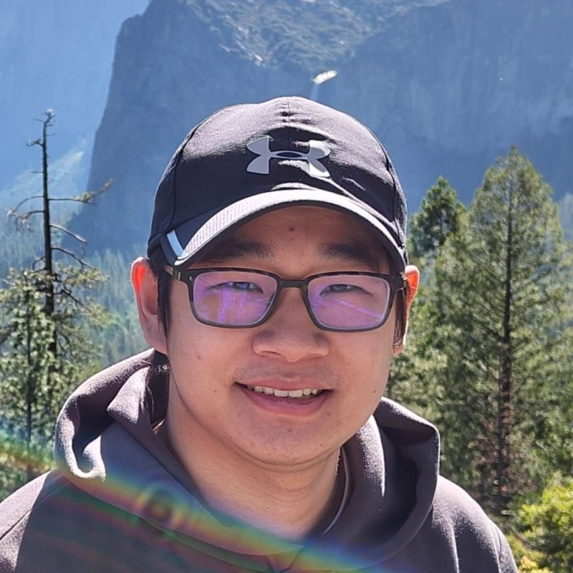
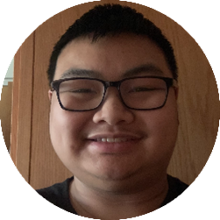
Roles
Daniel
Calle
Ivan
Kwok
Lance
Tieng
Team Lead
Full-stack Developer
Front-end Developer
(Drag-and-Drop)
Backend Developer
(Saving, Loading, DB)
WSU Capstone: 12-FA25-SP26-VI-WEB
Roles & Responsibilities

Slide 4
Goals
Catch up on report sections
Set-up dev environment
Develop first key features
Get client feedback
Continue development

Slide 5
Sprint Objectives
Finalize FRs, NFRs, and User Stories
Implement prototypes of key features
Setting up common dev environment
Get client feedback
Communicate with client and understand key features
Continue developing features/modifying to clients demands
WSU Capstone: 12-FA25-SP26-VI-WEB
Sprint Objectives

Slide 6
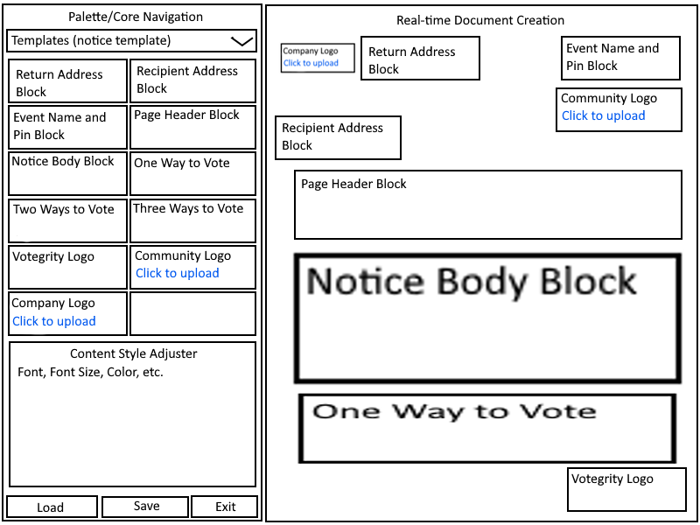
Prototype
Layout
During a meeting with the client, we were able to go over what the web-app should look like at a high level, similar to a Figma wireframe.

Slide 7







Feature Overview
WSU Capstone: 12-FA25-SP26-VI-WEB
Feature Overview

Slide 8
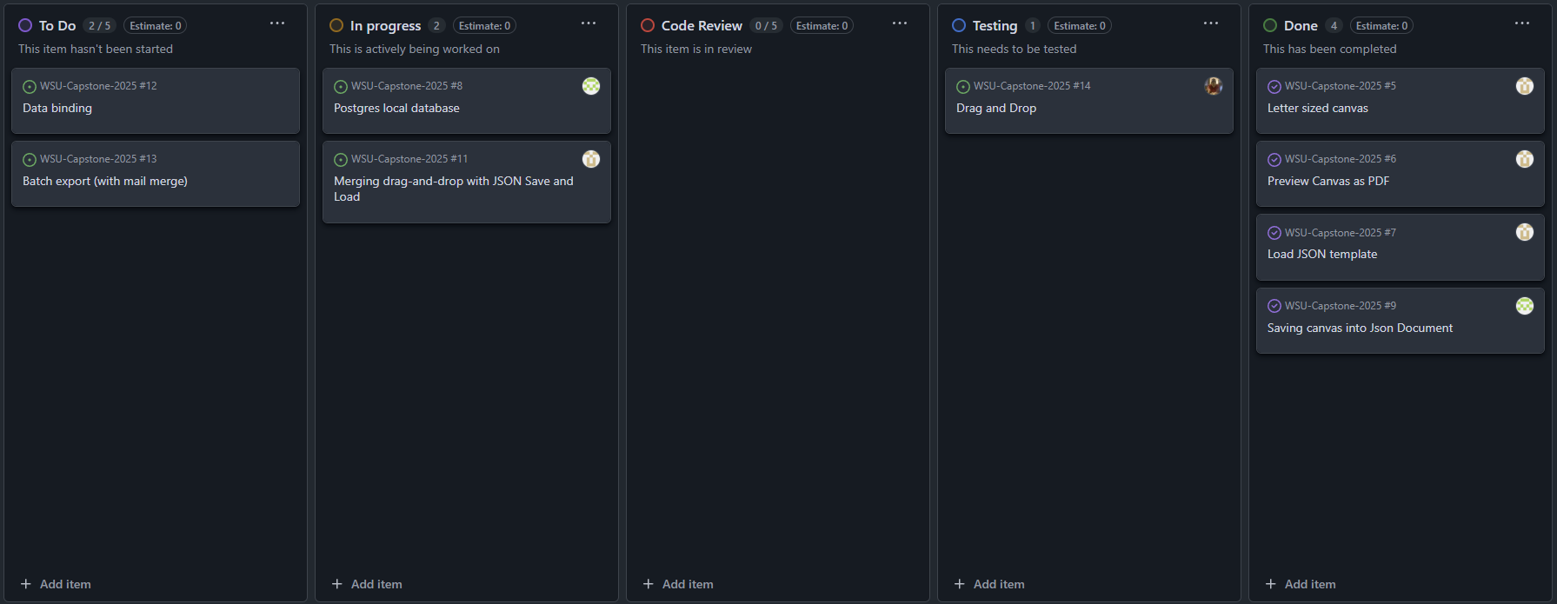
KanBan Board
For keeping track of features waiting to be assigned, in progress, and completed, we have utilized a Kanban board linked to our GitHub repository.
WSU Capstone: 12-FA25-SP26-VI-WEB
Kanban Board

Slide 9

Challenges
Time
Delayed
start
New
concepts
Other
courses
WSU Capstone: 12-FA25-SP26-VI-WEB
Challenges

Slide 10
What went
Client communication
Meeting frequency
Mutual understanding
Meeting expectations
Prototyping features
Increased productivity in relation to last sprint
Well?
WSU Capstone: 12-FA25-SP26-VI-WEB
What went well?

Slide 11
What could be
Report writing and documentation
Development speed
Testing
Better?
WSU Capstone: 12-FA25-SP26-VI-WEB
What could be better?

Slide 12
Action
Actions to take for next sprint
Looking forward to our next sprint, there are certain things we need to stop doing, certain things to start doing, and certain things we should continue doing.
Stop waiting for direct assignments
Start being more proactive in development and report writing
Continue communicating with the client and meeting expectations
WSU Capstone: 12-FA25-SP26-VI-WEB
Actions to take for next sprint

Slide 13
Assignments for Next Sprint
Daniel Calle
Ivan Kwok
Lance Tieng
Making existing features work in congruence
Check-in with client to make sure we are on the right track
Team Lead - Full-stack
Drag-and-Drop
Finalizing front-end design
Front-end - Drag-and-Drop
Backend logic and APIs
Data binding to fields in components on the canvas
“Mail-merge” export
Back-end - Database and logic
WSU Capstone: 12-FA25-SP26-VI-WEB
Next Assignments

Slide 14
Summary
and
Next Steps
Summary
Next Steps
We improved since our last sprint, implementing various key features and setting a good foundation for future development.
Client expectations have continuously been met, and feedback has been taken and used to create better code.
We plan to continue receiving feedback from our clients and continue to iterate new features as we move through sprint 3.
WSU Capstone: 12-FA25-SP26-VI-WEB
Summary and Next Steps

Slide 15
Thank You

