Slide 1

reveel
the simple film reel
revealer

Slide 2

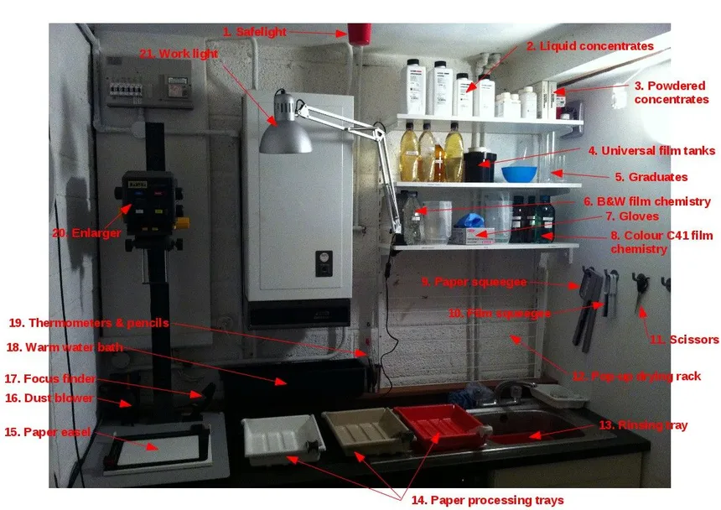
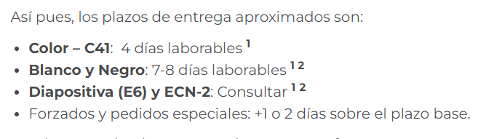
what do we offer
Stop waiting forever for your images
Develop film from your house, no darkrooms needed
Let’s make film accessible to everyone

Slide 3
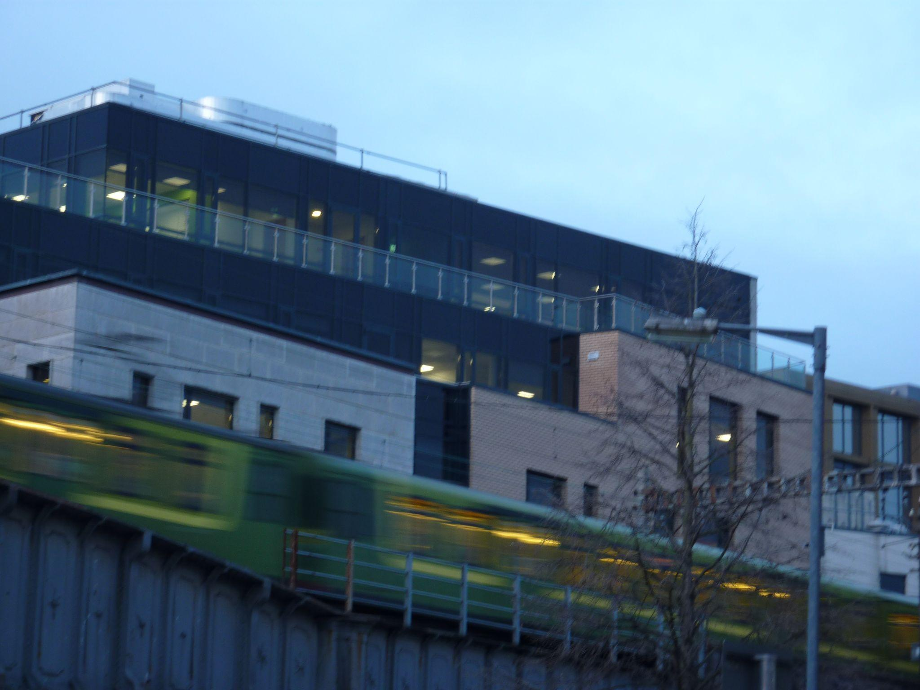
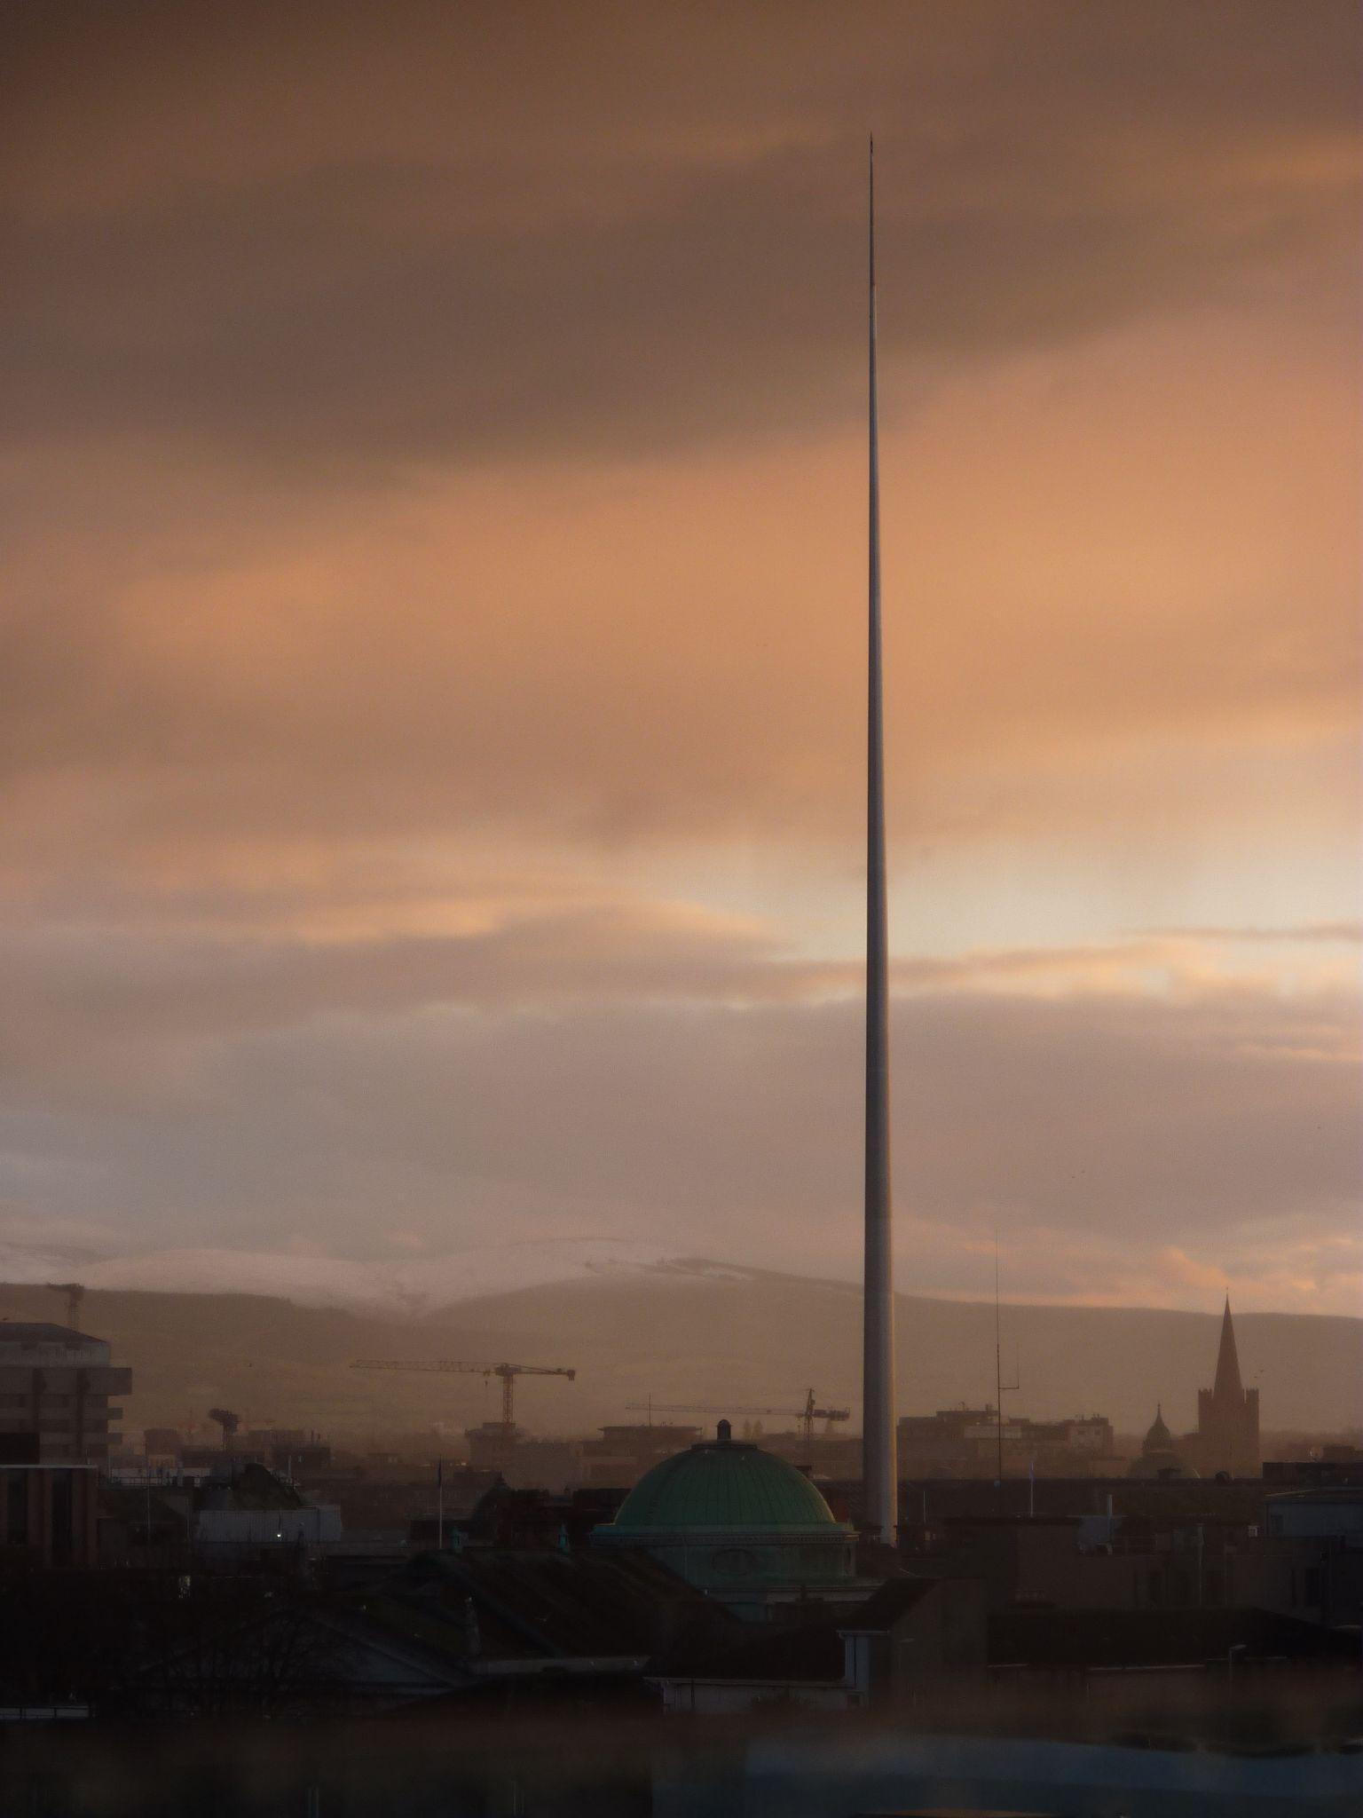
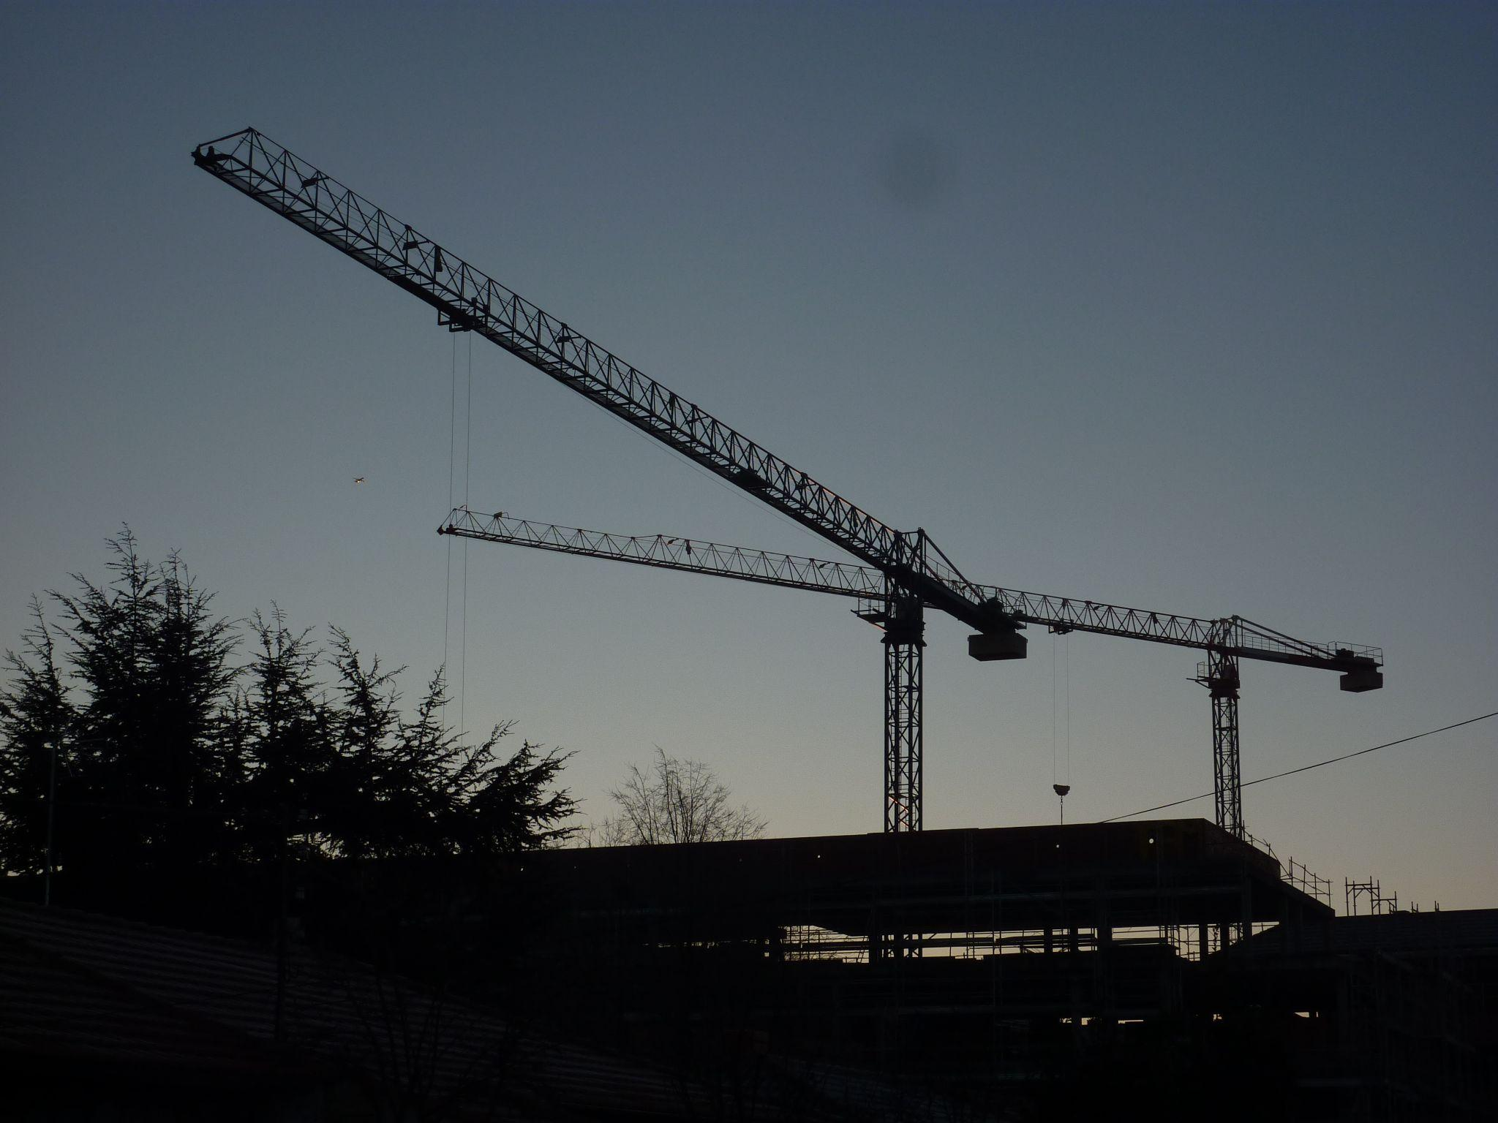
recapture the magic
remember the moment
develop a passion
photos are meant to mean something
with full quality, true-to-life images
and share it with your family and friends

