Slide 1
An Introduction to Ruby on Rails

Slide 2
Terminal Windows
Windows: Start, cmd.exe
OS X: Applications, Utilities, Terminal
Linux: gnome terminal, etc.
http://www.pragtob.info/rails-beginner-cheatsheet

Slide 3
Command Line Interface
cmd.exe | Linux/OSX
type, more | cat, more | Display contents of file
help | help, which | Commands available
help | man | Help on specific commands
cls | clear | Clear screen
copy | cp | Copy from one file to another
move | mv | Move one file to another
del, erase, rmdir, rd | rm, rmdir | Remove file or directory
ren, rename | mv | Rename file
cd | pwd | Display current directory
cd, chdir | cd | Change directory

Slide 4
Ruby
“Ruby is a dynamic, reflective, object-oriented, general-purpose programming language. It was designed and developed in the mid-1990s by Yukihiro "Matz" Matsumoto in Japan.”

Slide 5
Rails
Rails is a “full-stack” web application development framework. It has a powerful Object-Relational Model (ORM) for mapping objects to databases. It follows a “convention over configuration” model.
Many other frameworks have adopted these
Basecamp, Twitter, Scribd, Shopify, github, Hulu, etc.

Slide 6
Ruby on Rails (RoR)
http://rubyonrails.org

Slide 7
Installation
If you have a Mac system, you have ruby
http://www.k336.org/2015/10/sudo-less-ror-install-on-os-x.html
If you have Linux, you have ruby
gem install rails
If you have Windows: http://railsinstaller.org/en

Slide 8
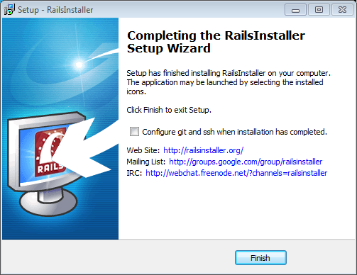
Windows Installer

Slide 9
Create a new app
$ rails new myapp
create
create README.rdoc
create Rakefile
create config.ru
create .gitignore
create Gemfile
create app
create app/assets/javascripts/application.js
[…]

Slide 10
Finished
[…]
Your bundle is complete!
Use `bundle show [gemname]` to see where a bundled gem is installed.
Post-install message from rdoc:
Depending on your version of ruby, you may need to install ruby rdoc/ri data:
<= 1.8.6 : unsupported
= 1.8.7 : gem install rdoc-data; rdoc-data --install
= 1.9.1 : gem install rdoc-data; rdoc-data --install
>= 1.9.2 : nothing to do! Yay!

Slide 11
Start the Server
$ cd myapp
$ rails server
=> Booting WEBrick
=> Rails 4.0.2 application starting in development on http://0.0.0.0:3000
=> Run `rails server -h` for more startup options
=> Ctrl-C to shutdown server
[2014-01-23 08:58:29] INFO WEBrick 1.3.1
[2014-01-23 08:58:29] INFO ruby 1.9.3 (2013-11-22) [i386-mingw32]
[2014-01-23 08:58:29] INFO WEBrick::HTTPServer#start: pid=1632 port=3000

Slide 12
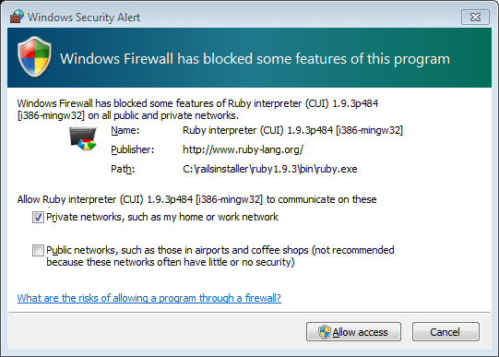
Allow it

Slide 13
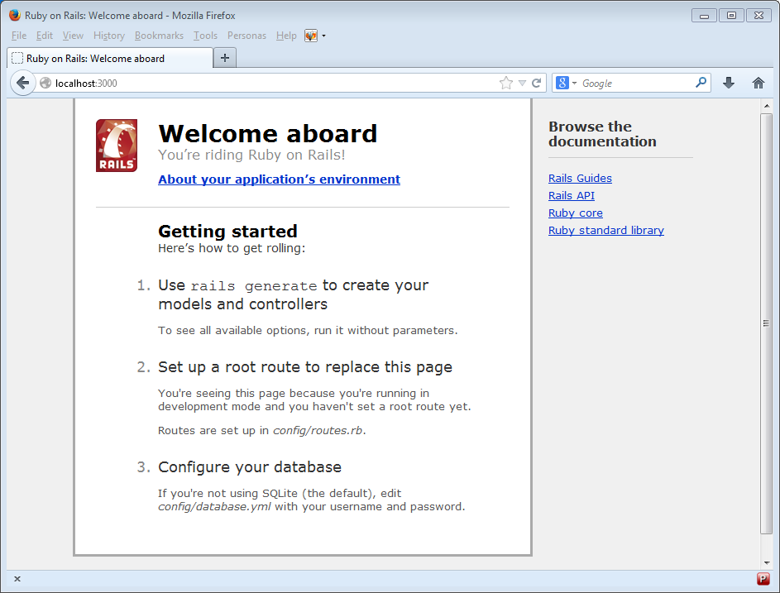
Surf to it

Slide 14
Easy, but less secure
$ gem sources -l
*** CURRENT SOURCES ***
https://rubygems.org/
$ gem source -a http://rubygems.org/
$ gem source -r https://rubygems.org/
$ gem sources -l
*** CURRENT SOURCES ***
http://rubygems.org/

Slide 15
A bit more complicated, but more secure
$ cd /System/Library/Frameworks/Ruby.framework/Versions/2.0/usr/lib/ruby/2.0.0/rubygems/ssl_certs
$ sudo curl https://raw.githubusercontent.com/rubygems/rubygems/master/lib/rubygems/ssl_certs/AddTrustExternalCARoot-2048.pem -o AddTrustExternalCARoot-2048.pem
$ sudo chmod 644 AddTrustExternalCARoot-2048.pem

Slide 16
Model-View-Controller (MVC)
The default way to create user-interactive applications
Created in 1979 by Trygve Reenskaug
Model
Keeps track of state (session and longer)
Persistence, often via database
Enforces consistency

Slide 17
MVC (Cont’d)
View generates user interface
Based on data in model
May look different based on browser, user role, assistive technologies, etc.
Controllers coordinate
Receives events from view
Interacts with model

Slide 18
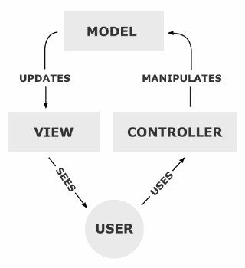
MVC Picture
Notes:
From wikipedia

Slide 19
MVC (Cont’d)
Important concept: separation of concerns
DB shouldn’t worry about how data are displayed
Display technology can change without affecting any other part of app
Can add JavaScript, etc.
Business logic in only one place

Slide 20
Separation of Concerns
Code/text only addresses one aspect of app
Easier to write, maintain, document, debug
Rails essentially enforces MVC to a certain extent

Slide 21
RoR Scaffolding
A scaffold in Rails is a full set of:
model
database migration for the model
controller to manipulate the model
views to view and manipulate the data
test suite for each of the above

Slide 22
Types
:primary_key
:string
:text (short strings)
:integer
:float
:decimal (fixed precision, currency)
:datetime
:timestamp
:time
:date
:binary
:boolean

Slide 23
Steps
rails new Demo --skip-bundle
cd Demo
bundle install --path vendor/bundle
rails generate scaffold Todo item:string
rake db:migrate
rake routes
rails server

