Slide 1
Docker
Docker workshop VSB – Centrum vzdělávání
Ivo Klimša

Slide 2

Ivo Klimsa
DevOps Manager
SolarWinds – DevOps Manager (2019/8 - )
SolarWinds – DevOps Team Leader (2017/11 – 2019/7)
SolarWinds – Senior System Engineer (2015/2 – 2017/10)
EmbedIT – Senior System Engineer (2014/1 – 2015/1)
TIETO – Application Administrator
OVANET a.s. - System Administrator (2007/7 – 2011/5)
Centrum vzdelavani 2006 – 2007/5
SYNOTIP - Service engineer (2006)
https://github.com/ivoklimsa
https://bit.ly/34ykzZx

Slide 3
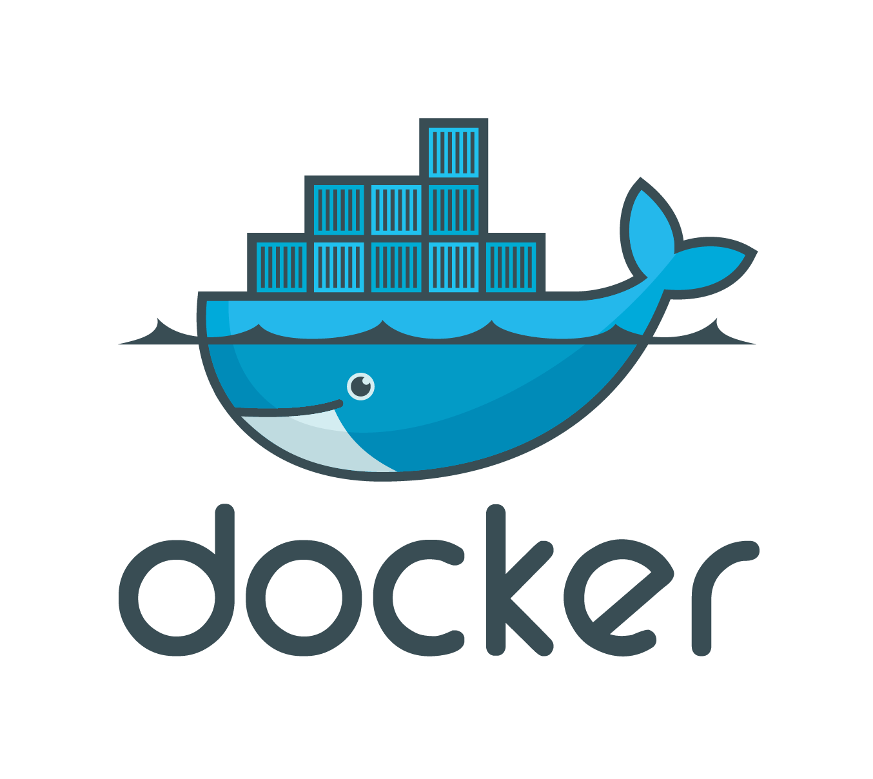
Agenda
Basic overview of Containers
Benefits
Workshop
Volumes
Networking
Clustering (Optional)

Slide 4
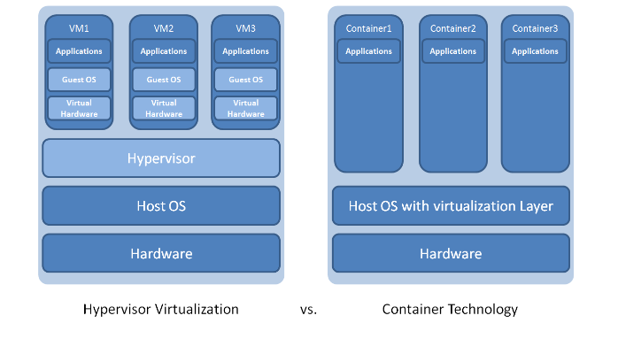
Containers?#!
What are containers?
Containers are a solution to the problem of how to get software to run reliably when moved from one computing environment to another. This could be from a developer's laptop to a test environment, from a staging environment into production and perhaps from a physical machine in a data center to a virtual machine in a private or public cloud.

Slide 5
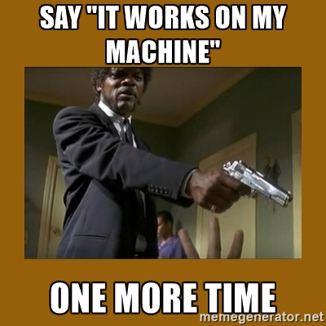
Standardized environment for your product
”Hmm, but it works on my machine”

Slide 6

Standardized interface between OS and container
Just install docker and everything will work

Slide 7
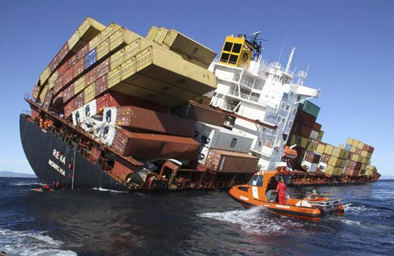
Porting images among developers is easy
Just pack it into an image and send anywhere – it will work the same everywhere

Slide 8
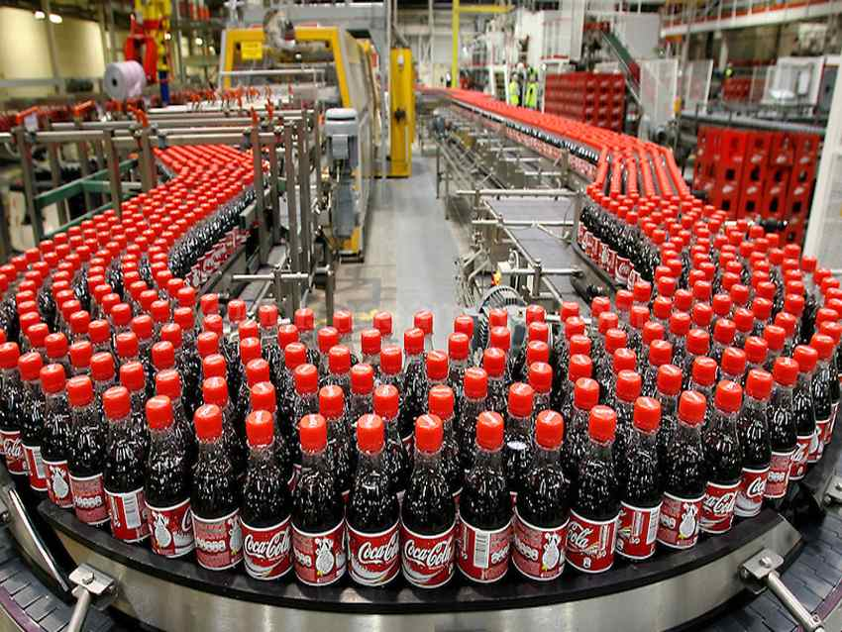
Fast and repeatable deployment
Create as many instances as you want

Slide 9
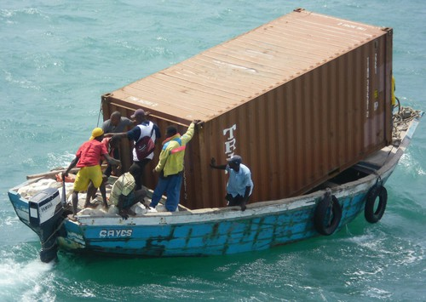
Containers are lightweight
Only application processes consume resources

Slide 10

Minimal upgrade downtime
Suitable application architecture allows minimizing downtime

Slide 11
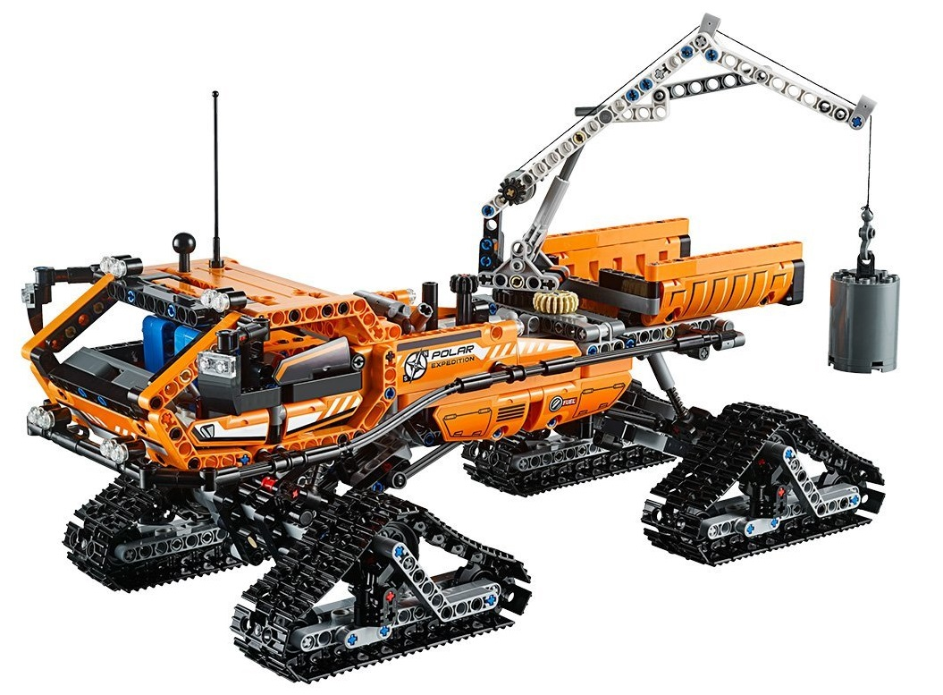
Support microservices and modular design
One process per one container

Slide 12
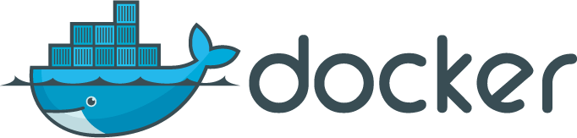
Docker
What is Docker?
Wikipedia defines Docker as:
an open-source project that automates the deployment of software applications inside containers by providing an additional layer of abstraction and automation of OS-level virtualization on Linux.
Developers use Docker to eliminate “works on my machine” problems when collaborating on code with co-workers.
Notes:
Docker images are the basis of containers.It’s a filesystem. Each time you’ve used docker run you told it which image you wanted.
Each Docker image references a list of read-only layers that represent filesystem differences. Layers are stacked on top of each other to form a base for a container’s root filesystem. The diagram below shows the Ubuntu 15.04 image comprising 4 stacked image layers.

Slide 13
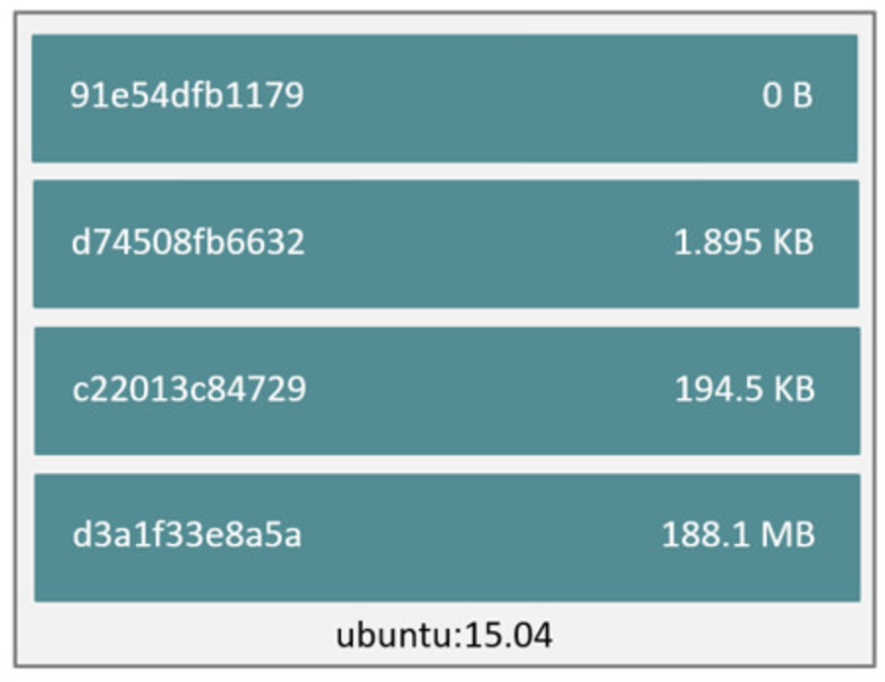
Docker
Images and layers
Notes:
Docker images are the basis of containers.It’s a filesystem. Each time you’ve used docker run you told it which image you wanted.
Each Docker image references a list of read-only layers that represent filesystem differences. Layers are stacked on top of each other to form a base for a container’s root filesystem. The diagram below shows the Ubuntu 15.04 image comprising 4 stacked image layers.

Slide 14
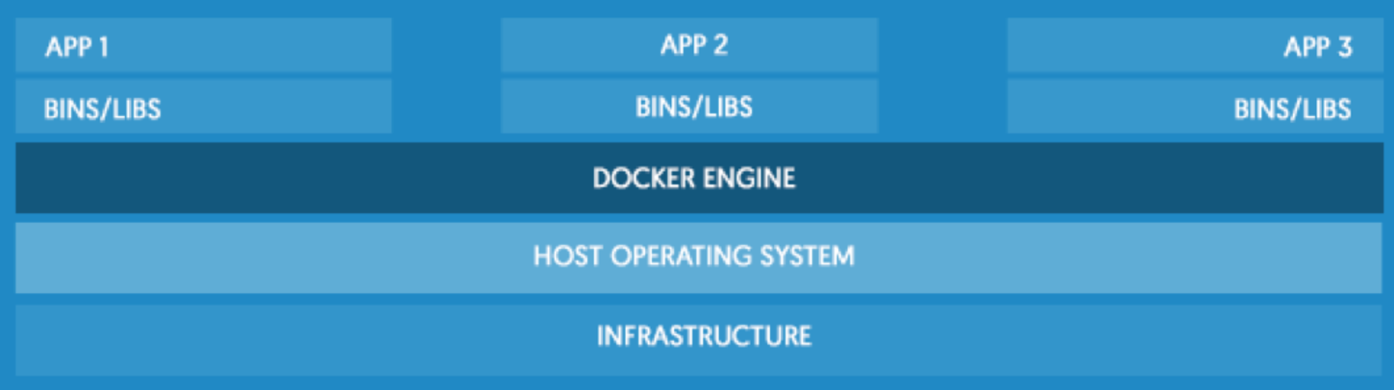
Docker
DOCKER ENGINE
Notes:
is a lightweight container runtime and robust tooling that builds and runs your container. Docker allows you to package up application code and dependencies together in an isolated container that share the OS kernel on the host system. The in-host daemon communicates with the Docker Client to execute commands to build, ship and run containers.

Slide 15
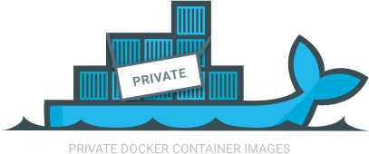
Docker
Registry
The Registry is a stateless, highly scalable server side application that stores and lets you distribute Docker images. The Registry is open-source, under the permissive Apache license.
You should use the Registry if you want to:
Tightly control where your images are being stored
Fully own your images distribution pipeline
Integrate image storage and distribution tightly into your in-house development workflow

Slide 16
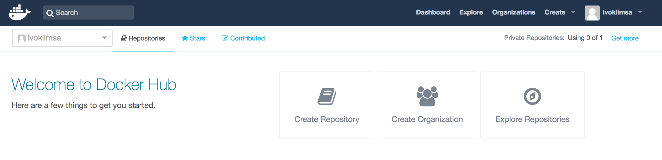
Docker
Docker hub
Notes:
Docker Hub is a cloud-based registry service which allows you to link to code repositories, build your images and test them, stores manually pushed images, and links to Docker Cloud so you can deploy images to your hosts. It provides a centralized resource for container image discovery, distribution and change management, user and team collaboration, and workflow automation throughout the development pipeline.

