Slide 1
Docker 101
Essential Container Concepts & Docker Basics
Ivo Klimsa 11 Jun 2020

Slide 2
DOCKER 101
{essentials}
History
Virtual Machine
Container Systems
Docker
Orchestration

Slide 3
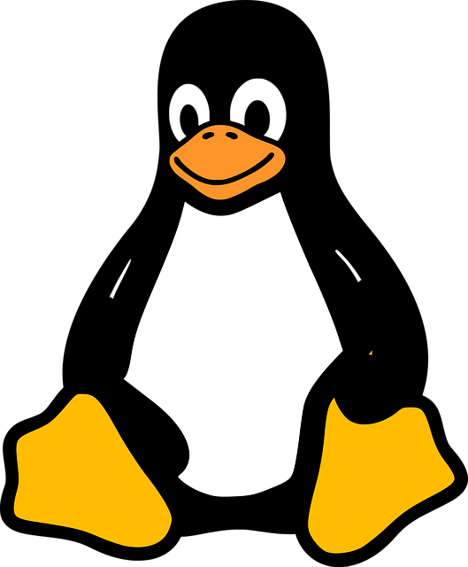
Before everything
Notes:
Linux Torvalds created the Linux Kernel in 1991 for use in his personal computer. Many developers quickly adopted the kernel for use in their OSS projects. OSS community has continued to grow and improve the Linux and his sub-components. Without Linux there wouldn’t be so much innovation.

Slide 4
Linux
{foundation of containers}
Kernel
Computer program that is a heart of a computer operating system.
NameSpaces
Allow partitioning of kernel resources.
Notes:
Kernel
It handles everything from a computer’s startup to memory and control of peripherals.
NameSpaces
Ensuring that one set of processes sees only the resources allocated to it. When another processes see a different set of resources.

Slide 5
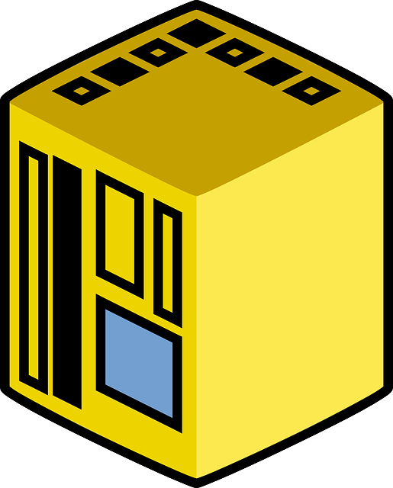

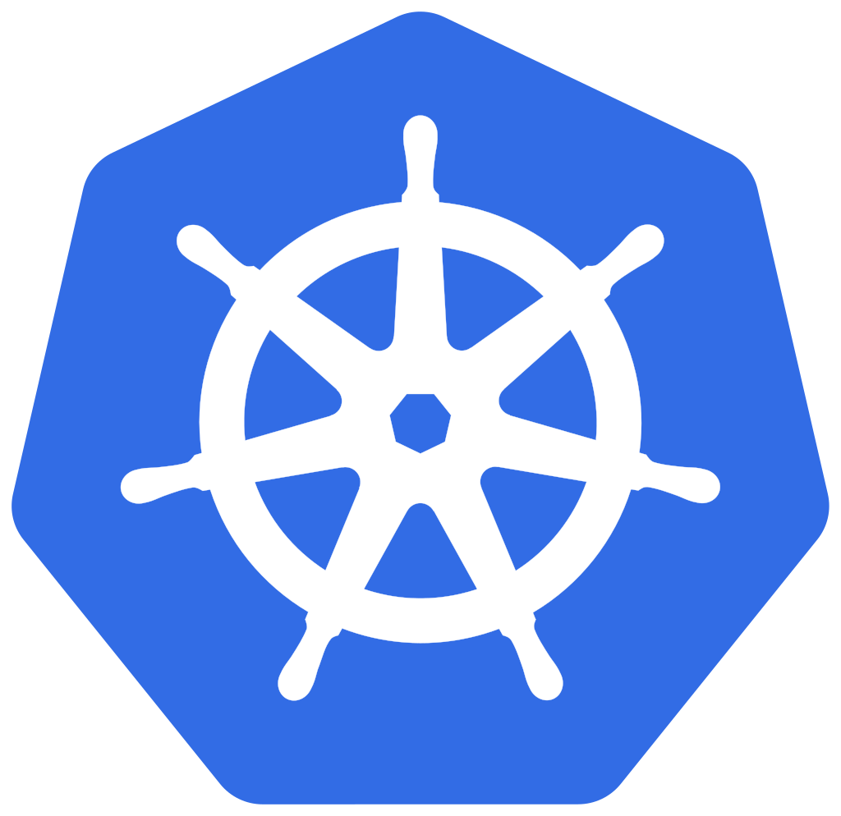

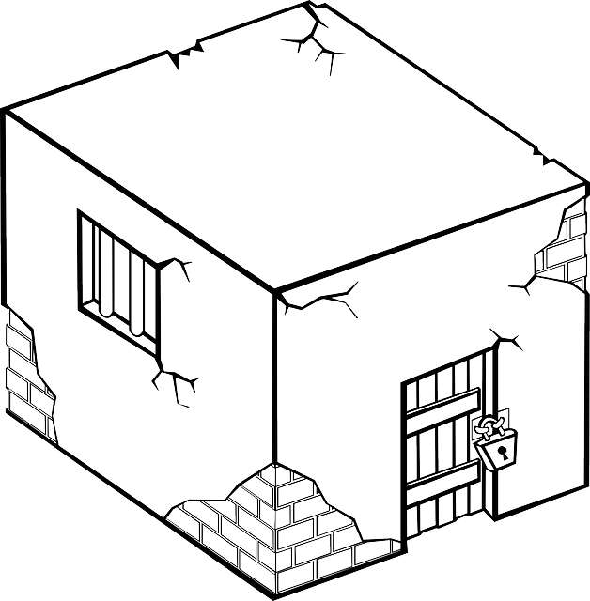

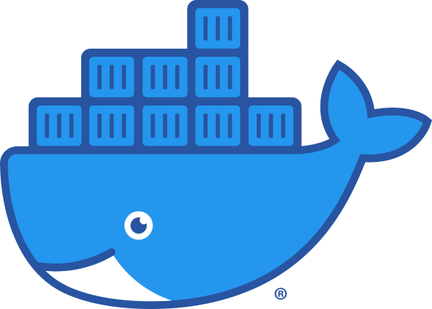
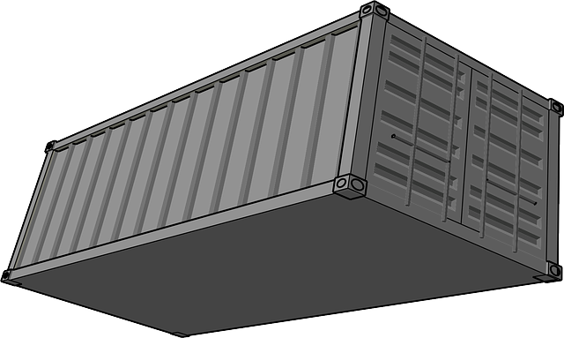
Back to 70’s
70’s
1982
2000
2006
2013
2014~2015
LMCTFY
CHROOT
1979
90’s
2004
2007
2013
Notes:
Mainframe
- were a scarce resource for business due to cost. This leads the way to the development of centralised computer and sharing
CHROOT
- operation that changes the apparent root directory for the current running process and its children. Single process target
UNIX
- chroot added
JAIL
- Bill Checkwick wanted to build an env. that allow him to study the crackers keystrokes. This led to simplified solution of CHROOT to jail command. It is a partition of the system with its own file system, user accounts,
FreeBSD
- jail command added into OS.
Solaris
- Introduced Solaris Zones. Gave an app. full user, process & file system space along with access to system hw.
Control Groups a.k.a Cgroups
- process containers designed for isolating and limited resource usage of process.
LXC
- OS system level virtualization by allowing multiple isolated Linux env. to run on shared Linux kernel
LMCTFY
- From Google, applications could be written to be container aware and thus programmed to create and manage their own sub-containers
Docker
- released as an OSS; helped provide the ability to package containers so that they could be moved from one env. to another
K8s
- OSS container orchestration system which was heavily influenced by Google’s Borg system.

Slide 6
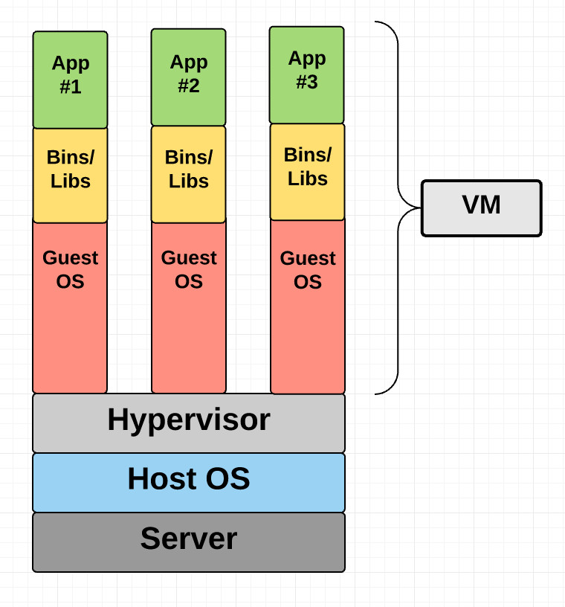
Virtual Machines
{VM & Hypervisors}
Hypervisor
Can run multiple OSs
Virtual Machine
Virtual Computer
Notes:
Hypervisor
- handles CPU, MEM, HDD, NETWORKIG for VM
VM
- provides virtual HW for guest OS. VM looks like a real machine

Slide 7
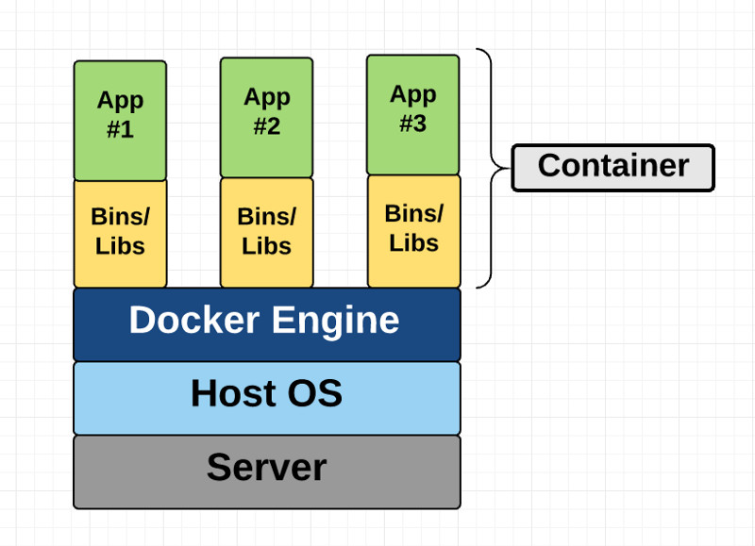
Container
Container is just a VM.
Notes:
Unlike a VM which provides hardware virtualization, a container provides operating-system-level virtualization by abstracting the “user space”.
For all intent and purposes, containers look like a VM. For example, they have private space for processing, can execute commands as root, have a private network interface and IP address, allow custom routes and iptable rules, can mount file systems, and etc.
The one big difference between containers and VMs is that containers *share* the host system’s kernel with other containers.

Slide 8
Container Systems
Control Groups
Resource limiting, Prioritization, Accounting, Control
More info https://man7.org/linux/man-pages/man7/cgroups.7.html
LXC
Chroot, Kernel Namespaces, SELinux / Apparmor, Seccomp policies, CGroups
More info https://linuxcontainers.org/lxc/introduction/
Docker
Easy to use, Application isolation, Routing Mesh, Services, Security management
Notes:
Cgroups - is a Linux kernel feature that limits, accounts for, and isolates the resource usage (CPU, memory, disk I/O, network, etc.) of a collection of processes. Started at Google 2006 as “process containers”. 2007 renamed to cgroups
Resource limiting - groups can be set to not exceed a configured memory limit, which also includes the file system cache
Prioritization - some groups may get a larger share of CPU utilization or disk I/O throughput
Accounting - measures a group's resource usage, which may be used, for example, for billing purposes
Control - freezing groups of processes, their checkpointing and restarting
LXC - OS level virtualization method for running multiple isolated Linux systems (containers) on a control host using a single Linux kernel. Combines the kernel's cgroups and support for isolated namespaces to provide an isolated environment for applications.

Slide 9
DOCKER
What is Docker and why is it so popular?
Notes:
Docker is an open platform for developing, shipping, and running applications. Docker enables you to separate your applications from your infrastructure so you can deliver software quickly. With Docker, you can manage your infrastructure in the same ways you manage your applications. By taking advantage of Docker’s methodologies for shipping, testing, and deploying code quickly, you can significantly reduce the delay between writing code and running it in production. And REMOVING “It works in my machine”
Easy to use
Fast
Modularity and scalability

Slide 10
Docker Platform
{provides tooling and a platform to manage the lifecycle of your containers}
Develop your application and its supporting components using containers.
The container becomes the unit for distributing and testing your application.
When you’re ready, deploy your application into your production environment, as a container or a service.
This works the same whether your production environment is a local data center, a cloud provider, or a hybrid of the two.
Notes:
Package and run an application in a loosely isolated environment called a container.
Lightweight because they don’t need the extra load of a hypervisor.
More containers on a given hardware combination

Slide 11
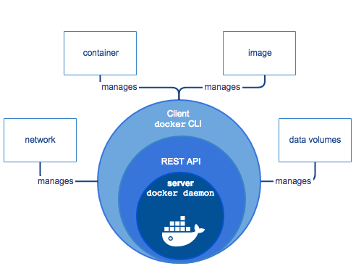
Docker Engine
{client-server application}
A server which is a type of long-running program called a daemon process
A REST API which specifies interfaces that programs can use to talk to the daemon and instruct it what to do
A command line interface (CLI)

Slide 12
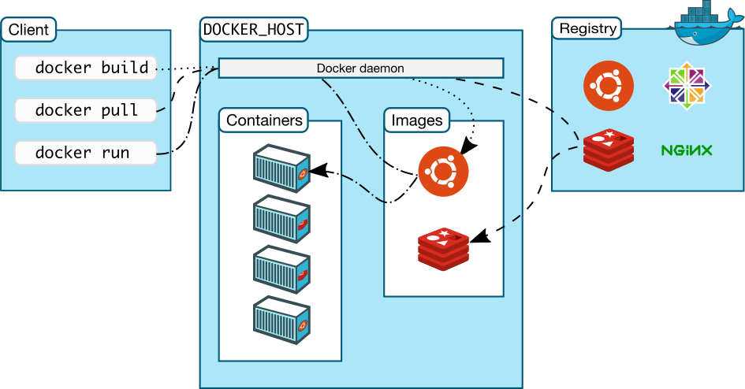
Docker Architecture
{client-server}
Docker Daemon
Docker Client
Docker Images
Docker Containers
Docker Registry
Notes:
Docker daemon (dockerd) listens for Docker API requests and manages Docker objects such as images, containers, networks, and volumes.
Docker Client what you, as the end-user of Docker, communicate with. Think of it as the UI for Docker. For example, when you run docker run
Docker Images read-only templates that you build from a set of instructions written in your Dockerfile.
Docker Containers instance of an image. You can create, start, stop, move, or delete a container using the Docker API or CLI . wraps an application’s software into an invisible box with everything the application needs to run. That includes the operating system, application code, runtime, system tools, system libraries, and etc.
Docker Registry stores Docker images.

Slide 13
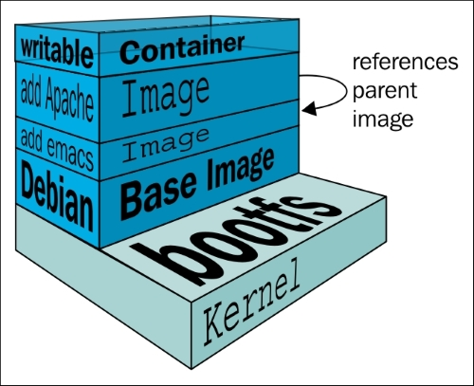
Docker Image & Container
{wraps an application’s software into an invisible box}
Image
Read-only template for container
Usually based on another image
Consist of layers
Built from Dockerfile
Container
Runnable instance of image
Isolated from other containers
Manageable (start, stop, delete)
Notes:
Container - network, volumes … attachable to

Slide 14
Docker File
{instructions to build an image}
# Nginx
#
# VERSION 0.0.1
FROM ubuntu
LABEL Description="This image is used to start the foobar executable" Vendor="ACME Products" Version="1.0"
RUN apt-get update && apt-get install -y inotify-tools nginx apache2 openssh-server
Notes:
A Dockerfile is where you write the instructions to build a Docker image.
Is a text document that contains all the commands a user could call on the command line to assemble an image. Using docker build users can create an automated build that executes several command-line instructions in succession.
More info https://docs.docker.com/engine/reference/builder/#dockerfile-examples

Slide 15
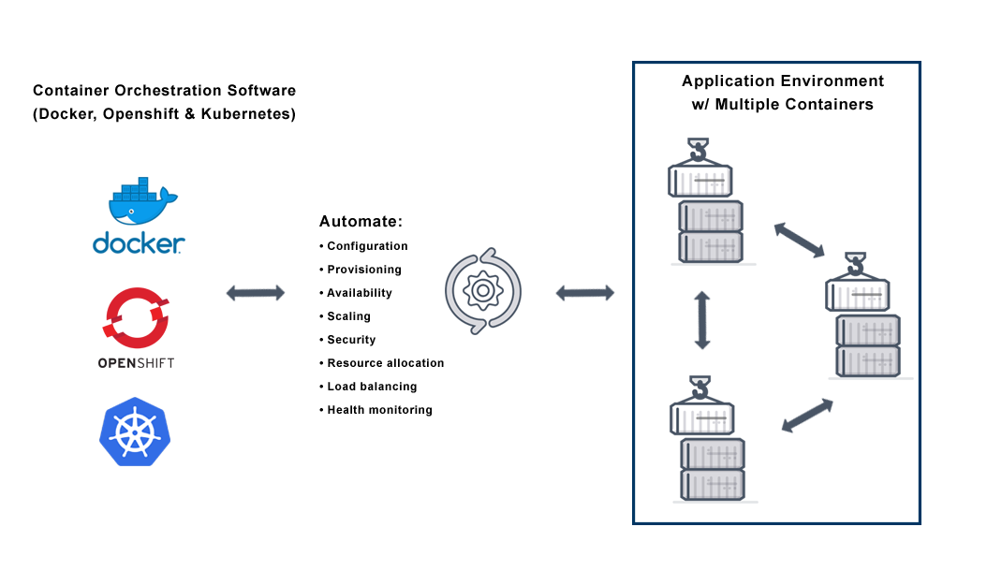
Container Orchestration
{Swarm, K8s, OpenShift}
Docker Swarm
OpenShift
Kubernetes
Notes:
Container orchestration is the automation of all aspects of coordinating and managing containers. Container orchestration is focused on managing the life cycle of containers and their dynamic environments.
Why we need container orchestration is used to automate the following tasks at scale:
• Configuring and scheduling of containers
• Provisioning and deployments of containers
• Availability of containers
• The configuration of applications in terms of the containers that they run in
• Scaling of containers to equally balance application workloads across infrastructure
• Allocation of resources between containers
• Load balancing, traffic routing and service discovery of containers
• Health monitoring of containers
Securing the interactions between containers.

