Slide 1
Docker – Internship Containers
Ivo Klimša

Slide 2
Agenda
Basic overview about Containers/Docker
Docker Basic commands
Workshop

Slide 3
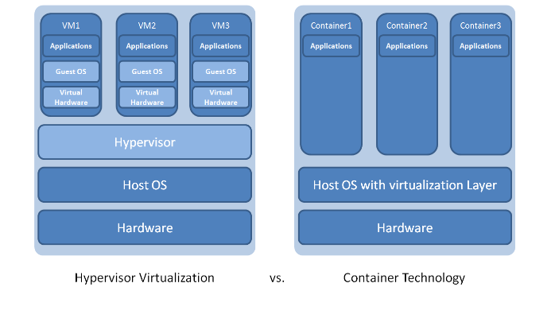
1.1 Containers?#!
What are containers?
Containers are a solution to the problem of how to get software to run reliably when moved from one computing environment to another. This could be from a developer's laptop to a test environment, from a staging environment into production and perhaps from a physical machine in a data center to a virtual machine in a private or public cloud.
Notes:
It's lightweight VM
The industry standard today is to use Virtual Machines (VMs) to run software applications. VMs run applications inside a guest Operating System, which runs on virtual hardware powered by the server’s host OS.
VMs are great at providing full process isolation for applications: there are very few ways a problem in the host operating system can affect the software running in the guest operating system, and vice-versa. But this isolation comes at great cost — the computational overhead spent virtualizing hardware for a guest OS to use is substantial.
Containers take a different approach: by leveraging the low-level mechanics of the host operating system, containers provide most of the isolation of virtual machines at a fraction of the computing power.
A full virtualized system gets its own set of resources allocated to it, and does minimal sharing. You get more isolation, but it is much heavier (requires more resources). With docker you get less isolation, but the containers are lightweight (require fewer resources). So you could easily run thousands of containers on a host, and it won't even blink. Try doing that with Xen, and unless you have a really big host, I don't think it is possible.

Slide 4
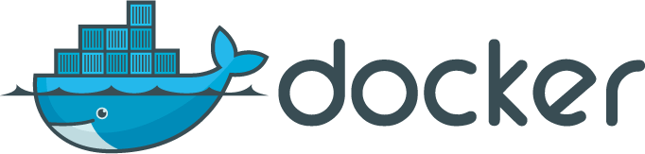
1.2 Docker
What is Docker?
Wikipedia defines Docker as:
an open-source project that automates the deployment of software applications inside containers by providing an additional layer of abstraction and automation of OS-level virtualization on Linux.
Developers use Docker to eliminate “works on my machine” problems when collaborating on code with co-workers.
Notes:
Docker is a tool that allows developers, sys-admins etc. to easily deploy their applications in a sandbox (called containers) to run on the host operating system i.e. Linux. The key benefit of Docker is that it allows users to package an application with all of its dependencies into a standardized unit for software development. Unlike virtual machines, containers do not have the high overhead and hence enable more efficient usage of the underlying system and resources.
Using containers, everything required to make a piece of software run is packaged into isolated containers. Unlike VMs, containers do not bundle a full operating system - only libraries and settings required to make the software work are needed. This makes for efficient, lightweight, self-contained systems that guarantees software will always run the same, regardless of where it’s deployed.
A full virtualized system gets its own set of resources allocated to it, and does minimal sharing. You get more isolation, but it is much heavier (requires more resources). With docker you get less isolation, but the containers are lightweight (require fewer resources). So you could easily run thousands of containers on a host, and it won't even blink. Try doing that with Xen, and unless you have a really big host, I don't think it is possible.

Slide 5
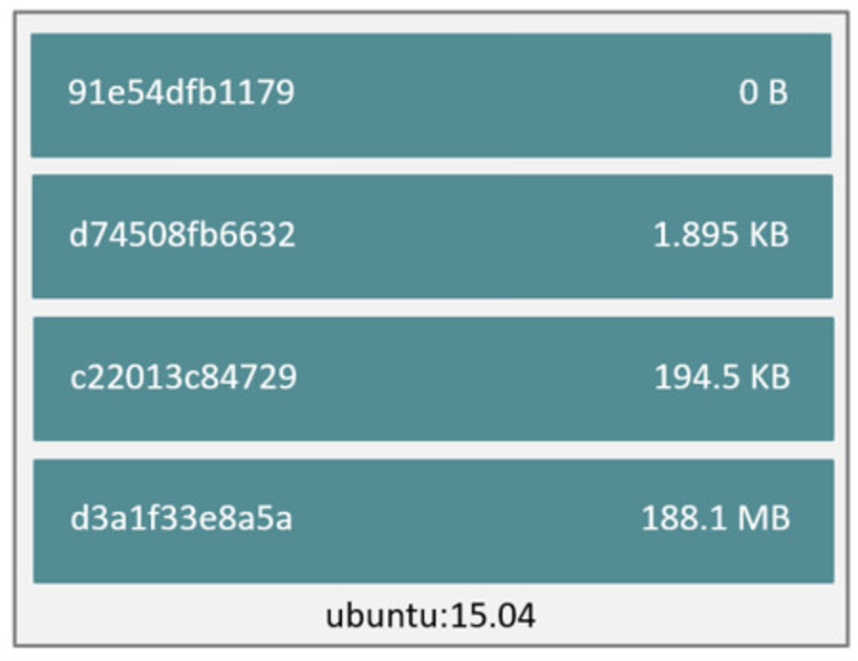
1.3 Docker
Images and layers
Notes:
Docker images are the basis of containers.It’s a filesystem. Each time you’ve used docker run you told it which image you wanted.
Each Docker image references a list of read-only layers that represent filesystem differences. Layers are stacked on top of each other to form a base for a container’s root filesystem. The diagram below shows the Ubuntu 15.04 image comprising 4 stacked image layers.

Slide 6
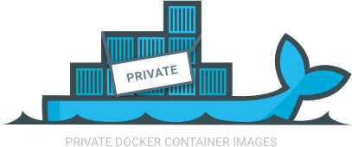
1.4 Docker
Registry
The Registry is a stateless, highly scalable server side application that stores and lets you distribute Docker images. The Registry is open-source, under the permissive Apache license.
You should use the Registry if you want to:
Tightly control where your images are being stored
Fully own your images distribution pipeline
Integrate image storage and distribution tightly into your in-house development workflow

Slide 7
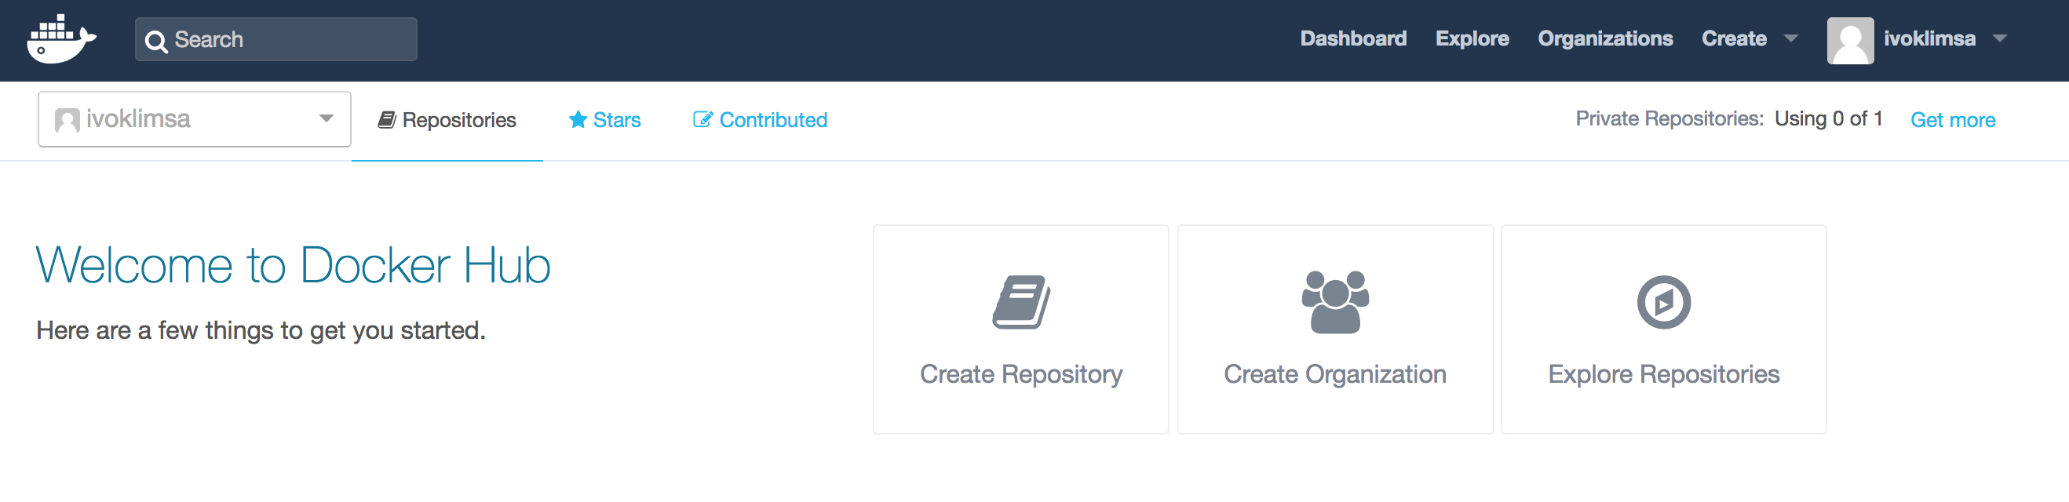
1.5 Docker
Docker hub
Notes:
Docker Hub is a cloud-based registry service which allows you to link to code repositories, build your images and test them, stores manually pushed images, and links to Docker Cloud so you can deploy images to your hosts. It provides a centralized resource for container image discovery, distribution and change management, user and team collaboration, and workflow automation throughout the development pipeline.

Slide 8
2.1 Docker run
last parameter is always command which you run in (is optional)
-i parameter: interactive mode
-d parameter: background mode
Example: docker run -i -t ubuntu:14.04 /bin/bash

Slide 9
2.2 Other commands
“docker images” – list images which you have in the system
“docker ps” – list running containers
“docker ps -a” – list all containers
“docker rmi <image name>” – remove the image
“docker rm <container name>” – remove container
“docker build –t <new image> .” – build new container
“docker exec <container name> <command>” – execute command inside running container
“docker start <container name>” – start existing container
“docker attach <container name>” – attach to existing session
“docker history <image name>” – list layers in the image
“docker login”, “docker push” – use when pushing to Docker hub

Slide 10
3.1 HELLO WORLD
Assignment:
From hello-world image create a container
Solution:
docker run hello-world

Slide 11
3.2 Instantiate container with UBUNTU
Assignment:
Create container with Ubuntu and launch a ‘bash’ process inside (interactively)
Exit from container
Hint: docker run --help

Slide 12
3.3 Instantiate container with UBUNTU - solution
Solution:
docker run –it ubuntu bash
exit

Slide 13
3.4 List all containers
Assignment:
List all existing containers (including non-active)
Find a name of the Ubuntu container
Hint: docker ps --help

Slide 14
3.5 List all containers - solution
Solution:
docker ps -a

Slide 15
3.6 Start existing stopped container
Assignment:
Start the Ubuntu container again
Hint: docker start --help

Slide 16
3.7 Start existing stopped container - solution
Solution:
docker start <container name>

Slide 17
3.8 Attach to the running container
Assignment:
Attach to the ‘bash’ process running in the container
Detach out the container
Hint: docker attach --help

Slide 18
3.9 Attach to the running container - solution
Solution:
Docker attach <container name>
Ctrl+P+Q

Slide 19
3.10 Interactive execution
Assignment:
Execute (interactively) ‘bash’ in a running container
Check if the process is running
Stop the ‘bash’ process in container and exit
Hint: docker exec --help

Slide 20
3.11 Interactive execution - solution
Solution:
docker exec -it <container name> bash
ps -ef
exit

Slide 21
3.12 Backgroud execution
Assignment:
Execute on background command “sleep 30” in container
Check if the process is running
Check if the process stopped after 30 seconds
Hint: docker exec --help

Slide 22
3.13 Interactive execution - solution
Solution:
docker exec -d <container name> sleep 30
docker exec -it <container name> bash
ps -ef
exit

Slide 23
3.14 List all local images
Assignment:
List all docker images on the local docker host
Hint: docker --help

Slide 24
3.15 List all local images - solution
Solution:
docker images

Slide 25
3.16 Create your own dockerfile
Assignment:
Create your dockerfile which:
Takes “ubuntu” as a baseimage
Update apt-get package database
Use apt-get to install “vim” editor
Hint: Google is your friend – try to find “dockerfile from” and “dockerfile run”

Slide 26
3.17 Create your own dockerfile - solution
Solution:
Good
FROM docker.io/ubuntu
RUN apt-get update
RUN apt-get install -y vim
Better
FROM docker.io/ubuntu
RUN apt-get update; apt-get install -y vim

Slide 27
3.18 Build your own docker image
Assignment:
Build new docker image by using your dockerfile
Check layer history for the new docker image
Hint: docker build --help, docker history --help

Slide 28
3.19 Build your own docker image - solution
Solution:
docker build –t vim-image –f <your dockerfile> .
docker history vim-image

Slide 29
3.20 Create apache server
Assignment:
Create a container with running Apache server (listens on port 80)
Map container’s port 80 on host’s port 80
Attach and show webpage hosted on the Apache server on your web browser
Hint: Set container to run on background
Hint: docker search --help, docker run –help, dockerfile

Slide 30
3.21 Create apache server - solution
Solution:
Dockerfile
FROM httpd:2.4
COPY ./public-html/ /usr/local/apache2/htdocs/
Build
docker build –t myweb –f dockerfile .
Run
docker run -d -p 80:80 myweb

Slide 31
3.22 Create DockerHub account and push there your image
Assignment:
Create your own account on hub.docker.com
Set the account as a docker registry for your local docker
Push your docker image to the docker registry
Hint: docker build --help, docker login --help, docker push –help
Hint: address for docker connection to hub.docker: https://index.docker.io/v1/

Slide 32
3.23 Create DockerHub account and push there your image
Solution:
Create your account on hub.docker.com
Perform these steps:
docker build -t <your login>/<your project name> -f <your docker file> .
docker login https://index.docker.io/v1/
docker push <your login name>/<your project name>

Slide 33
3.24 Clean up your environment
Assignment:
Delete all containers
Delete all images
Hint: docker rm --help, docker rmi --help

Slide 34
3.25 Clean up your environment - solution
Solution:
docker ps –a
docker rm –f <container id>
docker images
docker rmi <image id>

