Slide 1

Comfort Home Project
2nd Semester project

Slide 2
DEMO
Nr. | Presenter | Topic
1 | Ahmad | Introduction
2 | Stefan | Teamwork and organisation
3 | Ivaylo | System context
4 | Valentin | Technicalities
5 | Ahmad | Conclusion
6 | Valentin & Ivaylo | Demo
_______________________________________________________________________________________________

Slide 3
Problem
- Lavishly insulated
house with poor
ventilation
- Unnoticed high values
of dangerous gases
Solution
- Automated
indoor climate
control system
_______________________________________________________________________________________________

Slide 4
System requirements
Autonomous
Highly compatible
Customer friendly
Secure
_______________________________________________________________________________________________

Slide 5
Way of working
- Internal/external deadlines
- Group meetings
- Feedback teacher
- Meeting customer
_______________________________________________________________________________________________

Slide 6
Teamwork challenges
Unexpected new way of working
Working long distance
Teammate leaving
_______________________________________________________________________________________________

Slide 7
Configuration management
GIT
Feedback group members
_______________________________________________________________________________________________

Slide 8
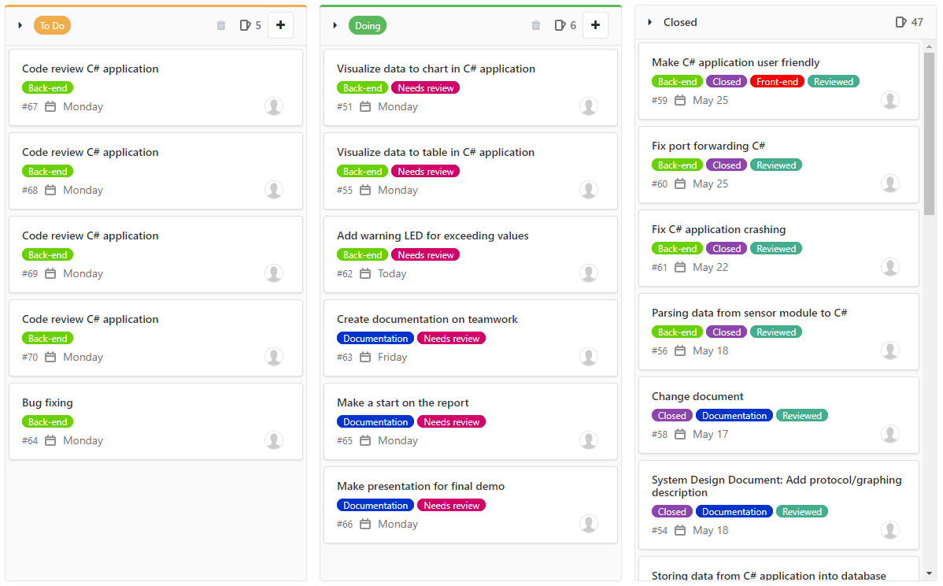

Slide 9

Technical challenge
Undelivered hardware
Hardware issues
Code bugs
_______________________________________________________________________________________________

Slide 10
System context
- Sensors gather data
- Module sends data
- Multiple background processes
- Storing data
- Visualizing data
_______________________________________________________________________________________________

Slide 11
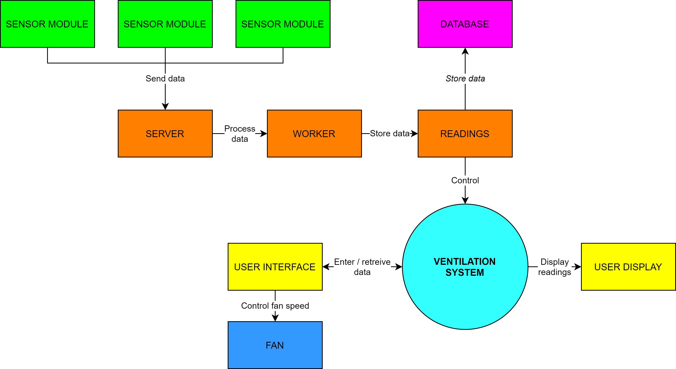
_______________________________________________________________________________________________

Slide 12
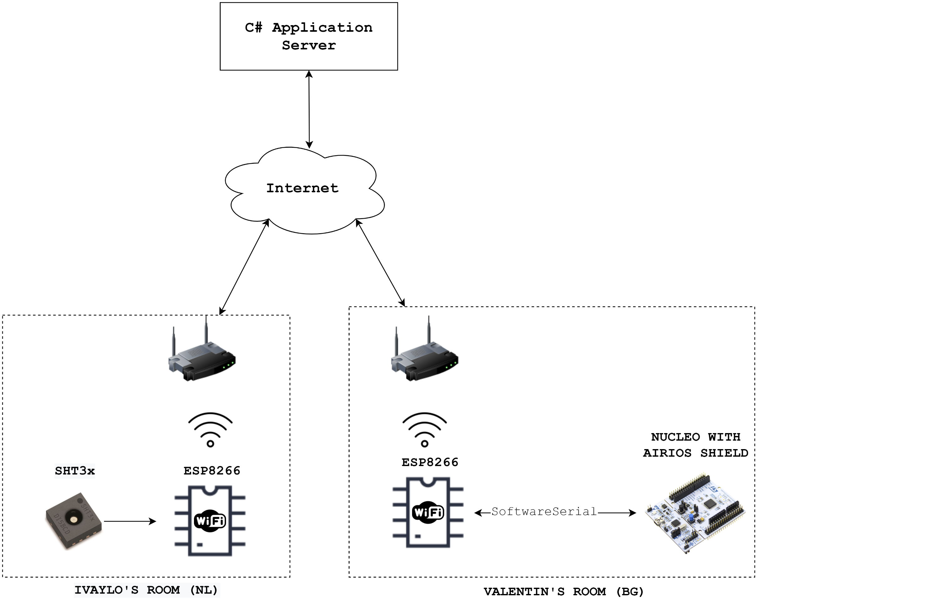
Demo Setup
_______________________________________________________________________________________________

Slide 13
Conclusion
Challenging project
Excellent learning experience
Dealing with complicated situations
_______________________________________________________________________________________________

