Slide 1

FIRST AIRBENDERS FINAL PRESENTATION

Slide 2
Problem
lavishly insulated house with poor ventilation
Solution
automated indoor climate control system

Slide 3
System requirements
Autonomous
Swift
Highly compatible
Customer friendly
Secure

Slide 4
Way of working
Internal/external deadlines
Group meetings
Communication messenger
Feedback teacher
Meeting customer

Slide 5
Configuration management
Git
Feedback group members
Branches

Slide 6
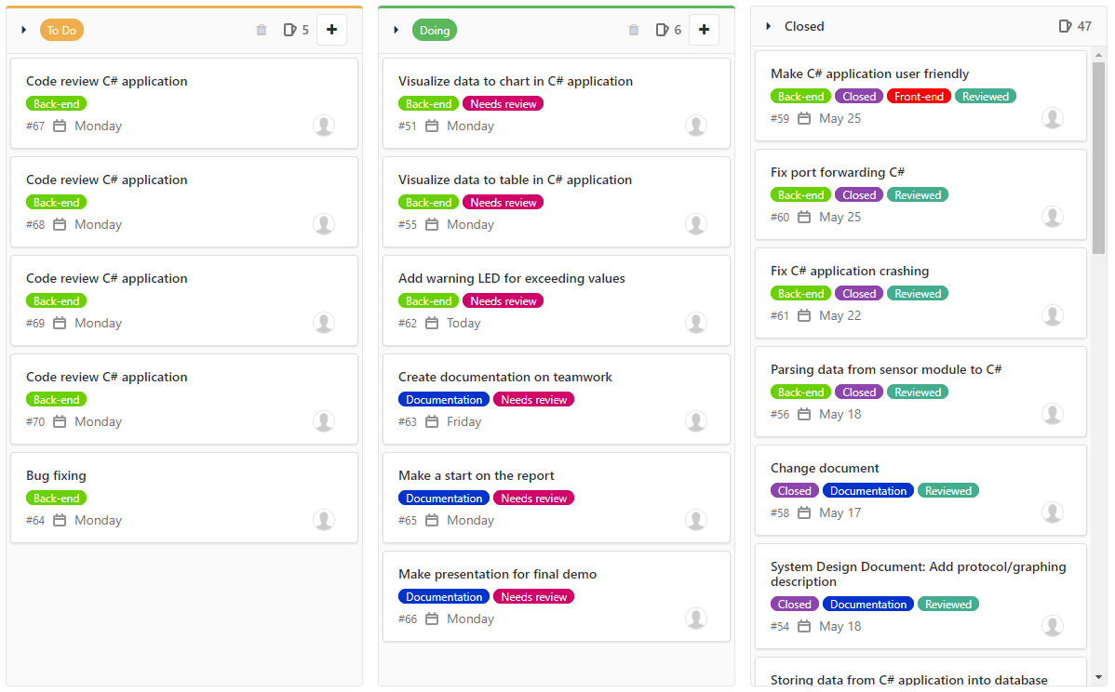

Slide 7
System context
Sensors gather data
Module sends data
Multiple background processes
Storing data
Visualizing data

Slide 8
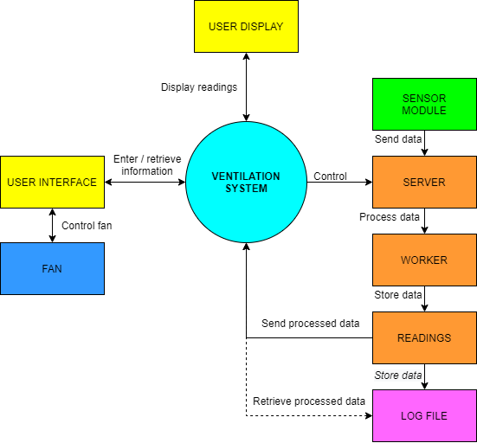

Slide 9
Technical challenges
Undelivered hardware
Hardware issues
Code bugs

Slide 10
Teamwork challenges
Unexpected new way of working
Working long distance
Teammate leaving

Slide 11
Conclusion
Challenging project
Excellent learning experience
Dealing with complicated situations

