Slide 1

FIRST AIRBENDERS SPRINT DEMO

Slide 2
Problem
lavishly insulated house with poor ventilation
Solution
automated indoor climate control system

Slide 3
System requirements
Autonomous
Swift
Highly compatible
Customer friendly
Secure

Slide 4
Way of working
Internal/external deadlines
Group meetings
Communication messenger
Feedback teacher
Meeting customer

Slide 5
Configuration management
Git
Feedback group members
Branches

Slide 6
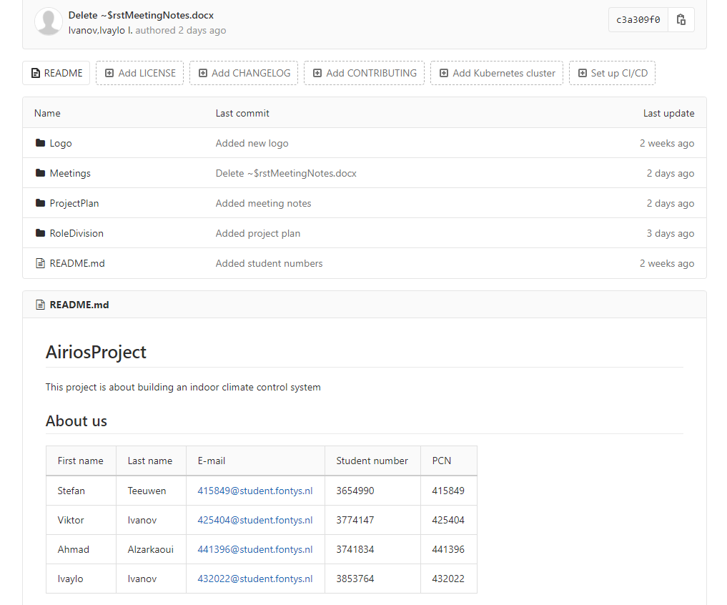

Slide 7
