Slide 1
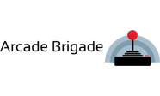
Industry Project
3^{d} Semester project
________________________________________________________________________

Slide 2
Game Console
Multiple games
Multiple players
________________________________________________________________________

Slide 3
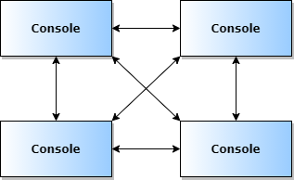
Modular Design
Communication via I2C
Console can be attached/detached to other console(s)
- Games can be added or removed
________________________________________________________________________

Slide 4
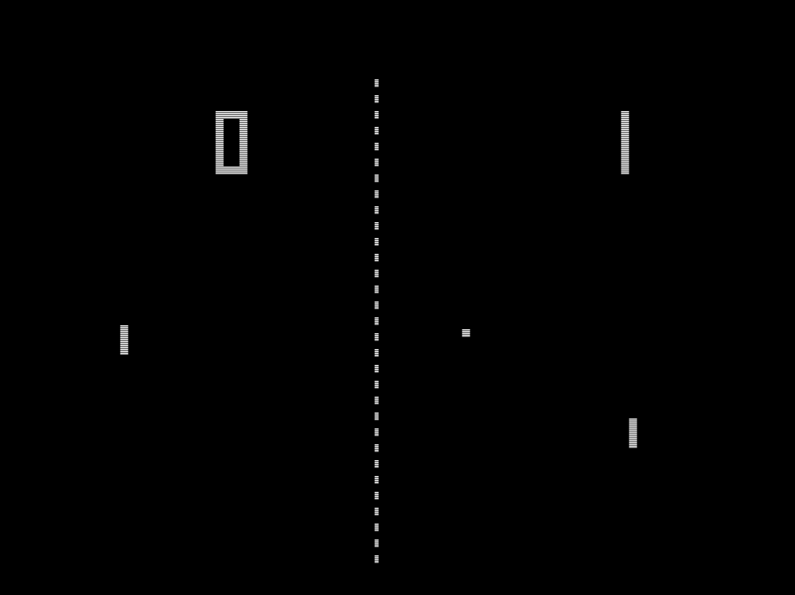
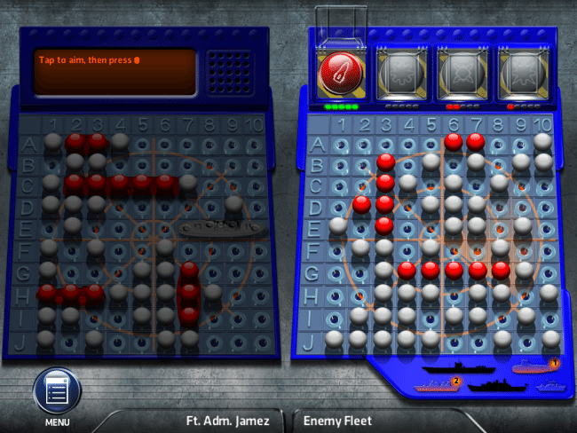
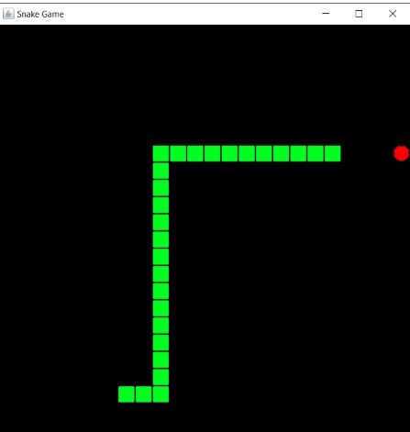
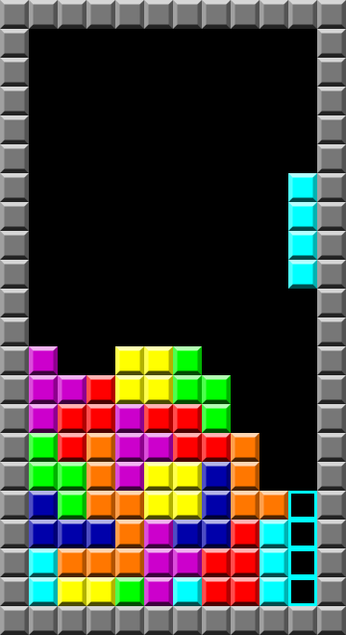
Game Ideas
Pong
Battleships
Snake
Tetris
________________________________________________________________________

Slide 5
Necessary hardware
Gyro sensor
Accelerometer
Button
Arduino
Joystick
LCD screen
________________________________________________________________________

Slide 6
Questions & feedback
________________________________________________________________________

Slide 7
Thanks for your attention!
________________________________________________________________________

