Slide 1

Connected game consoles
Team Arcade Brigade

Slide 2

Concept
Consoles, equipped with screen and joystick
Wirelessly connected
Playing games between friends

Slide 3


Games
Pong
Mafia (werewolf)

Slide 4

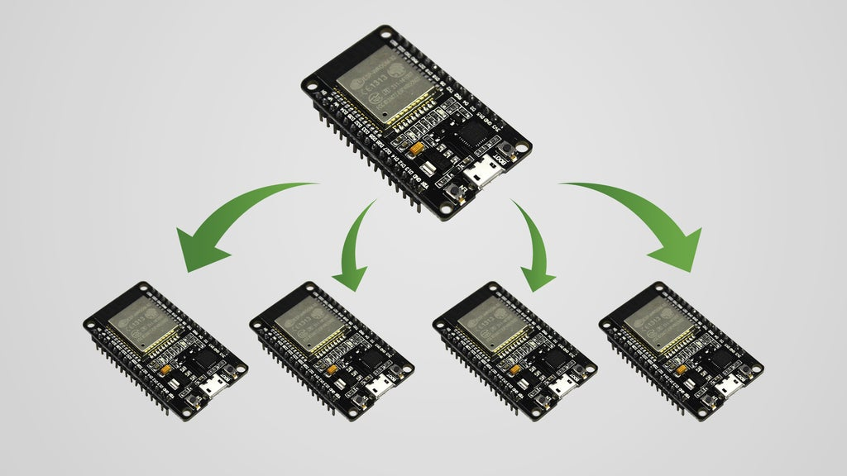
Features
Automatic connection
Disconnection handling
Wide range
Low battery usage

Slide 5
DEMO

Slide 6
Questions?

Slide 7
Thank you!

