Slide 1
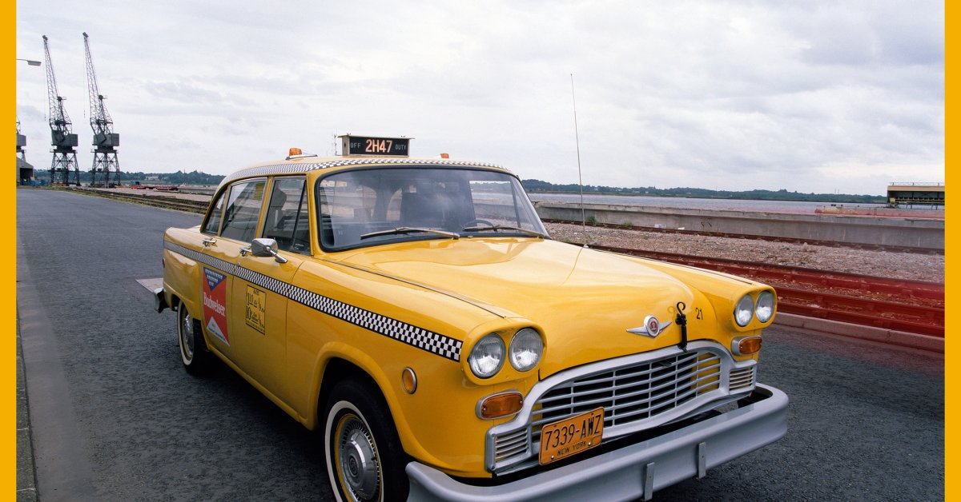
NY Taxi Guide
Presented By: Kubam Ivo

Slide 2
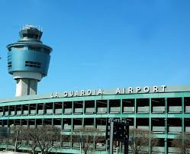
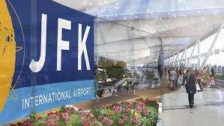
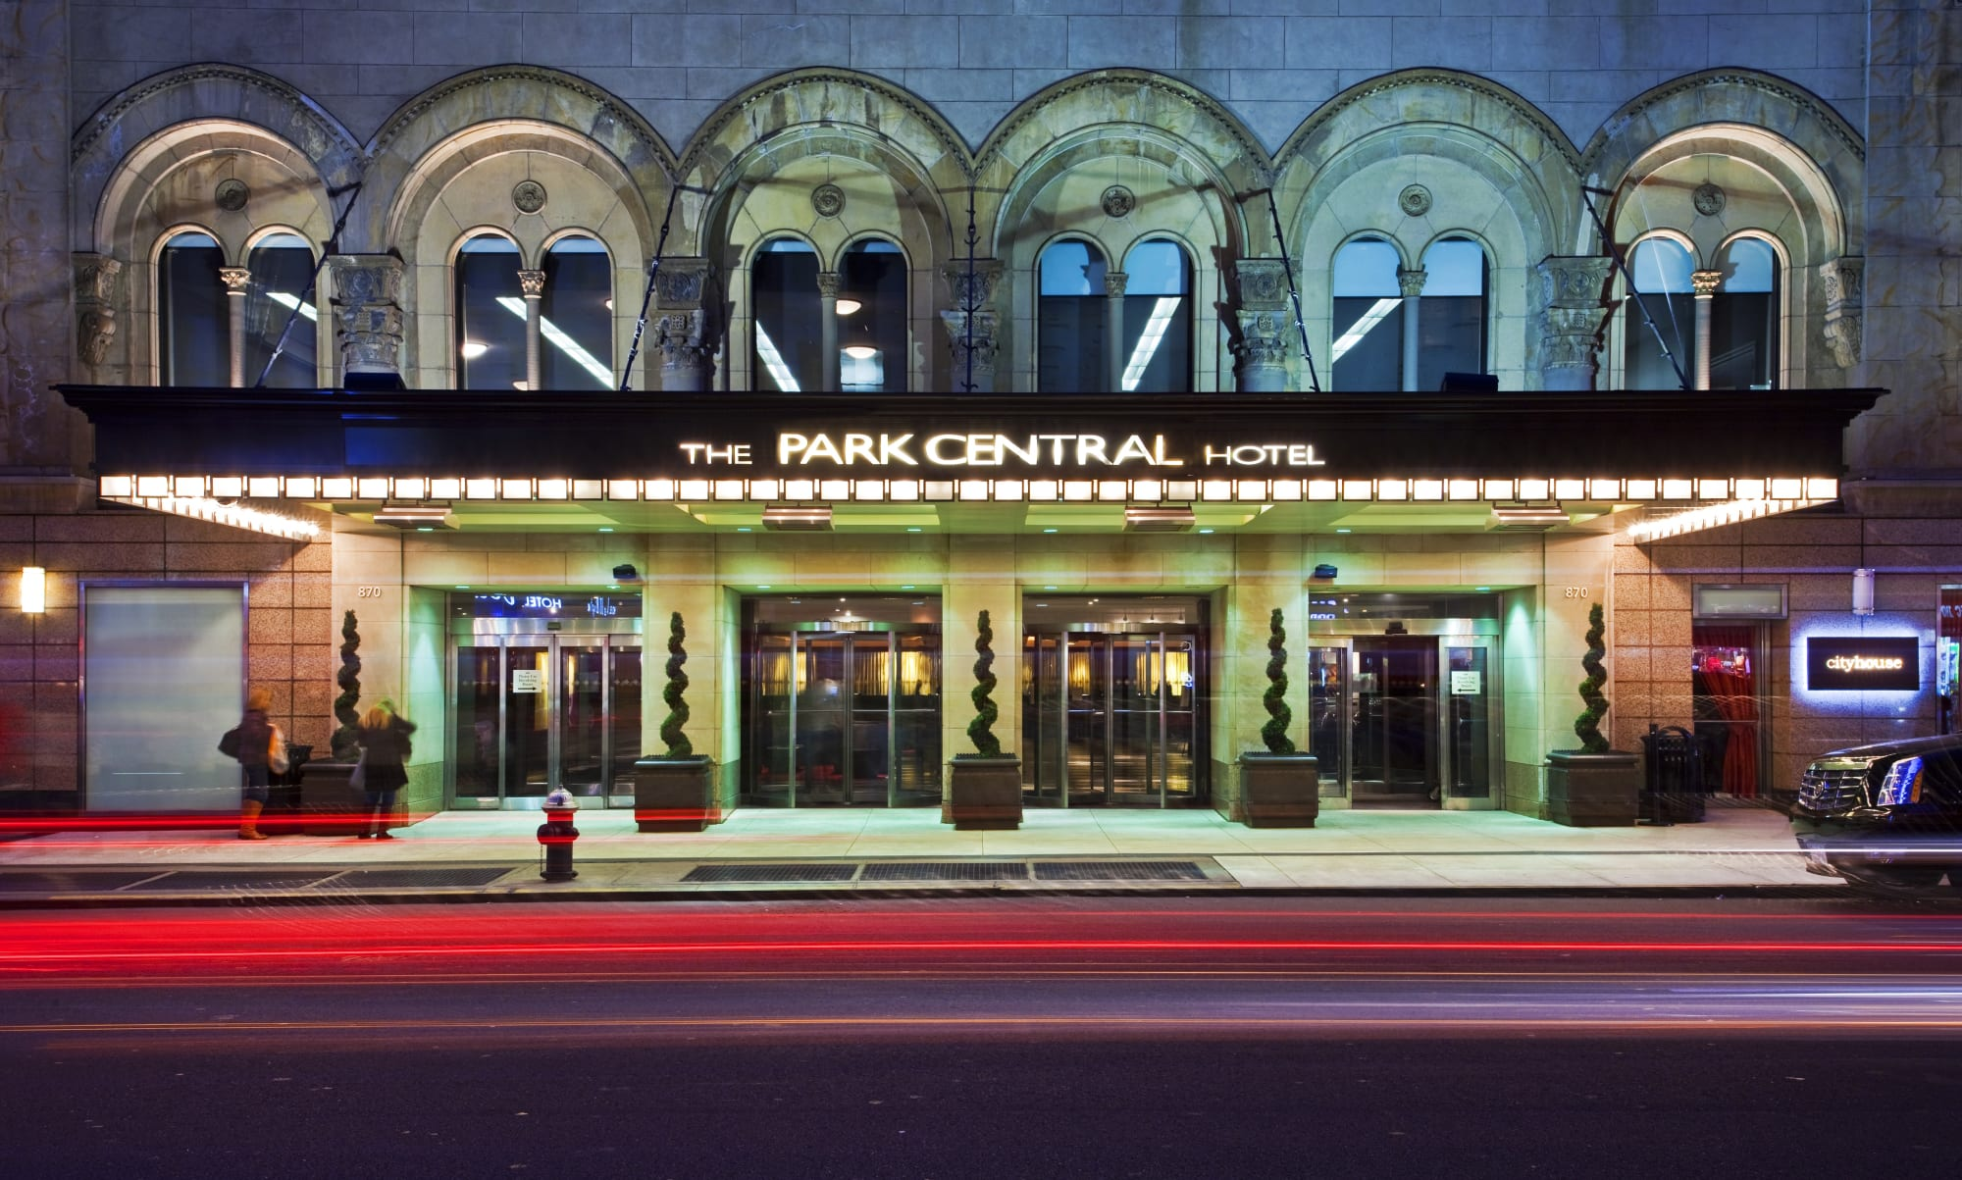
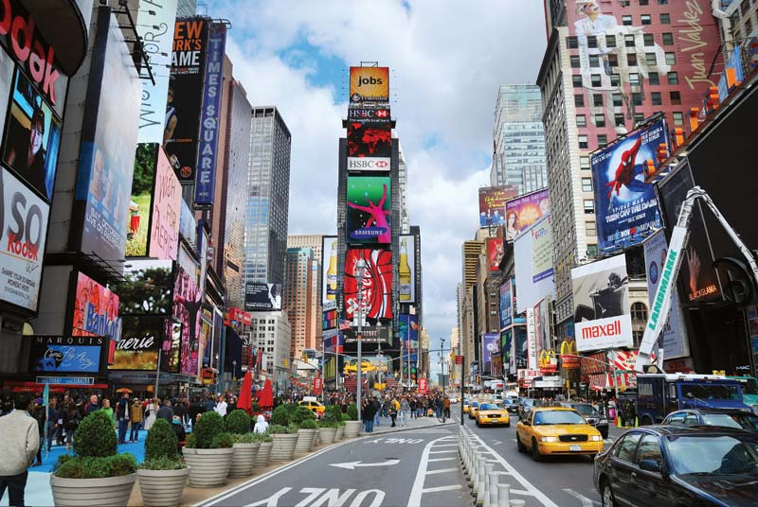
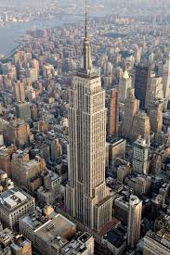
New York City, USA
LaGuadia Airport
JFK Airport
Central Park Hotel, Manhattan
Time Square, Manhattan
Empire State Building, Manhattan
Open: Always
Close: Never
Open: 12pm
Close: 9pm

Slide 3

Questions
JFK Airport or LaGuardia Airport?
Yellow or Green Taxi?
Expected trip amount and time duration to sites?
Best time slots to sites?

Slide 4
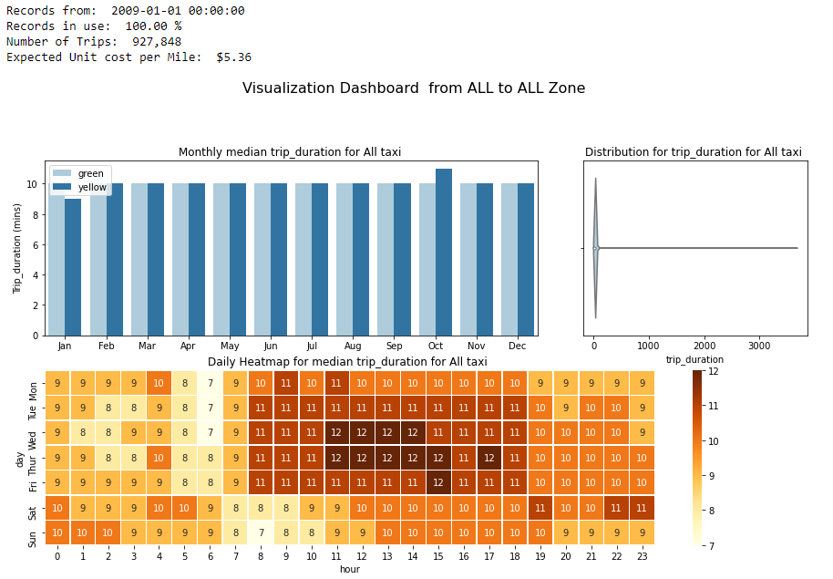

Slide 5

Conclusions
From LaGuardia airport, yellow taxi will take 20-25mins and will cost $(30-40 ) as oppose to 35-40mins for $(50-60) from JFK airport
Time square is always open so avoid rush hours of the day (7 to 7pm). After 8pm is a good time slot as it will cost $(8 to 10) for a trip with the yellow taxi that will last 7 to 10mins
Opening time for Empire state building is 12pm. A visit on Monday(10-12mins for 8-10$) or weekends (7-9mins for 7-9$) is best.

Slide 6
Thank You
Details:
New York Taxi Visualization Project
Kubam Ivo/GitHub
Kubam Ivo/ LinkedIn
ivombi97@gmail.com
ivombi@outlook.com

