Slide 1
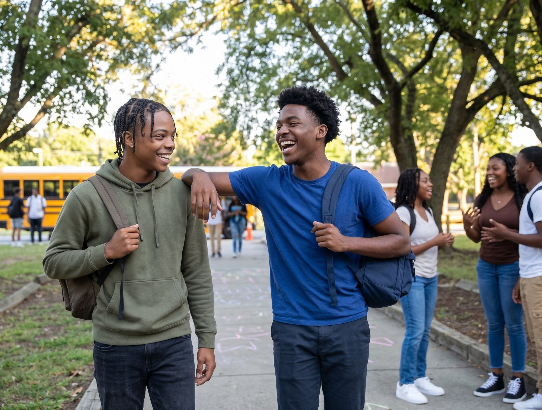

RVA Builds
RICHMOND ED FUND INITIATIVE
MEDIA
KIT

Slide 2
01
What is
RVA Builds?
150
500
17
120+
RPS grads aimed at registered
apprenticeships in 3 years
Students in paid trades
learning by 2028–29 (goal)
Partners: schools, the city,
business & unions
Paid work-based learning
hours per student
RVA Builds connects Richmond Public Schools students with paid, hands-on careers in construction and the skilled trades — before they even graduate. A Richmond Ed Fund initiative, backed by Bloomberg Philanthropies.
Build a career in the trades, before you graduate.

Slide 3
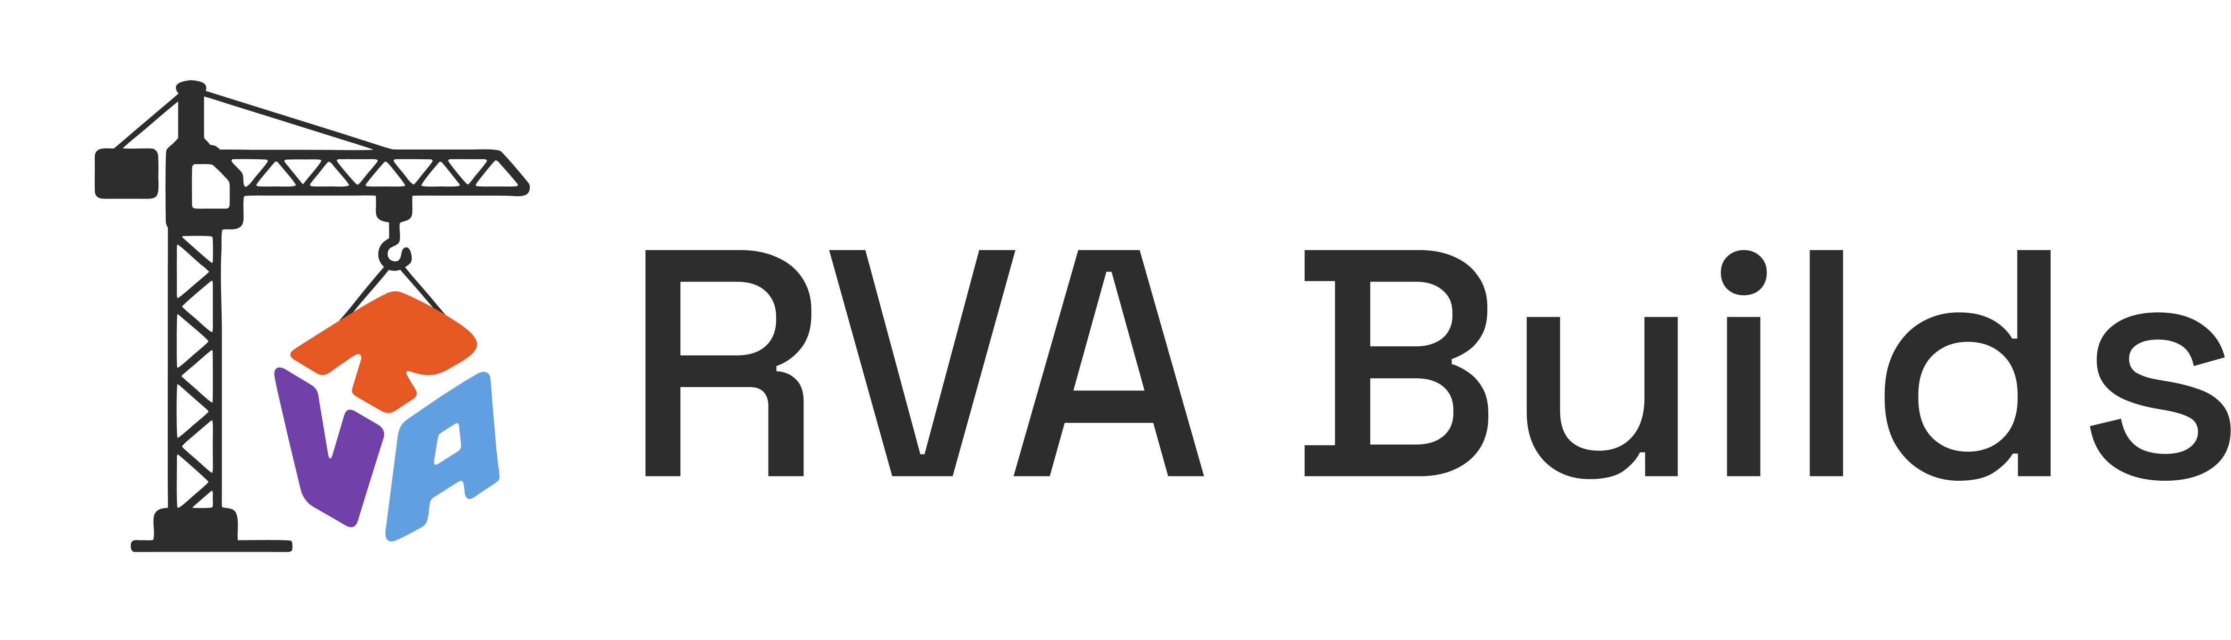
02
Primary Logo
Reproduction
The primary logo is full color on a white background. Use this version wherever possible.

Slide 4


02
Logo
Variations
The logo can also be used on a contextually colored background, as long as there's contrast.

Slide 5
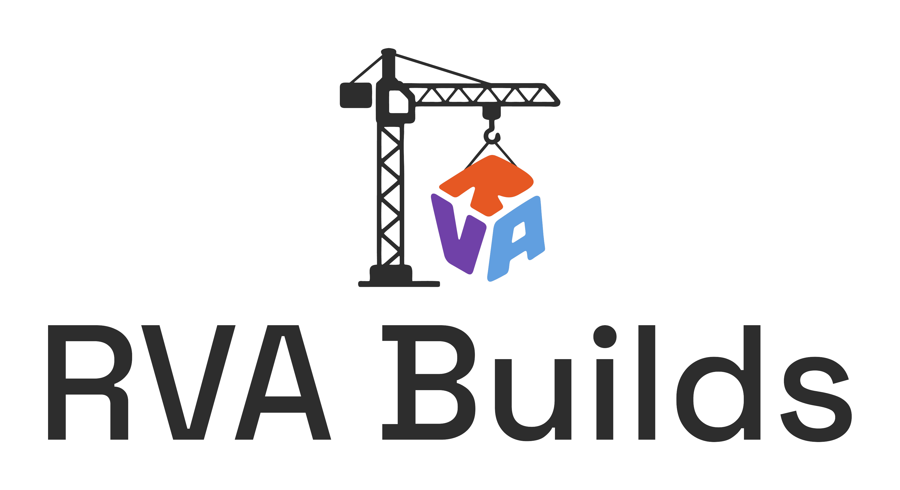

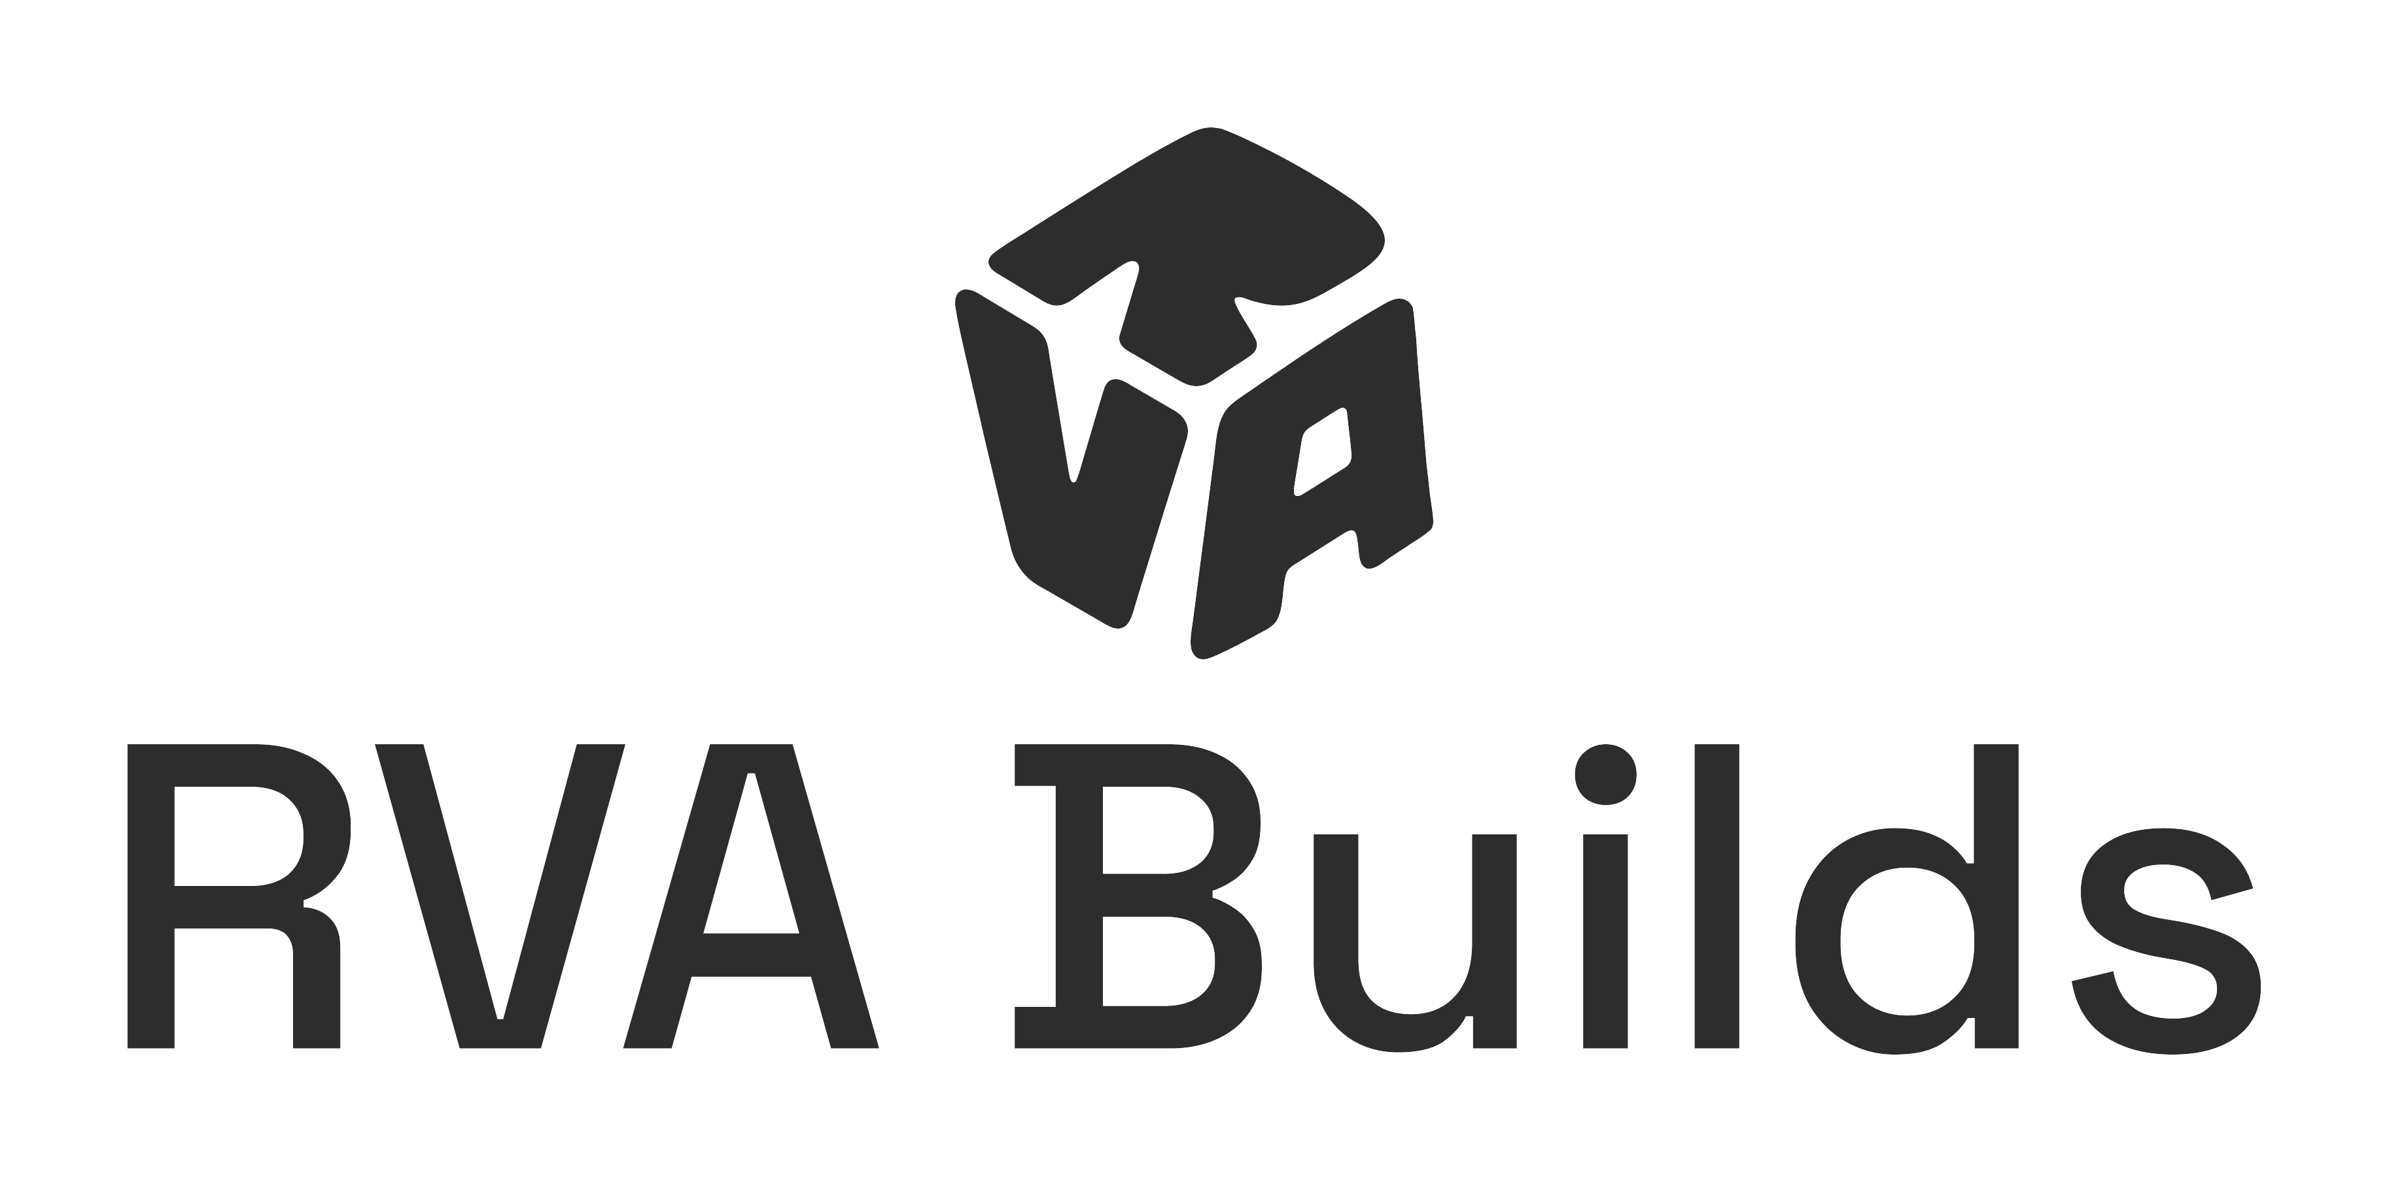
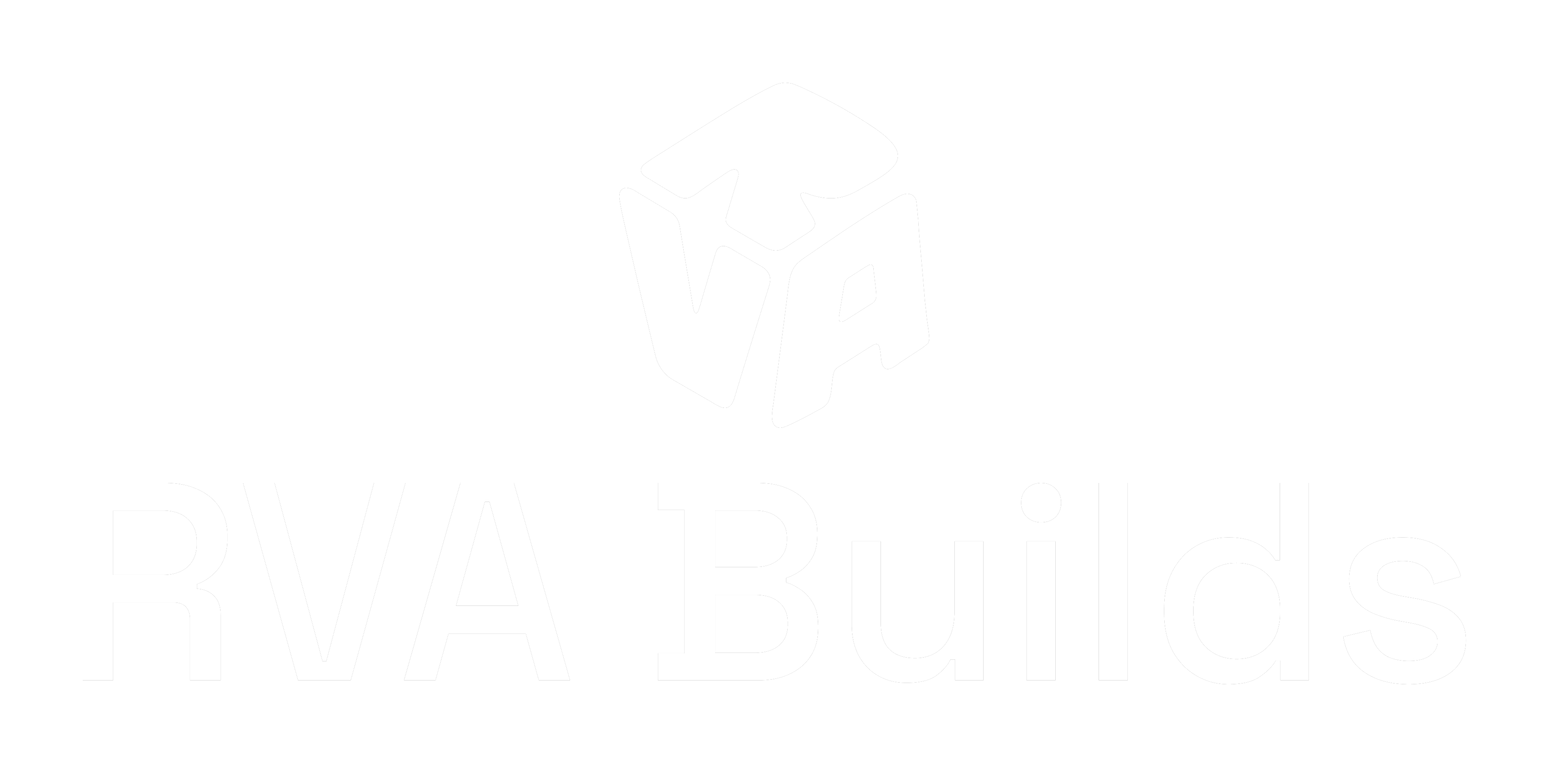
02
Stacked
Lockup
For square or vertical placements — social avatars, signage, mobile headers.

Slide 6
02
Do
Don't
Usage
Rules
✓ Keep clear space equal to the height of the cube icon.
✓ Use full color on white or photography with a dark overlay.
✓ Use the white mono mark on coral, purple, blue, or busy photos.
✓ Scale proportionally — never stretch.
✕ Don't recolor the cube or crane outside the brand palette.
✕ Don't place the full-color mark on low-contrast backgrounds.
✕ Don't add shadows, outlines, or effects to the mark.
✕ Don't rotate, skew, or crowd the logo.
No image or background should ever compete with the mark's clarity, and it must always appear in an approved color combination.

Slide 7
#F15C2C
R: 241
G: 92
B: 44
03
Coral — primary / action
Main
Colors
#329FE6
R: 50
G: 159
B: 230
These colors represent the identity of RVA Builds — meant to build trust between candidates and employers.
Blue — employer path
#7A35AE
R: 122
G: 53
B: 174
Purple — candidate path

Slide 8
#1A1A1A
Ink — body text
03
Secondary
Colors
#F6F6F6
Surface Soft — alt sections
These create contrast against the main palette and should be used sparingly, for text, surfaces, and system states.
#1F8A4C
Success
#C0392B
Danger

Slide 9
Space Grotesk
Aa
Aa
Aa
04
Typography
Medium
SemiBold
Bold
Schibsted Grotesk
Two contrasting typefaces: Space Grotesk for headlines, Schibsted Grotesk for body. Weights can vary, as long as the text stays legible.
Aa
Aa
Regular
Bold

Slide 10
Hopeful
“A choice-filled life is the standard.”
05
Trustworthy
“500 students, 17 partners, by 2028–29.”
Tone &
Voice
Civic
“Right here in Richmond, Virginia.”
Warm
“A student earning a paycheck and a future.”
Hopeful, trustworthy, civic, warm, data-informed, editorial.
Data-informed
“$23/hour minimum after graduation.”
Editorial
Full sentences, active voice, real quotes.

Slide 11
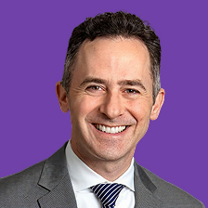
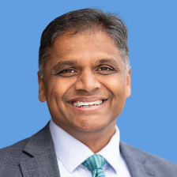
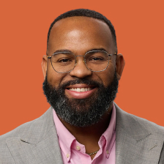
Our students deserve to graduate with real options. A choice-filled life is not a slogan; it's a standard we hold ourselves to.
Jason Kamras — Superintendent, Richmond Public Schools
06
Voices &
Leadership
By building direct pipelines from the classroom to local employers, we ensure young people have a clear path to stable careers.
Danny Avula — Mayor of Richmond
Approved leadership quotes, paired with headshots for editorial and press use.
Too many of our students leave high school without a real path to a career that can support a family. RVA Builds changes that.
Taikein Cooper — CEO, Richmond Ed Fund

Slide 12
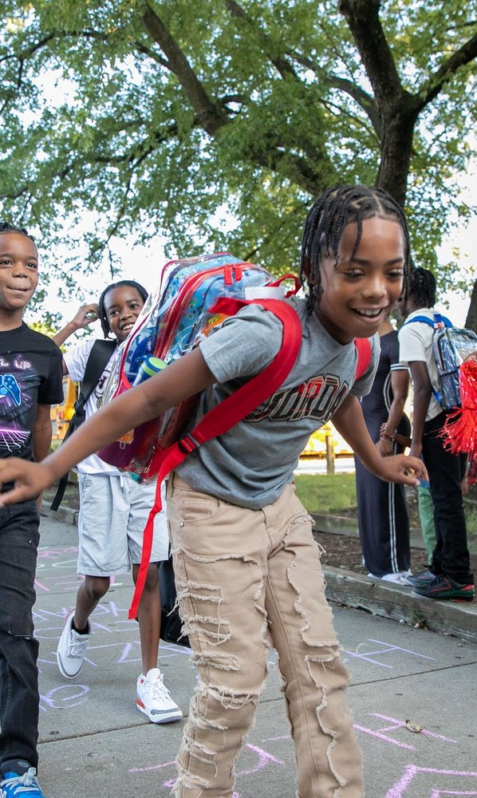
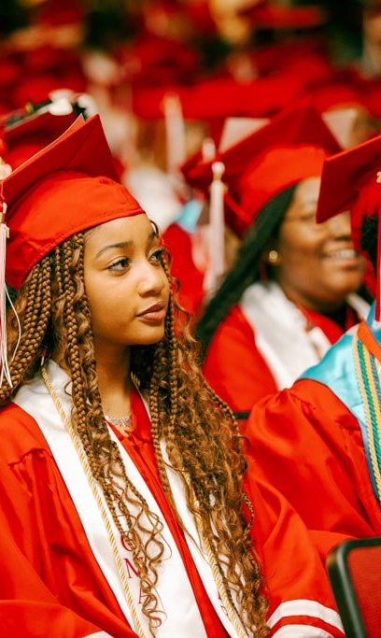
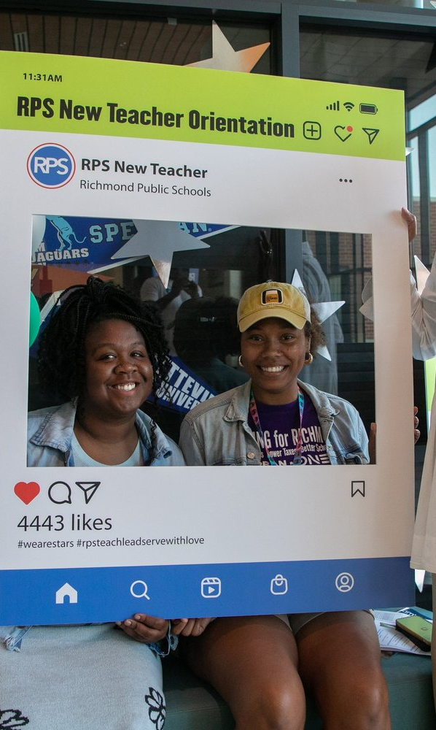
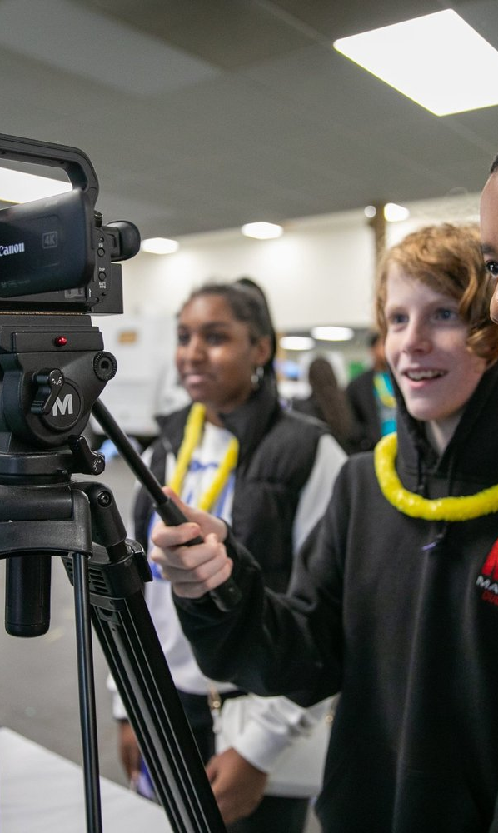
07
Photography
Every photo used in RVA Builds materials should show real working people, with genuine range in age, background, and trade.
Stock imagery and illustration should not be used.

