Slide 1
What I learned after I knew everything
How to provide value to your team when it’s 8, 32, 128 or 512 people
Igor von Nyssen
Director of Technology, Amazon
The views expressed in this talk and presentation are my own and do not necessarily represent the view of the company I work at.
Notes:
20 minutes talk, 20 minutes Q&A. ~0:30 here.

Slide 2
1998
The worst manager on the planet to not get fired.
Notes:
~1:30. Open with the story, not the bio. I was made a manager in my second week at my first real job. To this day I am sorry for the people who had to report to me. I was the worst manager on the planet to not get fired.
Since 2013 at Amazon: 8 SDEs launching the first IoT device in 2014, 30 people launching shelf technology for the first Just-Walk-Out store, today 4000 on grocery supply chain. Each size needed a different leader. The one thing that never changed: my job is to figure out how I provide the best value for my team.

Slide 3

About Me
1998 Startups
2003 Sony PlayStation
2013 Amazon
Notes:
~0:30. Today: Supply Chain for Amazon Grocery, operations and tech. One line, move on.

Slide 4
8, 32, 128, 512
Why these numbers
Notes:
~0:20. Set the stage: these are not round numbers, they are the points where the math forces a new layer. The next slides show why.

Slide 5
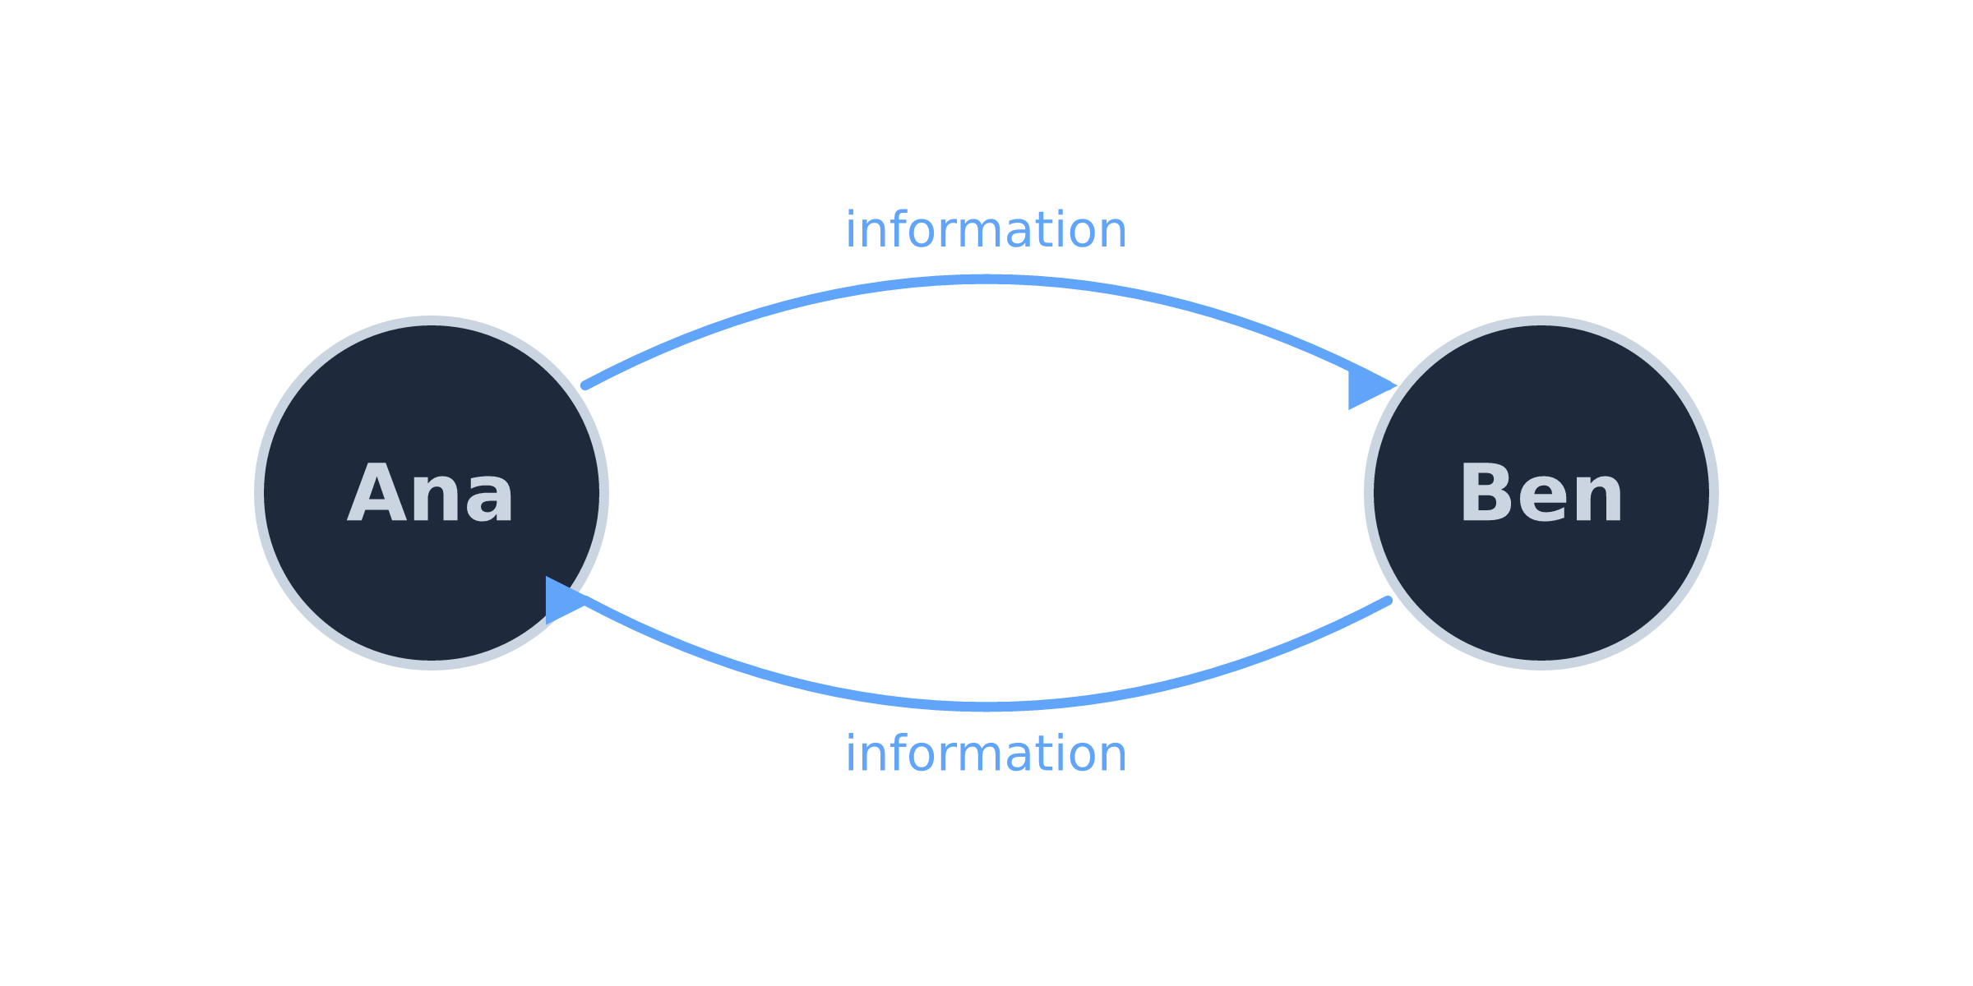
Notes:
~1:00 for this and the next slide. Two people, two directions of information flow. Everything is a conversation.

Slide 6
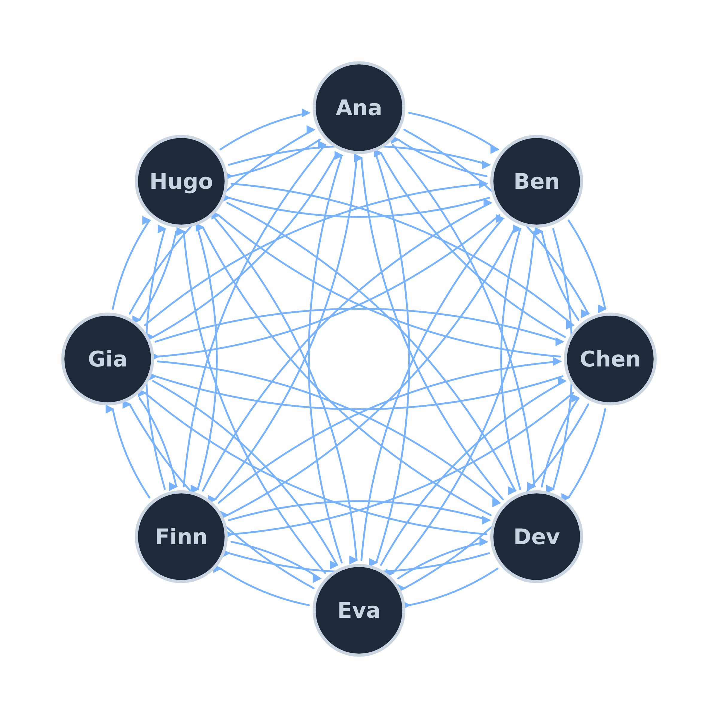
Notes:
8 people, 56 directed exchanges. Still works because everyone is in the room.

Slide 7
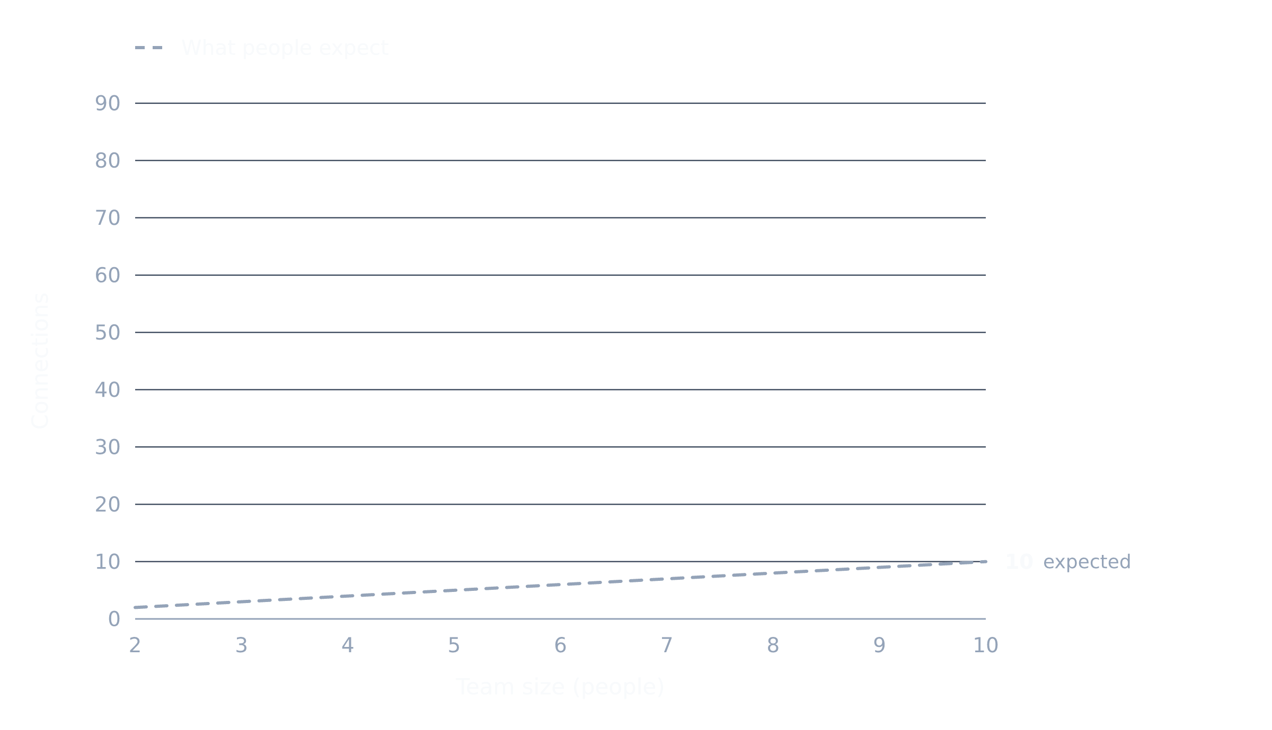
Notes:
~1:30 over three clicks. Click 1: what people expect, linear.

Slide 8
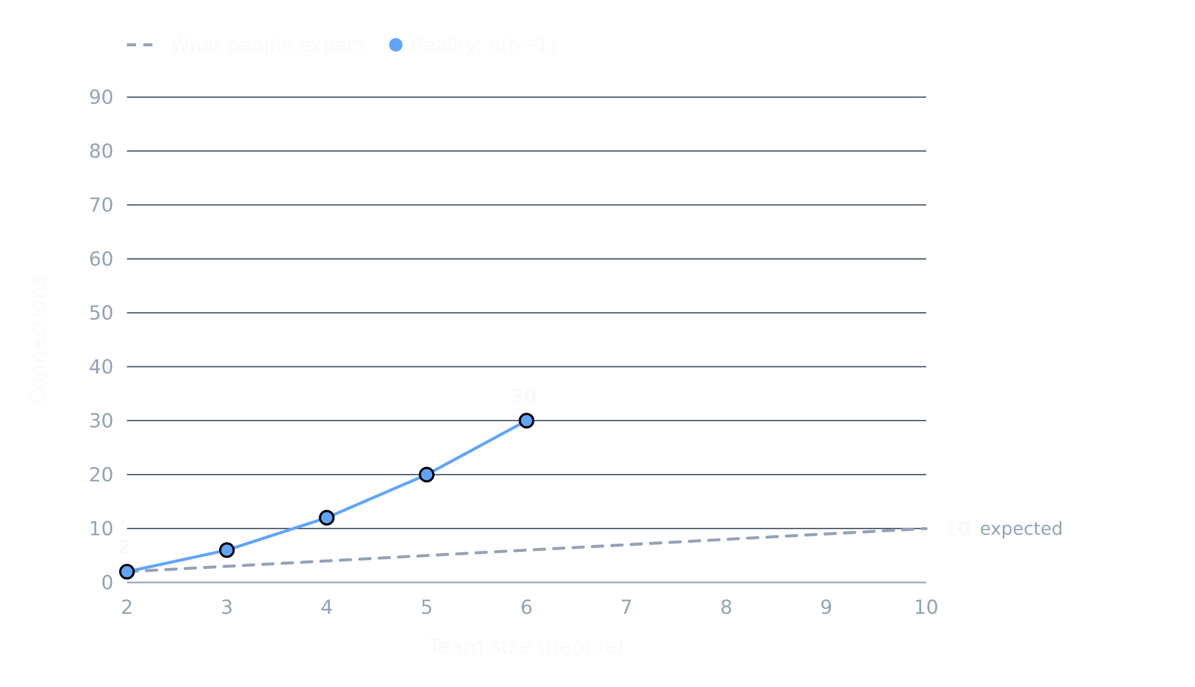
Notes:
Click 2: reality up to 6.

Slide 9
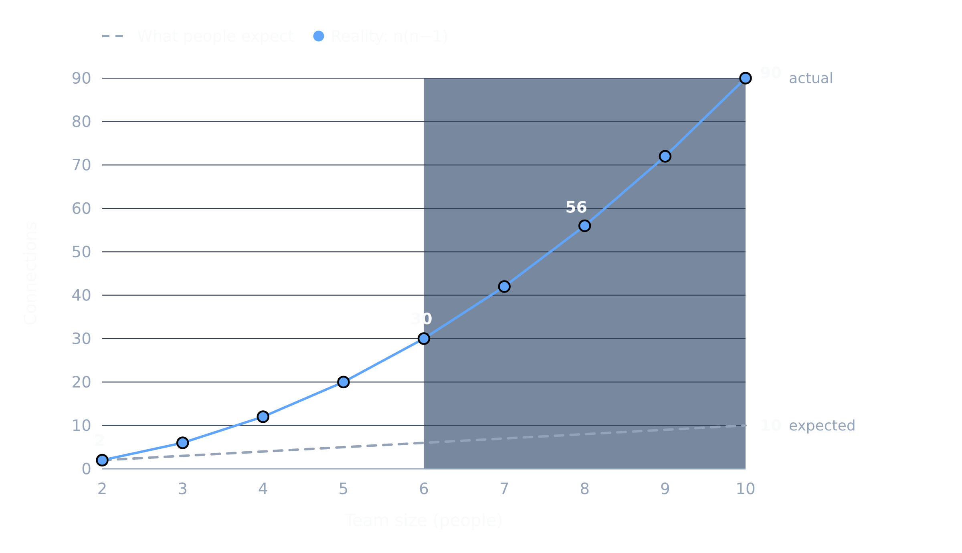
Notes:
Click 3: 6 to 10, where it stops being a team. The layering is forced on you by the math, not a choice.

Slide 10
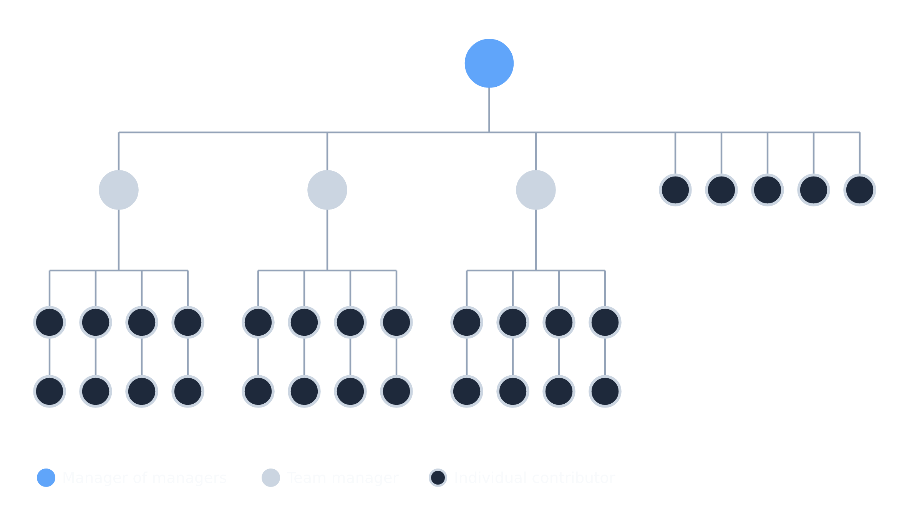
Notes:
~0:30. 8, 32, 128, 512: each number is where a new layer appears, and each layer changes your job.

Slide 11
What Happens at Each Layer
Notes:
~0:10. Transition from the math to the job. Four layers, four different jobs, one figure that loses a little more freedom each time.

Slide 12

Small Team (8)
Your job is to say no.
Notes:
~2:30. Say no, for the most part.
- You know everyone: who needs help, who is your best person.
- Your value is judgment, not visibility. Full information means your value is deciding, not gathering.
- Signal when you need help. Build the habit now, it cannot be added later.
- Pick the right process and expect it to change under pressure. Process efficiency, what comes next, think outside the box.
Figure: unimpeded, start of the four-step series.

Slide 13

Manager of Managers (32)
You are deaf and blind.
Your job is to find a way to say yes.
Notes:
~1:00. The biggest cognitive shift in the whole progression. To keep delivery on track you need a mechanism. Sets up the next slide.
Figure: adds blindfold and earmuffs.

Slide 14

The Weekly Review
Last updated
Status: last / today
Risk & Owner
Notes:
~1:30. The most concrete, reusable thing in the talk.
- Critical projects only.
- The columns are deliberately boring; the discipline is in the comparison between last status and today’s status.
- Brevity: issues hide behind words.
- Risks and owners, or it’s all watermelons. A project that has been green for weeks with no risks listed is the watermelon: green outside, red inside.
- This is uncomfortable for you and for your teams.

Slide 15

You Are Doomed (128)
You can steer 12 times a year.
“As of mm/dd we are COLOR, because …”
Make your organization self-sufficient.
Notes:
~2:00. Cadence is the point. You can steer 12 times a year, but your teams can be way more agile.
- Perhaps one super-important project you still stay close to.
- Formal goal review is your best tool: why is this important, how is this measured, as of date we are COLOR because.
- What does winning look like?
- Teaching is now part of your job description. Your only way to scale is to build your directs.
- Your organization is better for your presence, but does not require it to function.
Figure: adds the straitjacket.

Slide 16
Bullshit Software
“A bullshit job is a form of paid employment that is so completely pointless, unnecessary, or pernicious that even the employee cannot justify its existence even though, as part of the conditions of employment, the employee feels obliged to pretend that this is not the case.”
David Graeber, Bullshit Jobs
Notes:
~1:30 over two clicks. Quote alone, big type. Let them read it.

Slide 17
Bullshit Software
“A bullshit service is a piece of software so completely pointless, unnecessary, or pernicious that even the team running it cannot justify its existence, yet feels obliged to keep it alive and pretend otherwise.”
Notes:
Second click: the adapted version. At 128 this now exists in your tech. Find ways to identify it and kill it.

Slide 18

Your Voice Gets Very Quiet (512)
Calendar.
Common Sense.
Language.
Anecdotes.
Notes:
~3:00.
Tech, business and operations need different leadership.
Language: repeat yourself. Nobody hears you the first time, or the tenth.
Anecdotes: pick one defect that disagrees with your mental model and chase it down. 9 out of 10 reveal something important. Story: placed an order for the next day and could not add items, where I should have been able to. Followed up with the team and they told me that is by design, when the pick window closes. But it was the previous day, so the explanation did not hold water. There was a bug involving time zones and the feature was inaccessible to customers. There was also no metric to show whether customers were using the feature, so we had built it, deployed it, claimed victory and it did not work, silently.
Spoken: goal reviews become education sessions for you and your team. Speed is your job: experimentation, learning, delivery, decisions. The leaves of the org tree are still the most knowledgeable people: connect, travel, connect again. Your job is still systems engineering, focus on information flow.
Figure: adds the gag.

Slide 19
Tenets
Bad tenet
We will deliver high quality software for our customers.
Good tenet (unless you know better ones)
Make the best use of night time.
Clear, dark hours are the scarce resource; everything else (build time, code size, convenience) is negotiable against it.
Rusty Photon, my astrophotography app
Notes:
A good tenet is sharp, displays a trade-off, and is not a tautology. The second sentence is what makes it sharp: it names the scarce resource and what gets traded against it.

Slide 20
What Never Changes
Notes:
~0:10. The payoff for “one thing never changes” from the opening. Pause, then five pictures, one line each.

Slide 21

Be the Shepherd and the Wolf
Notes:
~0:20. Team performance depends on everyone knowing that everyone else is pulling their weight. You protect the flock and you remove the ones who are not.

Slide 22
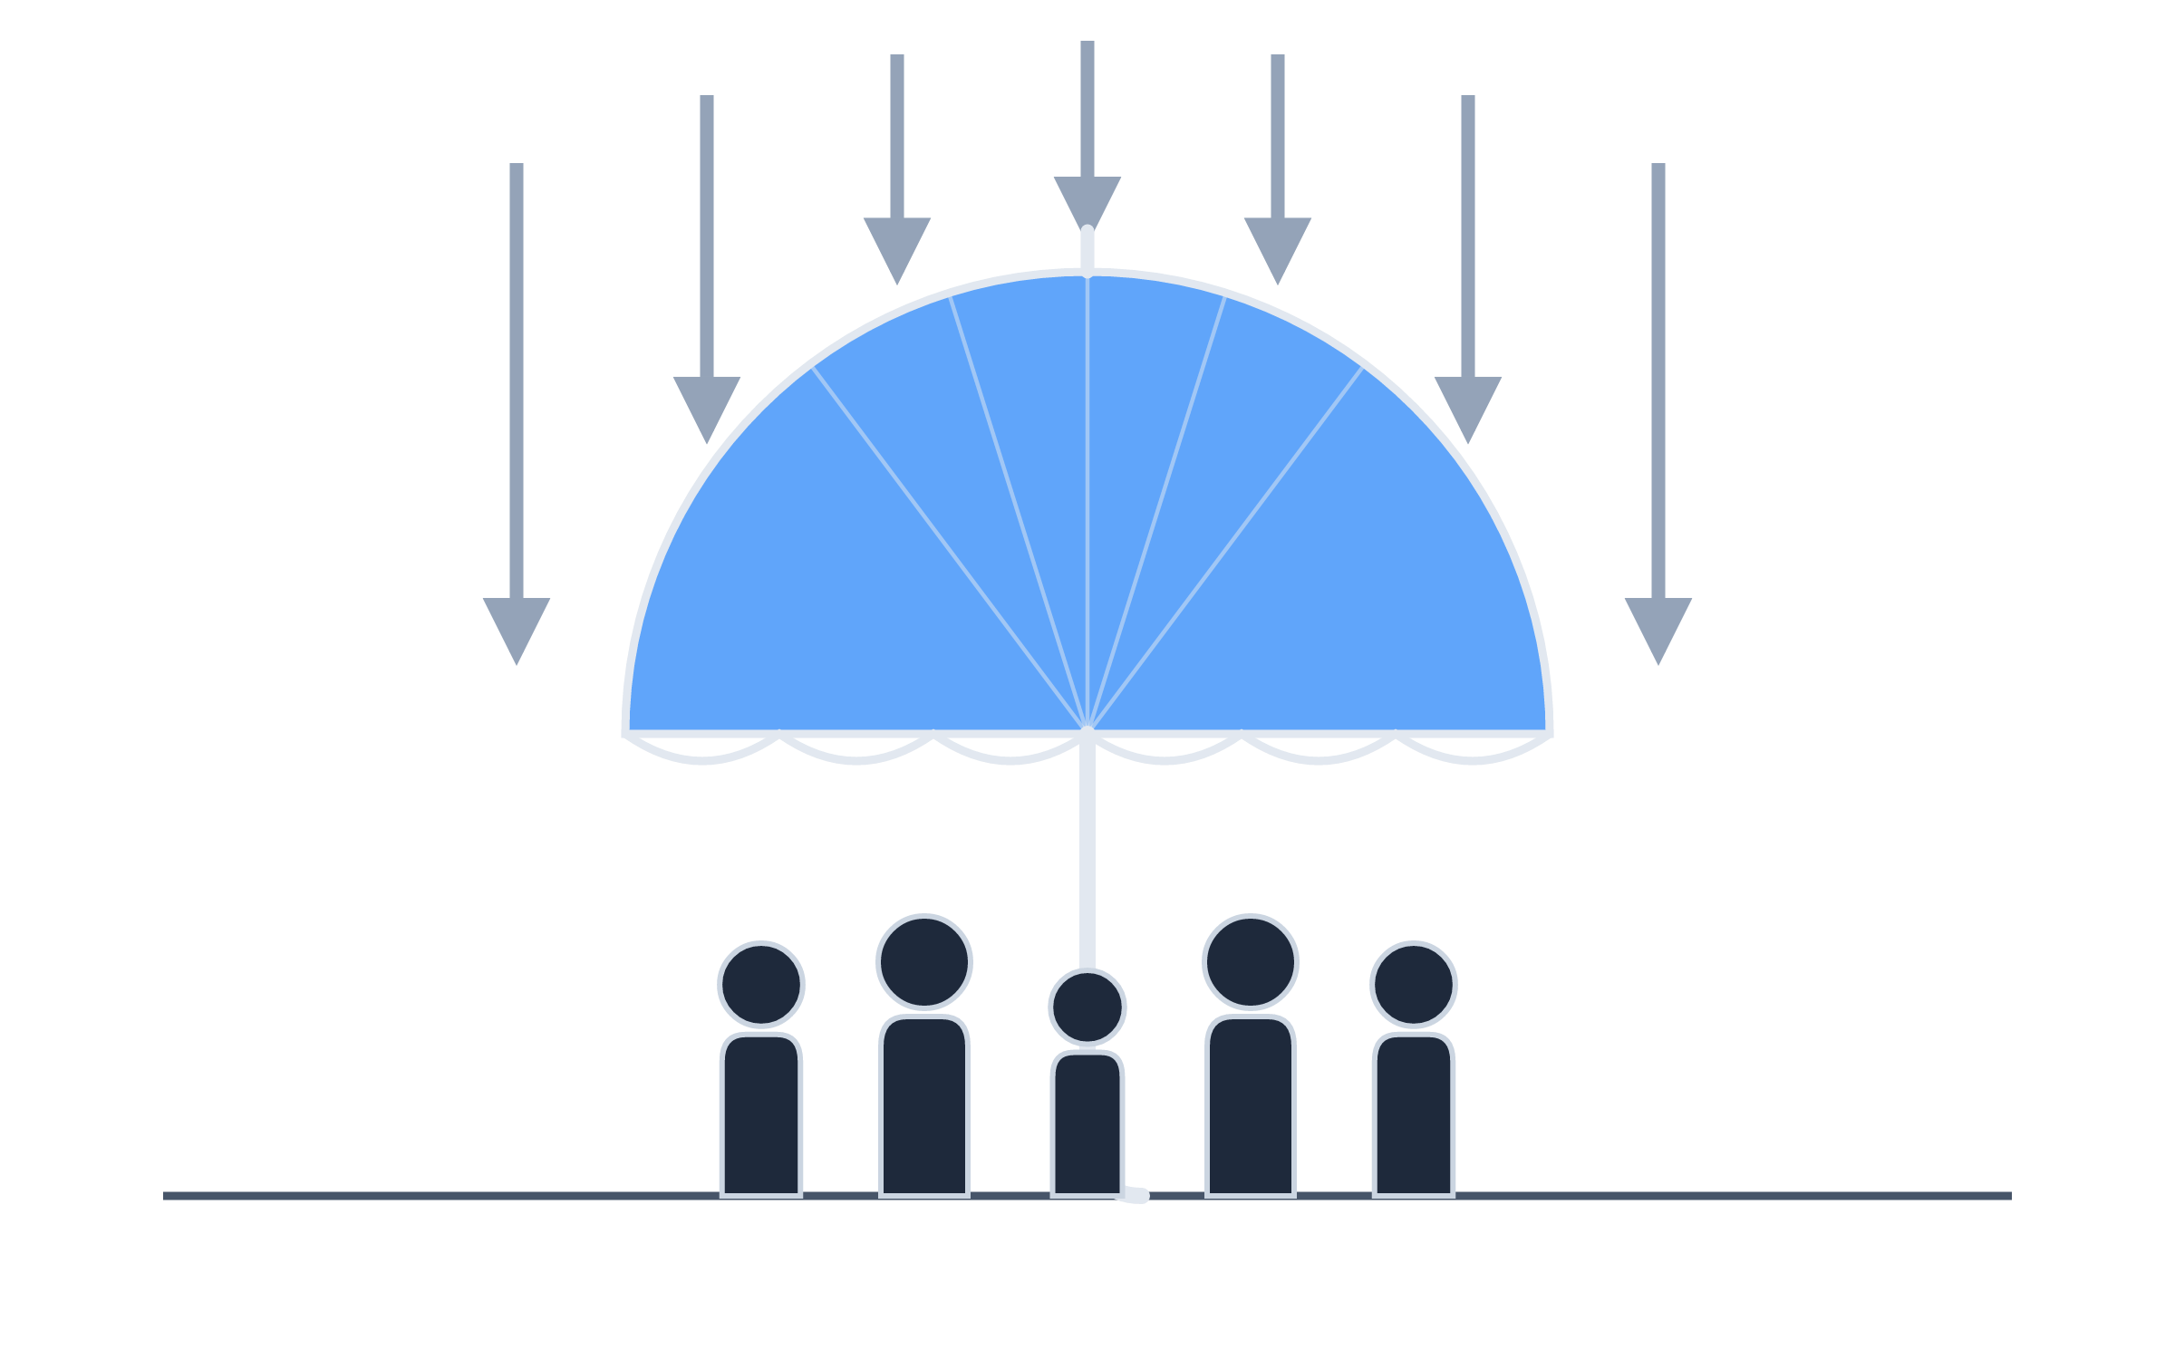
Leadership is Air Cover
Notes:
~0:20. Everyone will always think your team can do better. Your job is to absorb that so they can work.

Slide 23
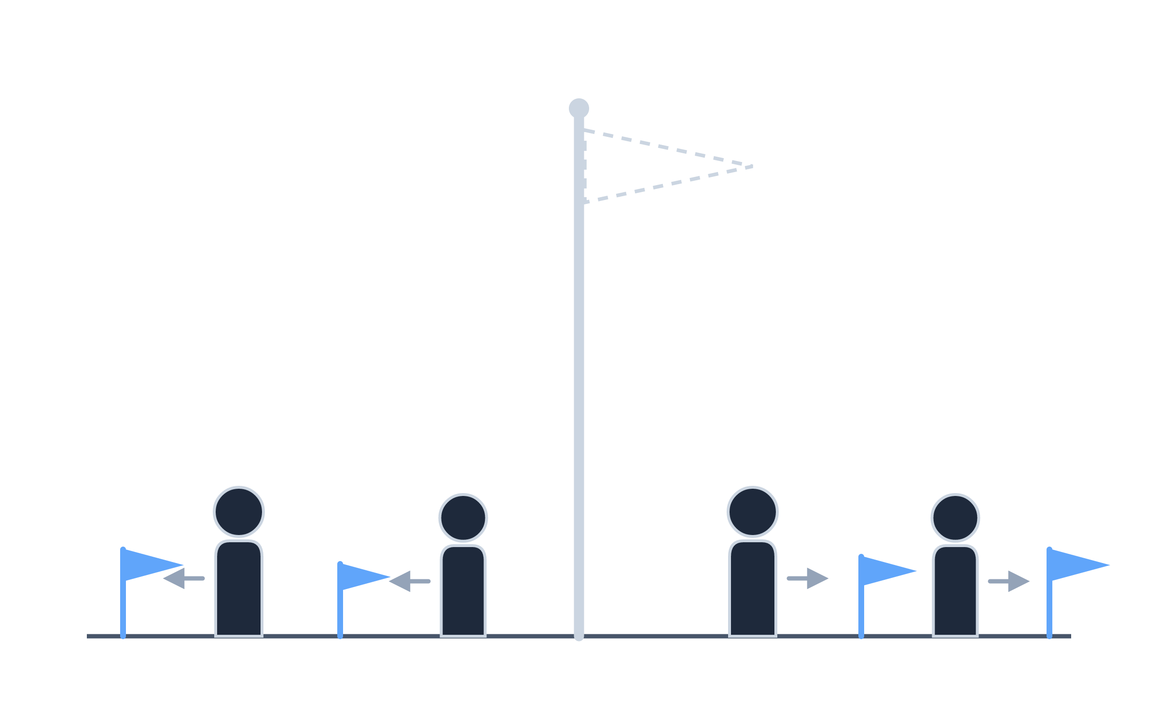
Show Them How to Win
Notes:
~0:20. If you did not show your team what winning looks like, they will make up their own goals and priorities, and they will be wrong in ways you cannot see.

Slide 24

Your Attention is a Spotlight
Notes:
~0:20. Where you focus your attention, things improve. The problems do not disappear, they migrate to wherever you are not looking.

Slide 25
Your Future is Not in Tech
It is in business.
Notes:
~0:20. Spoken, no notes. The missing picture makes it read as a verdict.

Slide 26
Questions
Notes:
20 minutes. Seed prompts if the room is slow to start:
- Which mechanism broke for you when your team grew?
- What did you stop doing at the last layer you added?
- What is the bullshit software in your org right now?
Books slide is next if a reading question comes up.
Dropped from slides, keep for Q&A: fire the “this cannot be done” people, connect your teams to your customers, expect failure and fail fast.

Slide 27
Books
High Output Management, Andy Grove
Wiring the Winning Organization, Gene Kim and Steven Spear
The Timeless Way of Building, Christopher Alexander
Notes:
Backup slide behind Questions. Only show if someone asks about reading.

