Slide 1
Fluid-Objects Interaction
Physically Based Simulation - 2014
Ivo Nussbaumer and Michael Rabinovich

Slide 2
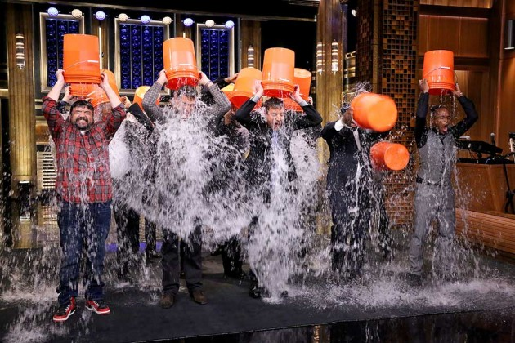
Recall

Slide 3
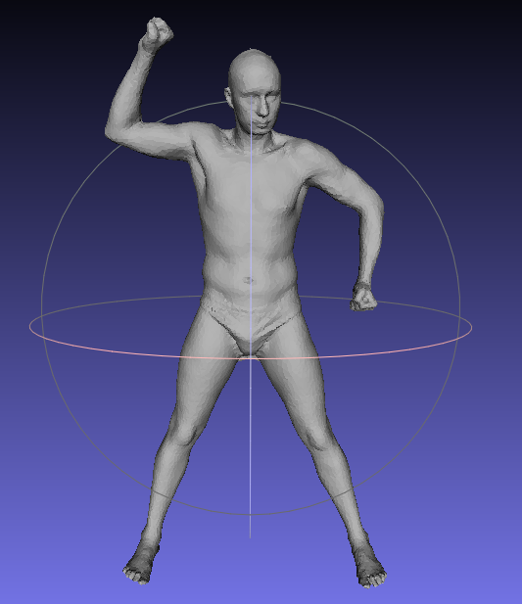
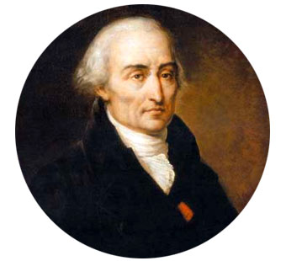
Ingredients
Rigid Body Collision Handling
SPH (Lagrangian method)

Slide 4
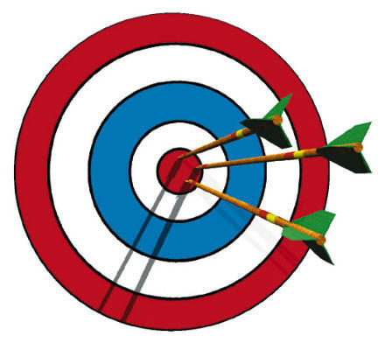
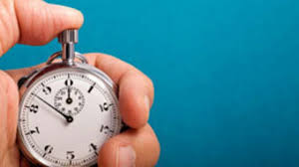
Change of Focus
Stability and Accuracy
SPH + Collision detection
Real Time Support
3K particles
40K faces

Slide 5

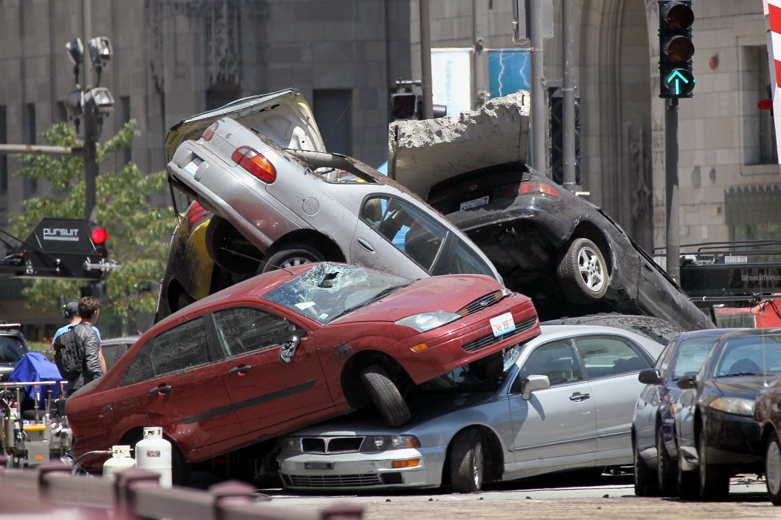
Traps
Stability
Correct Collision Handling

Slide 6
DEMO

Slide 7
Questions?

