Slide 1
Chameleon: Scalable Adaptation of Video Analytics (Strengths)
CS5052: Data-Intensive Systems
Dylan Piercy & Ivor Walker

Slide 2
Overview
What is Chameleon?
A video analytics system that dynamically adapts to changing video content in real-time.
Optimizes resource usage to be minimal (CPU, GPU, bandwidth) while maintaining high accuracy.
Avoids expensive profiling overhead through intelligent adaptation.

Slide 3
Overview
Core Question
How can we frequently adapt video analytics pipelines to dynamically changing video content, achieving the best possible resource-accuracy trade-off, without the overhead of exhaustive profiling?
Why This Matters
Real-world video analytics operate in:
Smart city deployments (thousands of cameras).
Resource-constrained cloud & edge environments.
Highly dynamic workloads (traffic, lighting, object density).

Slide 4
Strengths of Chameleon
5 Core Strengths to Chameleon:
Strength 1 — Temporal Correlation Optimisation
Strength 2 — Spatial Correlation Optimisation
Strength 3 — Smart Profiling Using Knob Independence
Strength 4 — Enables Dynamic Profiling
Strength 5 — Generalisable Solution

Slide 5
Dynamic Adaptation
Problem with Previous Systems
Earlier video analytics systems relied on static, one-time configurations.
Unable to adapt to real-world dynamics.
E.g. changing traffic speed, lighting, or scene complexity.
Chameleon’s Solution
Strength 1 — Temporal Correlation Optimisation
Strength 2 — Spatial Correlation Optimisation
Strength 3 — Smart Profiling Using Knob Independence

Slide 6
Strengths of Chameleon
5 Core Strengths to Chameleon:
Strength 1 — Temporal Correlation Optimisation
Strength 2 — Spatial Correlation Optimisation
Strength 3 — Smart Profiling Using Knob Independence
Strength 4 — Generalisable Solution
Strength 5 — Enables Dynamic Profiling

Slide 7
Strength 1 — Temporal Correlation Optimisation
Explanation
In real-world video streams, scene characteristics (object density, speed, lighting) often remain stable for several seconds or minutes. Chameleon exploits this by reusing previously selected top-k configurations for a camera, rather than frequently re-profiling.
Techniques
Temporal reuse: Good configurations persist over time (seconds to minutes) → reuse top-k.
Avoids full re-profiling unless content characteristics change significantly.
Impact
Reduces profiling frequency and computational cost.
Ensures real-time responsiveness without sacrificing accuracy.
~50% reduction in profiling cost.

Slide 8
Strengths of Chameleon
5 Core Strengths to Chameleon:
Strength 1 — Temporal Correlation Optimisation
Strength 2 — Spatial Correlation Optimisation
Strength 3 — Smart Profiling Using Knob Independence
Strength 4 — Generalisable Solution
Strength 5 — Enables Dynamic Profiling

Slide 9
Strength 2 — Spatial Correlation Optimisation
Explanation
Cameras deployed in similar environments (e.g. nearby traffic intersections) often observe similar scenes and object behaviours. Chameleon groups these cameras and uses a leader-follower strategy — one camera profiles new configurations, and others reuse its results, greatly reducing redundant profiling work.
Techniques
Spatial reuse: Similar cameras (e.g., nearby traffic cams) often share best configurations.
Camera groupings created based on observed video characteristics.
Leader-follower profiling strategy spreads profiling cost across cameras.
Impact
~30-60% additional reduction in system-wide profiling cost (on-top of temporal correlation).
Essential for scaling to smart cities / large camera deployments.

Slide 10
Strengths 1 & 2 — Related Works (1)
STC-Net: Spatial-Temporal Correlation Network for Video Anomaly Detection [1]
Summary STC-Net introduces a spatiotemporal long short-term memory (ST-LSTM) network that captures both spatial appearances and temporal variations within a unified memory cell. This design enables the model to learn the evolution of normal patterns more effectively.​
Evaluation Results STC-Net showed state-of-the-art performance on three standard video anomaly detection datasets:
UCSD Ped2: 96.7% AUC
CUHK Avenue: 87.8% AUC
ShanghaiTech: 73.1% AUC
Real-World Application Intelligent surveillance systems where accurate anomaly detection is critical.​

Slide 11
Strengths 1 & 2 — Related Works (2)
CTL: Spatial-Temporal Correlation and Topology Learning for Person Re-Identification [2]
Summary CTL introduces a framework that constructs multi-scale graphs to model spatial-temporal correlations and human body topology. Enables robust feature representation for person re-identification across non-overlapping camera views.
Evaluation Results Achieved state-of-the-art performance on two video benchmarks:
iLIDS-VID: CTL achieved a rank-1 accuracy of 81.6%, outperforming previous methods on this dataset.​
MARS: On this larger and more challenging dataset, CTL achieved a rank-1 accuracy of 84.6%.
Real-World Application Intelligent surveillance systems where accurate anomaly detection is critical.​

Slide 12
Strengths 1 & 2 — Related Works (3)
Focus: Querying Large Video Datasets with Low Latency and Low Cost [3]
Summary Reduces the cost of querying large video datasets by combining lightweight (cheap) specialized models with indexing techniques. Avoids scanning entire videos by sharing object detection results across queries.​
Evaluation Results Achieved up to 98% reduction in query latency and substantial cost savings compared to baseline methods, while maintaining high accuracy.
Real-World Application Suitable for large-scale video analytics platforms, such as city-scale traffic monitoring systems or video archives requiring fast query response.

Slide 13
Strengths of Chameleon
5 Core Strengths to Chameleon:
Strength 1 — Temporal Correlation Optimisation
Strength 2 — Spatial Correlation Optimisation
Strength 3 — Smart Profiling Using Knob Independence
Strength 4 — Generalisable Solution
Strength 5 — Enables Dynamic Profiling

Slide 14
Strength 3 — Smart Profiling Using Knob Independence
Explanation
Introduces configuration profiling by treating each system parameter ("knob") independently. Assumption of independence allows for a linear reduction in the profiling space, significantly decreasing the computational overhead required to identify optimal configurations.
Techniques
Observed that configuration knobs act mostly independently with monotonic cost behaviour.
Uses greedy hill-climbing to reduce search from an exhaustive search of O(n^{m}) to O(nm).
m knobs, n values for each knob.
Impact
Achieves near-optimal configs at a fraction of the cost.
Makes Chameleon feasible for real-time profiling on resource-constrained systems.

Slide 15
Strength 3 – Related Work (1)
NoScope: Optimizing Neural Network Queries over Video at Scale [4]
Summary Introduces a system that accelerates neural network-based video queries by automatically generating specialized models tailored to specific video streams. Uses a cascade of models, including difference detectors and specialized neural networks, to filter out frames unlikely to contain objects of interest, thereby reducing computational load.​
Evaluation Results Demonstrated up to 1000x speedup in processing video queries compared to baseline methods, with minimal loss in accuracy.​
Real-World Application Real-time video analytics, such as surveillance systems, where rapid processing of video streams is critical.​

Slide 16
Strength 3 – Related Work (2)
Focus: Querying Large Video Datasets with Low Latency and Low Cost [3] [Same Related Work as Strength 1 & 2]
Summary Reduces the cost of querying large video datasets by combining lightweight (cheap) specialized models with indexing techniques. Avoids scanning entire videos by sharing object detection results across queries.​
Evaluation Results Achieved up to 98% reduction in query latency and substantial cost savings compared to baseline methods, while maintaining high accuracy.
Real-World Application Suitable for large-scale video analytics platforms, such as city-scale traffic monitoring systems or video archives requiring fast query response.

Slide 17
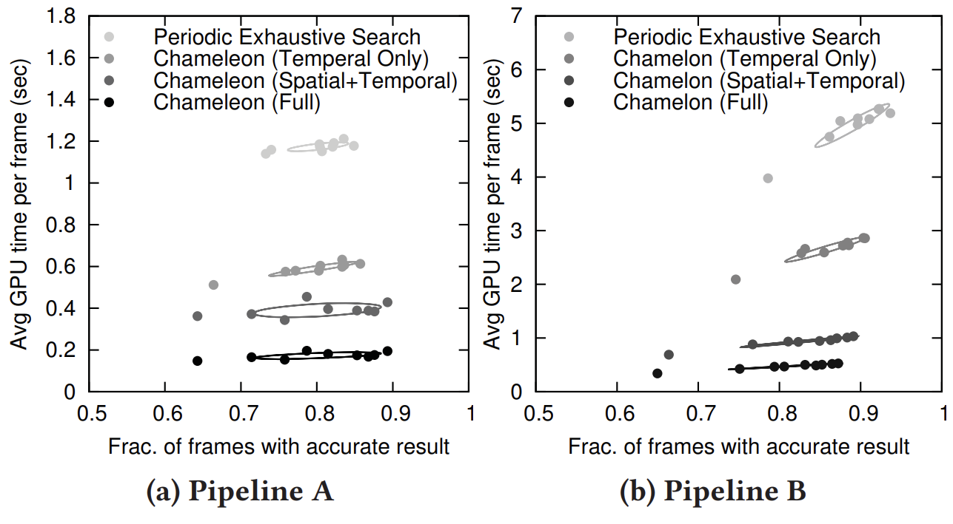
Evaluating Strength 1, 2 & 3 Profiling Costs
Technique | Profiling Cost Reduction (Approximate)
Temporal Reuse Only | ~50% Reduction
Temporal + Cross-Camera Sharing | ~60–70% Reduction (depending on scenario)
With Knob Independence Added | Up to ~90% Total Reduction

Slide 18
Evaluating Strength 1, 2 & 3 Accuracy
Chameleon achieves accuracy within ~1-2% of exhaustive search, static configuration methods.
F1 Scores:
Chameleon: ~ 0.78 – 0.81
Exhaustive Search: ~ 0.80 – 0.82
An F1 Score is a metric used to measure the accuracy of a system (harmonic mean).
F1 Score = 2 × (Precision × Recall) / (Precision + Recall)
Precision → How many of the detected objects were correct?
Recall → How many of the actual objects did you detect?

Slide 19
Strengths of Chameleon
5 Core Strengths to Chameleon:
Strength 1 — Temporal Correlation Optimisation
Strength 2 — Spatial Correlation Optimisation
Strength 3 — Smart Profiling Using Knob Independence
Strength 4 — Generalisable Solution
Strength 5 — Enables Dynamic Profiling

Slide 20
Video analytics
Using detection or tracking models on live streams is astronomically more expensive than the hardware or model training costs
A video sensor costs £6 on Alibaba (Alibaba, 2025)
Applying a trained model to video data requires a £4600 GPU or hundreds of pounds in cloud costs a year at the minimum (Kang, et. al., 2017)
How can we use Chameleon to reduce these processing costs?

Slide 21
Optimising analytics
Video analytics optimisers define:
Objective function, from the given domain
Maximise quality (e.g. stream resolution, object detection accuracy)
Minimise costs (e.g. stream lag, GPU cost)
Profiler, to understand its quality and costs by taking a sample of the stream and create a “config” (configuration) space
Optimiser, to produce the config to solve the objective function in our config space

Slide 22
Optimisers before Chameleon: MCDNN
2016: MCDNN optimises model knobs for mobile-deployed models
Object function: Minimise data and battery usage to achieve target false positive and false negative rates
Config space: “Catalogue” of “cascading” simplifications a full neural network
Difference detectors: check if object is duplicate of previous frame
Specialised models: models are retrained on “dominant” (always appearing) objects identified at start of stream
Full neural network only used if specialised models not confident
Optimiser: selects model and decides whether execution is local, cloud, or hybrid

Slide 23
Optimisers before Chameleon: Building on MCDNN
2017: NoScope uses MCDNN for cloud deployment only
Objective function to minimise GPU and cloud cost, optimiser only selects model
2017: FVC uses specialised models for a dynamic set of dominant objects
Periodically use complex “oracle” model to find dominant objects
Expensive to periodically consult oracle, done so infrequently
Config space: oracle and simpler model “specialised” on dominant objects set
Optimiser: Use specialised model if predicted to be accurate enough
2018: Focus builds on NoScope with a better optimiser
Objective function: Added minimisation of classification latency
Top-k indexing: cheapest model likely fails to correctly label object so output k labels
These cascade optimisers sacrifice generalisability for performance

Slide 24
Generalisability
Chameleon’s design avoids sacrificing generalisability
Not limited to a specific type of video feed or environment
Chameleon was tested on an indoor coffee shop, tracking human movement, and an outdoor traffic camera, tracking vehicles
Not specialised for just one type of environment (e.g. only traffic monitoring or only indoor surveillance), so beats cascade optimisers fairly
Adapts to changes in video content or environmental conditions
Chameleon was tested across 24 hours covering different lighting conditions, weather and shifts in object density (e.g. rush hours)
Can react to changes in environment without need to retrain specialised models or difference detectors

Slide 25
Strengths of Chameleon
5 Core Strengths to Chameleon:
Strength 1 — Temporal Correlation Optimisation
Strength 2 — Spatial Correlation Optimisation
Strength 3 — Smart Profiling Using Knob Independence
Strength 4 — Generalisable Solution
Strength 5 — Enables Dynamic Profiling

Slide 26
Video analytics schedulers
How do we allocate resources to multiple analytics pipelines on the same cluster?
What if these pipelines have conflicting demands?
e.g. police facial recognition needs a higher accuracy than customer counting
e.g. a Twitch stream can have more lag than airport security scanners

Slide 27
Schedulers before Chameleon
2015: Vigil optimises bandwidth for network of surveillance cameras
Objective function: maximise useful frames and minimise bandwidth usage
Optimiser: selects “important” frames, calculated by edge computing node
Visual clustering: avoid reuploading same frame from multiple cameras
Similar system employed in Avigilon Control Center today
2017: VideoStorm applies video analytics optimiser architecture
Objective function: Maximise “utility” (accuracy and low processing lag) of all streams without any one stream falling below its quality requirement (e.g. false negatives)
Beats schedulers based on YARN and Mesos (e.g Spark Streaming) that use fairness because they ignore video quality
These schedulers (and cascade optimisers) use static profiling

Slide 28
Static profiling
Config selected through static profiling become suboptimal if stream is “non-stationary” and profiling sample becomes unrepresentative
e.g. if the speed of cars changes in a traffic camera stream

Slide 29
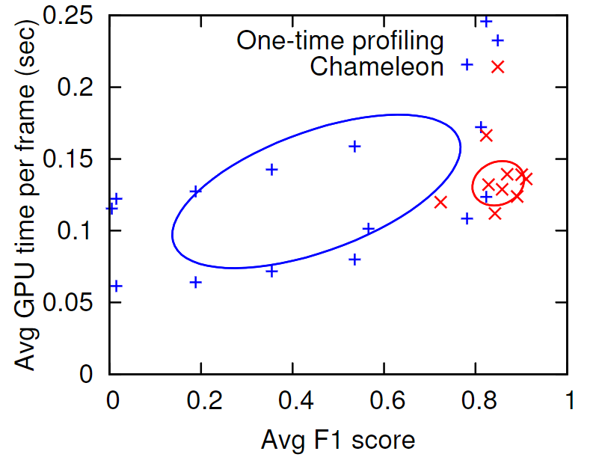
Static vs Dynamic profiling
Dynamic profilers chooses configurations that achieve a higher accuracy (F1 score) with the same resources compared to static profilers

Slide 30
Dynamic profiling
How can we dynamically profile a stream?
Too expensive to “periodically” profile and update the config (e.g. FVC)
Cost of searching our config space grows exponentially with number of knobs
Outweighs gains from using optimal knob configurations
As Dylan established, Chameleon makes assumptions about streams to make searching our config space cheaper and reduce its size
Effect of speed ups depends how true they are
If speed ups are great enough, we can periodically profile a non-stationary stream to select optimal configs

Slide 31
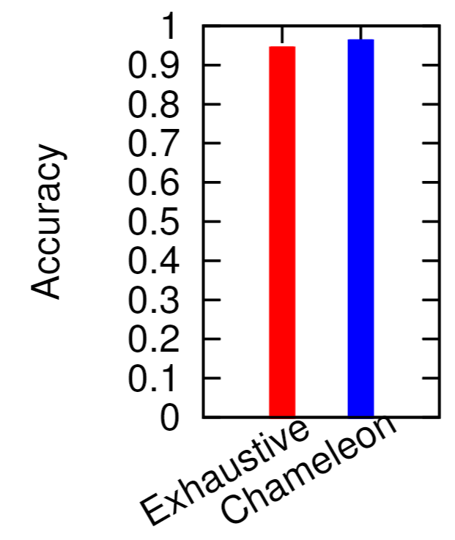
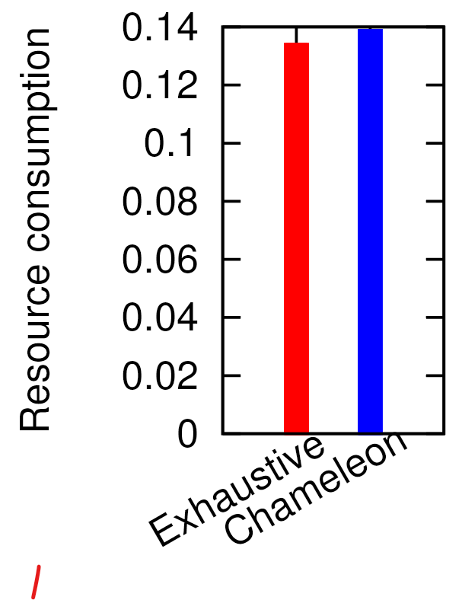
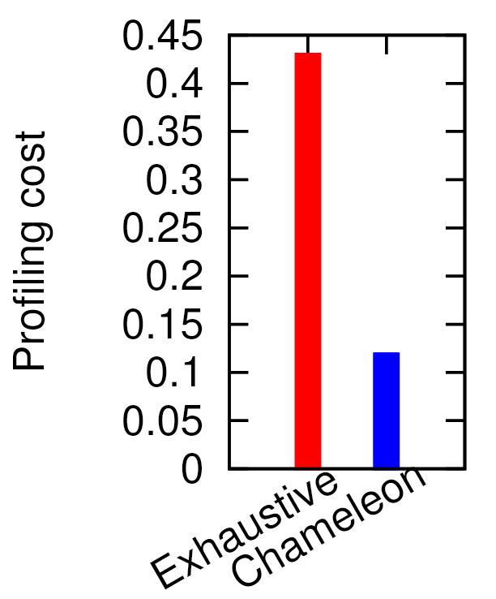
Periodic vs Chameleon profiling
Chameleon chooses a configuration that’s as accurate and as resource intensive as “exhaustive” (periodic) profiling but at a fraction of the “profiling” (search) cost

Slide 32
Chameleon and edge
Chameleon complements bandwidth-reducing edge technologies (e.g. Vigil)
Techniques used in Chameleon will “carry over” for bandwidth problems
2019: FilterForward reduces bandwidth usage by only sending domain-“important” frames (e.g, a defect) from edge to cloud
“Feature extractor” large neural network on cloud uses high resolution video to create a “map” between important features and activations
“Micro-classifiers” on the edge use map to classify frames as relevant or not
Chameleon knob-turning indirectly improves efficiency, FilterForward’s sharing computation improves efficiency directly
Feature extractor makes microclassifiers generalisable as they share activations
These edge-to-cloud technologies are being adopted by industry
Part of the IP camera protocol ONVIF as Profile G
Startups edge-to-cloud analytics, e.g. BriefCam

Slide 33
Improving frame removal with dynamic profiling
2020: Reducto improves on FilterForward with a simpler classifier and dynamic adaptation
Feature extractor maps indicators of a change in scene instead of entire features
Micro-classifier reduced in complexity to a binomial regression model
Dynamic profiling by failure: if micro-classifiers begin to fail, edge sends video to cloud and feature extractor produces a new map
Outperformed FilterForward and reduced processing cost by 39% compared to Chameleon, but can be used alongside Chameleon too
Profiling scheme could be improved to use spatial and temporal correlations before failure occurs to avoid excess bandwidth usage

Slide 34
Conclusion
Chameleon has a strong technical core
Exploits temporal correlations
Exploits spatial correlations
Employs a novel greedy optimisation algorithm made possible by independence of knobs
Chameleon made a significant impact in the video analytics space
Generalisable
Enabled dynamic profiling for video analytics, which produced enormous performance gains
Chameleon’s impact extends to other fields
Application in bandwidth optimisation
Foundations of other research papers and industrial applications

Slide 35
References
M. Zhao, Y. Liu, J. Liu, and X. Zeng, “Exploiting Spatial-temporal Correlations for Video Anomaly Detection,” in 2022 26th International Conference on Pattern Recognition (ICPR), Montreal, QC, Canada: IEEE, Aug. 2022, pp. 1727–1733, doi: 10.1109/ICPR56361.2022.9956287.
J. Liu, Z.-J. Zha, W. Wu, K. Zheng, and Q. Sun, “Spatial-Temporal Correlation and Topology Learning for Person Re-Identification in Videos,” in 2021 IEEE/CVF Conference on Computer Vision and Pattern Recognition (CVPR), Nashville, TN, USA: IEEE, Jun. 2021, pp. 4368–4377, doi: 10.1109/CVPR46437.2021.00435.
K. Hsieh, G. Ananthanarayanan, P. Bodik, S. Venkataraman, P. Bahl, M. Philipose, P. B. Gibbons, and O. Mutlu, “Focus: Querying Large Video Datasets with Low Latency and Low Cost,” in Proc. 13th USENIX Symposium on Operating Systems Design and Implementation (OSDI 18), Carlsbad, CA, USA, Oct. 2018, pp. 269–286, doi: [Details as provided online]. [Online]. Available: https://www.usenix.org/conference/osdi18/presentation/hsieh.
D. Kang, J. Emmons, F. Abuzaid, P. Bailis, and M. Zaharia, “NoScope: Optimizing Neural Network Queries over Video at Scale,” Aug. 08, 2017, arXiv: 1703.02529, doi: 10.48550/arXiv.1703.02529.
Alibaba, “Alibaba camera,” 2025. [Online]. Available: https://www.alibaba.com/showroom/vga-cmos-image-sensor.html.
S. Han, H. Shen, M. Philipose, S. Agarwal, A. Wolman, and A. Krishnamurthy, “MCDNN: An Approximation-Based Execution Framework for Deep Stream Processing Under Resource Constraints,” in Proc. 14th International Conference on Mobile Systems, Applications, and Services (MobiSys ’16), Singapore, Singapore, 2016, pp. 123–136, doi: 10.1145/2906388.2906396.
H. Shen, S. Han, M. Philipose, and A. Krishnamurthy, “Fast Video Classification via Adaptive Cascading of Deep Models,” 2017, arXiv: 1611.06453. [Online]. Available: https://arxiv.org/abs/1611.06453.
T. Zhang, A. Chowdhery, P. Bahl, K. Jamieson, and S. Banerjee, “The Design and Implementation of a Wireless Video Surveillance System (Vigil),” in Proc. 21st International Conference on Mobile Computing and Networking (MobiCom ’15), Paris, France, 2015, pp. 426–438, doi: 10.1145/2789168.2790123.
H. Zhang, G. Ananthanarayanan, P. Bodik, M. Philipose, P. Bahl, and M. J. Freedman, “Live Video Analytics at Scale with Approximation and Delay-Tolerance (VideoStorm),” in Proc. 14th USENIX Symposium on Networked Systems Design and Implementation (NSDI ’17), Boston, MA, USA, Mar. 2017, pp. 377–392. [Online]. Available: https://www.usenix.org/conference/nsdi17/technical-sessions/presentation/zhang.
J. Jiang, G. Ananthanarayanan, P. Bodik, S. Sen, and I. Stoica, “Chameleon: Scalable Adaptation of Video Analytics,” in Proc. ACM SIGCOMM ’18, Budapest, Hungary, 2018, pp. 253–266, doi: 10.1145/3230543.3230574.
Y. Li, A. Padmanabhan, P. Zhao, Y. Wang, G. H. Xu, and R. Netravali, “Reducto: On-Camera Filtering for Resource-Efficient Real-Time Video Analytics,” in Proc. ACM SIGCOMM ’20, Virtual Event, USA, 2020, pp. 359–376, doi: 10.1145/3387514.3405874.
C. Canel, T. Kim, G. Zhou, C. Li, H. Lim, D. G. Andersen, M. Kaminsky, and S. R. Dulloor, “Scaling Video Analytics on Constrained Edge Nodes (FilterForward),” 2019, arXiv: 1905.13536. [Online]. Available: https://arxiv.org/abs/1905.13536.
ONVIF, “ONVIF Profile G,” 2025. [Online]. Available: https://www.onvif.org/profiles/profile-g/.
BriefCam, “BriefCam,” 2025. [Online]. Available: https://www.briefcam.com/.

