Slide 1
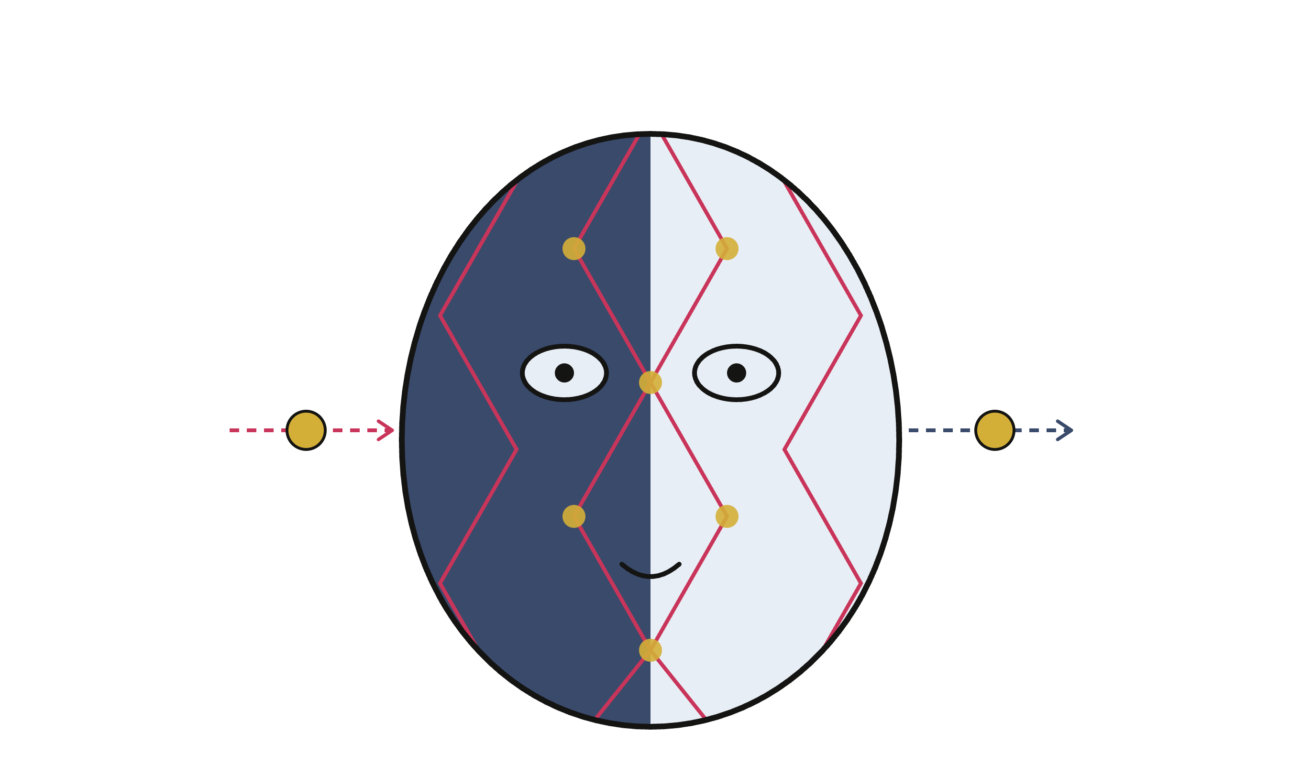
Harlequin
A local-first client-server AI agent harness Ivan Voras · CroAI

Slide 2
Why?
Agent harnesses are oddly local:
one user, local process, cloud LLM
What about shared environment? Business usage? Security?
Why not make it client-server-first, org-aware, local LLM-optimized
Two tensions drive every design decision in this talk:
The GPU is a contended resource
Every token costs latency
Notes:
Frame the talk: the interesting engineering is in the intersection — multi-user expectations (memory, notifications, background work) colliding with a single slow local model.

Slide 3
What?
Harlequin: a client-server AI agent harness
REST/SSE server
Thin clients
Optimized for a local model: one GPU, slow tokens, every token paid in latency
Research project · Go · SQLite · goja JS sandbox
Lightweight, no bells-and-whistles
Dubiously useful

Slide 4
Notes:
Demo: the TUI asking for a watch price — WebFetch with anti-bot fetching, a delegated small-model analysis, and the answer with per-turn PP/TG timing. Let it loop while introducing the architecture.

Slide 5
Go server, single binary
TUI client
REST / SSE API
Skills + hats
Web UI
Agent loop (Per-user)
Telegram…
SQLite
FTS + vector db
System+Shared+Per-user
Background jobs
llama.cpp
llama.cpp
Provider router with fallback (local → hosted API; OpenRouter support is built-in)
Sessions tracked per-user, role-aware (owner / admin / user), per-org, with shared data
LLM
embeddings
OpenAI-compatible API
OpenAI-compatible API

Slide 6

Local-model-optimised
Reference rig | gemma-4 26B (A4B MoE), Q4, 120k ctx, llama.cpp
Prompt processing | ~225–350 tok/s (degrades with depth)
Token generation | ~24–28 tok/s
First interaction time | ≈ 17 s before first response token
AOOSTAR MACO 5
AMD Ryzen 7 H255, Radeon 780M iGPU
32 GB unified memory, DDR5
≈ 270€ without RAM & SSD (2006-06)

Slide 7
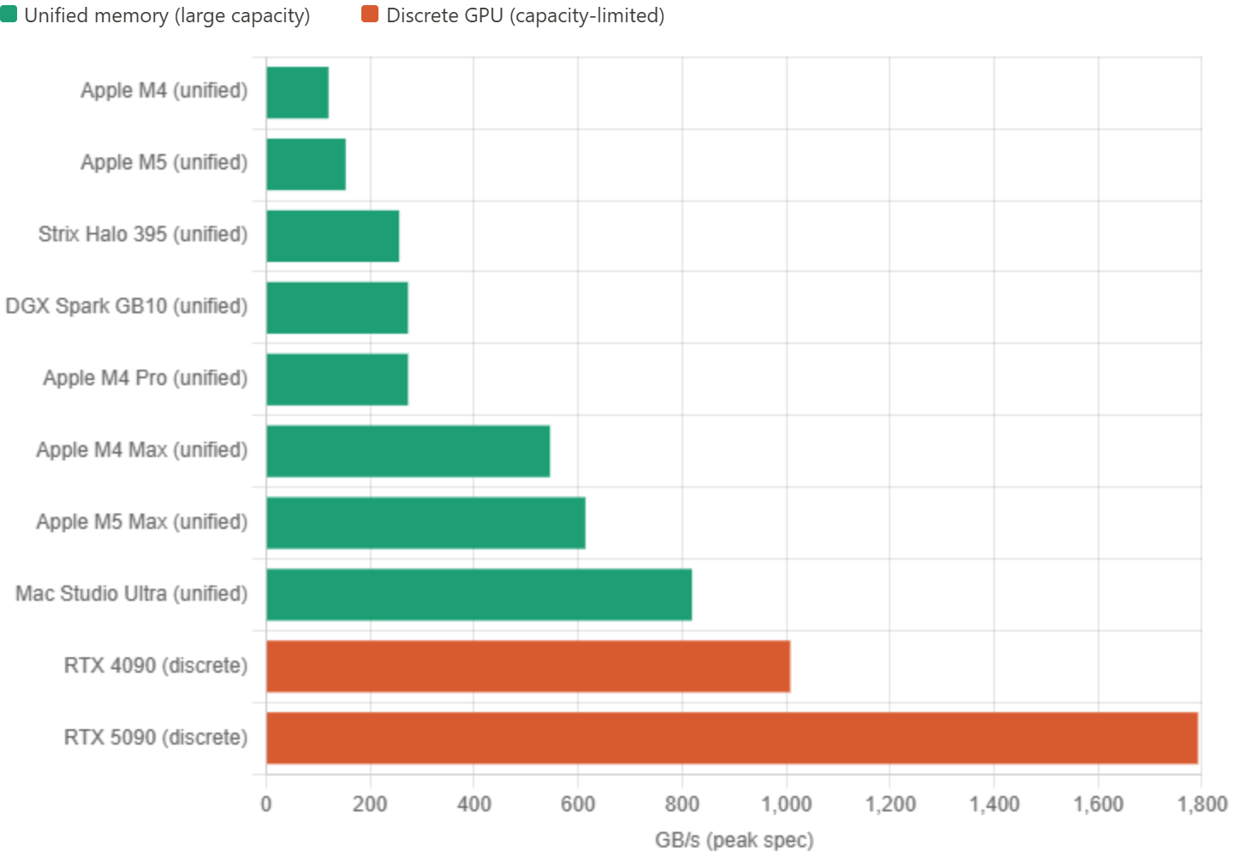
LLM performance: mostly RAM bandwidth
The H255

Slide 8
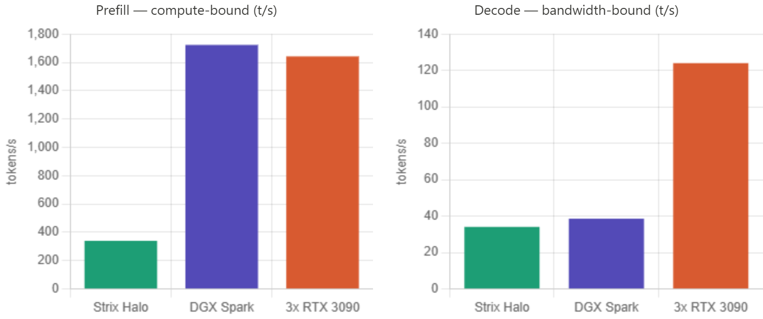
But… UX hugely depends on PP, which is comp
PP=Prompt Processing

Slide 9
Example performance: Strix Halo
Model | Total / active params | Quant tested | PP speed (t/s) | TG speed (t/s)
Llama 2 7B | 7B / 7B dense | Q4_0 | ~1,000–1,294 Level1Techs | ~46–48 Level1Techs
Qwen 3 30B-A3B | 30B / 3B MoE | Q4_K_XL | ~605 Level1Techs | 66–72 Level1Techs
Gemma 4 26B-A4B | 25.2B / 3.8B MoE | BF16 (Q8 ~2× faster) | ~500–600 Akehir | ~20 (≈40 at Q8) Akehir
Gemma 4 E4B | tiny MoE | BF16 | ~500–600 | ~20 Akehir
Qwen 3.6 35B-A3B | 35B / 3B MoE | Q4-class | 214 (at 128k depth) Nuxt | 34.5 (at 131k depth) Nuxt
gpt-oss-120B | 120B / ~5B MoE | MXFP4 | ~340 AIMultiple | ~34 AIMultiple
Dots1 | 142B / 14B MoE | Q4_K_XL | ~63 Level1Techs | ~21 Level1Techs
Llama 4 Scout | 109B / 17B MoE | Q4_K_XL | ~264 Level1Techs | ~17–19 Level1Techs
Mistral Small 3.1 | 24B / 24B dense | Q4_K_XL | ~317 Level1Techs | ~14 Level1Techs
Gemma 4 31B | 31B / 31B dense | BF16 (Q8 ~2× faster) | ~100–150 (≈300 at Q8) Akehir | ~3–4 (≈6 at Q8) Akehir
ATTN: ~100 t/s PP, 5 t/s TG means a 4,000-token prompt takes ~40 seconds before the first word appears, then generates at 5 t/s.

Slide 10
Dynamic per-request deadlines from a rolling PP-rate estimate — no fixed timeouts
Live prompt-processing progress streamed to the client (return_progress)
Cloud-API instincts (retry, fan out, “just make another call”) must be unlearned
Notes:
Cloud-API thinking does not transfer: timeouts, retries, and parallel calls all have to be re-derived when PP is 300 tok/s and TG is 25.

Slide 11
One GPU, many jobs
Background LLM work: memory extraction, conflict judges, auto-titling, maintenance sweeps
Naive
Background jobs share llama.cpp slots with live turns → interleaved inference, everything slow
Worst at server start: a memory sweep degraded user turns for minutes
Harlequin
Single background slot + preemption: a live turn cancels the in-flight background completion; the job restarts later (restartable by design)
Measured: turn preempts a running judge in < 1 s

Slide 12
Gating keys off the provider: only the local provider serializes — hosted APIs run background work in parallel.
Notes:
War story: “two prompts at once” turned out to be three separate ungated paths — extraction’s judge calls, the auto-titler, and a startup cross-scope sweep. Found by tailing llama.cpp slot logs (launch/release lines per task). The debugging method is as interesting as the fix for this audience.

Slide 13
KV-cache economics
Case | Tokens processed | Wall time
Mid-turn step (prefix matches KV) | ~150 of 21k | ~3 s
New turn, thinking model | 21,176 of 21,176 | 94 s

Slide 14
Reasoning tokens are in the KV but stripped from replayed history → prefix diverges every turn
SWA models can’t partially rewind → all-or-nothing without checkpoints
Mitigations, measured: --swa-full (VRAM ↑) · context checkpoints (~106 MiB each, host RAM, share the --cache-ram budget) · replay thinking (ctx ↑3k/turn)
Harness rule: keep the prompt prefix byte-stable — deterministic tool order, stable system prompt
Notes:
Verified empirically: system prompt byte-identical across 6 turns (sha1 diff of session logs), so the miss was NOT app-side. llama.cpp’s n_past logs show where reuse happens. Good “measure, don’t guess” moment.

Slide 15
Client-server
Why: shared org memory, roles, usage accounting, one GPU for the whole org
REST + SSE; turns stream tokens, thinking, tool calls, PP progress
Interfaces: each session tagged with its medium — TUI, Web, Cron, Telegram
Messages queue while a turn is in flight; ask_user ends the turn cleanly
TUI and web client kept at feature parity
Notes:
Contrast with laptop-local harnesses: identity, authz, and audit are first-class. The agent loop runs server-side, so any thin client works.

Slide 16
Single-executable deployment
One Go binary: skills, hats, SQL migrations, web UI — all embed.FS
SQLite compiled in (CGO + sqlite-vec); vendored headers, no system deps
Baked assets deployed to the data dir with a hash manifest — local edits preserved, unchanged files upgraded
Config: YAML for structure, .env for secrets, env overrides
make build # CGO_ENABLED=1, -tags sqlite_fts5 scp bin/harlequin-server you@box: && ./harlequin-server
Notes:
Ops story: a single file + a data directory. The deploy-with-manifest trick is the interesting part — it’s how baked skills coexist with local edits.

Slide 17
SQLite everywhere
Three tiers:
data/harlequin.db system: users, tokens data/shared.db org: shared memories, docs
data/users/<id>/user.db memories, conversations, cron
Per-user DBs opened per request, closed after — thousands of users, no connection pools
No cross-file foreign keys: composite ids (u.4 / s.7) fuse the tiers in code
FTS5 + sqlite-vec in the same file
full-text and vector search next to the data
Backup = copy a directory; per-user isolation by construction
Notes:
“Why not Postgres+pgvector?” — deployment story (single binary, zero services) and per-user isolation. Be honest about limits: write concurrency per file, EachUser sweeps are sequential.

Slide 18
Sandboxed paths
JS sandbox and tools resolve special file paths:
skill://<skill>/<path> — read-only files from a skill bundle; resolution honors overrides (hat → user → org → deployed); backs load()/include(), run_js, and cron js targets
storage://<path> — per-user persistent store (.storage): read / write / list / remove / exists; survives runs — generated parsers, saved recipes, web-watch baselines
tmp://<path> — per-user transient scratch (.tmp): same API, ephemeral — e.g. WebFetchDOM stashes a fetched page as a tmp:// handle
One resolver; unknown scheme → error. No host filesystem or network outside these roots.

Slide 19
Embeddings to speed things up
311M multilingual embedder (granite) on its own llama.cpp — cheap, always available
Hybrid retrieval: FTS5 + vector legs fused with Reciprocal Rank Fusion
Embeddings as a pre-filter for LLM judges: only top candidate pairs reach the 26B model
Slot keys (user.preferred_currency) get their own embedding leg
Theme: the 311M model runs constantly so the 26B model runs rarely.
Notes:
Conflict detection embeds + searches first, judges only candidates. This is the cost-control pattern repeated across the whole system.

Slide 20
Measured: slot-key embedding leg
1,000 synthetic org memories · 154 sloppy user queries · granite-embedding-311m

Slide 21
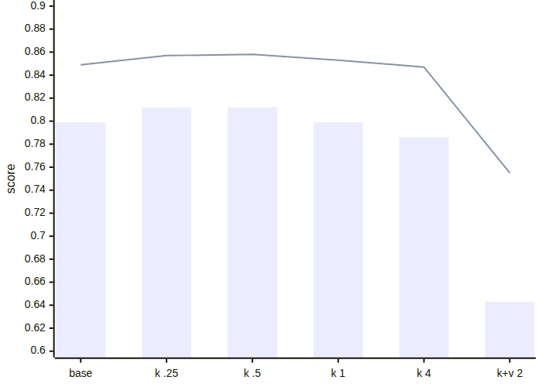
Variant | R@1 | MRR
baseline (FTS + vec, RRF) | 0.799 | 0.849
+ key leg, w=0.25 | 0.812 | 0.857
+ key leg, w=0.50 | 0.812 | 0.858
+ key leg, w=4.0 | 0.786 | 0.847
+ key+value, w=2.0 | 0.643 | 0.755
Notes:
Two lessons: (1) modest, weighted extra legs sharpen the top rank; (2) embedding the value into the slot vector actively hurts — attribute lookups ask FOR the value, so value text is noise against the query. Over-weighting boosts everything sharing an attribute key and pushes the exact entity off rank 1.

Slide 22
The memory model
Two scopes: user (personal) and shared (org) — fused into one search view
Slot keys: canonical attributes (organisation.name) — idempotent writes, exact lookups
Auto-extraction after each turn (background, preemptible), deduped against explicit writes
Conflict detection on write: FTS+vector candidates → LLM judge, structured JSON, confidence ≥ 7 gate
Provenance, TTL, pinning; cross-scope reconcile (an attribute can’t live in both scopes)
Memory glob rendered into the system prompt; the rest recalled via memory_search
Notes:
Emphasize the autonomous-judgment rule: every unattended LLM decision carries a self-reported confidence and is discarded below 7 — silence over placeholder garbage. A harness-level convention, not per-feature.

Slide 23
Skill files are templated Markdown
Every skill / hat / system-prompt .md is run through a sandboxed JS template before use
<?js ... ?> blocks executeJavaScript; print()/println() splice output in place
Same per-user ctx everywhere: ctx.user, ctx.date, ctx.memoryGlob(g), ctx.memorySearch(q), ctx.searchDocs(q)
Lets a static prompt pull in live state at render time
Fails closed: a JS error or timeout aborts the whole render
## What you know about the user
<?js
var slots = ctx.memoryGlob("user.*");
if (slots.length > 0) {
for (var i = 0; i < slots.length; i++) {
println("- " + slots[i].key +
": " + slots[i].content);
}
} else {
println("- (nothing stored yet)");
}
?>
— skills/system_prompt.md (excerpt)
Notes:
The same templating runs for skills, hats, and the default system prompt. Point at the snippet: the memory block is not static text — it globs the user's slot-keyed memories at render time, so each user gets a different prompt from the same file. ctx also exposes memorySearch and searchDocs for RAG-into-prompt. Tie back to the byte-stable-prefix point: this block only changes when memory changes.

Slide 24
Hats
A hat = persona per conversation („wearing the hat of an account manager, I do X”): own system prompt + curated skill set
--- description: Maintains the organisation's website. skills: [example-greeter] --- You are Harlequin acting as the organisation's **webmaster**…
Hats can override the sets of tools, skills and the system prompt
Keeps the default prompt small — important when PP costs 95 s

Slide 25
Notifications & polling
Cron kind | Runs | Cost
js | sandboxed script, DOM diff | zero LLM tokens
skill | full agent turn | a whole conversation
Server-side notification store; clients poll once a minute + ack/dismiss
Why polling: clients are ephemeral TUIs — presence tracking decides who gets pinged where
Outbound channels: in-app, email (SMTP), Telegram — per-user config
Producers: web-watch cron checks (JS, no LLM), auto-titler, ask_user, scheduled skills
Notes:
The js-vs-skill cron split is the cost story again: a page-change watcher runs every 30 min for free; the LLM only wakes up when something changed.

Slide 26
No bash. JavaScript!
Pro: security
sandbox: no filesystem, no exec, no network except allow-listed fetch
Hard interrupt timeout, output caps
Per-user virtual stores (tmp://, storage://) instead of paths
Multi-user server: arbitrary shell is never the first solution
(will probably have to use it…)
Con: flexibility
ES5.1 + much of ES6 (built-in interpreter named „goja”) — no npm, no node APIs
No external tools or pipes; everything via injected helpers (dom.*, fetch)
Long-tail tasks need a helper added server-side first

Slide 27
Same sandbox everywhere: run_js tool · skill templating · skill-defined tools · cron jobs
Notes:
Live anecdote: asked for 200 digits of π, the model wrote a Machin-formula arctan series with BigInt in the sandbox, first try had a sign bug, second try correct — verified against mpmath. Algorithm-not-recall is enforced by the system prompt; the sandbox makes it safe to let a model run code on a shared server.

Slide 28
Making a 26B model behave
System prompt engineering for small models: short sections, one rule per bullet, examples over abstractions, mechanical decision rules
“Computed answers”: single expression → calculator; multi-step → run_js; the answer must repeat tool output exactly
Judges: structured JSON + confidence gate (≥ 7) for every unattended decision
Grounding: tool output is data, not instructions (web content!); “don’t know” beats guessing
Same 26B model, same question (“first 200 digits of π”): before — recites digits from its weights, ignores its own buggy script; after — writes a BigInt Machin series, self-corrects, answers from tool output.
Notes:
ML experts will appreciate that harness design substitutes for model capability: the same model fails or succeeds depending on prompt structure and verification loops.

Slide 29
Numbers recap
Thing | Number
Chat model PP / TG (26B A4B, Q4, single GPU) | ~225–350 / ~24–28 tok/s
21k-token prompt, cold | ~95 s
21k-token prompt, KV hit (mid-turn) | ~3 s
Background job preempted by a live turn | < 1 s
SWA context checkpoint size (this model) | ~106 MiB host RAM
External services required | 0 (binary + llama.cpp)

Slide 30

Takeaways
Local models change harness design: schedule the GPU like a contended resource
Keep prompt prefixes byte-stable; know your KV cache (SWA ≠ free reuse)
Small embedders everywhere; the big model only behind candidate filters + confidence gates
SQLite + embed.FS = an org-grade agent server that deploys as one file
Sandboxed JS beats shell for multi-user agents — and costs you npm
github.com/ivoras/harlequin · Star it!

