Slide 1


Testing / Monitoring
Ivor Bosloper / june 2014
Notes:
How we changed our practice of testing / monitoring services

Slide 2

Simple running example

Slide 3
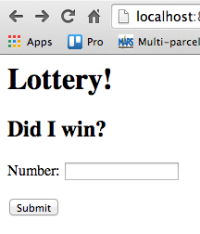
Simple running example
Ticket
--------------------------
Number: CharField

Slide 4
Django app
./manage.py startapp (settings etc)
models.py
urls.py, views.py
admin.py
tests.py (unittest, webtest)
Notes:
TDD guys would argue the tests.py goes up ☺

Slide 5

Keep it working

Slide 6




Django → JS

Slide 7


In-Browser test
Selenium

Slide 8
Casper → Selenium
Iterative vs. chain/callback-based
Python vs. coffeescript (function names)
Visible execution vs. screenshots
Selenium IDE vs. programming
Timing javascript stays hard

Slide 9
Selenium setup
+ phantomjs: stability in Jenkins
+ Firefox:
  Misses rightclick
+ Chrome:
  Misses doubleclick on pos, but ok
  Headless PyVirtualDisplay

Slide 10

And now…
  Clients start calling
Notes:
Clients call because it doesn’t work

Slide 11
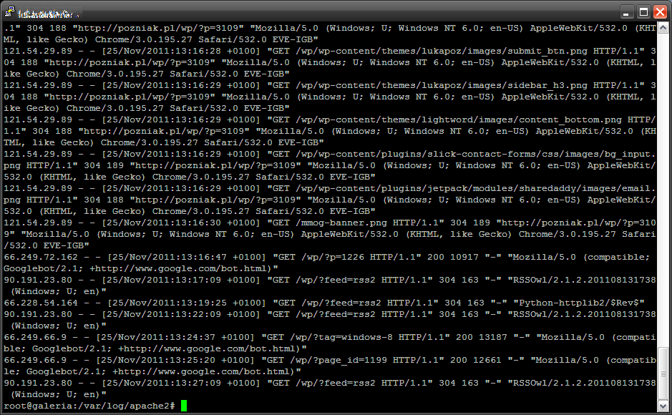
No errors in our log

Slide 12
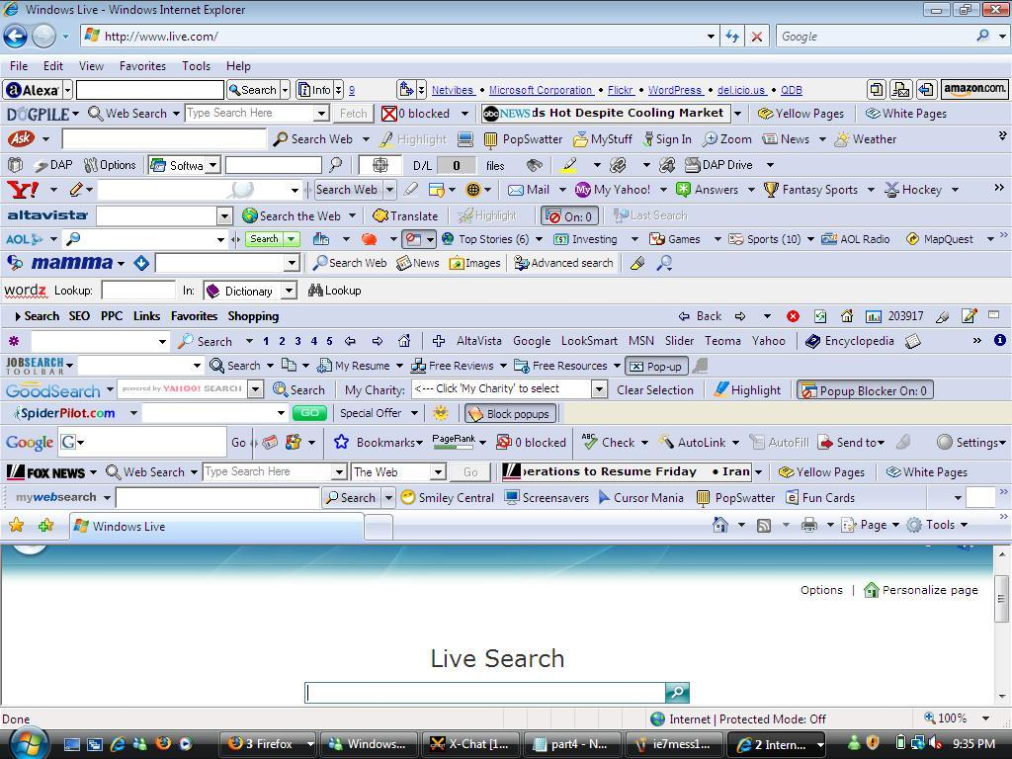
Browser plugins
Notes:
They have a different browser then you have tested

Slide 13
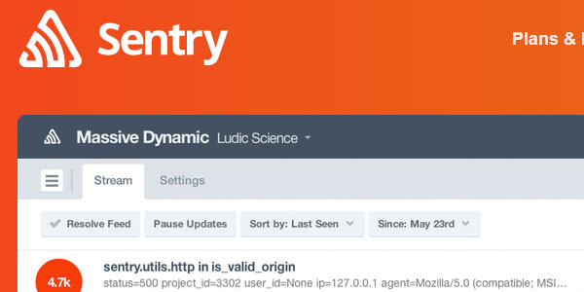
Sentry
Notes:
Sentry to the rescue

Slide 14
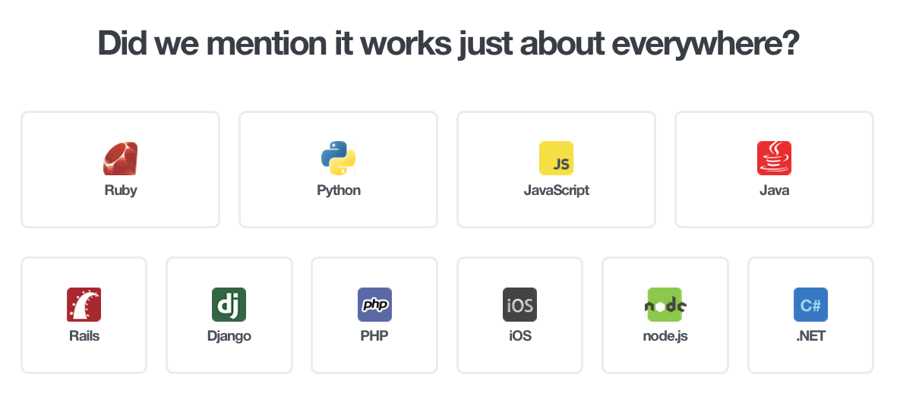
Sentry

Slide 15
Sentry
Uncaught exceptions
Option: 404 handler
Celery
Raven-JS
Combination of events

Slide 16
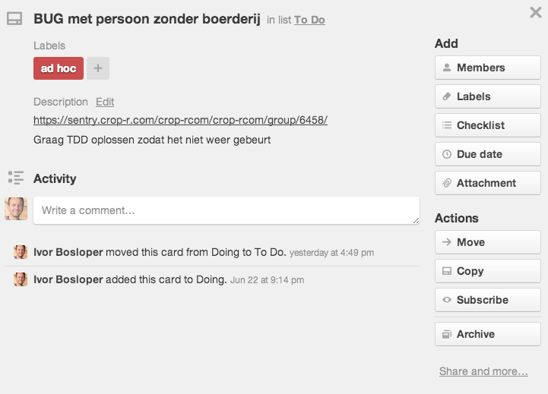
Results
~20% of bug reports point to Sentry

Slide 17
More monitoring
Nagios / Pingdom
Munin / mrtg

