Slide 1
Java Message Service
Basics and usage in sirma enterprise platform,
Ivo Rusev,
Materials available at:
https://github.com/ivorusev/jms-tutorial-app
https://github.com/ivorusev/jms-tutorial-resources

Slide 2
What is Middleware and Types
In middleware we integrate new components or to scale existing ones as efficiently as possible.
Types:
Remote Procedure Call - which allows procedures in one application to call procedures in remote applications as if they were local calls.
Object Request Broker - which enables an application’s objects to be distributed and shared across heterogeneous networks.
Message Oriented Middleware (MOM);

Slide 3
How Does the Whole Thing Work?
We install jms provider in our application server;
We define our Administration objects
Connection factories;
Queues;
Topics;
We create consumers and producers to work with messages;
The producers publish to topics and queues;
The consumers subscribe to topics and queus and read messages.

Slide 4
Again with a Picture
TODO

Slide 5
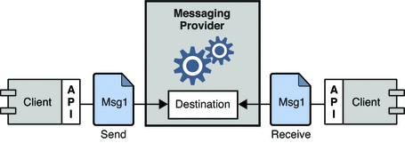
General Idea of Messaging
Messaging is a method of communication between software components or applications;
Messaging enables distributed communication that is loosely coupled;
The sender and the receiver do not have to be available at the same time in order to communicate.

Slide 6
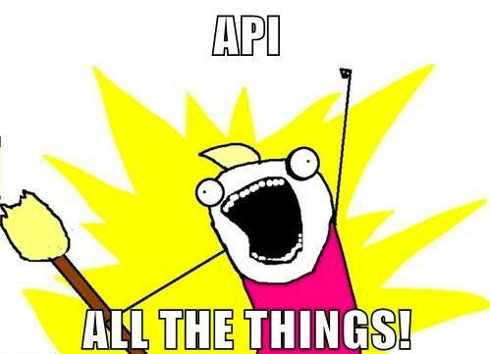
JMS API
The Java Message Service is a Java API that allows applications to create, send, receive, and read messages;
The JMS API enables communication that does not only have the characteristics of messaging in general but is also:
Asynchronous: A JMS provider can deliver messages to a client as they arrive; a client does not have to request messages in order to receive them;
Reliable: The JMS API can ensure that a message is delivered once and only once;
Guarantees order: message order is kept (queue structure).

Slide 7
Basic JMS API Concepts
A JMS provider is a messaging system that implements the JMS interfaces;
Which one do we use?
JMS clients: components that produce and consume messages;
Messages are the objects that communicate information between JMS clients;
Topic/Queue: the to main mechanisms, used from providers to handle messages;

Slide 8





JMS Service Providers and What do we Use
Weblogic – Oracle;
MQSeries – IBM;
SoniqMQ – Postgres.
ActiveMQ – Apache;
HornetQ/ ActiveMQ Artemis – WildFly;
What’s the story with ActiveMQ?
HornetQ code was donated to ActiveMQ and is now developed under a new name – ActiveMQ Artemis.

Slide 9
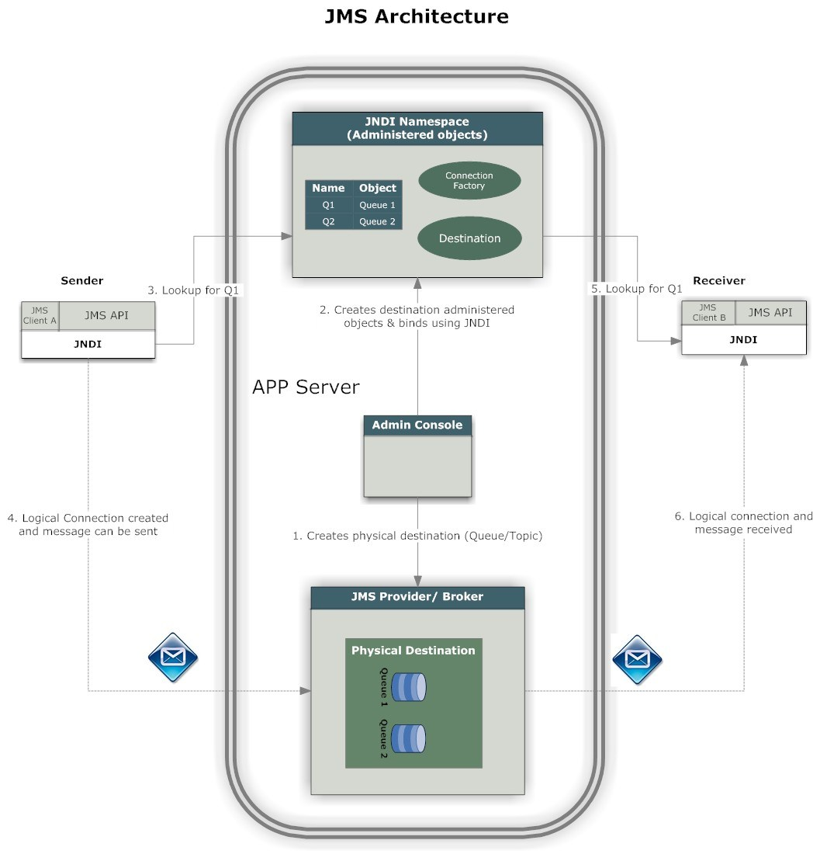
JMS Architecture
JMS Clients – looked up from JNDI;
What is JNDI?
Administrative tool;
Destination;
Connection factories.
Messages;
Objects used to transfer the data.
JMS Provider.

Slide 10
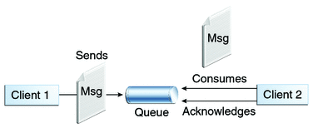
JMS Queue
Point-to-point;
Only one client / consumer gets the message (#rememberBBanchev);
Messages have to be delivered in the order sent;
The Queue knows who the consumer or the JMS client is. The destination is known;
Every message successfully processed is acknowledged by the consumer.

Slide 11
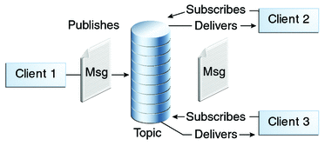
JMS Topic
Publish/subscribe model;
Multiple clients subscribe to the message;
Here is no guarantee messages have to be delivered in the order sent;
The Topic, has multiple subscribers and there is a chance that the topic does not know all the subscribers. The destination is unknown.

Slide 12

Dead Letter Queue
Messages are redelivered to a client when any of the following occurs:
A transacted session is used and rollback() is called.
A transacted session is closed before commit() is called.
A session is using CLIENT_ACKNOWLEDGE and Session.recover() is called.
A client connection times out (perhaps the code being executed takes longer than the configured time-out period).
But what happens with messages that stop redelivering after the max attempts?

Slide 13
Dead Letter Queue
Once a message's redelivery attempts exceeds the maximumRedeliveries configured for the Redelivery Policy:
a "Poison ACK" is sent back to the broker letting him know that the message was considered a poison pill;
The Broker then takes the message and sends it to a Dead Letter Queue so that it can be analyzed later on.
It is possible to discard DLQ messages;
You can set DLQ for every Queue.

Slide 14

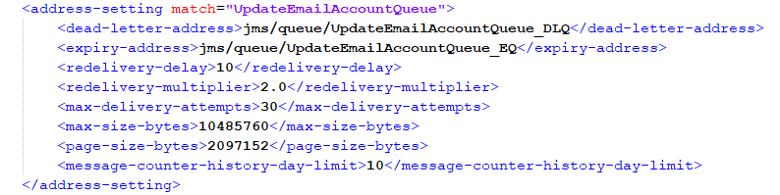
To JMS or not to JMS (1)
Don’t just pick an MQ because “decoupling is good”;
They have a learning curve (Simplified in SEP by the core team);
JMS Clients have tons of configurations;
If you overuse your MQ, then it adds latency to your system;
Harder to track the program flow when analyzing problems (you can’t just see the stacktrace).

Slide 15
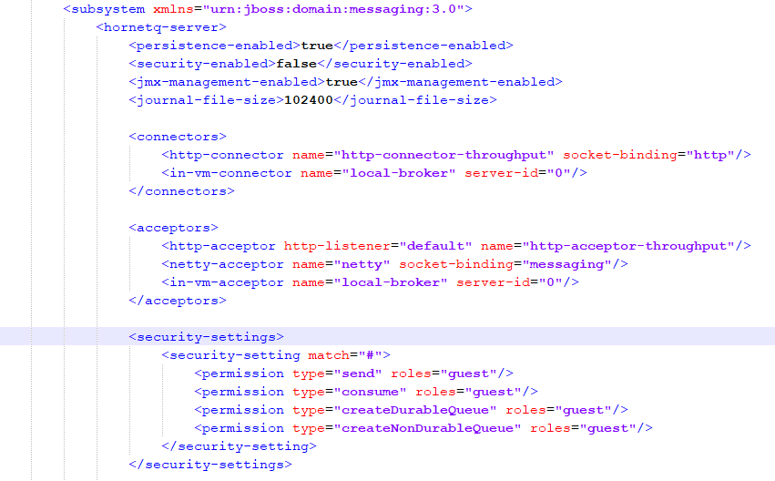
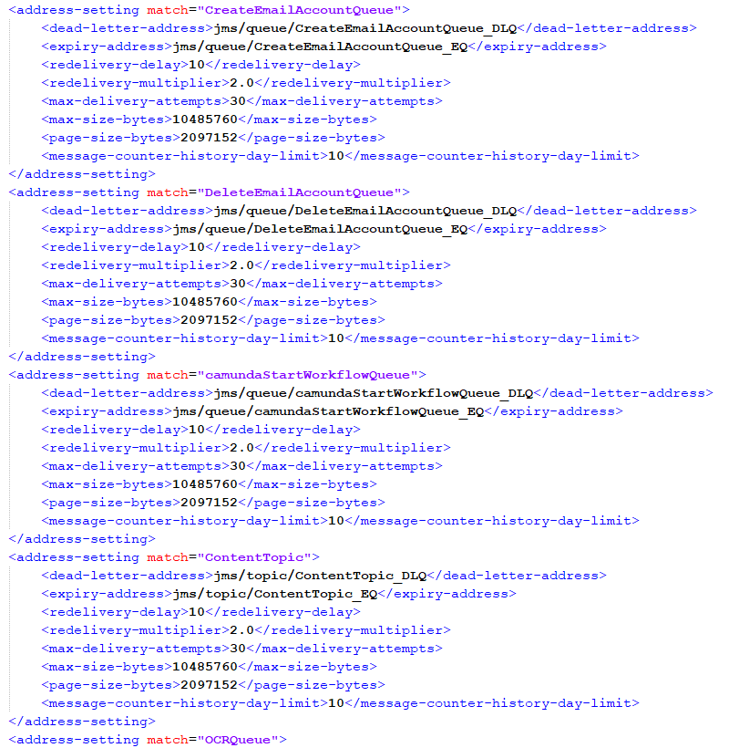
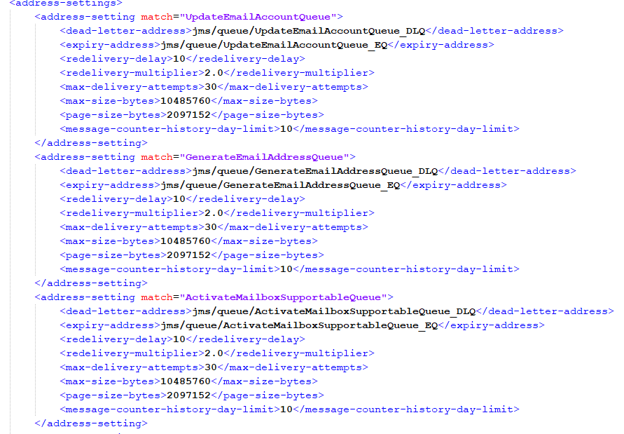

Slide 16
To JMS or not to JMS (2)
When to consider using MQ:
Decoupling;
Redundancy - Sometimes processes fail when processing data. Unless that data is persisted, it’s lost forever;
Scalability - Because message queues decouple your processes, it’s easy to scale up the rate with which messages are added to the queue or processed; simply add another process;
Elasticity & Spikeability - When your application hits live and there’s huge load, mitigates it;
Resiliency - When part of your architecture fails, it doesn’t need to take the entire system down with it (#rememberOCR).

Slide 17
To JMS or not to JMS (3)
When to consider using MQ:
Delivery Guarantees - The redundancy provided by message queues guarantees that a message will be processed eventually
Ordering Guarantees - In a lot of situations, the order with which data is processed is important. (#remembereGov)
Asynchronous Communication - A lot of times, you don’t want to or need to process a message immediately. Message queues enable asynchronous processing, which allows you to put a message on the queue without processing it.

Slide 18
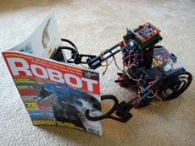
JMS Usages (1) : OCR
What did we do?
Platform
On content assign add to Topic;
Consume the messages from the topic and send them to a queue.
Service
Reads from the queue, OCRs, sends the information back.
Why did we do it?
Scalability;
Delivery Guarantees;
Resiliency.

Slide 19
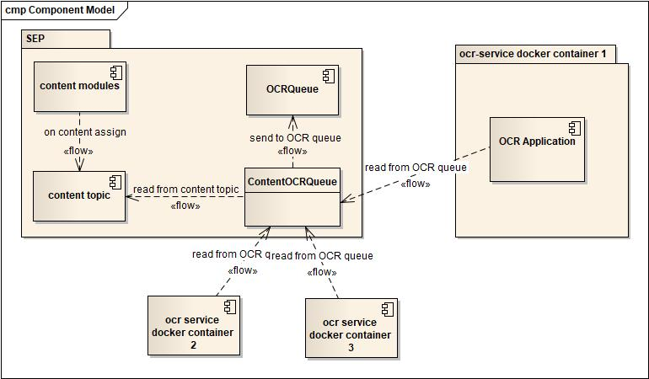
Optical Character Recognition JMS Usage
SEP Design
Adding contents to Topic;
Subscribing to Topic and sending to queue.
OCR Service Design
Listens for queue messages;
Synchronous OCR processing.

Slide 20

What did Viktor do?
What did Viktor do?
Viktor was bored;
Viktor submitted a 1000 pages document.
Don’t be like Viktor
What happened to the OCR service?
Took it ~24h +/- 10h to process the document;
What about the documents uploaded meanwhile?

Slide 21

JMS Usages (2) : eGov
eGov – eServiceApplicationProcessor
Quick eGov architecture overview;
What did we do?
Why did we do it?
Delivery Guarantees;
Ordering Guarantees;
Elasticity & Spikeability.
Why not implement it with persistent tasks? Order and states!

Slide 22
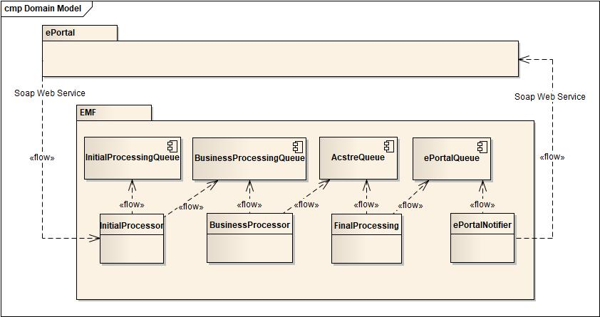
eGov Receiving Service Application Design
ePortal
SOAP WS communication;
EMF
System of JMS Queues.

Slide 23
JMS Usages (3): eGov
The lost cases fiasco;
What happened?
On the ePortal was changed a certain library which was not changed in cmf;
This caused “poisoned” messages to enter the queue in cmf;
How did we recover from it?
Replaced the library with the same version;
Jms messages were retried.

Slide 24
JMS Usages (3) : Zimbra
What did we do?
Why did we do it?
Delivery Guarantees;
Resiliency;
Elasticity & Spikability.

Slide 25
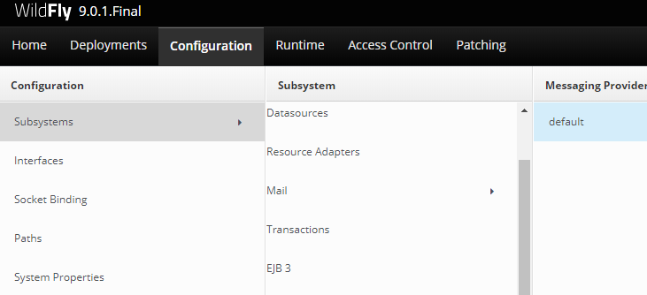
Monitoring Queues in WildFly
WildFly Management Console;
Add a new user in the management realm using add-user.bat / add-user.sh.
Open Server’s address, port 8080

Slide 26
Next time: demonstration
JMS demonstration with activemq and wildfly11

Slide 27

Questions?

