Slide 1
Java Message Service
DEMOnstration jms 2.0

Slide 2
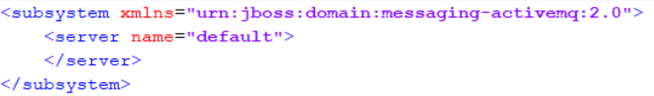
Configuring the JMS Provider (1)
Add the activeMQ extension;
Add the activeMQ subsystem;

Slide 3
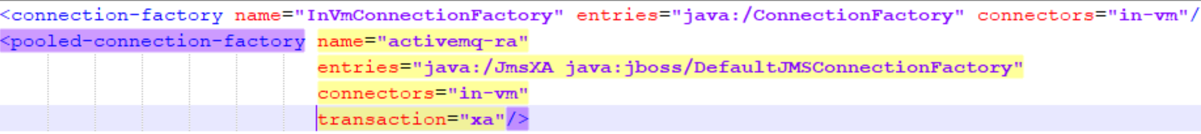
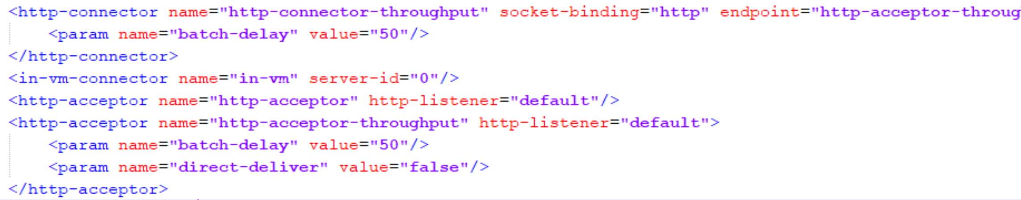
Configuring the JMS Provider (2)
Connection Factory;
HTTP acceptor and connector

Slide 4
Queue and Topic Definitions;
Note the JNDI names.
Queue: java:jboss/exported/jms/queue/test
Topic: java:jboss/exported/jms/topic/test

Slide 5
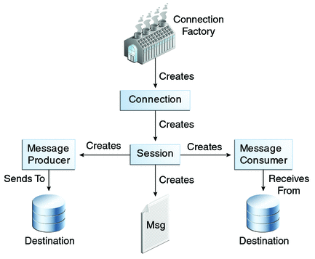
JMS API Programming Model

Slide 6
Basic JMS API Concepts
connection factory - is the object a client uses to create a connection to a provider. A connection factory encapsulates a set of connection configuration parameters that has been defined by an administrator;
Can be injected with:
@Resource(lookup = "jms/ConnectionFactory")
private static ConnectionFactory connectionFactory;
Or looked up from JNDI

Slide 7
JMS Session
A session is a single-threaded context for producing and consuming messages. You use sessions to create the following:
Message producers
Message consumers
Messages
Queue browsers
Temporary queues and topics
To create a transacted session use:
Session session = connection.createSession(true, 0);

Slide 8
JMS Topic/Queue
Queue queue = InitialContext.doLookup("java:jboss/exported/jms/queue/test");
@Resource(lookup = "jms/ConnectionFactory")

Slide 9
JMS Message Producers

Slide 10
JMS Message Consumers

Slide 11
JMS Message Listeners vs Message Driven Beans

