Slide 1
Java Message Service
Basics and usage in sirma enterprise platform
Ivo Rusev
Materials available at:

Slide 2
Message Oriented Middleware (MOM)
Is software or hardware infrastructure supporting sending and receiving messages between distributed systems;

Slide 3
General Idea of Messaging
Messaging is a method of communication between software components or applications;
Messaging enables distributed communication that is loosely coupled;
The sender and the receiver do not have to be available at the same time in order to communicate.

Slide 4
JMS API
The Java Message Service is a Java API that allows applications to create, send, receive, and read messages;
The JMS API enables communication that does not only have the characteristics of messaging in general but is also:
Asynchronous: A JMS provider can deliver messages to a client as they arrive; a client does not have to request messages in order to receive them;
Reliable: The JMS API can ensure that a message is delivered once and only once;
Guarantees order: message order is kept (queue structure).

Slide 5





JMS Service Providers and What do we Use
Weblogic – Oracle;
MQSeries – IBM;
SoniqMQ – Postgres.
ActiveMQ – Apache;
HornetQ/ ActiveMQ Artemis – WildFly;
What’s the story with ActiveMQ?
HornetQ code was donated to ActiveMQ and is now developed under a new name – ActiveMQ Artemis.

Slide 6
Basic JMS API Concepts
A JMS provider is a messaging system that implements the JMS interfaces;
(Already mentioned) Which is the JMS Provider we use?
JMS clients: components that produce and consume messages;
Messages are the objects that communicate information between JMS clients;
Topic/Queue: the to main mechanisms, more details later;

Slide 7
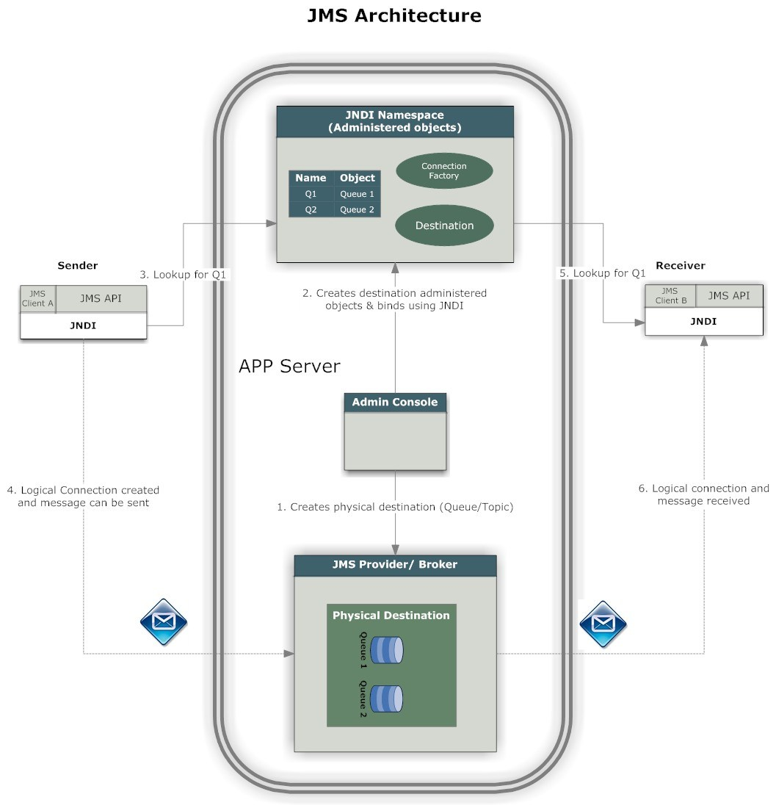
JMS Architecture
JMS Clients – looked up from JNDI;
What is JNDI?
Administrative tool;
Destination (physical);
Connection factories.
Messages;
Objects used to transfer the data.
JMS Provider.

Slide 8
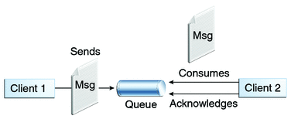
JMS Queue
Point-to-point;
Only one consumer gets the message (#rememberBBanchev);
Messages have to be delivered in the order sent;
The Queue knows who the consumer or the JMS client is. The destination is known;
Every message successfully processed is acknowledged by the consumer.

Slide 9
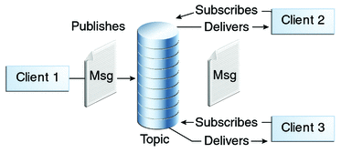
JMS Topic
Publish/subscribe model;
Multiple clients subscribe to the message;
Here is no guarantee messages have to be delivered in the order sent;
The Topic, has multiple subscribers and there is a chance that the topic does not know all the subscribers. The destination is unknown.

Slide 10

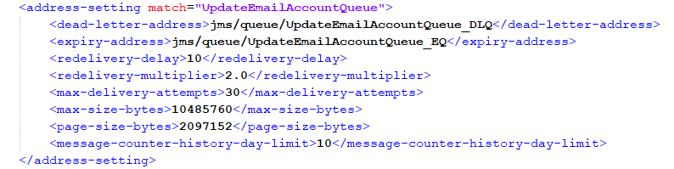
To JMS or not to JMS (1)
Don’t just pick an MQ because “decoupling is good”;
They have a learning curve (Simplified in SEP by the core team);
JMS Clients have tons of configurations;
If you overuse your MQ, then it adds latency to your system;
Harder to track the program flow when analyzing problems (you can’t just see the stacktrace).

Slide 11
To JMS or not to JMS (2)
When to consider using MQ:
Decoupling
Redundancy - Sometimes processes fail when processing data. Unless that data is persisted, it’s lost forever;
Scalability - Because message queues decouple your processes, it’s easy to scale up the rate with which messages are added to the queue or processed; simply add another process;
Elasticity & Spikeability - When your application hits live and there’s huge load, mitigates it;
Resiliency - When part of your architecture fails, it doesn’t need to take the entire system down with it (#rememberOCR).

Slide 12
To JMS or not to JMS (3)
When to consider using MQ:
Delivery Guarantees - The redundancy provided by message queues guarantees that a message will be processed eventually
Ordering Guarantees - In a lot of situations, the order with which data is processed is important.
Asynchronous Communication - A lot of times, you don’t want to or need to process a message immediately. Message queues enable asynchronous processing, which allows you to put a message on the queue without processing it.

Slide 13
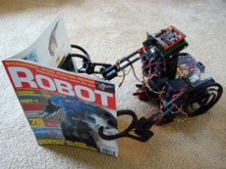
JMS Usages (1) : OCR
What did we do?
Platform
On content assign add to Topic;
Consume the messages from the topic and send them to a queue.
Service
Reads from the queue, OCRs, sends the information back.
Why did we do it?
Scalability;
Delivery Guarantees;
Resiliency.

Slide 14
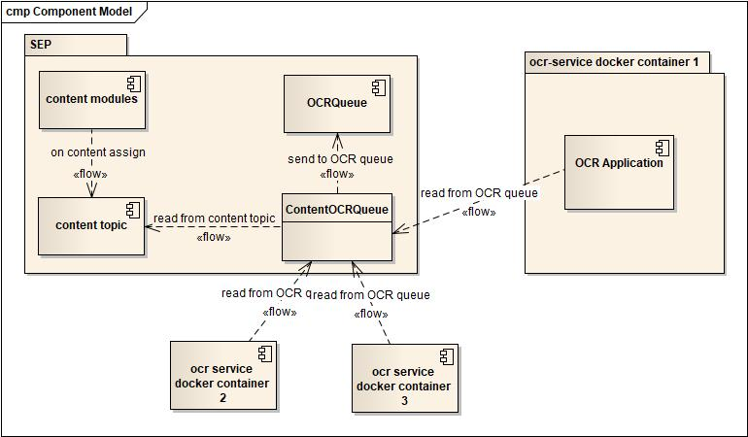
Optical Character Recognition JMS Usage
SEP Design
Adding contents to Topic;
Subscribing to Topic and sending to queue.
OCR Service Design
Listens for queue messages;
Synchronous OCR processing.

Slide 15

JMS Usages (2) : eGov
eGov – eServiceApplicationProcessor
Quick eGov architecture overview;
What did we do?
Why did we do it?
Delivery Guarantees;
Ordering Guarantees;
Elasticity & Spikeability.
Why not implement it with persistent tasks? Order and states!

Slide 16
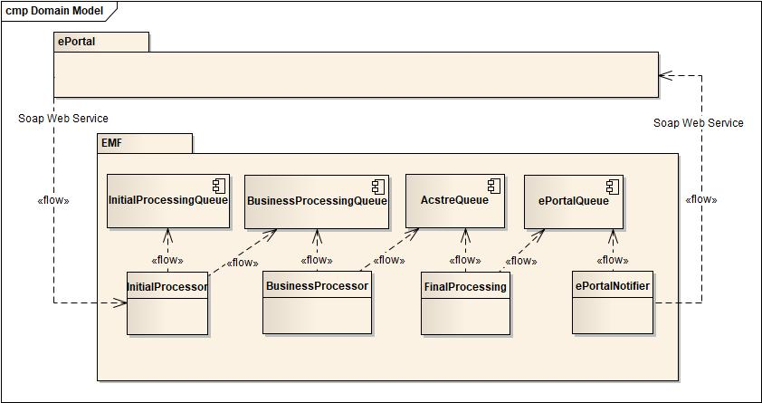
eGov Receiving Service Application Design
ePortal
SOAP WS communication
EMF
System of JMS Queues

Slide 17
JMS Usages (3) : Zimbra
What did we do?
Why did we do it?
Delivery Guarantees;
Resiliency;
Elasticity & Spikability.

Slide 18
DLQ

Slide 19
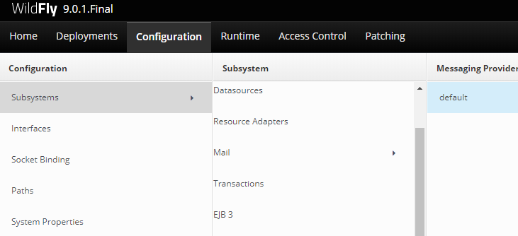
Monitoring Queues in WildFly
WildFly Management Console;
Add a new user in the management realm using add-user.bat / add-user.sh.
Open Server’s address, port 8080

Slide 20
Next time: demo
JMS demonstration with activemq and wildfly11

Slide 21

Questions?

