Slide 1
Java Message Service
Basics and usage in sirma enterprise platform

Slide 2
JMS Basics
Enables communication that is loosely couple;
The receiver does not have to know anything about the sender;
The message format has to be known to both.
JMS communication is also reliable;
The receiver and the sender don’t have to online at the same time;
The JMS API can ensure that a message is delivered once and only once
If the message is not consumed without error it retries.

Slide 3
Basic JMS API Concepts
JMS clients: components that produce and consume messages;
Messages are the objects that communicate information between JMS clients;
Topic/Queue: the to main mechanisms, more details later;

Slide 4
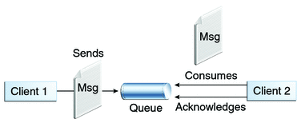
JMS Queue
Point-to-point
Only one consumer gets the message;
Messages have to be delivered in the order sent;
The Queue knows who the consumer or the JMS client is. The destination is known;
Every message successfully processed is acknowledged by the consumer;

Slide 5
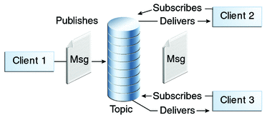
JMS Topic
Publish/subscribe model;
Multiple clients subscribe to the message;
Here is no guarantee messages have to be delivered in the order sent;
The Topic, have multiple subscribers and there is a chance that the topic does not know all the subscribers. The destination is unknown.

