Slide 1
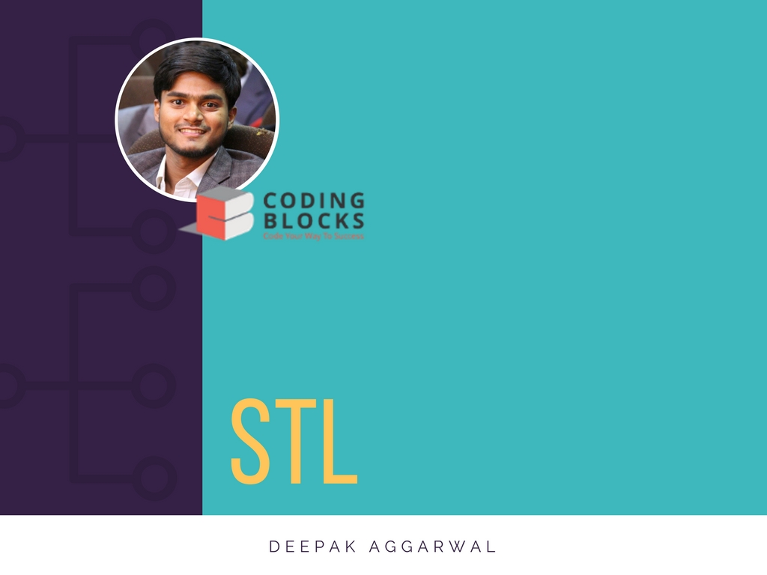
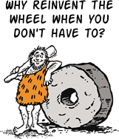

Slide 2
What Is STL?
Standard
Template
Library
STL is a large piece of code that every compiler must supply so that every programmer can rely on it.
Notes:
STL is a large piece of code that every compiler must supply so that every programmer can rely on it.

Slide 3
What does a computer deal with?
Data
Algorithm
Data Structure/Container

Slide 4
Data + algorithm
Notes:
How does data and algo bind together?
-Function to print a char and int array
-

Slide 5
Generic Programming

Slide 6
Data + Container

Slide 7
SEQUENTIAL
CONTAINER
ASSOCIATIVE
ANYTHING THAT CONTAINS DATA
ADAPTERS

Slide 8
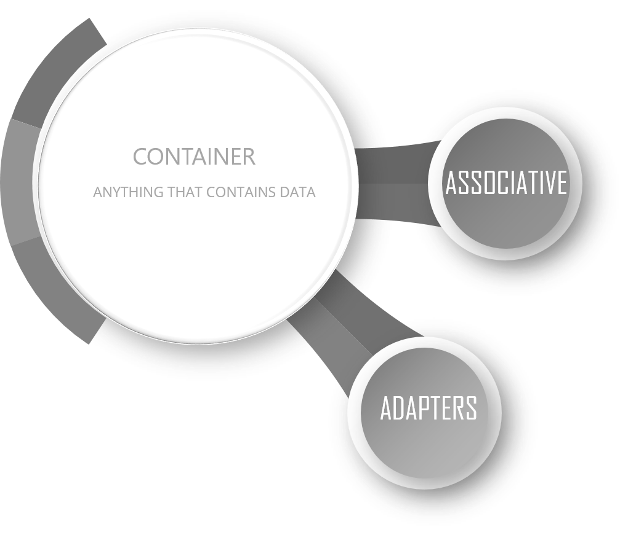
SEQUENTIAL
- Stores data in a particular sequence
- Position matters
vector
list
forward_list
deque
array

Slide 9
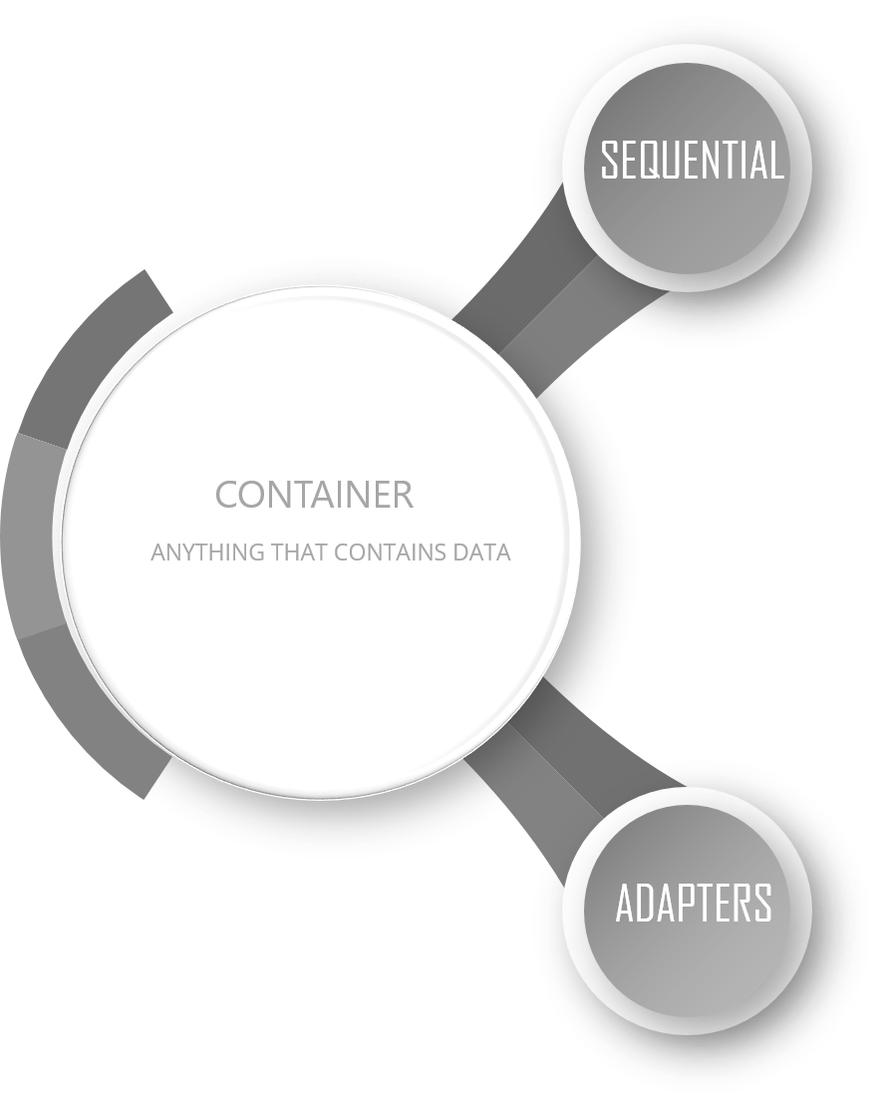
-
- Data is somehow associated with itself
- Position does NOT matters
ASSOCIATIVE
map
multimap
set
multiset
unordered_map
unordered_set

Slide 10
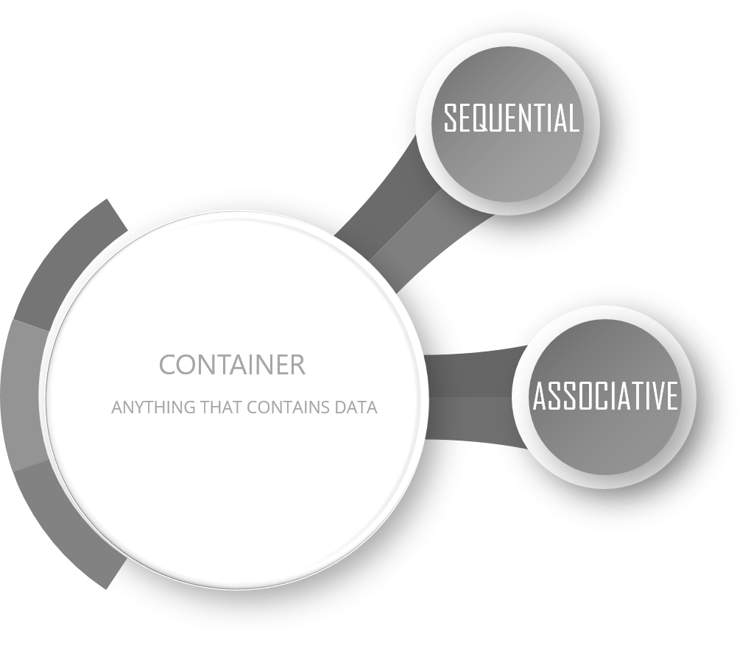
- Sit on already existing containers and restrict their functionalities
- Are pure concepts
stack
queue
priority_queue
ADAPTERS

Slide 11
Algorithm + Container

Slide 12
Iterator
RANDOM ACCESS
BIDIRECTIONAL
FORWARD
INPUT
OUTPUT

Slide 13
An Insight
remove_if
reverse_copy
lower_bound
-merge
next_permutation
Notes:
remove_if

Slide 14
remove_if
Notes:
remove all integers less than 33
remove all students having score less than 33

Slide 15
reverse_copy

Slide 16
lower_bound
Notes:
greater than equal to
operator <

Slide 17
merge
Notes:
back_inserter

Slide 18
next_permutation

Slide 19
priority_queue
- The element that’s removed appears in the last of the container

Slide 20
Happy Programming
deepak@codingblocks.com
Visit us at www.codingblocks.com

