Slide 1
Endgame Tactics

Slide 2
Endgame Tactics
Suppose that the
・
・
・
・
・
・
・
An Endgame

Slide 3
Endgame Tactics

Slide 4
Endgame Tactics (Chess)
Pawn Endings
Rook Endings
♙ : ♚
♙ : ♟
♙♙ : ♟
…
♖ : ♟
♖ : ♟♟
…
R vs R Endings
R vs N Endings
...

Slide 5
Endgame Tactics (Shogi)
Pattern 2
Pattern 1
Pattern 3
...

Slide 6
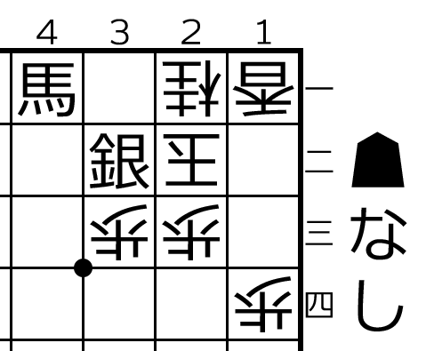
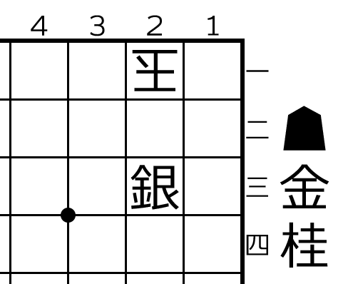
Endgame Tactics (Shogi)
Pattern 2
Pattern 1
Pattern 3
TBA
...

Slide 7
Endgame Tactics (Shogi)
Pattern 1’
Pattern 2
The Covering is not unique.
Pattern 1
Pattern 2’
Pattern 3’
Pattern 3

