Slide 1
Data Science: Final Project
Kindle Fire & Other Tablets Customer Reviews and Sales Analysis
by Ivory Poo

Slide 2
Dataset overview
Two sets of data: Weekly Sales Rankings and Customer Reviews.
Customer reviews data consists of reviews for 2163 tablet products
93.3% of customer reviews are specifically for Amazon Kindle Fire.
Amazon Kindle Fire ranked the 1st selling product over the 24 weeks.
All sales analysis is done with sales ranking.

Slide 3
Objective
Investigate the sales and customer reviews for Amazon Kindle Fire and other tablets, to answer the questions:
1. What is the overall customer rating on Amazon Kindle Fire?
2. For rating of 1 and rating of 5, what are the messages to producer/seller?
3. For other tablets with high/ low sale ranking, what does customers say about the product?
4. For other tablets, do customer reviews and ranking have an effect on sales ranking?

Slide 4
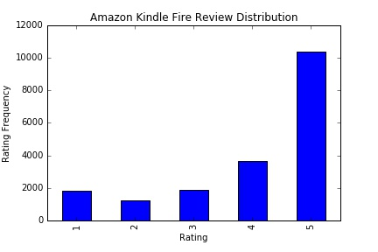
Amazon Kindle Fire Ranking Distribution

Slide 5

Verified Purchase:
30% of the reviews are unverified.
I will exclude the unverified reviews in the following analysis for accurarcy.

Slide 6
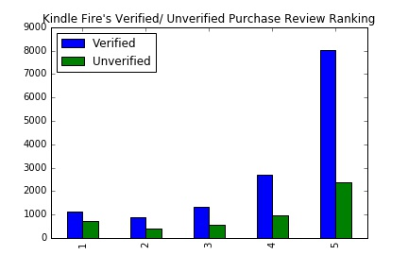
Amazon Kindle Fire Ranking Distribution by verified/ Unverified Purchase

Slide 7
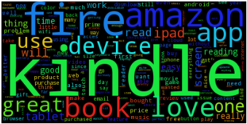
Kindle Fire's WordCloud for ALL the Verified-purchase customer reviews.
*Verified-purchase

Slide 8
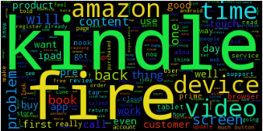
Kindle Fire's WordCloud for Bad Reviews
*Verified purchase & Average vote of helpfulness in top 100 & Rating =1

Slide 9
Kindle Fire's WordCloud for Bad Reviews
Insight:
The keywords tell the producer what the customer dislike about the product. The producer can use these feedback to improve the product in order to increase the sales.
Beside kindle, fire and amazon, the keywords are time, device, video and content.
Tablet producer may look further into the size of video and time related functions in order to increase customers’ satisfactions.
Other than that, the content that Amazon Kindle Fire is offering seems to be a concern for the customer.

Slide 10
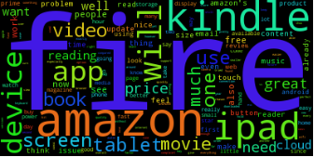
Kindle Fire's WordCloud for Good Reviews
*Verified purchase & Average vote of helpfulness in top 100 & Rating =5

Slide 11
Kindle Fire's WordCloud for Good Reviews
Insight:
The keywords tell the producer, what the customers like about the product. It also gives insight to other tablets producer, what are customers’ expectations when they buy a tablet.
Beside kindle, fire and amazon, the keywords are iPad, movie, video screen and cloud.
Video also show up in the review of rating of 5. This keyword is interesting to look into since it has high distinction in customers’ likings.
Besides that, it seems that customers who are happy about Amazon Kindle Fire tend to compare the product with iPad, and they like about the screen and cloud storing.

Slide 12
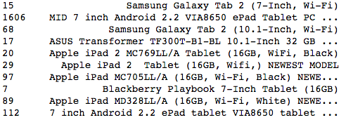
Other tablets & reviews
Top 10 others tablets in sales ranking:

Slide 13
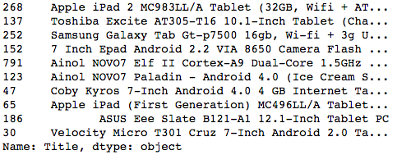
Other tablets & reviews
Bottom 10 others tablets in sales ranking:

Slide 14
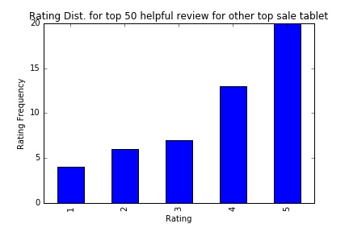
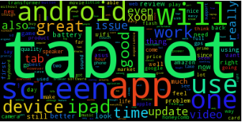
Rating Distribution/ WordCloud in top 50 sale ranking for other tablets:

Slide 15
Rating Distribution/ WordCloud in top 50 sale ranking for other tablets:
Insight:
The ranking is increasing gradually from rank of 1 to rank of 3, and shot high to rank of 4 and rank of 5.
The top keywords are tablet, app, Android, and screen.
Seller may look into the size of tablet screen, it may be the reason the buyer like or care the most when buying tablets.
Tablet producer may look further into Android system and apps.

Slide 16
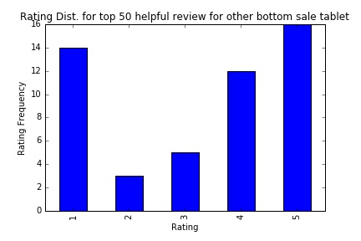
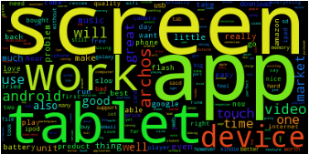
Rating Distribution/ WordCloud in bottom 50 sale ranking for other tablets:

Slide 17
Rating Distribution/ WordCloud in bottom 50 sale ranking for other tablets:
Insight:
The ranking of 5 is the most, followed by ranking of 1, which implies that products in low sale ranking has high distinction in regards to buyers’ liking.
The top keywords are screen, app and tablets.
This three keywords also show up in the product review of top 50 ranking.
Tablet producer may look further into screen and apps in order to increase customers’ satisfication.

Slide 18
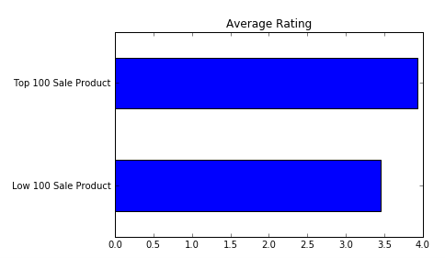
Relationship between Sales & Customer Rating:
Insight: The average rating of the 100 product with highest and lowest sale is: 3.93 & 3.46. It seems that the relationship between sale rank and review rank is positive but the strength is weak.

Slide 19
Summary
In this set of data, among all the tablets, customer has highest satisfaction on Amazon Kindle Fire.
The intuitive keywords (other than the brand name and tablet synonyms) that shows up the most in all the reviews are screen, app and video.
The relationship between sale rank and review rank is positive but the strength is weak.

