Slide 1
Microservices
Develop, test, release and operate the delivery in a continuous manner without compromising all high quality bars, but being cost effective.

Slide 2
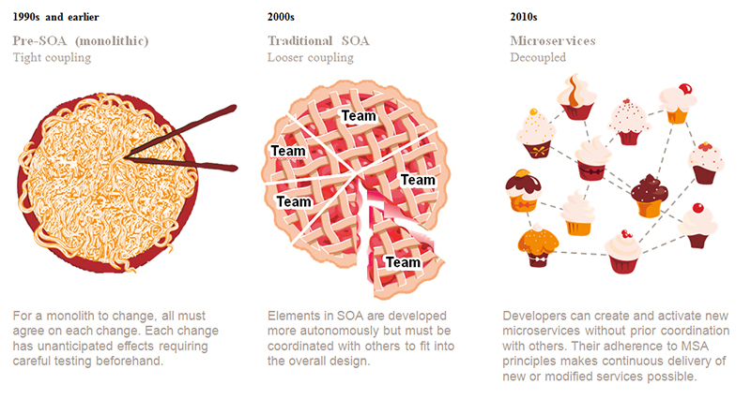
Architecture Transformation

Slide 3
Forces of the Deployment Architecture
There is a team(s) of developers working on the application
New team members must quickly become productive
The application must be easy to understand and modify
You want to practice continuous deployment of the application
You must run multiple copies of the application on multiple machines in order to satisfy scalability and availability requirements
You want to take advantage of emerging technologies (frameworks, programming languages, etc)

Slide 4
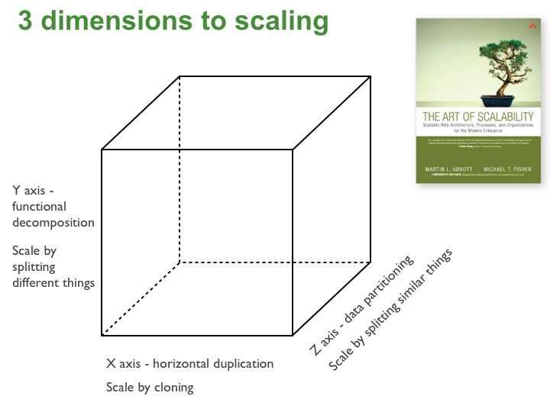
Solution - The Scale Cube

Slide 5
Microservice Architecture
The term "Microservice Architecture" has sprung up over the last few years to describe a particular way of designing software applications as suites of independently deployable services. While there is no precise definition of this architectural style, there are certain common characteristics around organization around business capability, automated deployment, intelligence in the endpoints, and decentralized control of languages and data.
In short, the microservice architectural style is an approach to developing a single application as a suite of small services, each running in its own process and communicating with lightweight mechanisms, often an HTTP resource API. These services are built around business capabilities and independently deployable by fully automated deployment machinery. There is a bare minimum of centralized management of these services, which may be written in different programming languages and use different data storage technologies.

Slide 6
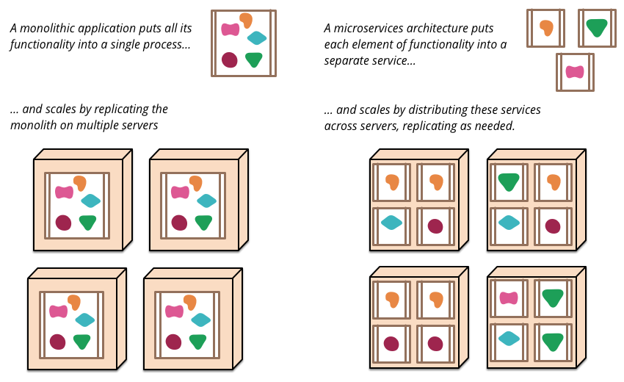
Scaling (Decompositioning)

Slide 7
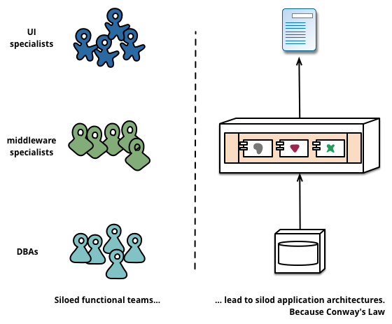
Organized around Business Capabilities
Any organization that designs a system (defined broadly) will produce a design whose structure is a copy of the organization's communication structure.
-- Melvyn Conway, 1967

Slide 8
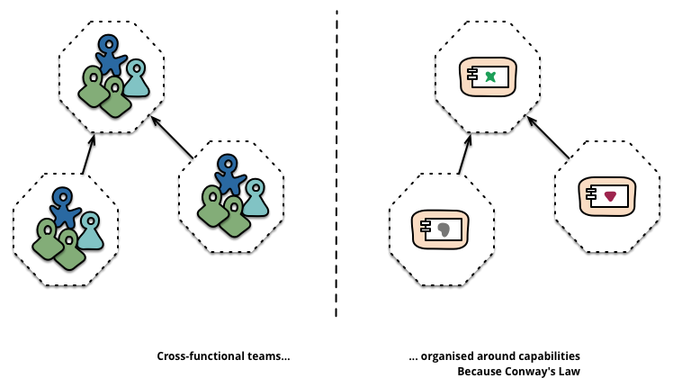
Service boundaries reinforced from the Org chart

Slide 9
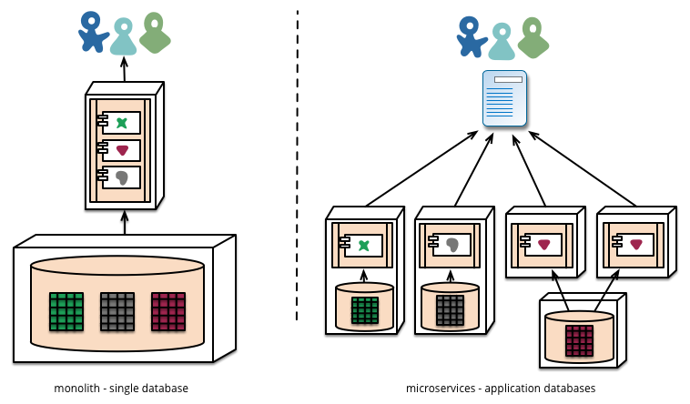
Decentralized Data Management

Slide 10
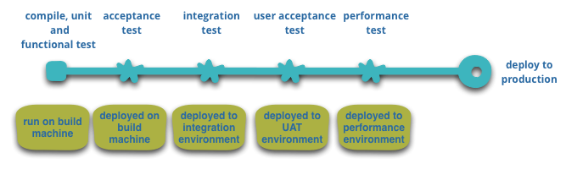
Infrastructure Automation
Teams building microservices requires extensive use of infrastructure automation techniques (CICD).

Slide 11
Design for Failure
A consequence of using services as components, is that applications need to be designed so that they can tolerate the failure of services.
Any service call could fail due to unavailability of the supplier, the client has to respond to this as gracefully as possible.
This is a disadvantage compared to a monolithic design as it introduces additional complexity to handle it.
The consequence is that microservice teams constantly reflect on how service failures affect the user experience.
Netflix's Simian Army induces failures of services and even datacenters during the working day to test both the application's resilience and monitoring.

Slide 12
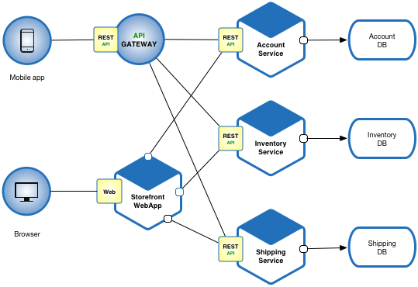
Example - Fictitious e-commerce application

Slide 13
Microservices Pros
Each microservice is relatively small
Easier for a developer to understand
The IDE is faster making developers more productive
The application starts faster, which makes developers more productive, and speeds up deployments
Each service can be deployed independently of other services - easier to deploy new versions of services frequently
Easier to scale development. It enables you to organize the development effort around multiple teams. Each (two pizza) team is owns and is responsible for one or more single service. Each team can develop, deploy and scale their services independently of all of the other teams.
Improved fault isolation. For example, if there is a memory leak in one service then only that service will be affected. The other services will continue to handle requests. In comparison, one misbehaving component of a monolithic architecture can bring down the entire system.
Each service can be developed and deployed independently
Eliminates any long-term commitment to a technology stack. When developing a new service you can pick a new technology stack. Similarly, when making major changes to an existing service you can rewrite it using a new technology stack.

Slide 14
Microservices Cons
Developers must deal with the additional complexity of creating a distributed system.
Developer tools/IDEs are oriented on building monolithic applications and don’t provide explicit support for developing distributed applications.
Testing is more difficult
Developers must implement the inter-service communication mechanism.
Implementing use cases that span multiple services without using distributed transactions is difficult
Implementing use cases that span multiple services requires careful coordination between the teams
Deployment complexity. In production, there is also the operational complexity of deploying and managing a system comprised of many different service types.
Increased memory consumption. The microservice architecture replaces N monolithic application instances with NxM services instances. If each service runs in its own JVM (or equivalent), which is usually necessary to isolate the instances, then there is the overhead of M times as many JVM runtimes. Moreover, if each service runs on its own VM (e.g. EC2 instance), as is the case at Netflix, the overhead is even higher.

Slide 15
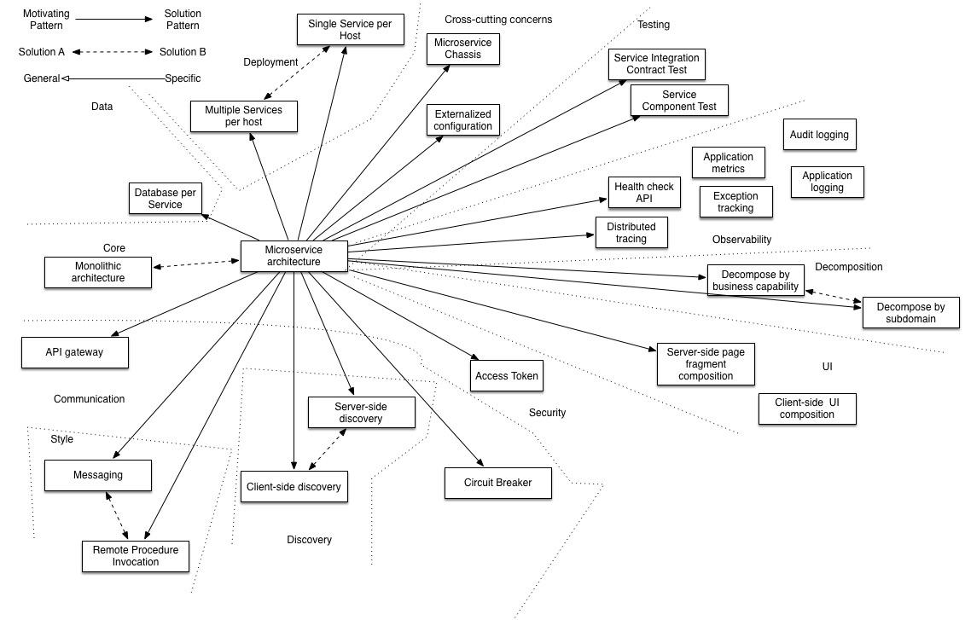
Patterns address issues that you will encounter when applying the microservice architecture

Slide 16
Battleships
Most large scale web sites including Netflix, Amazon and eBay have evolved from a monolithic architecture to a microservice architecture.
Netflix, which is a very popular video streaming service that’s responsible for up to 30% of Internet traffic, has a large scale, service-oriented architecture.
They handle over a billion calls per day to their video streaming API from over 800 different kinds of devices. Each API call fans out to an average of six calls to backend services.
Amazon.com originally had a two-tier architecture. In order to scale they migrated to a service-oriented architecture consisting of hundreds of backend services. Several applications call these services including the applications that implement the Amazon.com website and the web service API. The Amazon.com website application calls 100-150 services to get the data that used to build a web page.
The auction site ebay.com also evolved from a monolithic architecture to a service-oriented architecture. The application tier consists of multiple independent applications. Each application implements the business logic for a specific function area such as buying or selling. Each application uses X-axis splits and some applications such as search use Z-axis splits. Ebay.com also applies a combination of X-, Y- and Z-style scaling to the database tier.

Slide 17
How to decompose the application into services?
Another challenge is deciding how to partition the system into microservices. This is very much an art, but there are a number of strategies that can help:
Decompose by business capability and define services corresponding to business capabilities.
Decompose by domain-driven design subdomain.
Decompose by verb or use case and define services that are responsible for particular actions. e.g. a Shipping Service that’s responsible for shipping complete orders.
Decompose by by nouns or resources by defining a service that is responsible for all operations on entities/resources of a given type. e.g. an Account Service that is responsible for managing user accounts.

Slide 18


