Slide 1
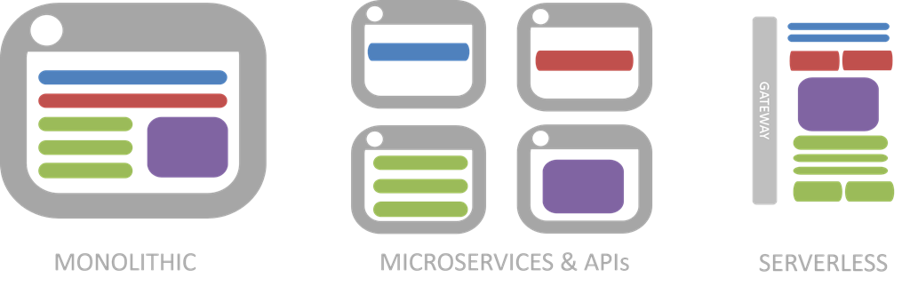
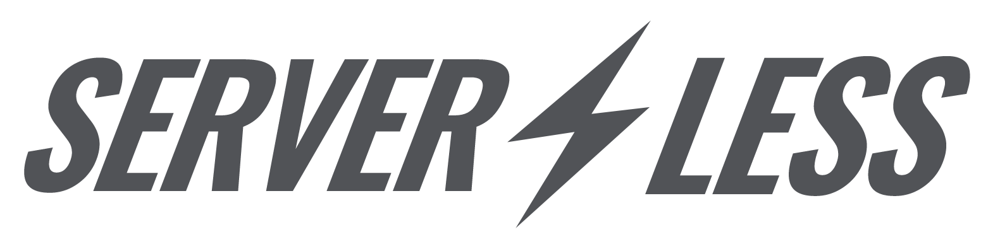
Develop, test, release and operate the delivery in a continuous manner without compromising all high quality bars, but being cost effective.

Slide 2
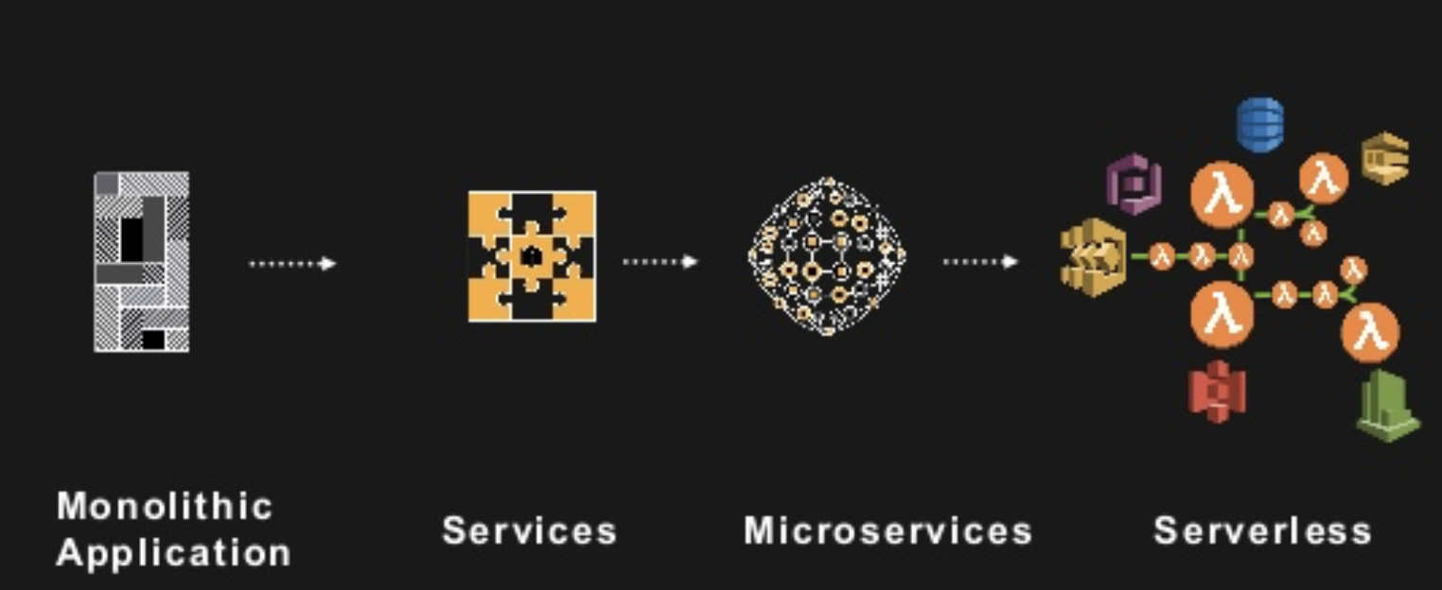
Progression to serverless

Slide 3
Serverless computing
Serverless runtimes is a cloud computing execution model in which the cloud provider dynamically manages the allocation of machine resources. Pricing is based on the actual amount of resources consumed by an application, rather than on pre-purchased units of capacity. It is a form of utility computing.
Several serverless databases have been released to supplement the pay-on-use persistence layer. These systems extend the serverless execution model to the RDBMS and NoSQL, eliminating the need to provision or scale virtualized or physical database hardware.

Slide 4
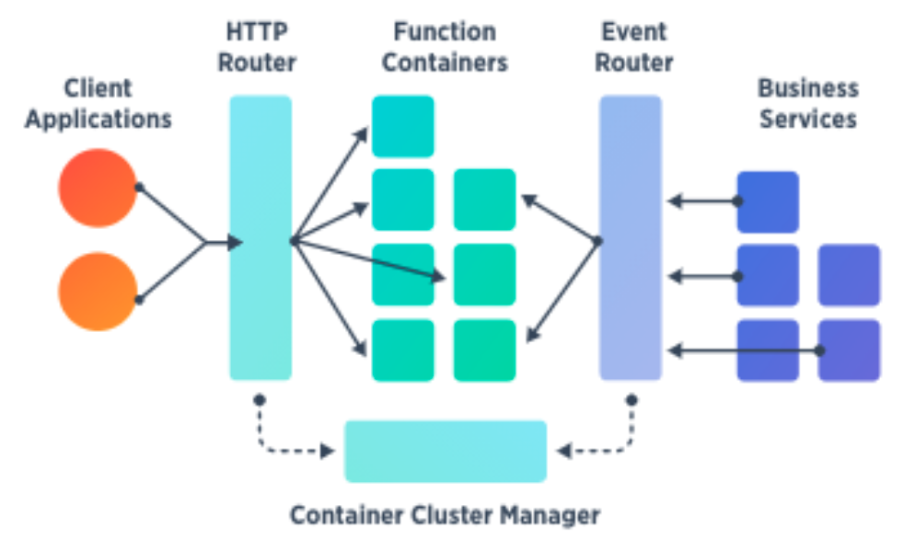
Origin of ‘Serverless’
Serverless computing still requires servers. The name "serverless computing" is used because the server management and capacity planning decisions are completely hidden from the developer or operator. Serverless code can be used in conjunction with code deployed in traditional styles, such as microservices. Alternatively, applications can be written to be purely serverless and use no provisioned services at all

Slide 5
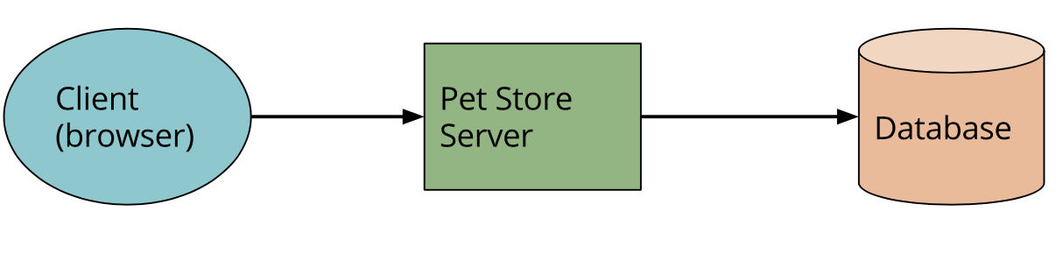
A couple of examples - UI driven
Traditional 3-tier client-oriented system with server-side logic (e-commerce).
With this architecture the client can be relatively unintelligent, with much of the logic in the system - ui/ux, authentication, page navigation, searching, transactions - implemented by the server application.

Slide 6
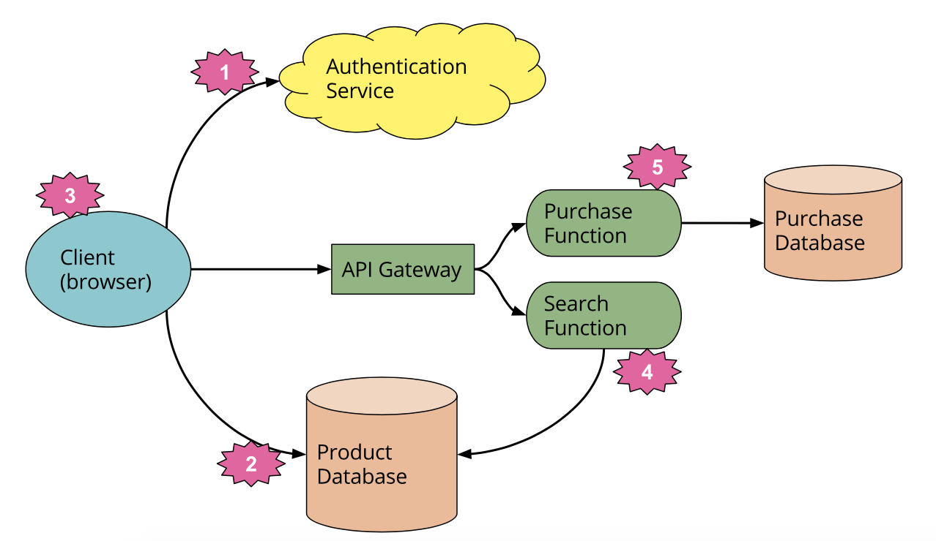
A couple of examples - UI driven
With a Serverless architecture this may end up looking more like this:

Slide 7
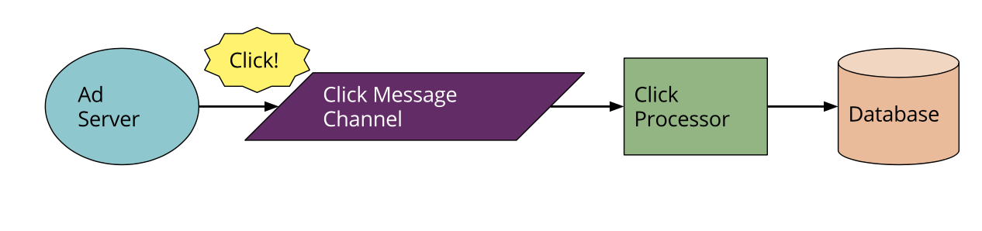
A couple of examples - Message driven
Traditionally, the architecture may look like this. The ‘Ad Server’ synchronously responds to the user - we don’t care about that interaction for the sake of this example - but it also posts a message to a channel that can be asynchronously processed by a ‘click processor’ application that updates a database, e.g. to decrement the advertiser’s budget.

Slide 8
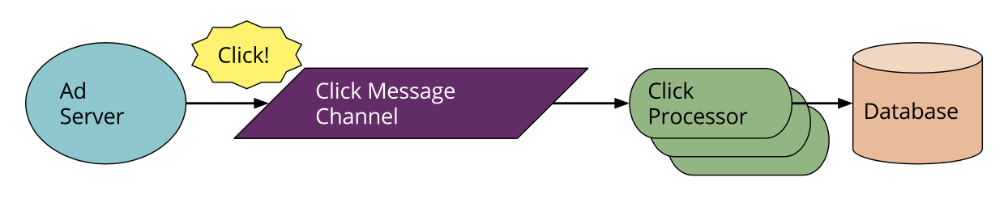
A couple of examples - Message Driven
In the Serverless world this looks like:
There’s a much smaller difference to the architecture here compared to our first example. We’ve replaced a long lived consumer application with a FaaS function that runs within the event driven context the vendor provides us. Note that the vendor supplies both the Message Broker and the FaaS environment - the two systems are closely tied to each other.

Slide 9
Unpacking ‘Function as a Service’
Opening description of AWS Lambda
AWS Lambda lets you run code without provisioning or managing servers. (1) ... With Lambda, you can run code for virtually any type of application or backend service (2) - all with zero administration. Just upload your code and Lambda takes care of everything required to run (3) and scale (4) your code with high availability. You can set up your code to automatically trigger from other AWS services (5) or call it directly from any web or mobile app (6).
Fundamentally FaaS is about running back end code without managing your own server systems or your own server applications. That second clause - server applications - is a key difference when comparing with other modern architectural trends like containers and PaaS (Platform as a Service.)

Slide 10
State
FaaS functions have significant restrictions when it comes to local (machine / instance bound) state. In short you should assume that for any given invocation of a function none of the in-process or host state that you create will be available to any subsequent invocation. This includes state in RAM and state you may write to local disk. In other words from a deployment-unit point of view FaaS functions are stateless.

Slide 11
Execution Durations
FaaS functions are typically limited in how long each invocation is allowed to run. At present AWS Lambda functions are not allowed to run for longer than 5 minutes and if they do they will be terminated.
This means that certain classes of long lived task are not suited to FaaS functions without re-architecture, e.g. you may need to create several different coordinated FaaS functions where in a traditional environment you may have one long duration task performing both coordination and execution.

Slide 12
Startup Latency
At present how long it takes your FaaS function to respond to a request depends on a large number of factors, and may be anywhere from 10ms to 2 minutes. That sounds bad, but let’s get a little more specific, using AWS Lambda as an example.
If your function is implemented in Javascript or Python and isn’t huge (i.e. less than a thousand lines of code) then the overhead of running it in should never be more than 10 - 100 ms. Bigger functions may occasionally see longer times.
If your Lambda function is implemented on the JVM you may occasionally see long response times (e.g. > 10 seconds) while the JVM is spun up. However this only notably happens with either of the following scenarios
Is it a concern? How to jump over it?

Slide 13
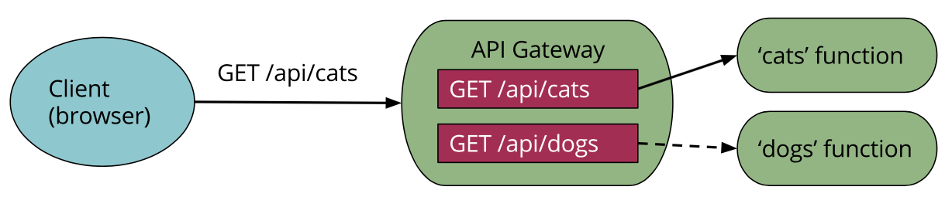
API Gateway
One aspect of FaaS that we brushed upon earlier is an ‘API Gateway’. An API Gateway is an HTTP server where routes / endpoints are defined in configuration and each route is associated with a FaaS function. When an API Gateway receives a request it finds the routing configuration matching the request and then calls the relevant FaaS function. Typically the API Gateway will allow mapping from http request parameters to inputs arguments for the FaaS function. The API Gateway transforms the result of the FaaS function call to an http response, and returns this to the original caller.

Slide 14
Benefits
Reduced operational cost
BaaS Reduced development cost
FaaS scaling cost
Optimizations is the root of cost savings
Easier Operational Management
Scaling benefits of FaaS beyond costs
Reduced packaging and deployment complexity
Time to market / experimentation
Greener computing

Slide 15
Drawbacks
Vendor locking
Performance
Resource limits
Security
Debugging and optimizations
No OPS? Really?

Slide 16
Function as a service (FaaS) platforms
Zimki, released in 2006, but it was not commercially successful.
Google released Google App Engine, in 2008 which featured metered billing for applications that used a custom Python framework, but could not execute arbitrary code.
AWS Lambda, introduced by Amazon in 2014, was the first public cloud vendor with an abstract serverless computing offering. AWS Lambda initially supported only Node.js. From 2016 supports Python, Java, and C#, and code written in other languages can be invoked indirectly via Node.js
Google Cloud Platform offers Google Cloud Functions, which supports Node.js and other languages.
IBM has published OpenWhisk as an open source serverless platform. OpenWhisk includes native support for Node.js, Python, Java, and Swift, and supports other languages and runtime via Docker containers.
Microsoft Azure offers Azure Functions, which is offered both in the Azure public cloud or on-premises via Azure Stack.

Slide 17
Serverless databases
Azure Data Lake is a highly scalable data storage and analytics service. The service is hosted in Azure, Microsoft's public cloud. Azure Data Lake Analytics provides a distributed infrastructure that can dynamically allocate or de-allocate resources so customers pay for only the services they use.
Google Cloud Datastore is an eventually-consistent document store. It offers the database component of Google App Engine as a standalone service.
Firebase, also owned by Google,[12] includes a hierarchical database and is available via fixed and pay-as-you-go plans.
FaunaDB is a globally distributed, transactional database, based on technology from Twitter. It spans multiple public cloud providers with pay-as-you-go pricing, and is also available on-premises.

Slide 18
Demo
Goal
Develop, test, release and operate the delivery in a continuous manner without compromising all high quality bars, but being cost effective.
Scope
The entire build, test and operations infrastructure is as-code
Functional artefact as GitHub project going behind a multi-stage API Gateway
Automated Functional test and E2E tests as code, multiple quality-gates
Multiple API stages, Lambda aliases bound to stages and code-tags
E2E automated Jenkins pipeline
B/G deployments using Route53
Variety of monitoring systems (Uptime, Pingdom, Neustar, DataDog, CloudWatch)

Slide 19
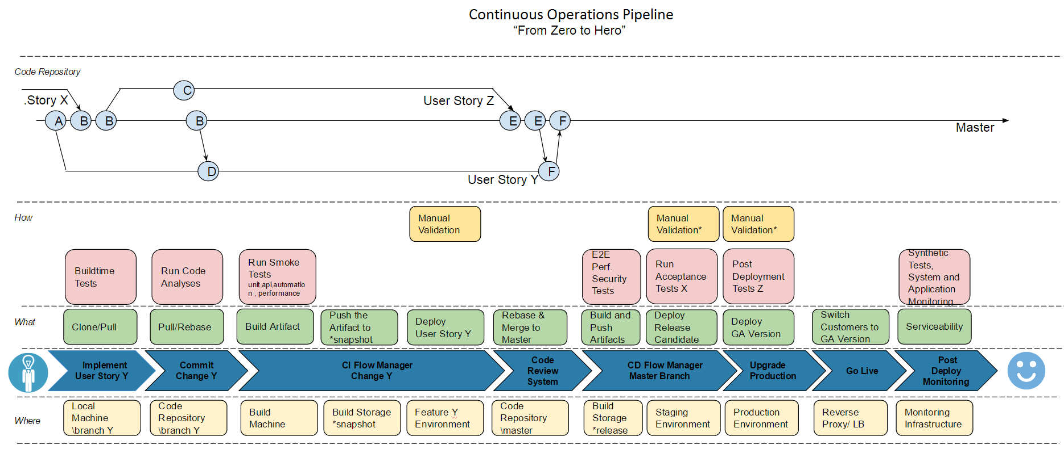
“From Zero to Hero”
Notes:
Stress we are doing real tests against the real environment on each jenkins step (not mocking)

Slide 20
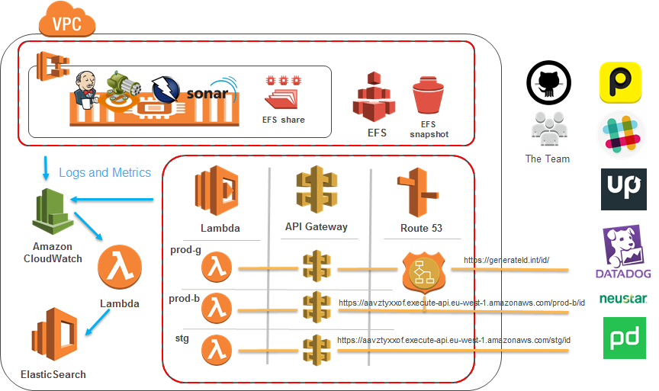
Scope

Slide 21
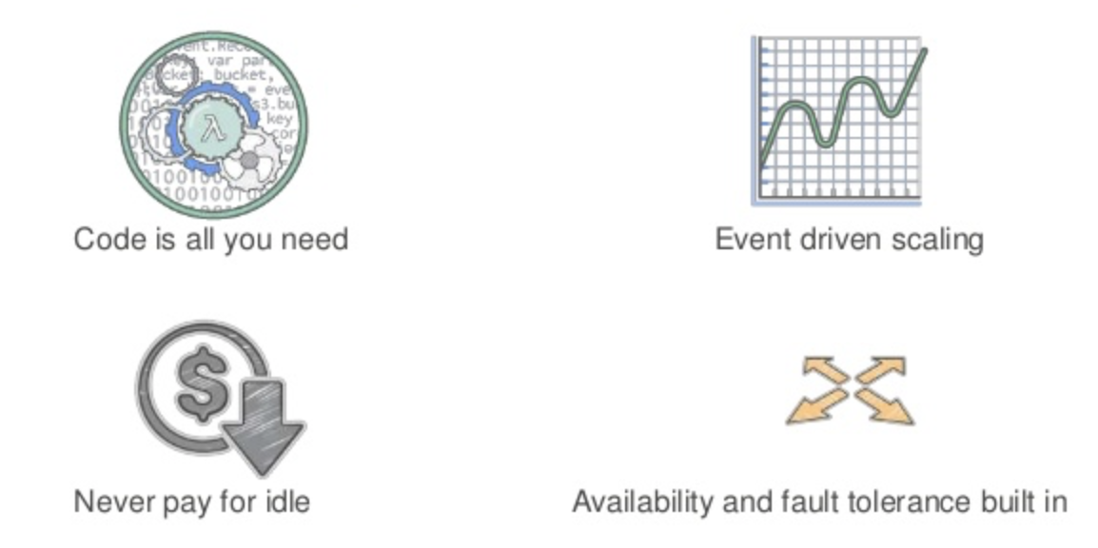
AWS Lambda
What is a Lambda
Aliases vs Versions
Execution rate limits (per Alias)
3000 concurrent executions per second
In our case up to ~1M executions per seconds *
Cost:
Lambda rates
First 1 million requests per month are free
$0.20 per 1 million requests thereafter ($0.0000002 per request)
You are charged $0.00001667 for every GB-second used (rounded to nearest 100ms per execution)
“generateId” case study
4.04$ for 20M executions per month
Comparison / analogy with container based solutions
*generateId request duration is 3ms (95th%,1h Gatling simulation) => “generateId” throughput is 3000/0.003=1000000 rps

Slide 22

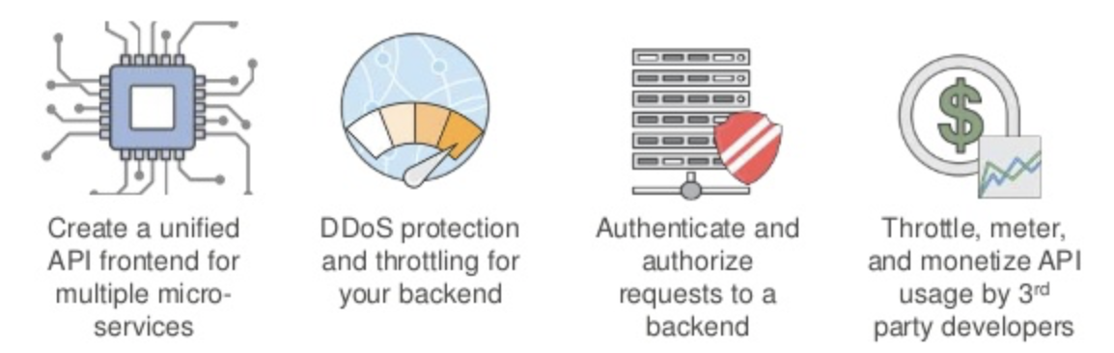
AWS API GATEWAY
Stages
Pricing
Rates
$3.50 per million API calls received, plus the cost of data transfer out, in gigabytes.
generateId case study
71,8$ per 20M requests per month;

Slide 23
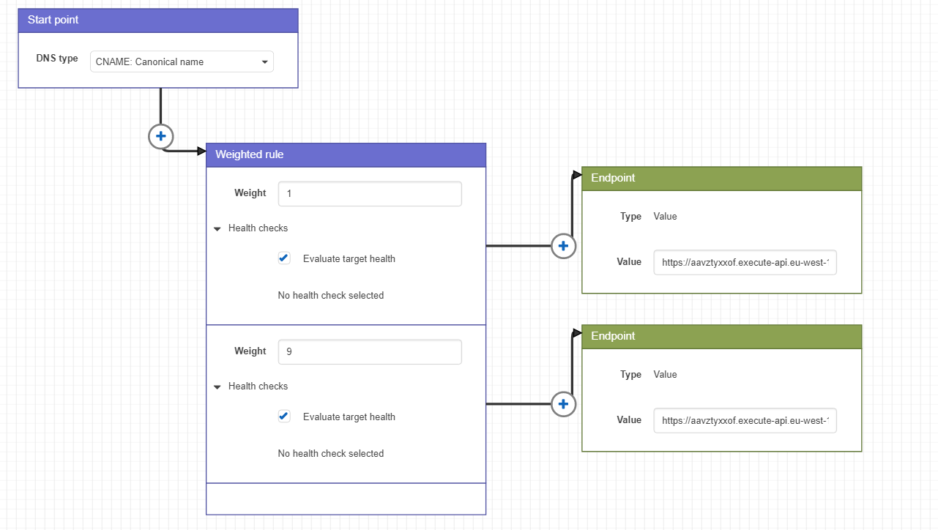

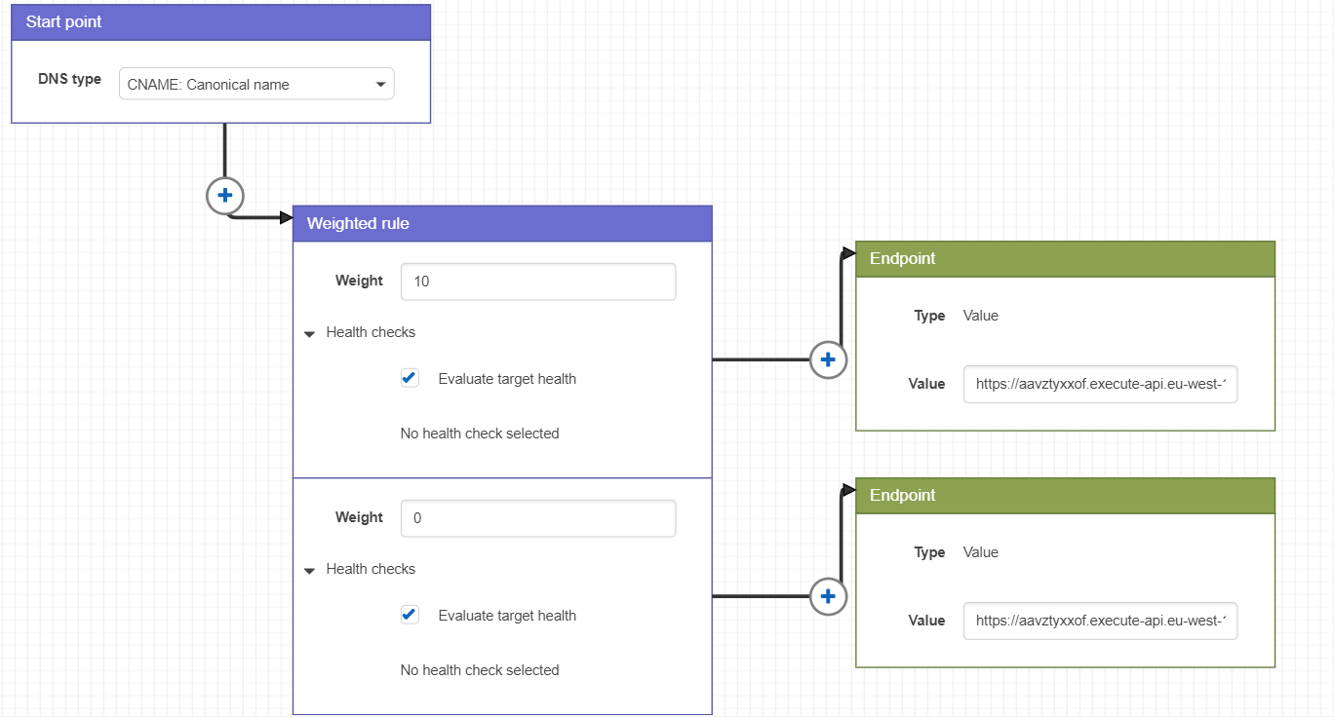
AWS Route 53
Route 53 Traffic policy
Pricing
Monthly
50$ per activated policy

Slide 24


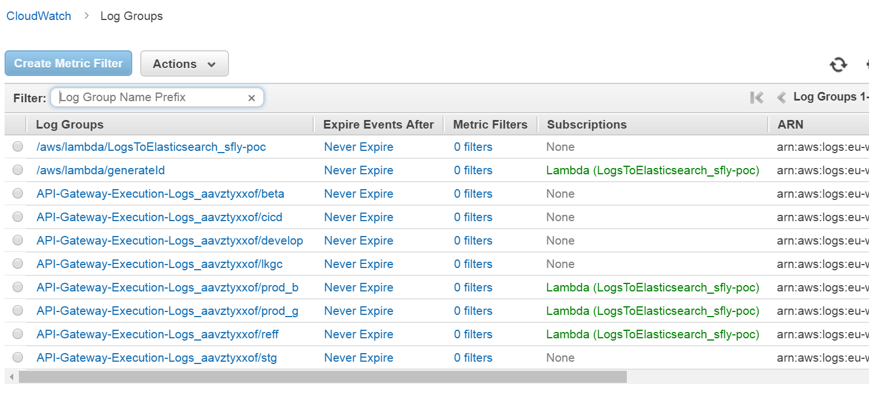
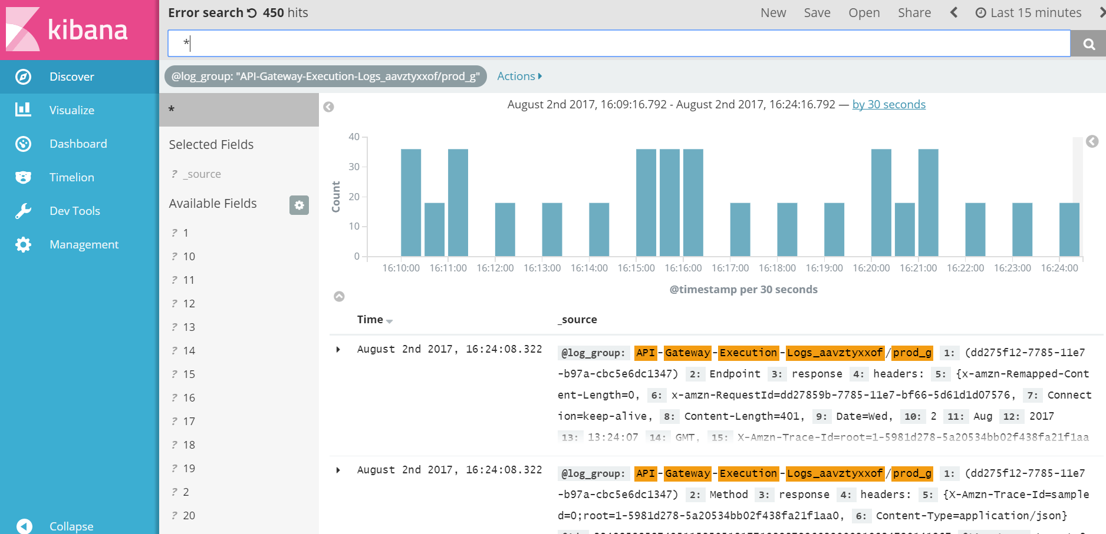
AWS Logging and Monitoring
CloudWatch
Monitoring
Logging
AWS ES
Elasticsearch Service

Slide 25
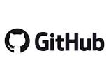
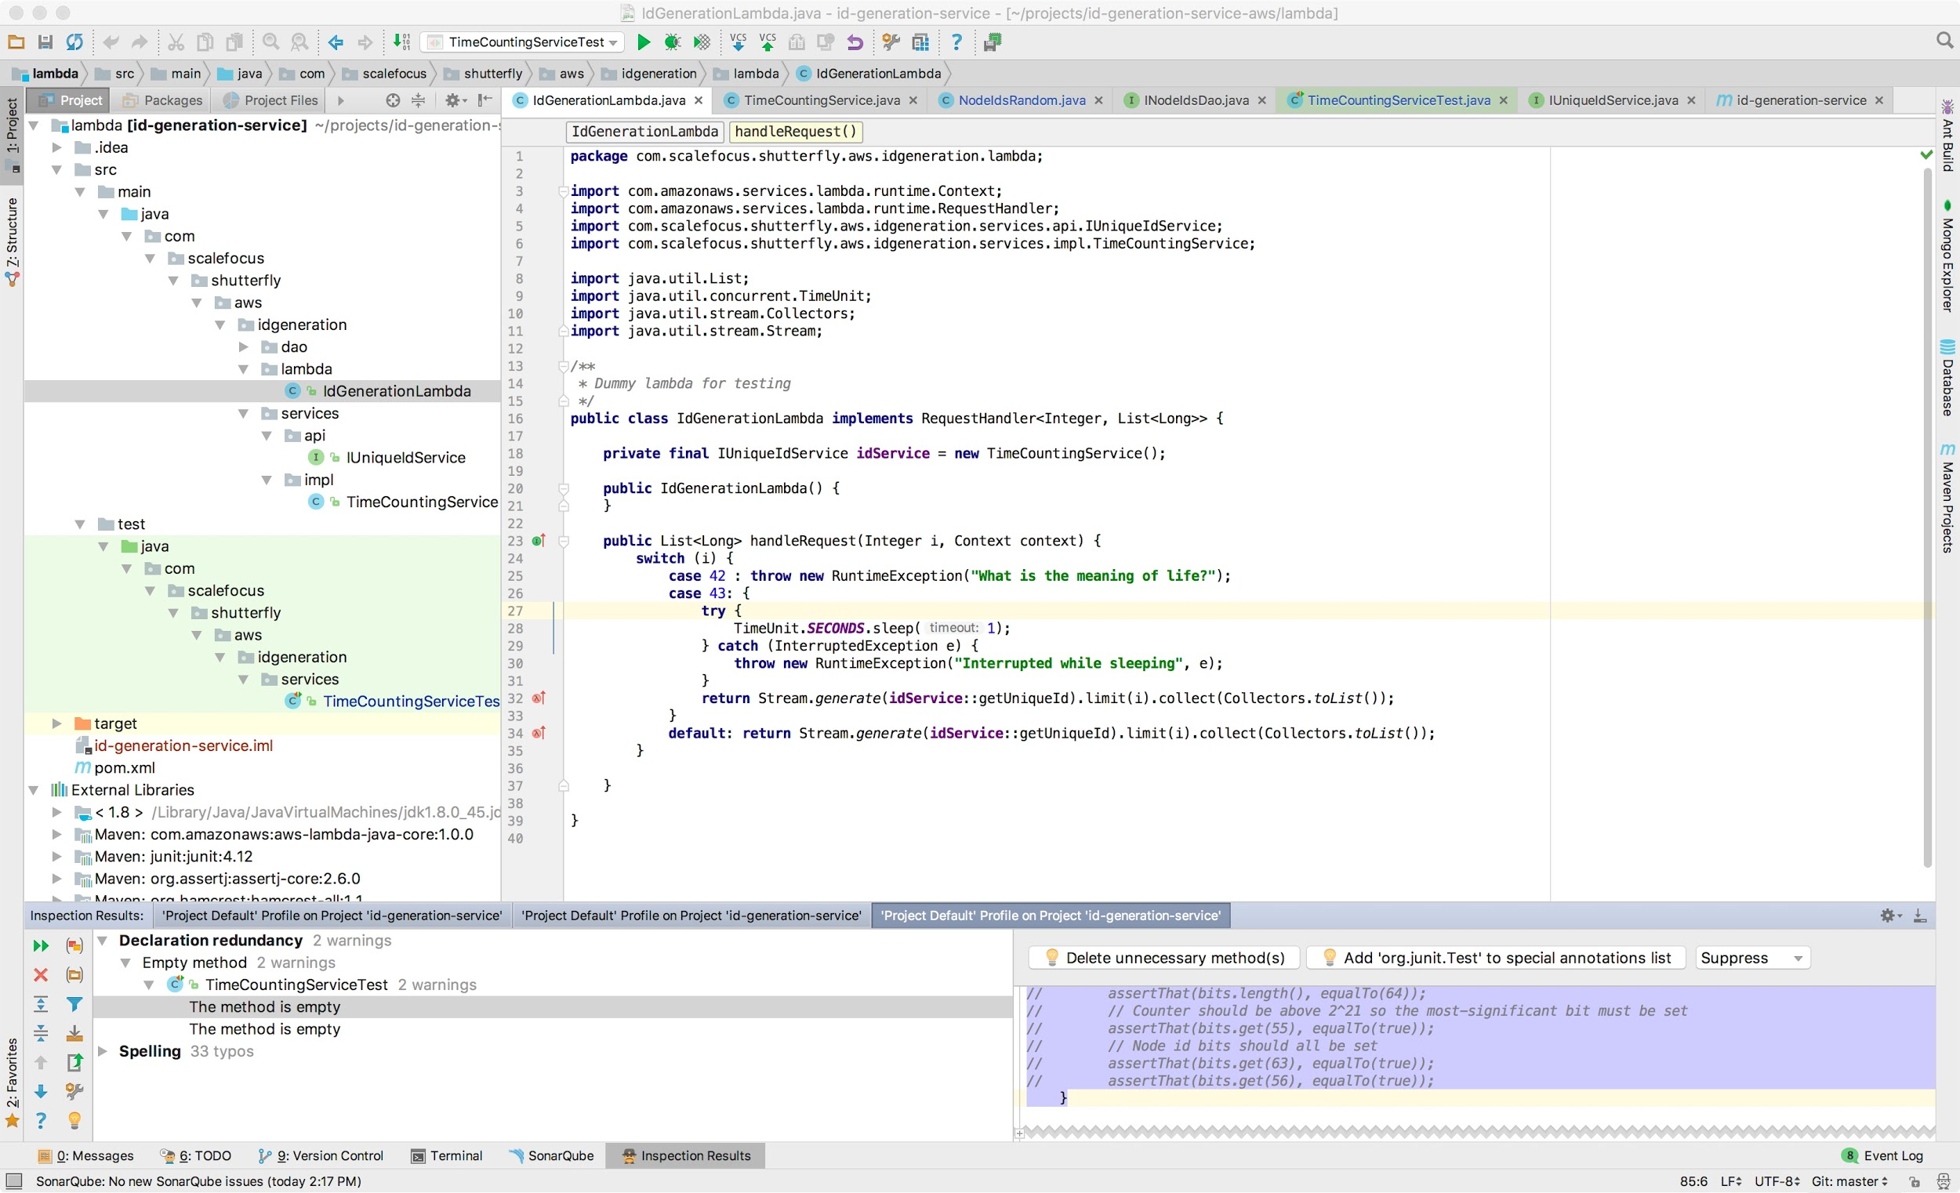

Development Infrastructure
Local Development Environment
GitHub Based project using feature-branch workflows with code-reviews
Local Lambda development
Unit tests
Integration with SonarQube (local static code-validation)
Equivalent set-up for Lambda and functional tests project (RestAssured scenarios against AWS API Gateway with configurable stages)
Both part of the same repository

Slide 26
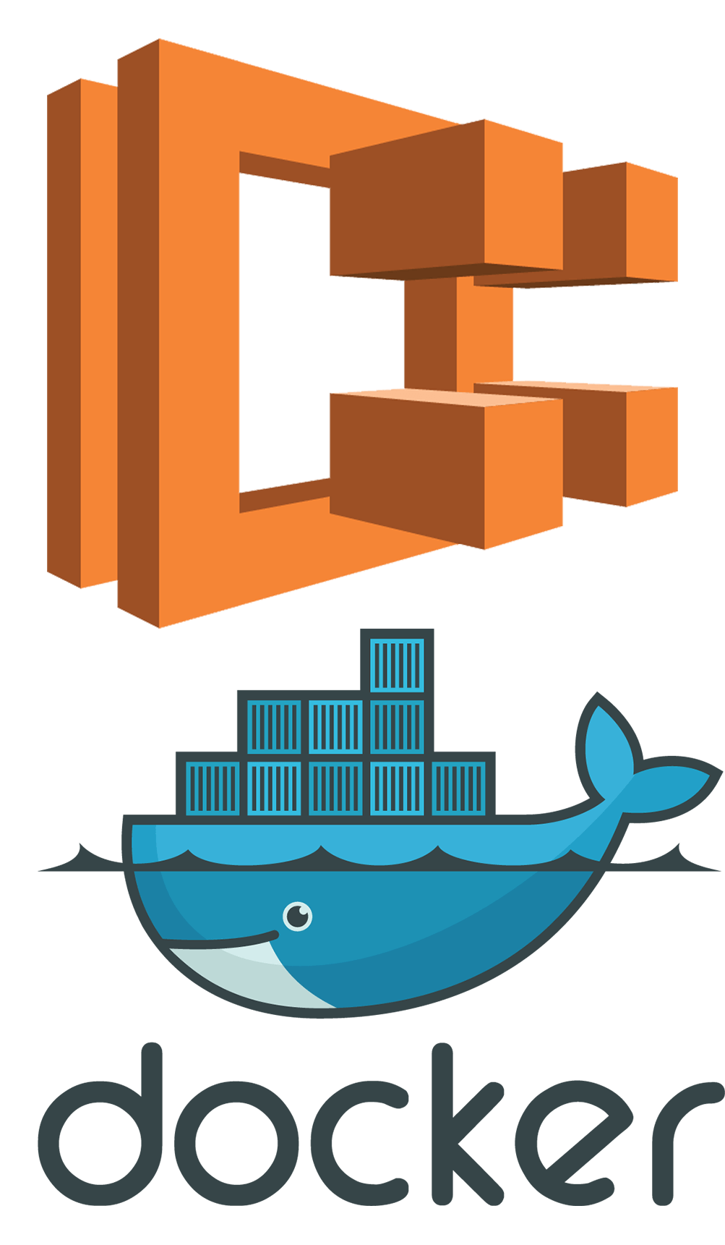
CICD Infrastructure-as-Code
Build, Deploy and Testing infrastructure
HA, Self Healing and Easy Scaling containers running in AWS ECS
All Major Configurations are stored in GitHub as-Code
ECS CloudFormation
ECS Task-definitions
Dockerfile
Docker-compose
Jenkins configuration
Datadog monitors and alerts
DR Objectives:
RPO 1h
RTO <1h
Implemented pro-active Monitoring and Alerting

Slide 27

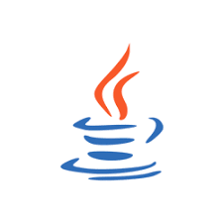
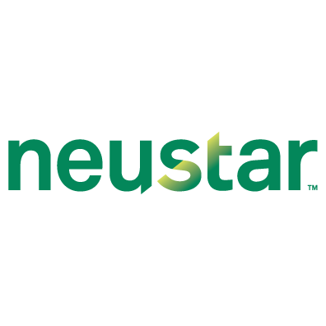

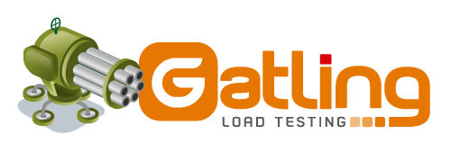

Quality Gates
POC gates
SonarQube Quality Gates
E2E
Automation/Functional
Performance
OSS Dependency checker
Vulnerability testing
Synthetic checks
Status feedback
Slack
GitHub commit message

Slide 28

Notes:
Break prod_g deployment, changing stage deployment version with the broken one (demonstrate alerts in slack and synthetic monitorings …
Demonstrate the main pipelines in Jenkins (REFF, CICD, Promote to PROD_G)
Demonstrate LAMBDA ALIASES (reff and develop versions)
Make a commit and run the REFF
Push origin/slow -> demonstrate passed and failed Gates
*sonar
*owasp
*functional tests
*gatling (failed) > acceptance criteria Latency 95th% >300ms
Demonstrate LAMBDA ALIASES (reff and develop versions) -> changed the version
Demonstrate with postman /reff/id is slower than /stg/id and prod_b/id
Fix prod_g and demonstrate the monitoring -> datadog, pingod, neustar and slack

Slide 29
Afterwords
Continuous Operations is not a target, it's a long-way journey starting with a general mind-shift and continuous improvement of the process, tool-set and engineering it self.

Slide 30


