Slide 1




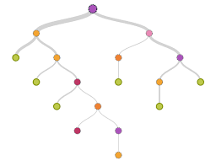

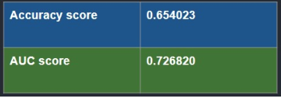
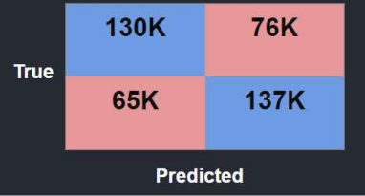
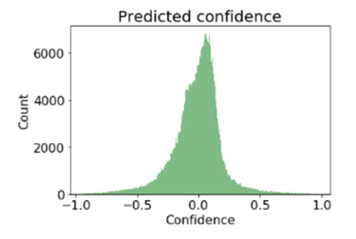
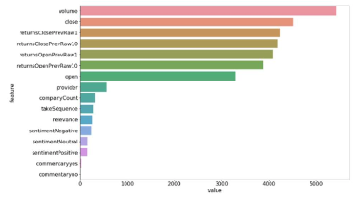
Using news analytics to predict stock market movements
Ivo Tadic
Hood College / CS-522 Data Mining
Introduction
Model
Conclusions
Do News have an effect on Stock Market movement?
Two Sigma has released a Kaggle competition for Data Scientist to try to find the answer to that question. Based on Datasets from Thomson Reuters (News Dataset) and Intrinio (Market Dataset). [1]
The solution has some processing restrictions (CPU) and some runtime memory restrictions (RAM). The Algorithm selected should be able to process the data within the required boundaries.
The LGBM Classifier provides a good starting point to create a prediction that includes both News and Market data and the results show better accuracy compared to other models that only use Market data.
Objective
Predict Market movement based on news and market datasets.
6 hours of runtime
2 CPU cores
16 GB RAM Limit
Future Work
Now that we have a solid baseline the next step would be to try a neural network with limited amount of data.
Understanding why the true negatives and false positives is that big would be something to review further and to understand the data behind that specific use case.
Amongst tree classifiers the LGBM Classifier provides the speed and memory usage to allow us to process the data within the boundaries.
LGBM Classifier
Decision Tree Boosting Algorithm
Fast and low memory usage!
News Data [3]
Market Data [2]
REFERENCES
PREDICT
RESULTS
[1] Kaggle (2018), Two Sigma: Using News to Predict Stock Movements, https://www.kaggle.com/c/two-sigma-financial-news.
[2] Intrino (2018), Intrino’s Main Site, https://intrinio.com/.
[3] Thomson Reuters (2018), Main Site , https://www.thomsonreuters.com/en/products-services/financial.html/.
Our results show that news data provide value to the accuracy but the market data itself accounts for the most important features in the decision tree generated with the train data.
The confusion matrix shows that there is a big number of true negatives and false positives.
Accuracy / AUC Scores
Confusion Matrix
Market Movement
Prediction Confidence
Feature importance
Contact Information
Ivo Tadic
Hood College Graduate School
it3@hood.edu

