Slide 1
Using news analytics to predict stock price performance
Ivo Tadic

Slide 2
Agenda
Introduction
Data
Solution
Results
Future

Slide 3
Introduction
Data
Solution
Results
Future
Kaggle Competition
News Data
Solution
Market Performance Prediction
Market Data

Slide 4
Introduction
Data
Solution
Results
Future
News Data
Date/Time
Source
Content
Urgency
Sentiment (+/-)
Content stats
Asset Codes (Market Data)

Slide 5
Introduction
Data
Solution
Results
Future
Market Data
Date/Time
Market Asset Code
Open/Close
Volume
Previous returns 1, 10 days
Returns Next 10 days

Slide 6
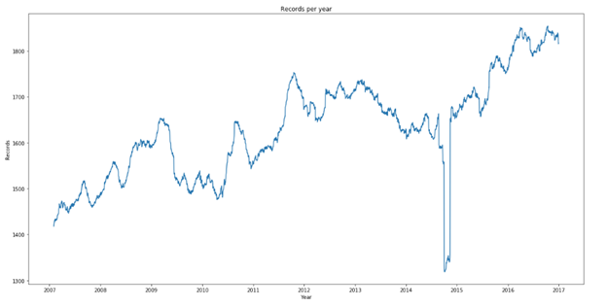
Introduction
Data
Solution
Results
Future
Available records per year

Slide 7
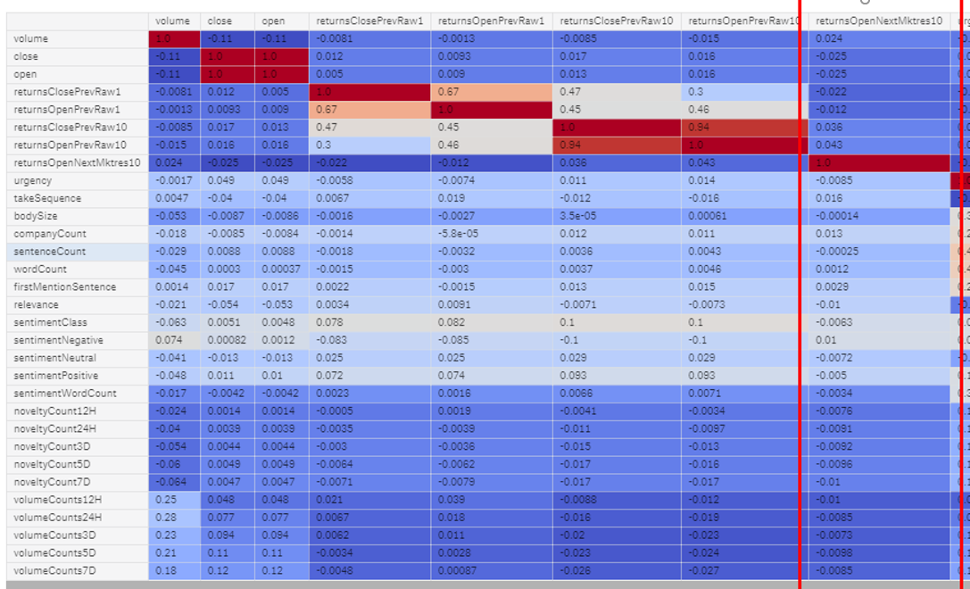
Introduction
Data
Solution
Results
Future
Correlation

Slide 8
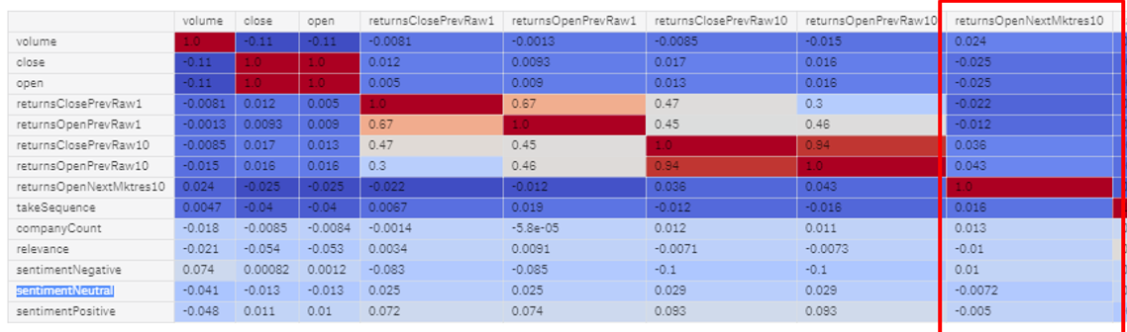
Introduction
Data
Solution
Results
Future
Correlation Selected features

Slide 9
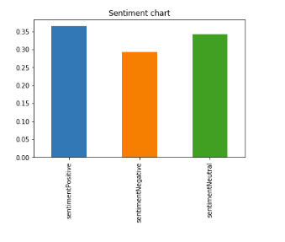
Introduction
Data
Solution
Results
Future
Sentiment (mean)

Slide 10
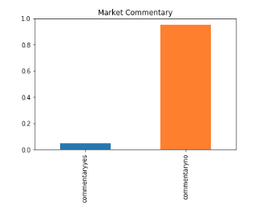
Introduction
Data
Solution
Results
Future
Market commentary (mean)

Slide 11
Introduction
Data
Solution
Results
Future
Restrictions
16 GB Memory
9 Hours total runtime
4 CPU cores

Slide 12
Introduction
Data
Solution
Results
Future
Algorithms considered
LSTM (Long short-term memory)
An improved type of Recurrent Neural Networks.
RNNs are good for sequence predictions.
RNNs are limited to remember context behind a sequence.
LSTMs can remember or forget things thanks to the cell dependencies (context, previous, current)
Option 2. LGBM Classifier
Decision Tree Boosting Algorithm
Speed / Memory optimized

Slide 13
Introduction
Data
Solution
Results
Future
Algorithms considered
LGBM Classifier
Decision Tree Boosting Algorithm
Speed / Memory optimized

Slide 14
Introduction
Data
Solution
Results
Future
Accuracy / AUC
Accuracy score | 0.654023
AUC score | 0.726820

Slide 15
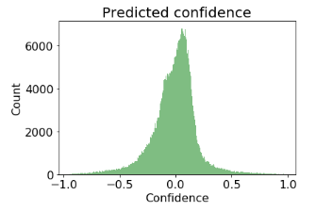
Introduction
Data
Solution
Results
Future
Predicted confidence

Slide 16
Introduction
Data
Solution
Results
Future
Confusion Matrix
130K | 76K
65K | 137K
True
Predicted

Slide 17
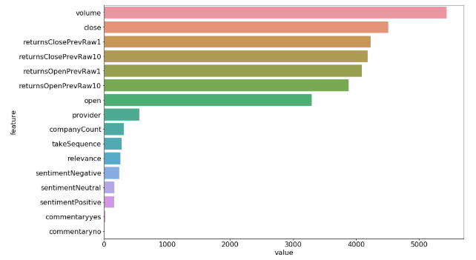
Introduction
Data
Solution
Results
Future
Feature importance

Slide 18
Introduction
Data
Solution
Results
Future
Feature importance

Slide 19
Introduction
Data
Solution
Results
Future
Group similar asset codes.
Analyse the data behind True Negatives and False Positives to minimize them.

Slide 20
Thank you!

