Slide 1

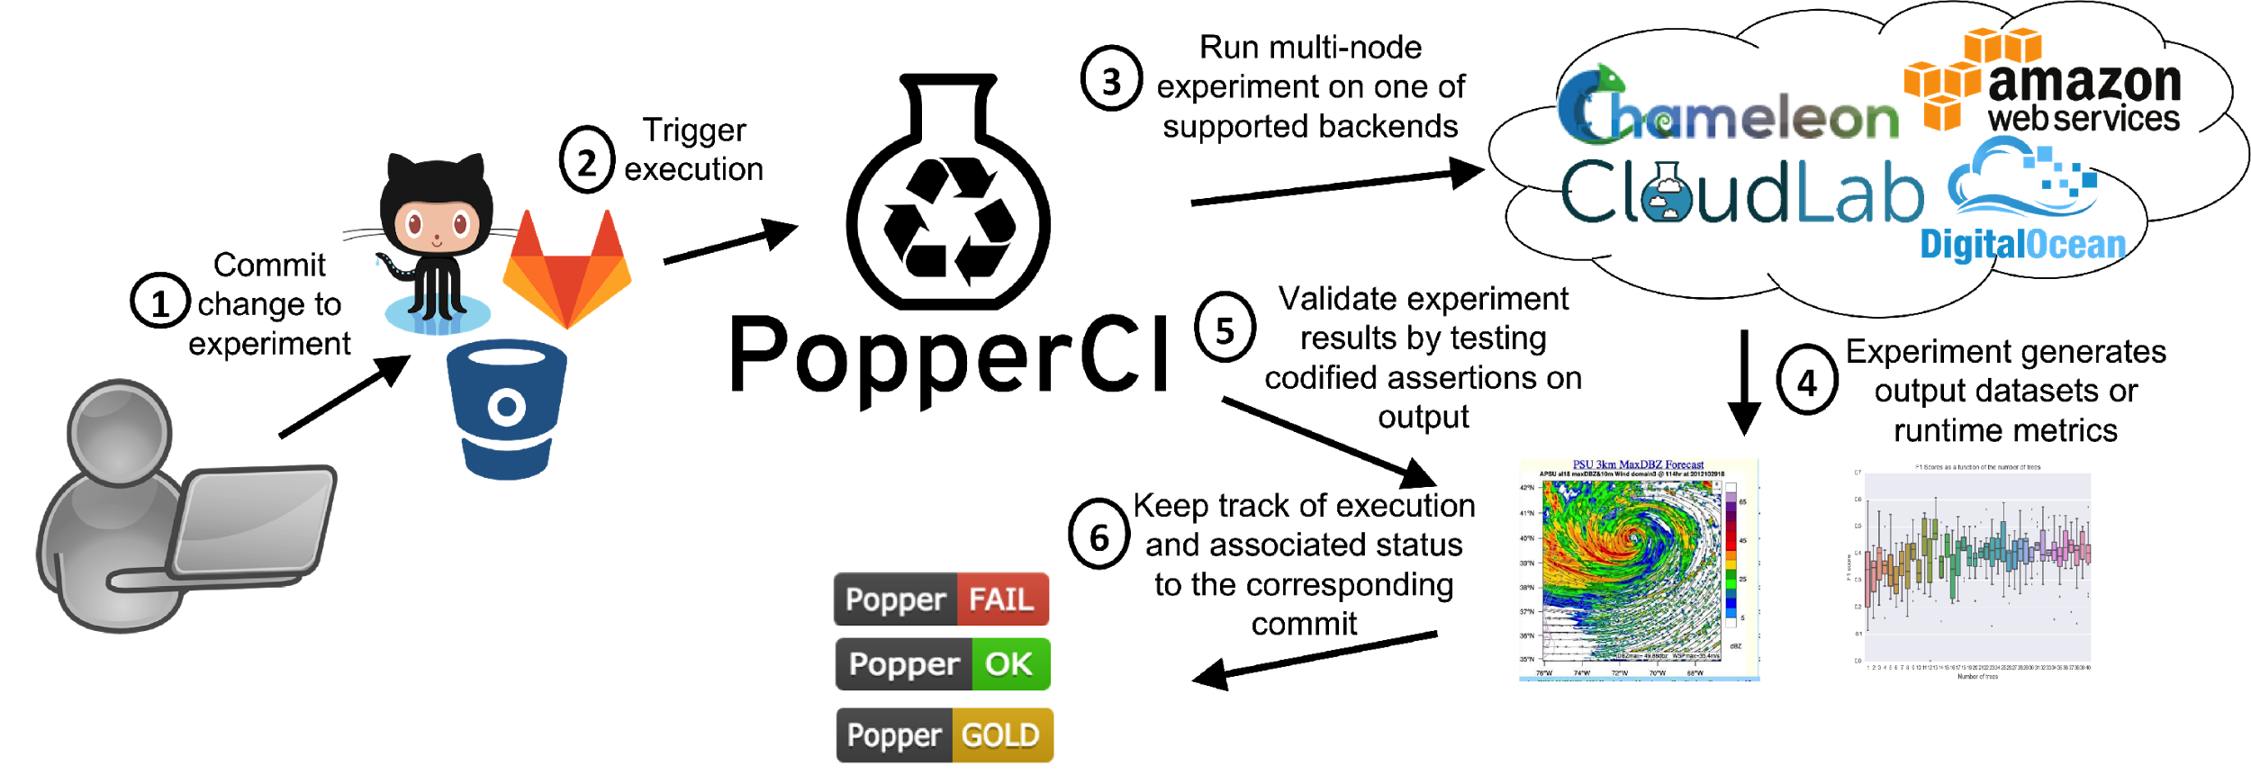


:

Slide 2












Black Swan

Slide 3
Search:
Pipeline:
spark
Results:
spark-crail
+
spark-tensorflow
-
Stage: cluster-setup
Description: This stage allocates a set of nodes on the configured backend and writes a YAML file with metadata about each of the nodes in the cluster.
Required variables:
CLOUDLAB_USER_NAME
CLOUDLAB_PASSWORD
CLOUDLAB_CERT_PATH
Description: This pipeline benchmarks tensorflow embedded in Spark workers.
Runs on: CloudLab, ChameleonCloud
Status:
Dependencies
Docker +17.03
Python 2.7
Import
Import
spark-tpch
+

