Slide 1
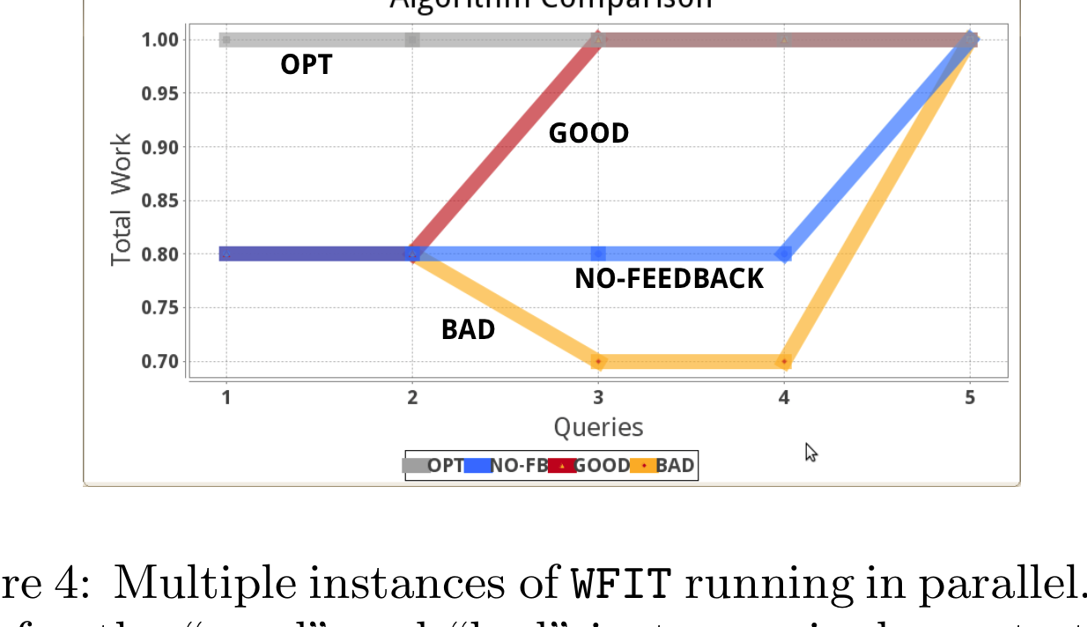
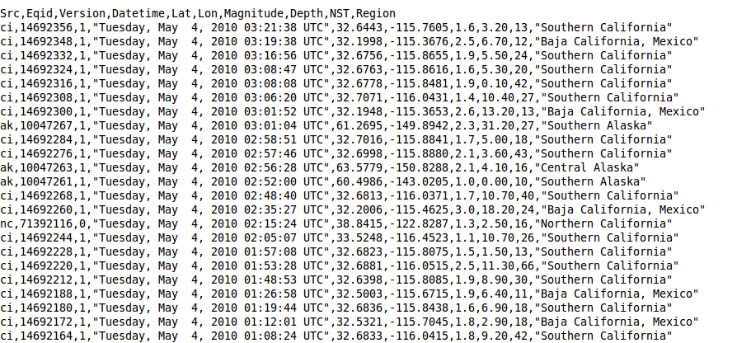
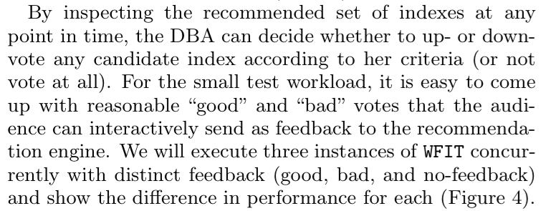
Experiment Goal: Show that my system or algorithm improves the current state-of-the-art.
Figure
Raw data
Means of Experiment
Observations

Slide 2
Obtain/recreate
means of experiment.
Re-run and check validation clauses against output. Any validation failed?
Original work findings are corroborated
no
Any significant differences between original and recreated means?
yes
yes
Update means of experiment
Cannot validate original claims
no

