Slide 1



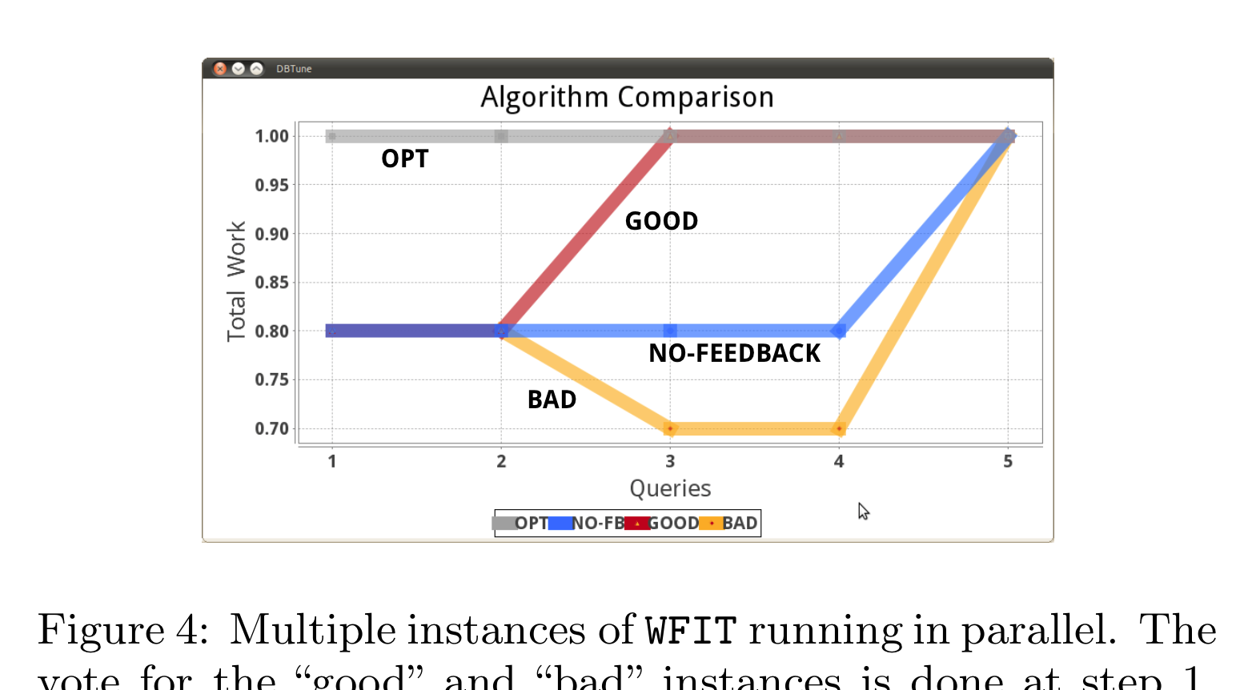
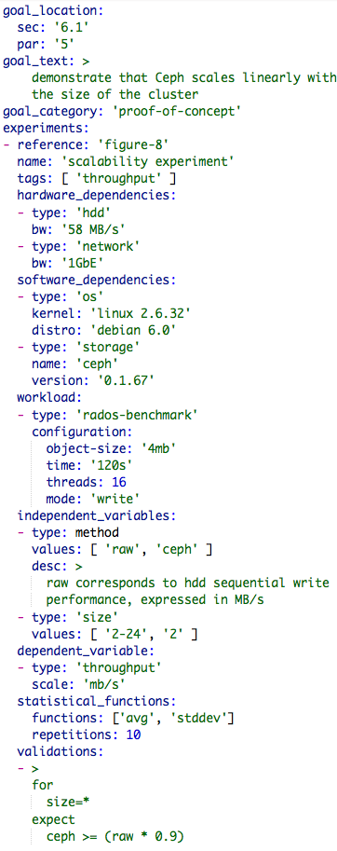
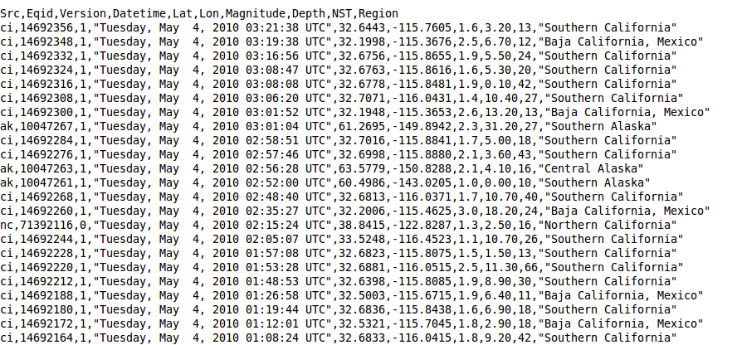
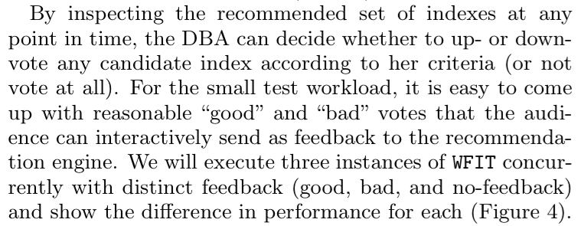
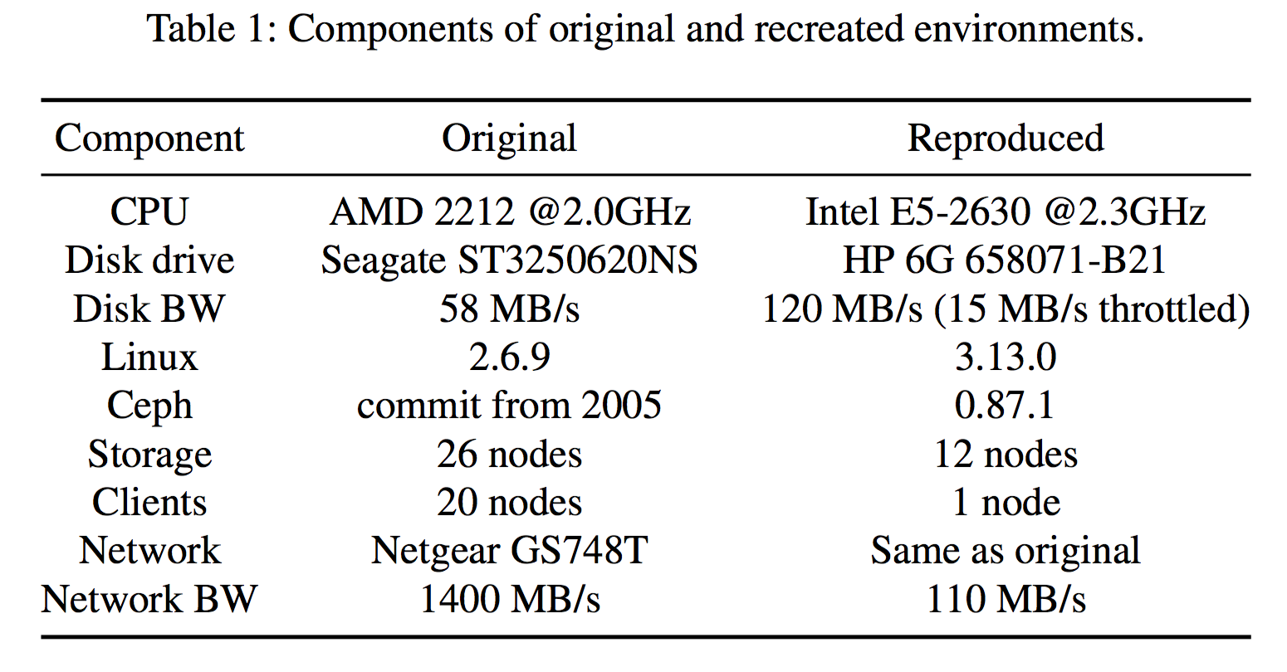
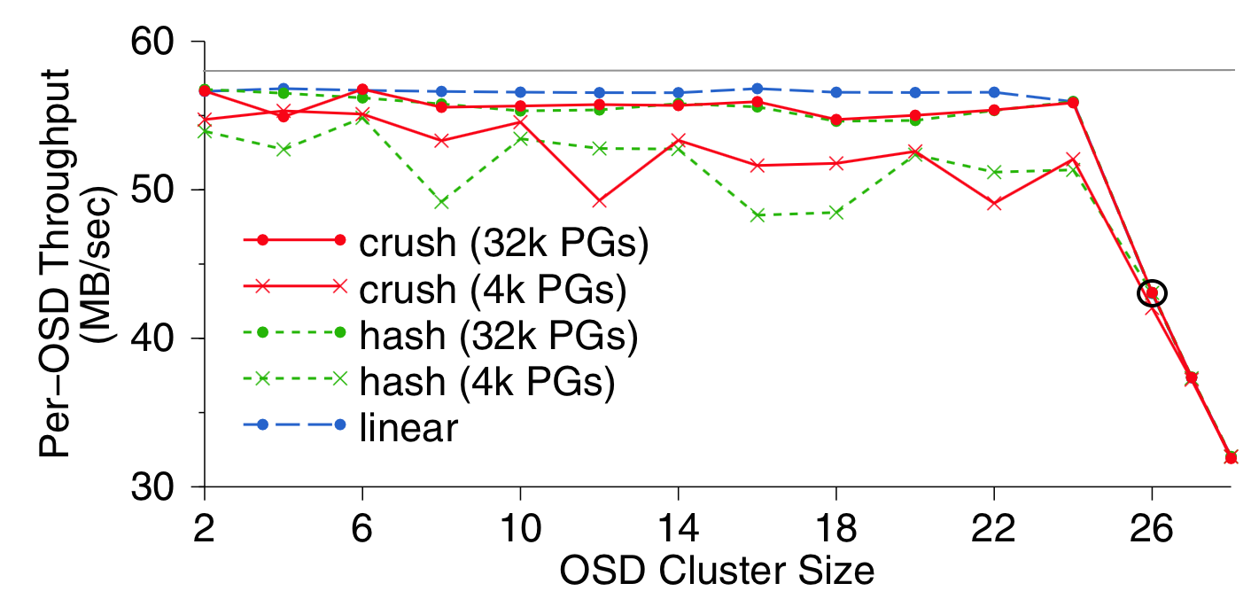
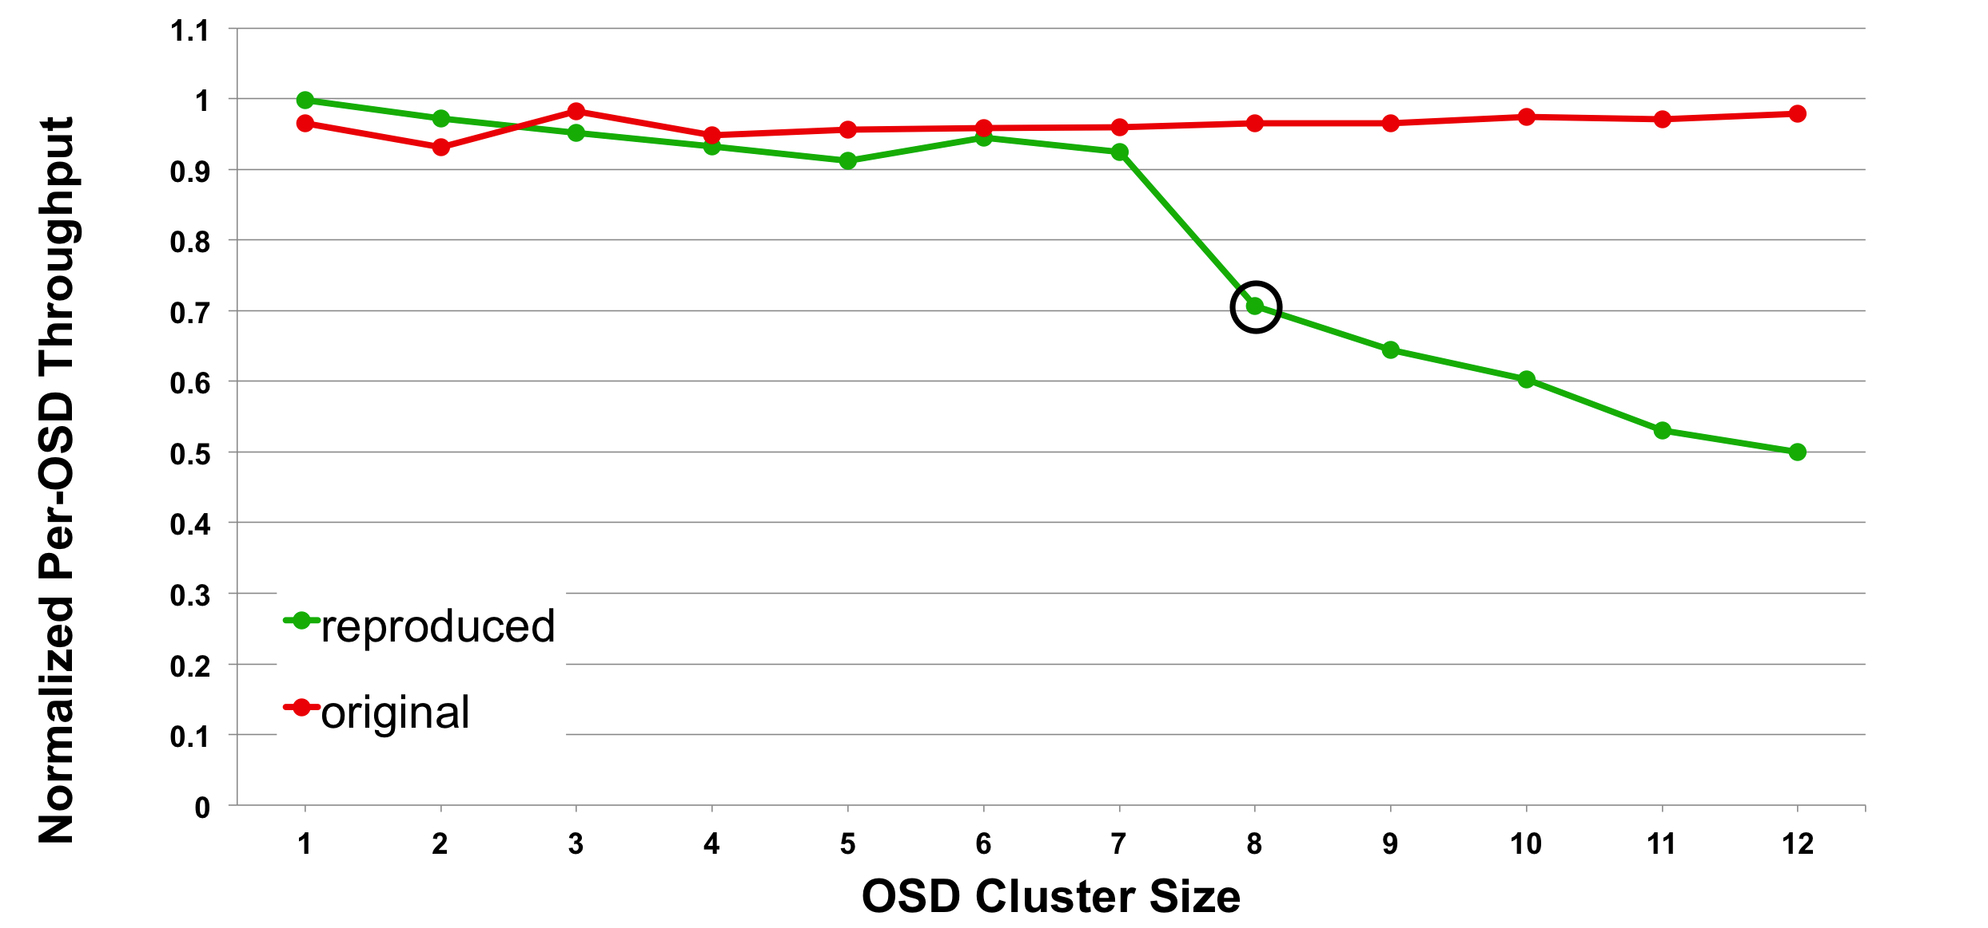
Tackling the Reproducibility Problem in Systems Research with Declarative Experiment Specifications Ivo Jimenez, Carlos Maltzahn (UCSC) | Adam Moody, Kathryn Mohror (LLNL) | Jay Lofstead (Sandia) | Andrea Arpaci-Dusseau, Remzi Arpaci-Dusseau (UW)
SRL
UCSC Systems Research Lab
Experiments in Systems Research
Experiment Specification Format (ESF)
libs
Goals: An experiment is designed with a particular goal in mind, for example, to show that under certain circumstances, a new system or algorithm improves the state-of-the-art by an order of magnitude.
Means of an Experiment: An experiment is composed of a relatively complex computational environment that includes one or more of the following: hardware, virtualization, OS, configuration, code, data and workload. We refer to these as the means of the experiment and use this term to denote the particularities of how the experimental environment and procedures are carried out.
data
code
OS
hardware
Meta-Analysis
We analyze the high-level structure of an experiment.
Schema of Experiment Results: While it is important to capture the output data of an experiment, making it part of the ESF would be cumbersome. Instead, it is preferable to have a description of the metrics being captured, i.e., the metadata of the experiment’s output. For example, if the measurements are stored in a CSV file, the experiment specification should include the metadata of each column such as name, aliases, types, scales and ranges.
Experiment Goal: Show that my system or algorithm improves the current state-of-the-art.
Figure
Means of Experiment
Raw data
Observations
Observations and Validation Statements: We propose using a declarative language for codifying observations. Such a language provides an author with a mechanism to succinctly write descriptive statements that can be used to test for reproducibility.
Our Approach
ESF
An experiment specification format (ESF) that describes all the high-level components of an experiment.
Aver
Validation language (aver) that allows scientists to declaratively and succintly express the observations that back the claims of their work.
Validation Workflow
Case Study: Ceph OSDI ‘06
ESFs simplify the experiment validation process.
We illustrate our approach by taking a published paper and describing the goals, means, and observations, including the validation clauses, that define the reproducibility criteria for one of the experiments contained in it.
Obtain/recreate
means of experiment.
Re-run and check validation clauses against output. Any validation failed?
no
Original work findings are corroborated
yes
Any significant differences between original and recreated means?
yes
Update means of experiment
no
Cannot validate original claims
Status and Future Work
The experiment specification is available online¹. In addition to this, we have created a validation checking engine² that takes statements in the aver language and validates them against a dataset corresponding to performance metrics of a system. We are working on a framework that fully automates the validation process, taking an ESF as input, executing an experiment to validate its claims and output the result of the validation.
Figure 1: Reprinting Figure 8 from the original paper. The original caption reads: “object storage device (OSD) write performance scales linearly with the size of the OSD cluster until the switch is saturated at 24 OSDs. CRUSH and hash performance improves when more PGs lower variance in OSD utilization.” The experiment sequentially writes 4 MB objects to minimize random I/O. Our main focus is on the red solid line with circle markers. The point where linear scalability breaks is encircled in black.
Figure 2: Reproducing a scaled-down version of the original OSDI ’06 scalability experiment. The x-axis corresponds to the size of the cluster (in number of OSDs). The y-axis represents normalized throughput (to meaningfully compare against original results) with respect to the raw performance of the hard disk drives in the cluster. The red line corresponds to the original results and the green line to the one generated by the re-execution of the experiment. The point where linear scalability breaks is encircled in black.
1:https://github.com/ivotron/esf
2:https://github.com/ivotron/aver

